Slide 1
KNIME Analytics Platform

Slide 2
Summary of this lesson
„If the only tool you have is a hammer, you tend to see every problem as a nail”
-Abraham Maslow
First the tool or the knowledge?
*This lesson refers to Appendix B of the GIDS book

Slide 3
Content of this lesson
Download and Install
The Workbench
More on Nodes
Metanodes and Components
KNIME Community Hub
Build your first „Hello“ Workflow

Slide 4
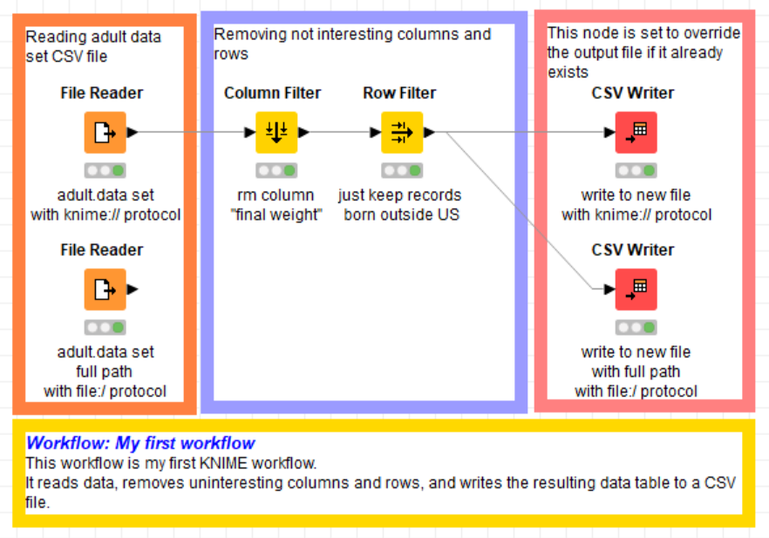
Datasets
Dataset used : adult dataset
Example Workflows:
  „My First Workflow“ https://kni.me/w/kYeZOLeAJXo9Mvol
    Read from CSV file, Excel file and SQLite.
    Filter rows and columns
    Write to CSV file

Slide 5
Download and Install

Slide 6

KNIME Analytics Platform
Open and opensource modular Data Science platform
Covers all the data science needs:
Based on the visual programming paradigm
Provides a diverse array of extensions:
  Text Mining
  Network Mining
  Cheminformatics
  Deep Learning
  Many integrations, such as Java, R, Python, Weka, Keras, Plotly, H2O, etc
  ... And more
Data Access
Data Preparation
Data Visualization
Machine Learning
Testing
Deployment

Slide 7
KNIME Business Hub
KNIME Analytics Platform
To develop data science solutions
  Structured data
  Unstructured data
  Machine Learning
  Statistics
Open source
Free
KNIME Business Hub
To integrate the solutions into the IT environment
  Scheduling
  MLOps
  Easy deployment
  REST architecture
  Auditing tools
Closed source
Yearly license

Slide 8
Installation
https://www.knime.com/downloads
Select the KNIME Analytics Platform version for your computer:
  Mac
  Windows – 32 or 64 bit
  Linux
Download the archive and extract the file, or download the installer package and run it

Slide 9
The Workbench

Slide 10
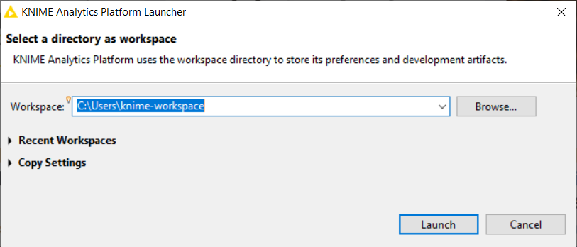
The KNIME Workspace
The workspace is the folder/directory in which workflows (and potentially data files) are stored for the current session.
Workspaces are portable (just like KNIME Analytics Platform)

Slide 11
The KNIME Workbench

Slide 12
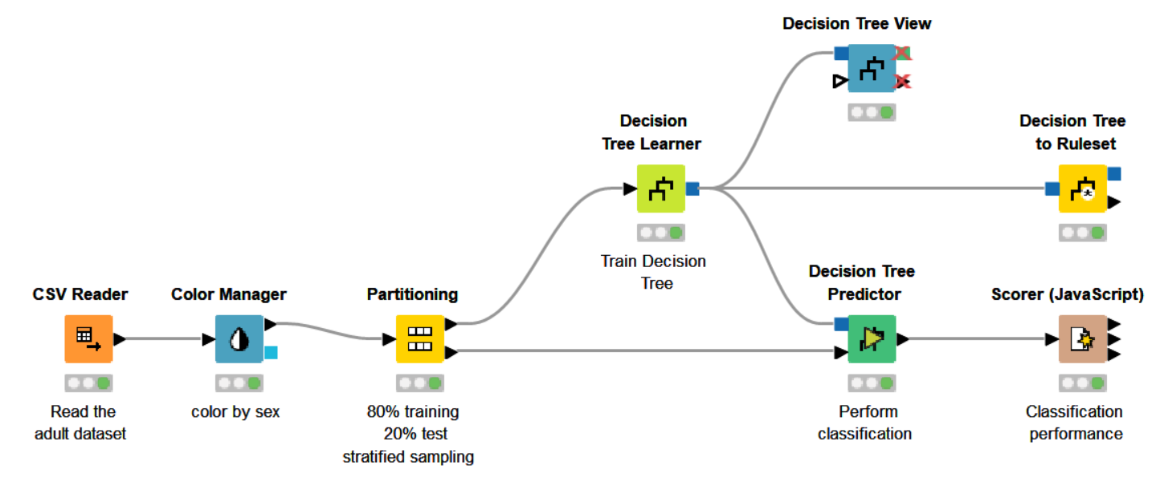
Workflow
A workflow is a pipeline of nodes, each configurable to perform a specific task.
The data flow through nodes from left to right

Slide 13
KNIME Explorer
This panel displays all the workflows in the selected workspace
  LOCAL: projects saved on your own machine
  EXAMPLES: hundreds of read-only example workflows
  My-KNIME-Hub: additional space where you can share your workflows with the community or just park your work for yourself
Provides a search box and buttons to
  Refresh the view
  Select the currently displayed workflow
Can display 4 types of content
  Workflows
  Workflow groups
  Data files
  Shared Components

Slide 14
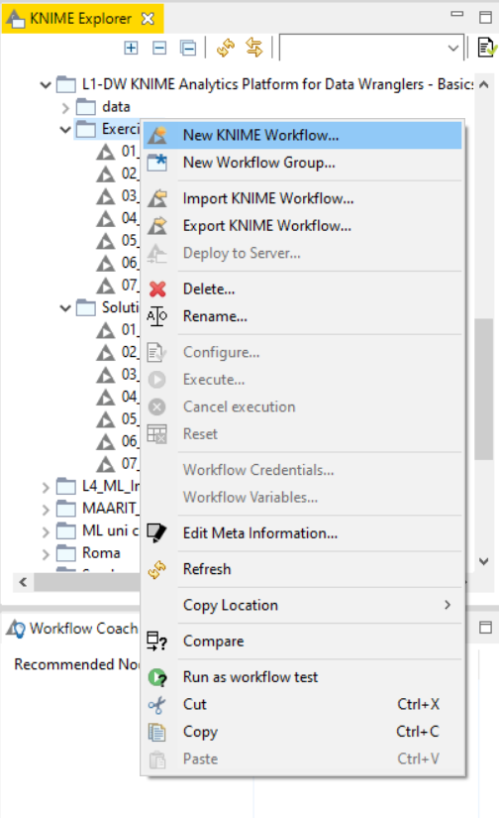
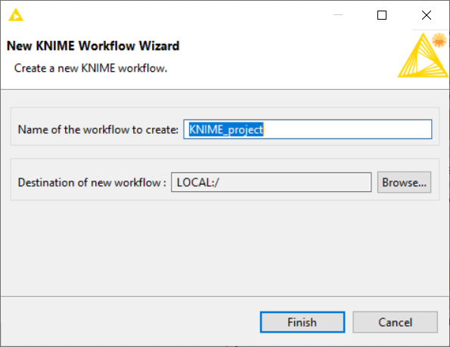
Creating a new workflow
Click anywhere on the KNIME Explorer to create a new workflow or workflow group

Slide 15
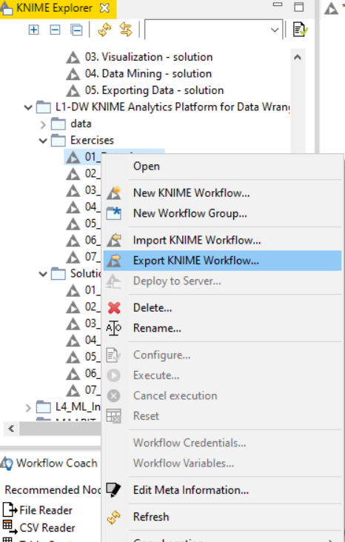
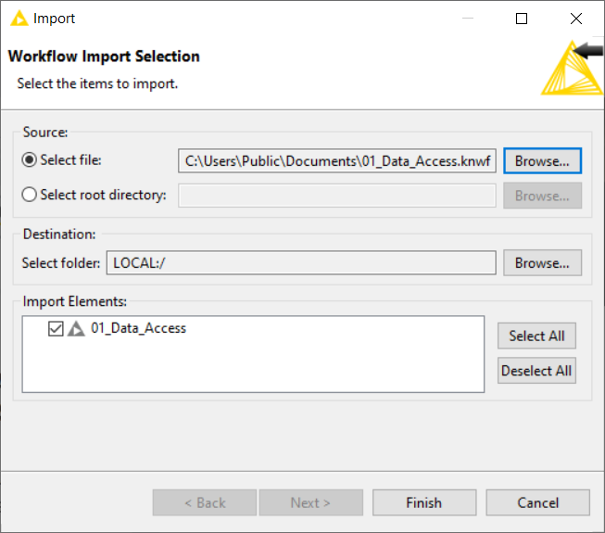
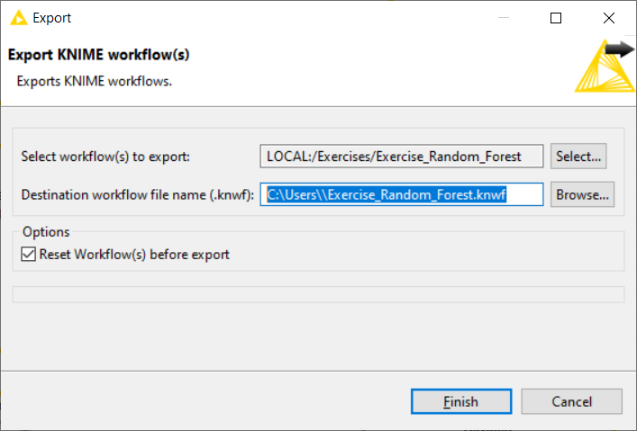
Importing and Exporting Workflows
Right-click anywhere in KNIME Explorer to import a workflow
Right-click on a workflow or workflow group to export the selected workflow

Slide 16
Node Repository
The Node Repository contains all KNIME nodes - ordered by category with further subcategories.
Extensions installation can sensibly increase the number of nodes
Two search methods:
  Crisp Search
  Fuzzy Search
Nodes can be added by drag and drop from the Node Repository to the Workflow Editor

Slide 17
Node Description
The Description window gives information about:
  Node Functionality
  Input & Output
  Node Settings
  Ports
  References to literature

Slide 18
Workflow Description
When selecting the workflow, the Description window gives information about the workflow’s:
  Title
  Description
  Associated Tags and Links
  Creation Date
  Author

Slide 19
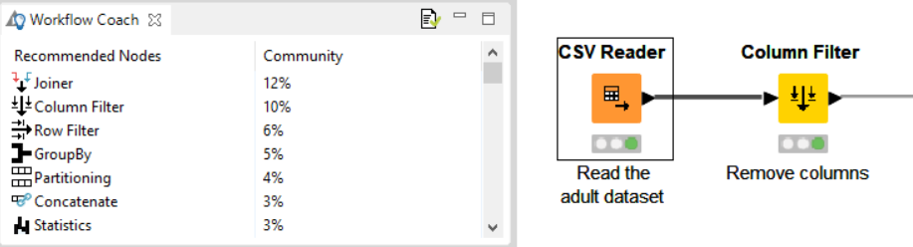
Workflow Coach
Node Recommendation engine
It gives hints about which node to use next in the workflow
It is based on world-wide KNIME community usage statistics
It can also be set to use personal and local group usage statistics

Slide 20
Console and Other views
Console view prints out error and warning messages about what is going on under the hood
Click on View and select Other… to add additional views

Slide 21
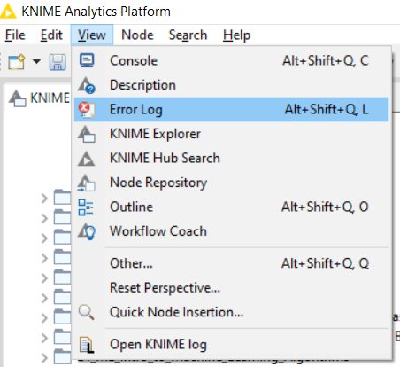
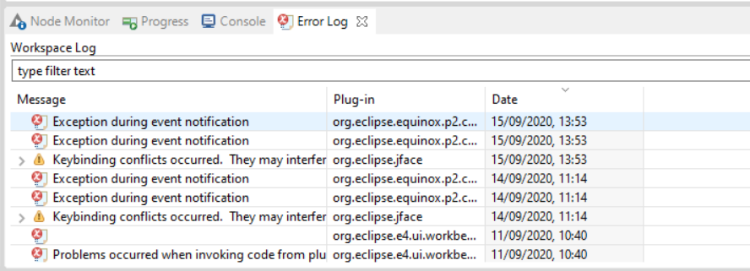
Error Log View
Tip: enabling and checking the Error Log view can help while debugging your project

Slide 22
More on Nodes

Slide 23
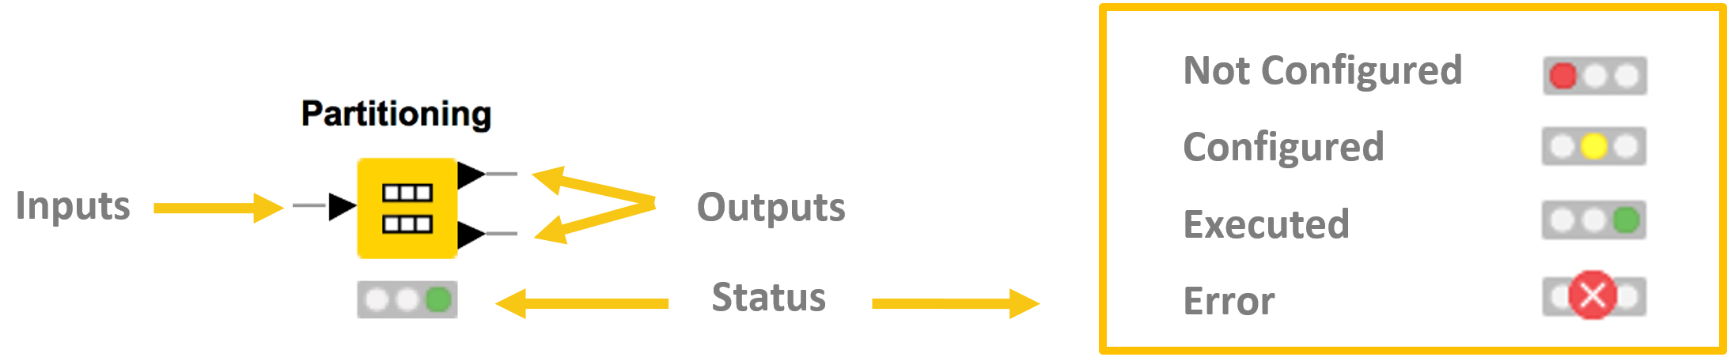
More on Nodes…
Nodes are the basic processing units of a workflow
Each node has a number of input and/or output ports
Data is transferred over a connection from an out-port to the in-port(s) of other nodes
Under each node, a light shows its status

Slide 24
Data Port Types
Model
Flow Variable
Image
Data
DB Connection
DB Data
A pipeline of such nodes makes a workflow
The result of the node’s operation on the data is provided at the out-port to successor nodes
Only port of the same type can be connected

Slide 25
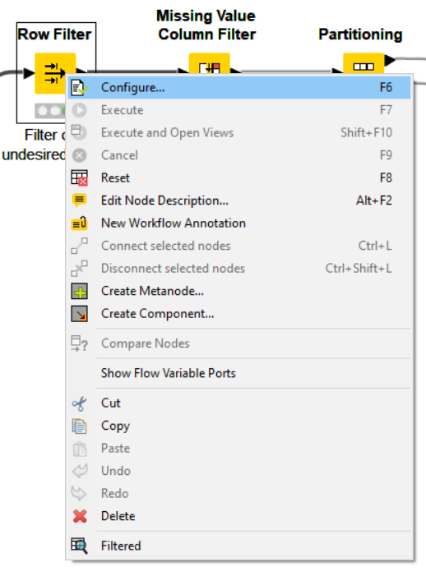
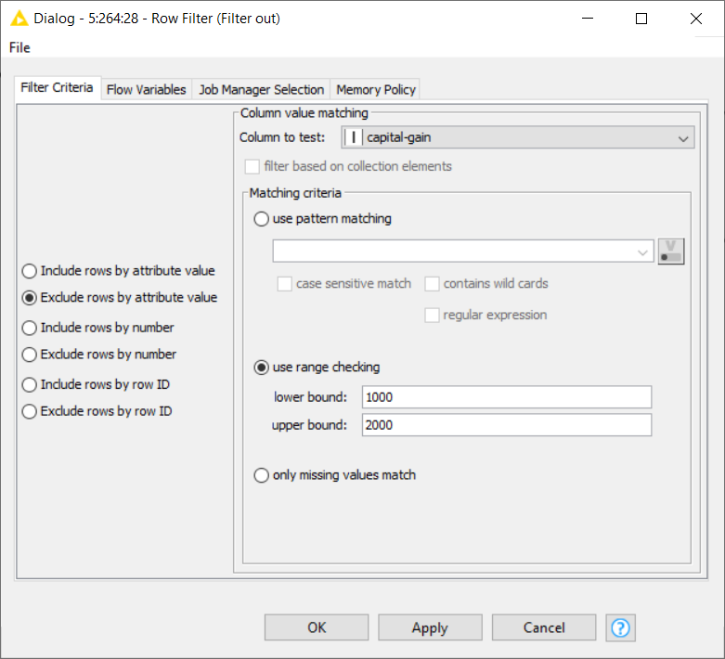
Node Configuration
Most nodes require configuration
To access a node configuration window:
  Double-click the node
  OR
  Right-click > Configure

Slide 26
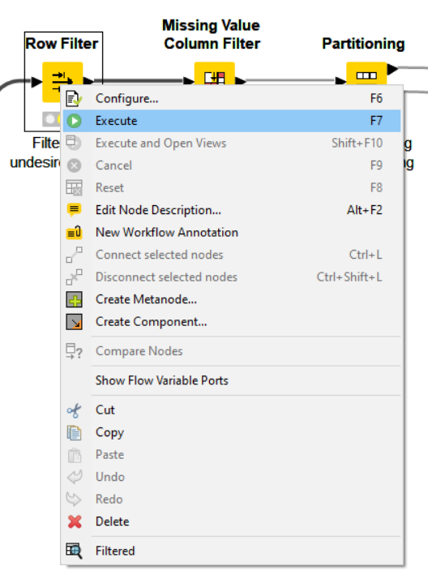
Node Execution
Right-click node
Select Execute in context menu
If execution is successful, status shows green light
If execution produces warnings, status show yellow triangle
If execution encounters errors, status shows a red X

Slide 27
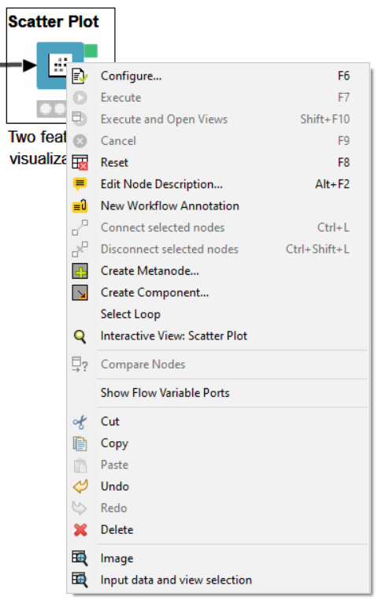
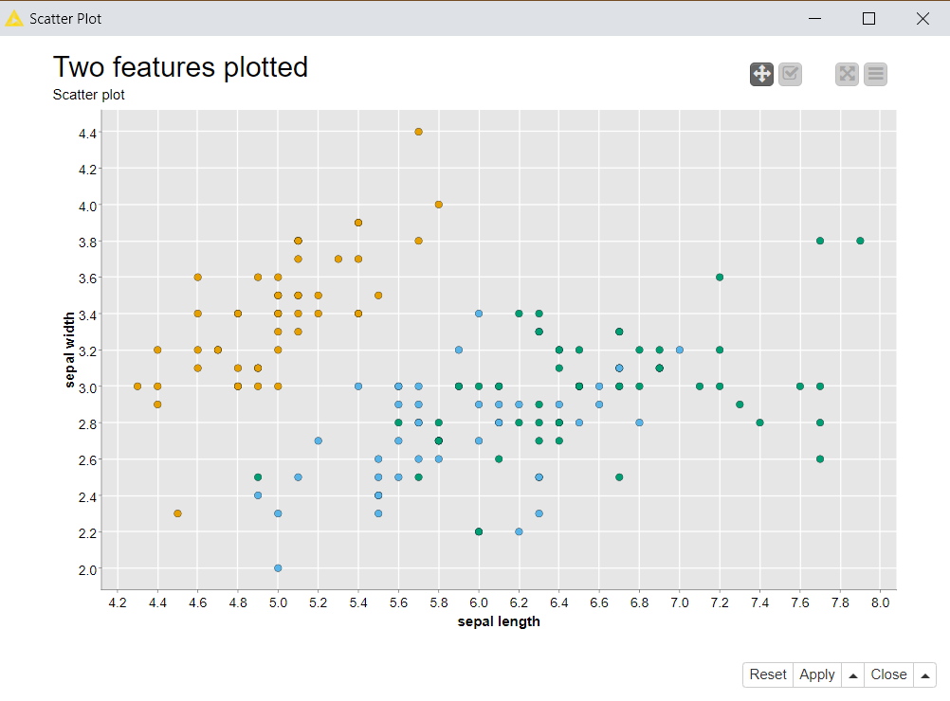
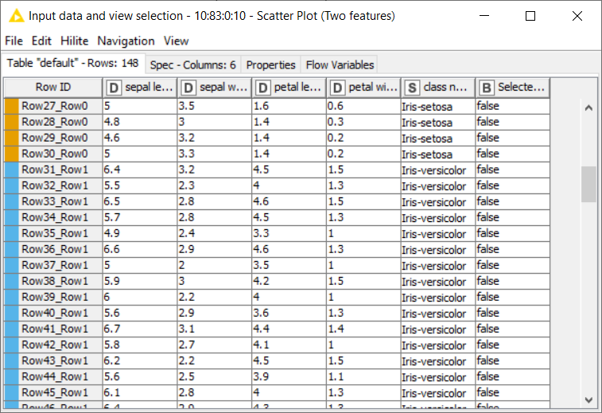
Node Views
Interactive View
Data View

Slide 28
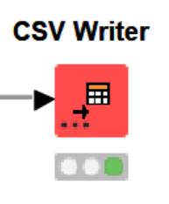
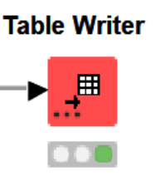
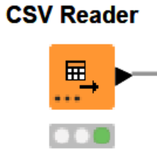
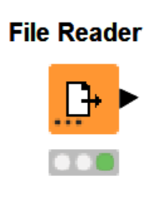
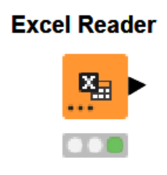
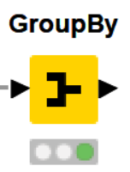
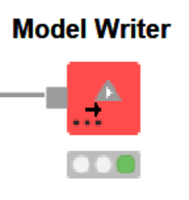
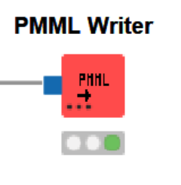
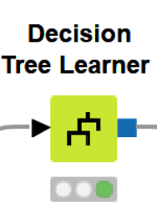
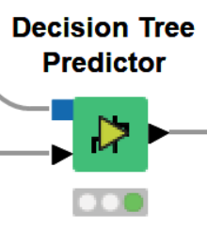
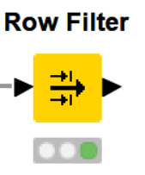
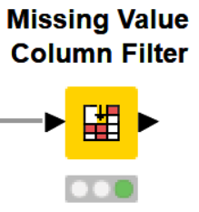
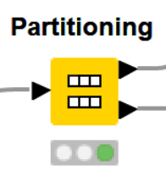
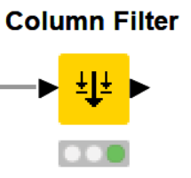
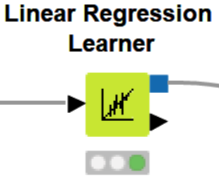
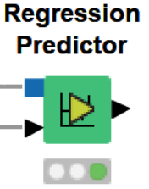
Frequently Used Nodes
Writers
Readers
GroupBy
Learners/Predictors
Filters
Partitioning

Slide 29
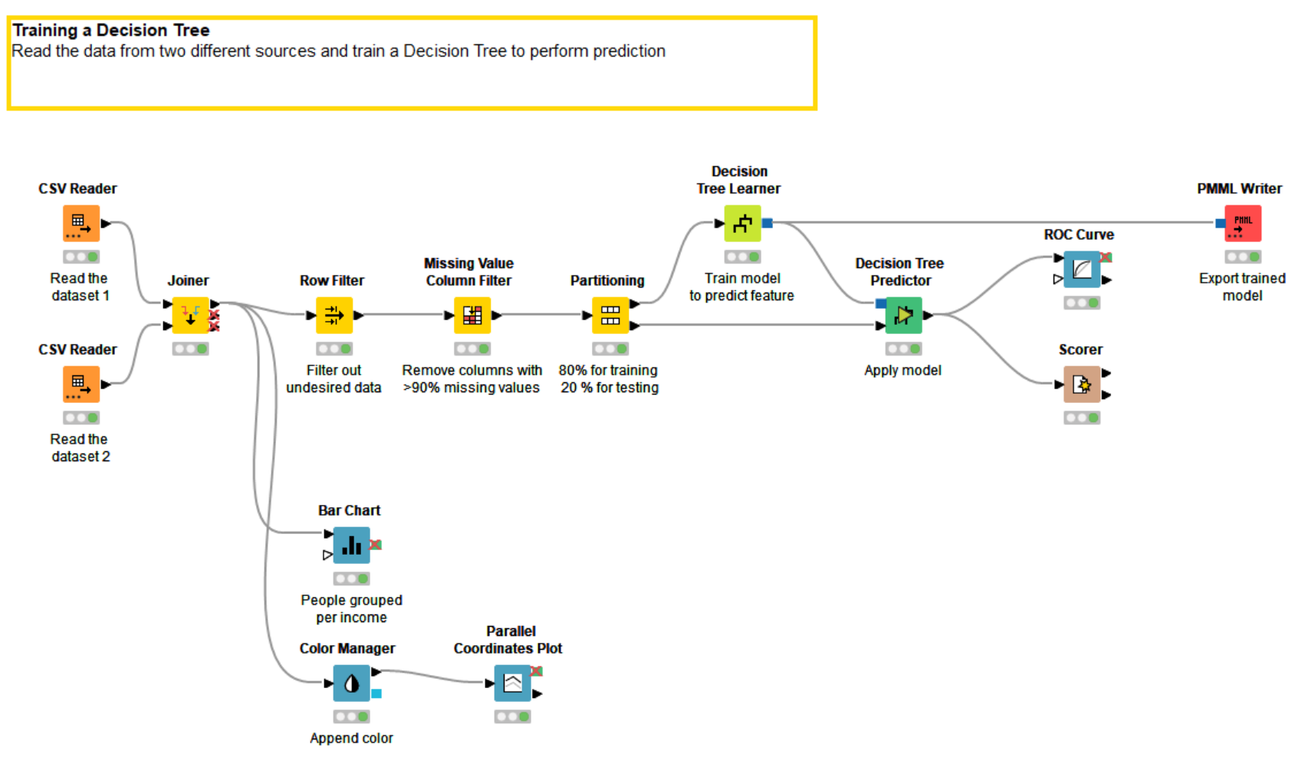
Tidy up workflows
Workflow can easily become complex and difficult to understand

Slide 30
Metanodes and Components

Slide 31
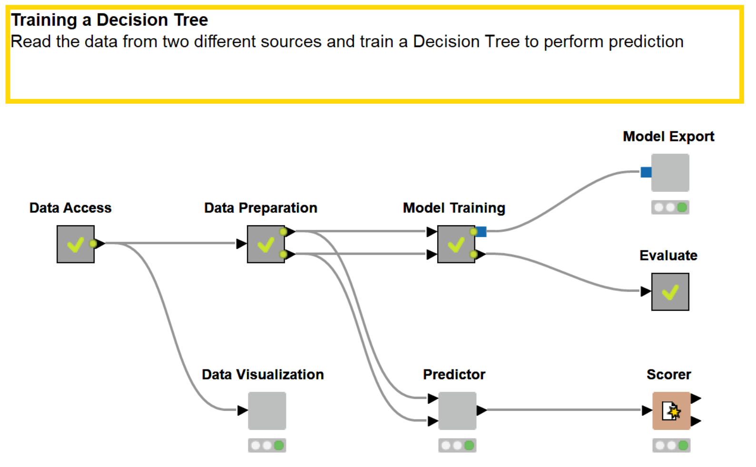
Tidy up workflows
Metanodes and components can help tidying up, encapsulating nodes performing common operations

Slide 32
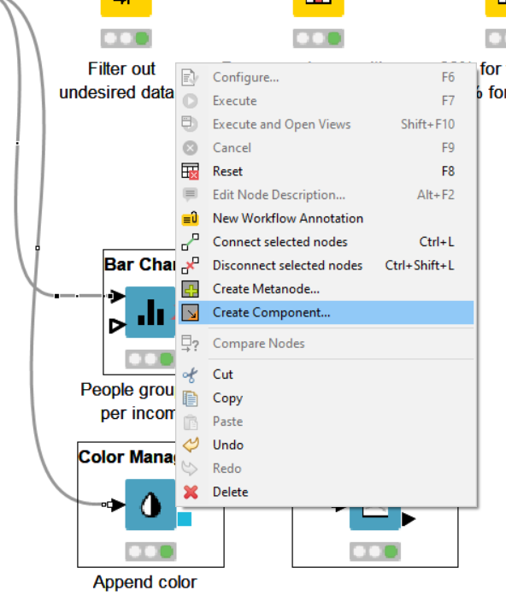
Components
Steps to build a component or a metanode
  Select related nodes that you want to group
  Right click
  Select Create component… or Create Metanode…
  Give it a name
Components have more sophisticated features:
  Encapsulate flow variables, i.e. the parameters only live inside the component
  Provide a configuration window: variables and parameters within the component can be edited by Right Click -> Configure…
  Build a composite view: Visualization inside the component can be grouped in a dashboard

Slide 33
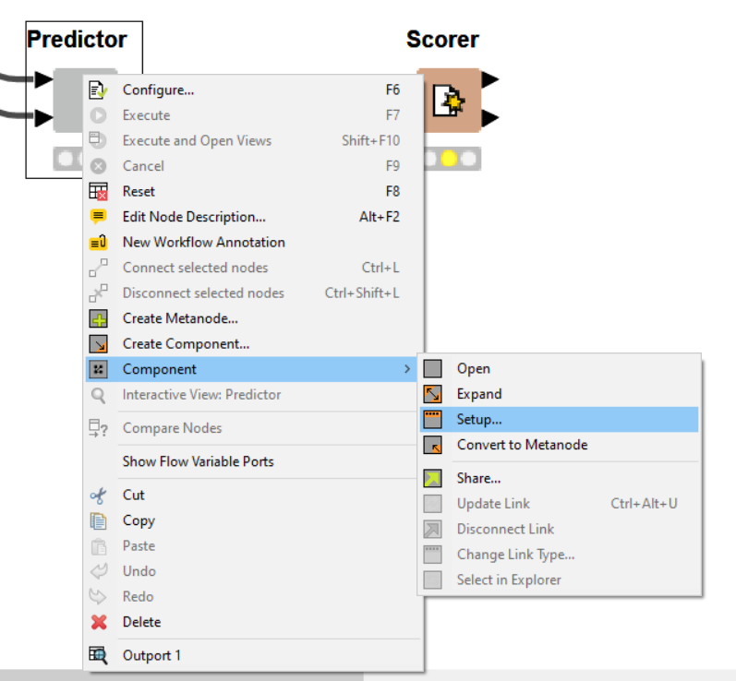
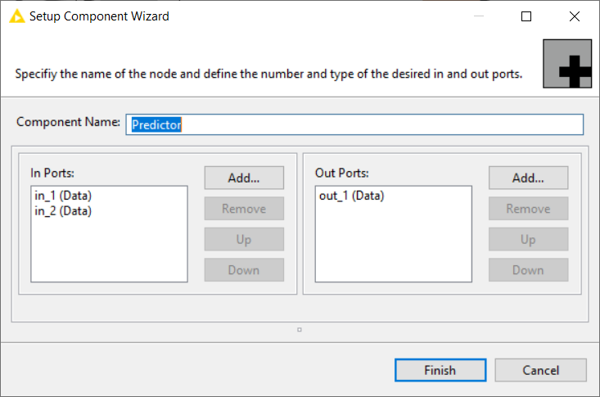
Submenu Component
Right click on the Component and select Setup… from the submenu Component to access further customization settings, such as the component name and the ports

Slide 34
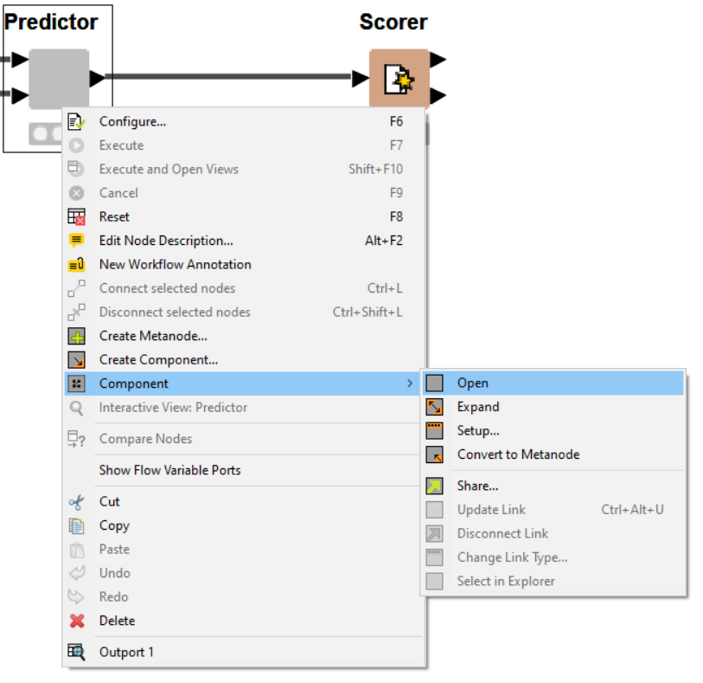
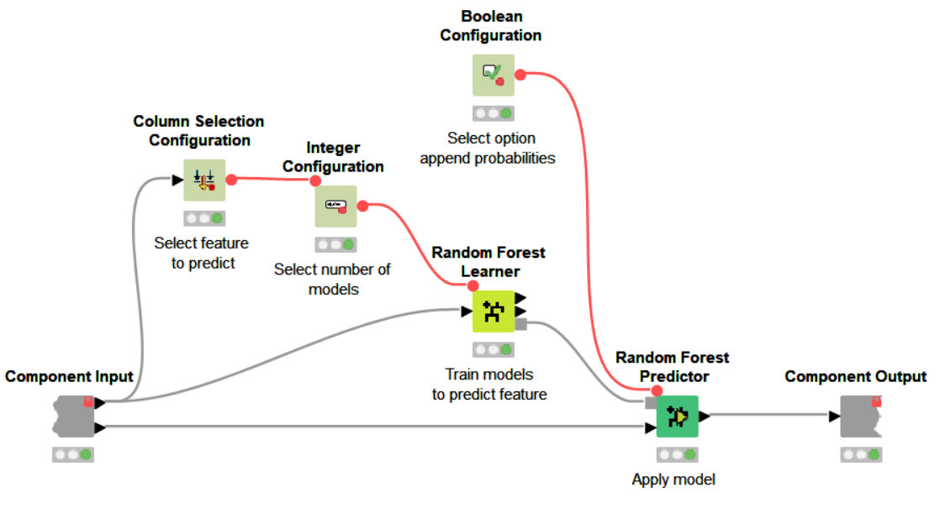
Inside a component
Shortcut:
Ctrl + double click on component to open its content

Slide 35
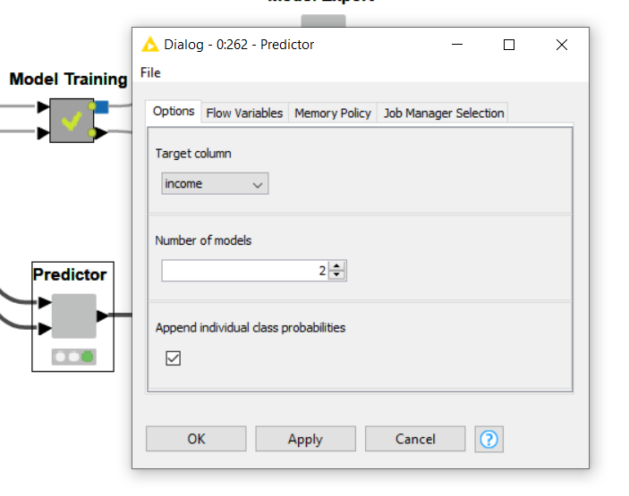
Components Configuration Window
Components can be configurable
From the configuration window (Right click -> Configure…) the user can enter some parameters
The entered parameters change the behaviour of the nodes inside the component

Slide 36
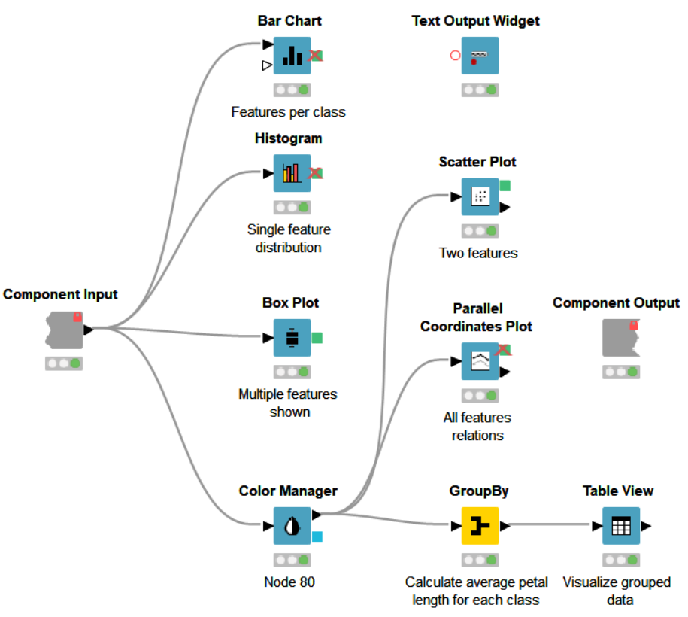
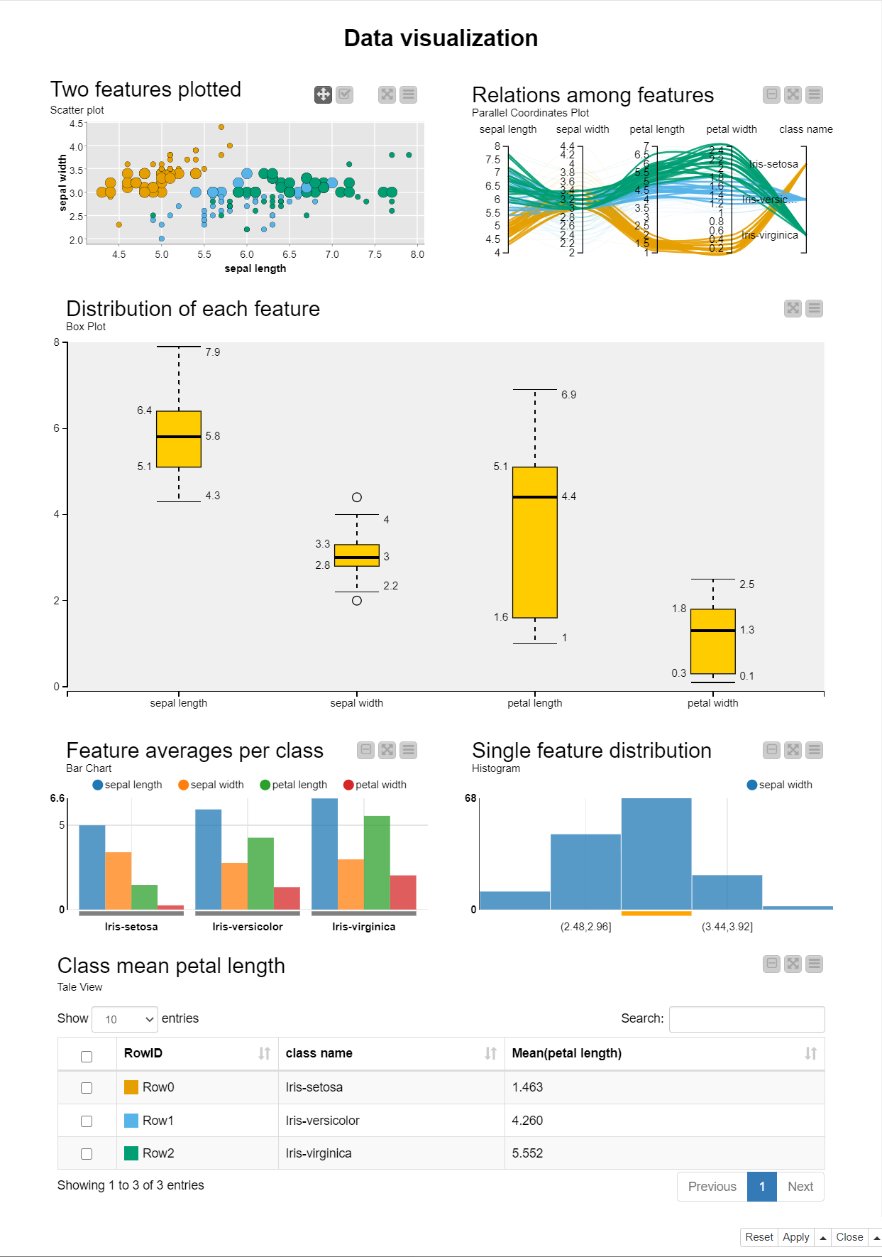
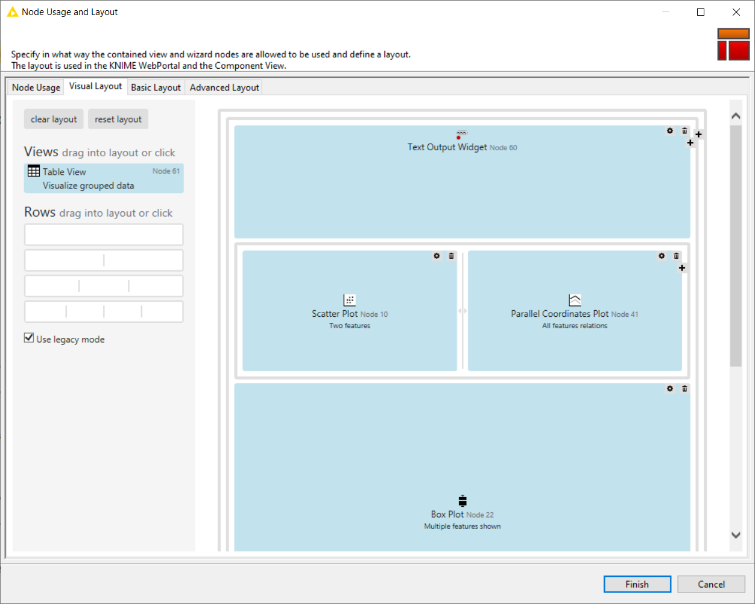
Components Composite View
The visualization nodes within the component can be organized to build an interactive composite view
You can organize and reshape the node views from the Visual Layout window (from inside the component, last icon on the toolbar)

Slide 37
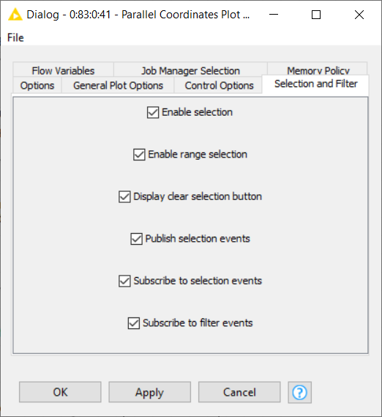
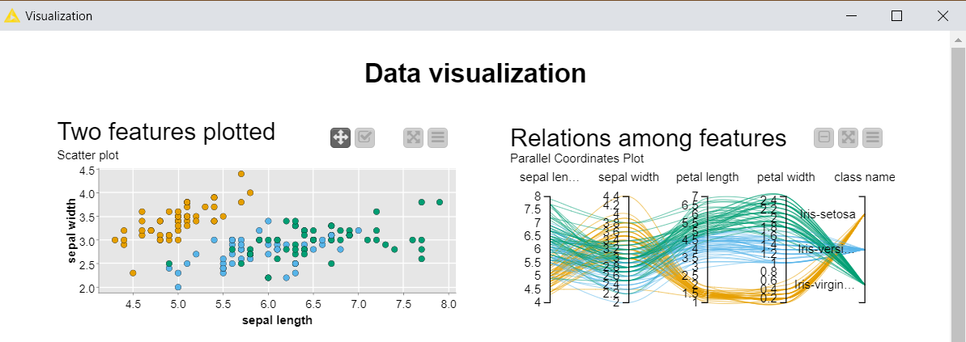
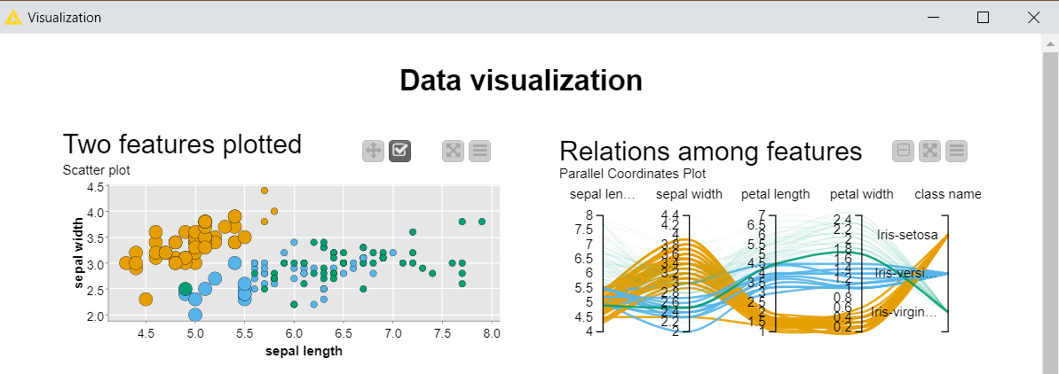
Composite views interactivity
Enable publication and subscription to selection events to make the composite view interactive: data selected in one view are highlighted in the others

Slide 38
KNIME Community Hub

Slide 39
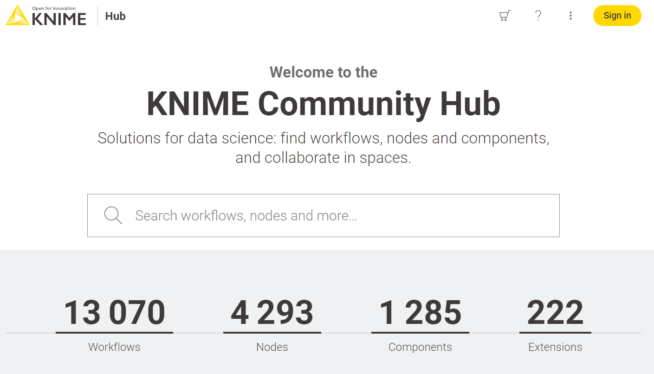
KNIME Community Hub
A place to share knowledge about Workflows and Nodes https://hub.knime.com

Slide 40
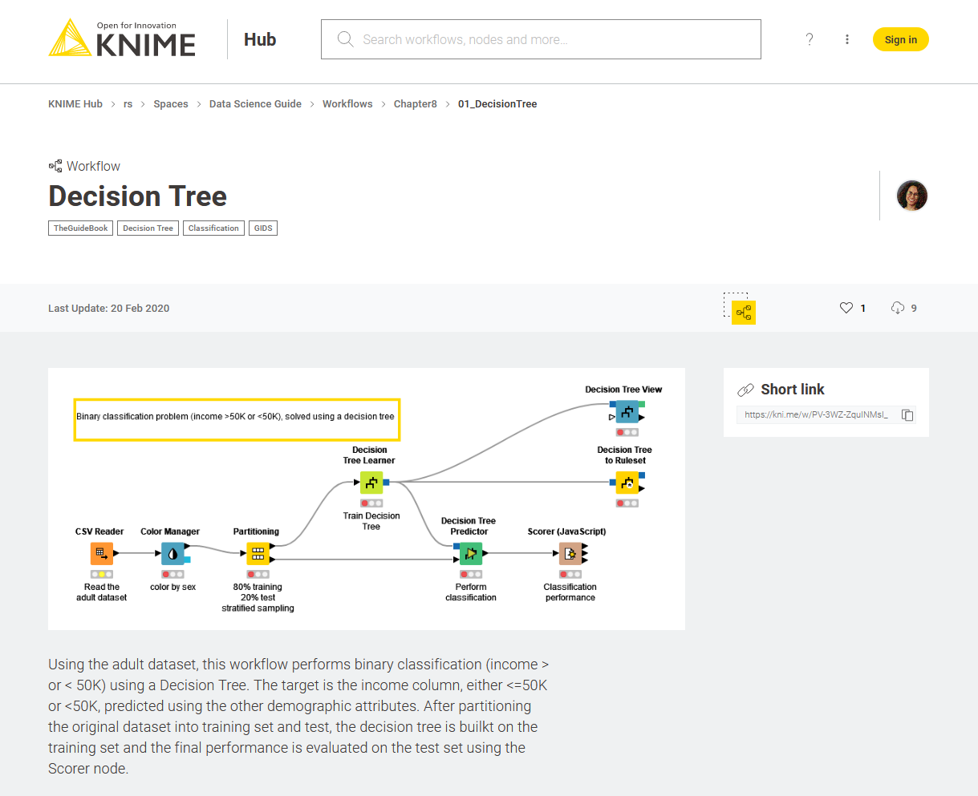

KNIME Community Hub
Workflows
Nodes, Shared Components and Extensions

Slide 41

KNIME Community Hub Spaces
Private Space
Your personal space. Upload here your workflows and components (max 1GB) to have them always available in a central place
Public Space
Shared with the KNIME community. Everyone can find and download them from the KNIME Community Hub

Slide 42

Downloading and importing a workflow from the KNIME Community Hub
Searching for the Tag “theguidebook” will show you all the workflows related to this book

Slide 43


Downloading and importing a workflow from the KNIME Community Hub
Method 1
Download the workflow, locate it into your machine and import it as seen before

Slide 44


Downloading and importing a workflow from the KNIME Community Hub
Method 2
Drag and drop the icon directly into the KNIME Explorer at the desired location

Slide 45



KNIME Cheat Sheets
https://www.knime.com/cheat-sheets

Slide 46




KNIME Books
e-book downloads from KNIME Press
https://www.knime.com/knimepress
with code: <Promotion-Code>

Slide 47

Free e-Learning Courses about KNIME Analytics Platform
https://www.knime.com/knime-self-paced-courses

Slide 48
Build your first Hello Workflow

Slide 49


Create your first workflow
Right Click on the LOCAL folder in the KNIME Explorer and select New KNIME Workflow
From the pop up window, insert the name of your first workflow

Slide 50



Read the dataset
Drag and drop the CSV Reader node from the Node Repository to add it to the workflow
Open the configuration window (double click) and select the file on your machine containing the adult dataset

Slide 51


Remove columns
Some columns have unnecessary information. Remove them with a Column Filter node

Slide 52


Remove Rows
Add a Row Filter node and configure it to only keep entries whose “native-country” value is not “United-States”

Slide 53


Write to new file
Finally add a CSV Writer node to the pipeline.
Configure and execute it to write the transformed dataset to a new file

Slide 54


Annotations
Annotations are coloured editable boxes that you can add to your workflow
They help you making it more readable and visually pleasant
Click on the upper left corner icon to customize text and appearance of an annotation
Right click anywhere on your workflow and add a New Workflow Annotation from the context menu

Slide 55
Thank you

