Slide 1
Deployment

Slide 2
Summary of this lesson
„Data Scientist is just a sexed up word for Statistician“
-Nate Silver
How do we move the models to production?
*This lesson refers to chapter 10 of the GIDS book

Slide 3
Content of this Lesson
Deployment
Model Deployment
Model Management
Practical Example

Slide 4
Deployment

Slide 5
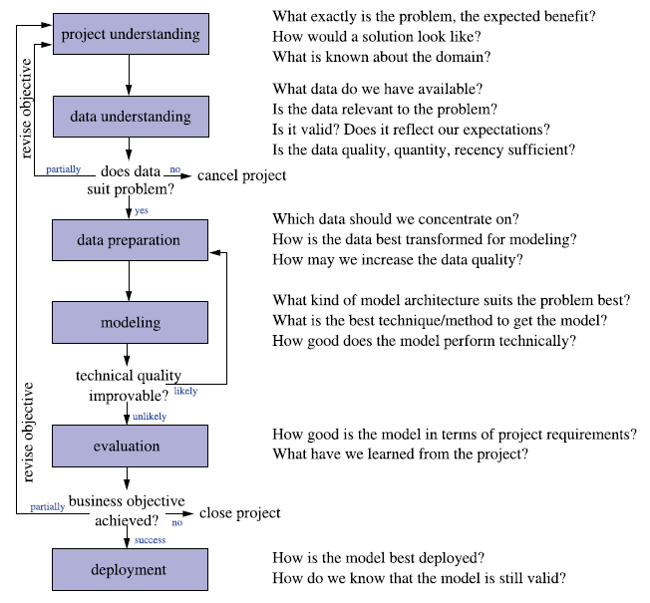
The Data Science Process
SEMMA
Sample, Explore, Modify, Model, Assess
CRISP-DM
Cross Industry Standard Process for Data Mining
KDD
Knowledge Discovery in Databases

Slide 6
A Classic Data Science Project
It always starts with some data …
Data Preparation
Model Training
Model Optimization
Model Testing
Deployment
Data Manipulation
Data Blending
Missing Values Handling
Feature Generation
Dimensionality Reduction
Feature Selection
Outlier Removal
Normalization
Partitioning
…
Model Training
Bag of Models
Model Selection
Ensemble Models
Own Ensemble Model
External Models
Import Existing Models
Model Factory
…
Parameter Tuning
Parameter Optimization
Regularization
Model Size
No. Iterations
…
Performance Measures
Accuracy
ROC Curve
Cross-Validation
…
Files & DBs
Dashboards
REST API
SQL Code Export
Reporting
…
Guide to Intelligent Data Science Second Edition, 2020

Slide 7
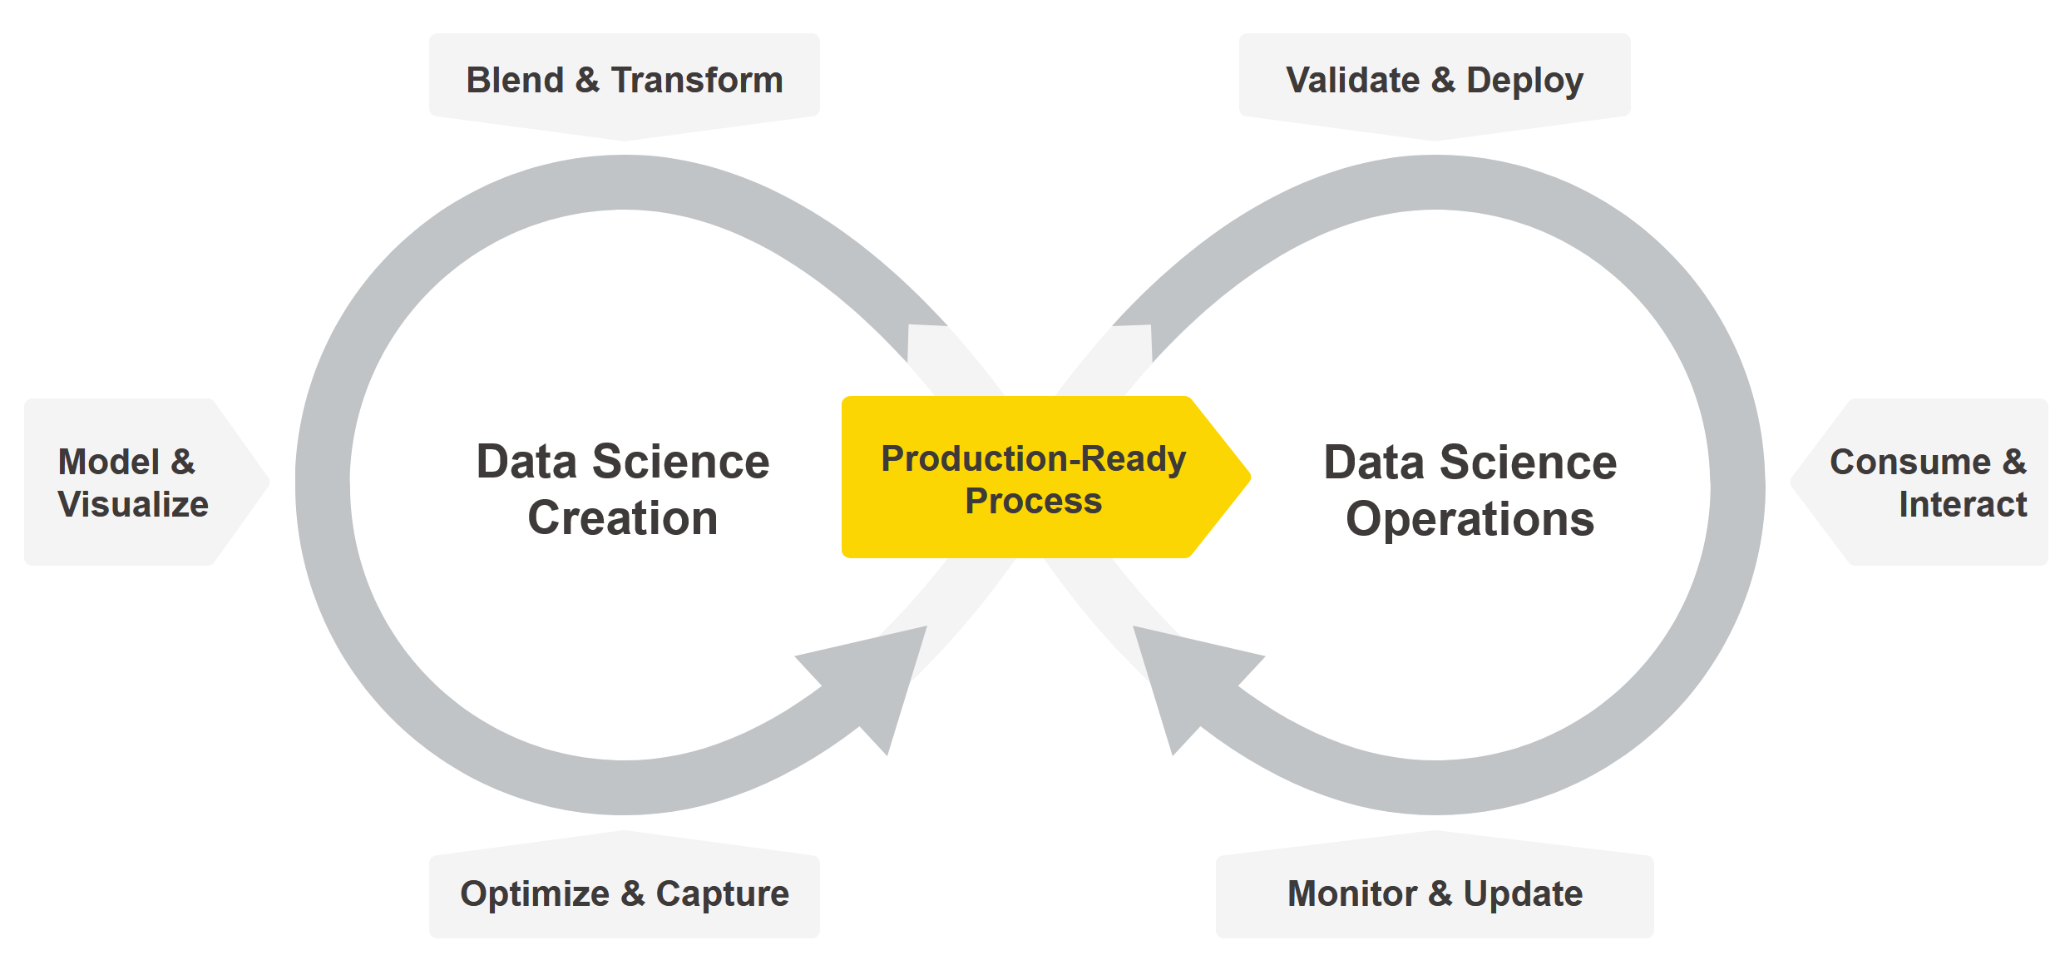
What comes after Deployment?
Lab
Real-World

Slide 8
What is model deployment?
Notice the dashed line between model testing and model deployment?
This is where the jump from the lab to the real world happens
Eventually a trained model must be included in a final application to be used by external applications and/or end users
The final application is the deployment application
The step of building the application around the trained model is called deployment
Notice that the deployment application must be developed and finally put into production like all pieces of software
When the deployment application is moved into production, so is the trained model

Slide 9
Deployment requirements
Easy
It must be easy for the application developer to include the trained model into the deployment application
Easy to use for end users
Easy to integrate in a Service Oriented Architecture
Safe
At the same time it must be correct. For example, it must include the whole data preparation part.
Most reasons of deployment failures are in the not faithful export of the pre-processing and post-processing steps from the training application into the deployment application.
Think of a model trained on normalized data and of a deployment application where normalization has been forgotten.

Slide 10
The model journey
Once in the real world, the deployment application and the trained model must oblige to the laws of IT
Automation
On demand & scheduled execution
Monitoring and Updating
Auditing
Justify decisions
Store previous executions
Reproducibility
Security
Protection of sensitive data
Protection of sensitive applications
Versioning & Disaster Recovery

Slide 11
Deployment Options

Slide 12
Deployment
Deployment
Usage of a trained model in an application to provide answers for a real-world use case
In its own application
Easy to use for end users (as a web application)
Easy to integrate in a Service Oriented Architecture (as a web service)
Consumed by external Applications
As a file in standard format
As a software library

Slide 13
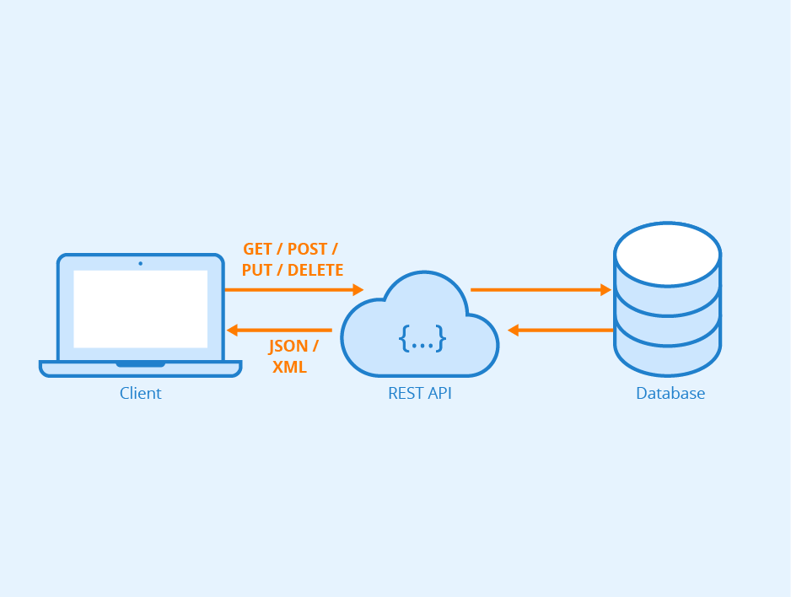
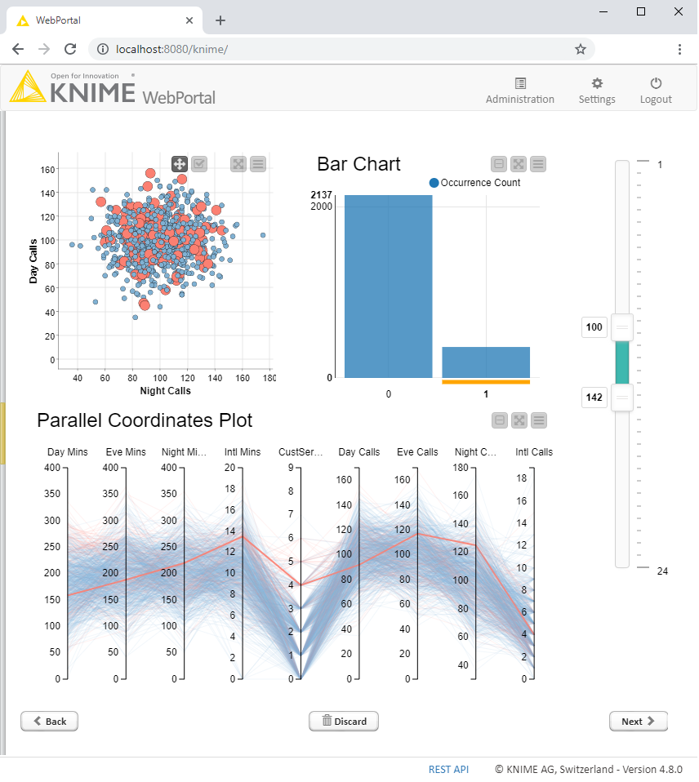
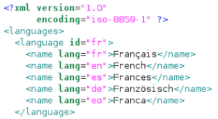
Deploying the ML Model
Inside its own application
In a web service
in a web application
ML model
as a software library
as a file in a standard format
Consumed by external applications

Slide 14
Deployment in its own application
Easy to use for end users
If the model has been deployed into an application for end users, it must be easy to use also for non-experts and non-data-scientists kind of users
As a web application from a web browser
Hide model complexity
Offer touchpoints for exposed parameters
Easy to integrate in a Service Oriented Architecture
As a web service
Via standard interfaces for web services

Slide 15
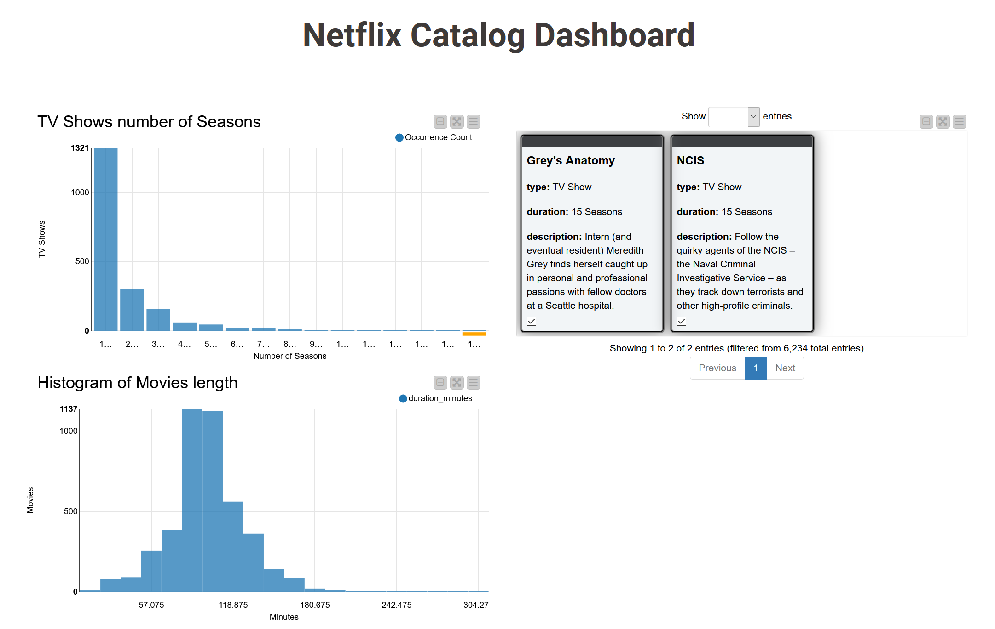
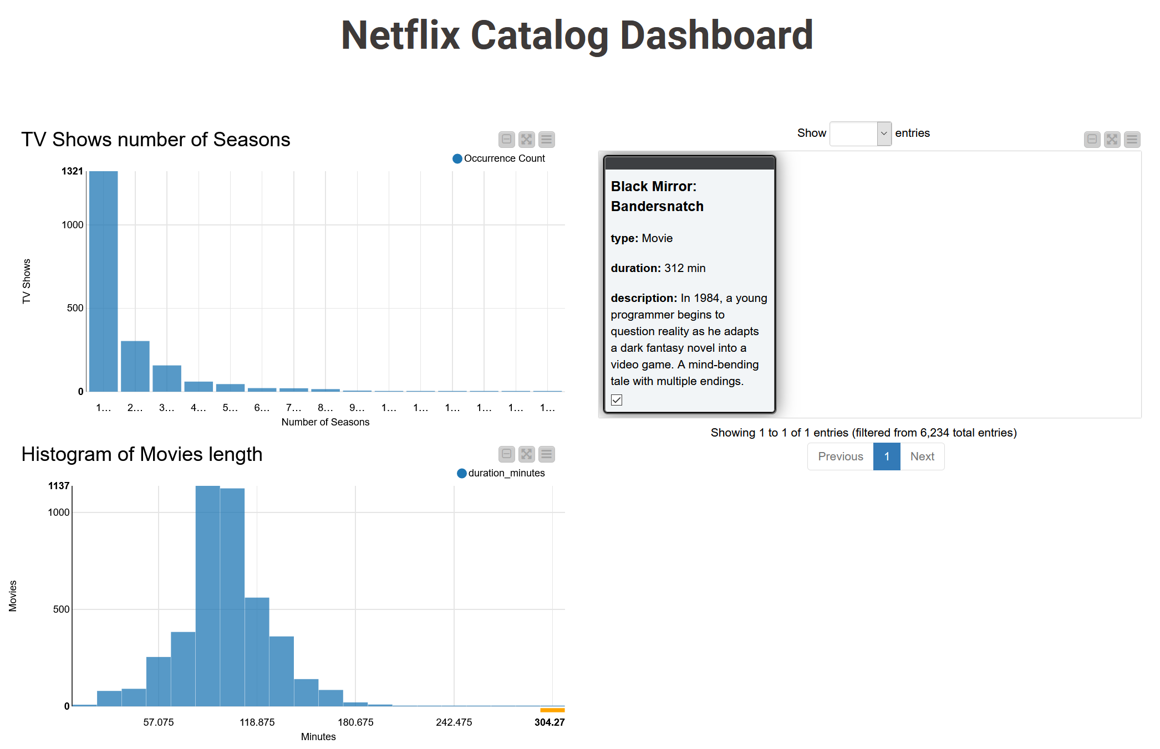
Deployment in a web application
One page usually includes an Interactive Dashboard to show the results
Fast and intuitive decision support even for non expert users
Can show model prediction and more complex interactive data visualization

Slide 16
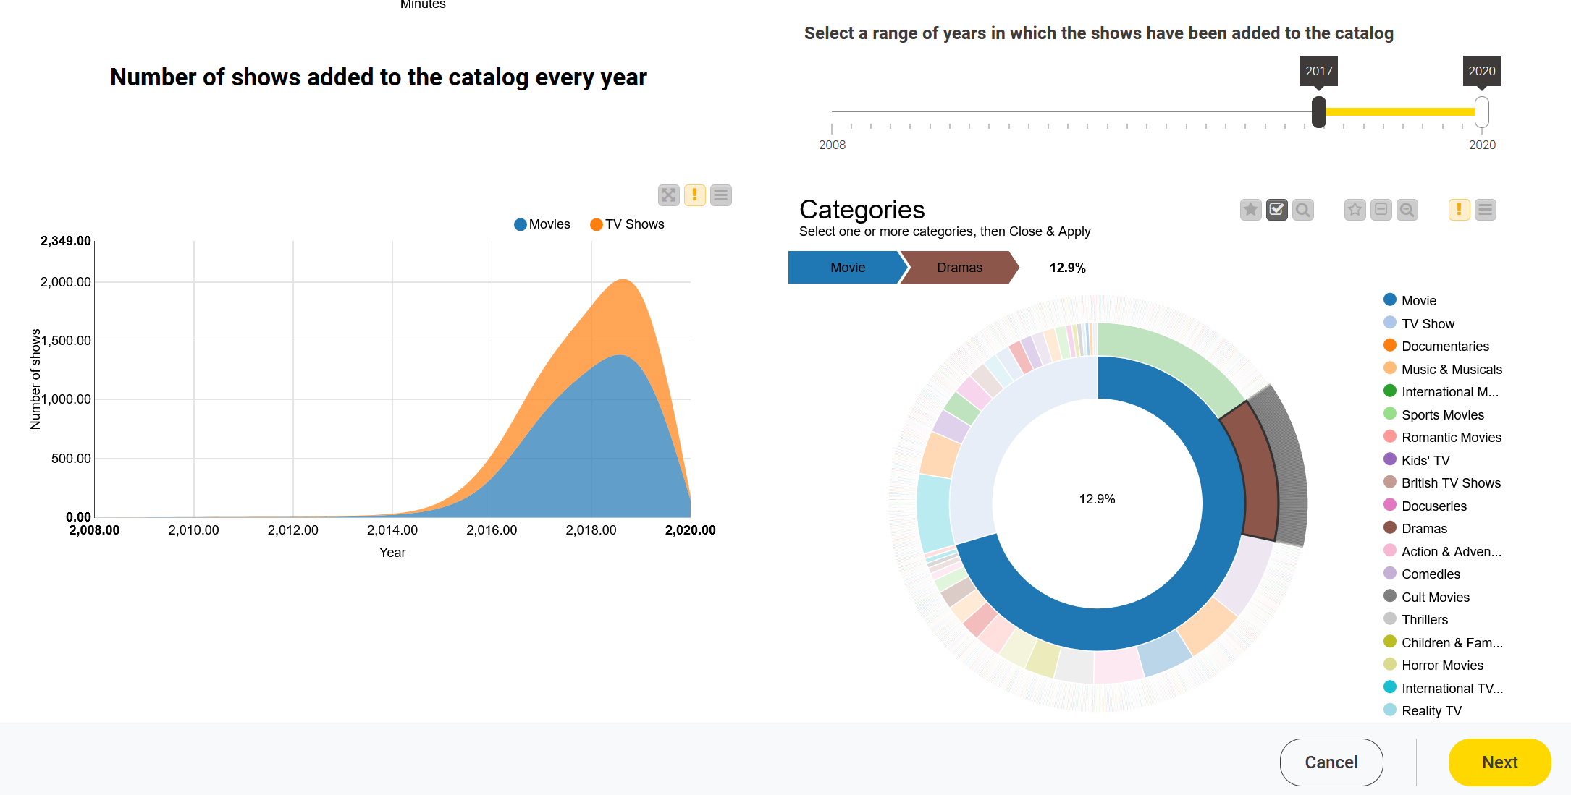
Deployment in a web application
Interactive plots and charts
Data selection across plots, charts, and tables
Items such as: range slider, selection bullets, menus, …

Slide 17
Guided Analytics
One final dashboard page ➔ to show results
What about having touchpoints that require end user interaction?
Hide complexity in automated snippets
Expose parameters interesting to the end users via touchpoints
Example: Guided Automation.
Train a number of models on the selected training set
Sequence of Touchpoints could be:
5. Select Execution Engine
1. Load Data
2. Select Target
3. Filter Columns
4. Select Models
6. Show Results

Slide 18
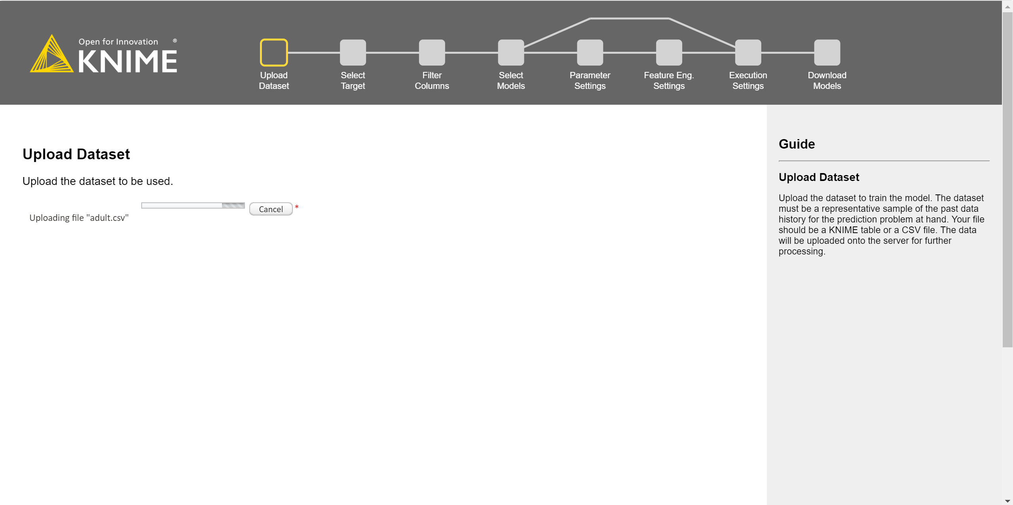
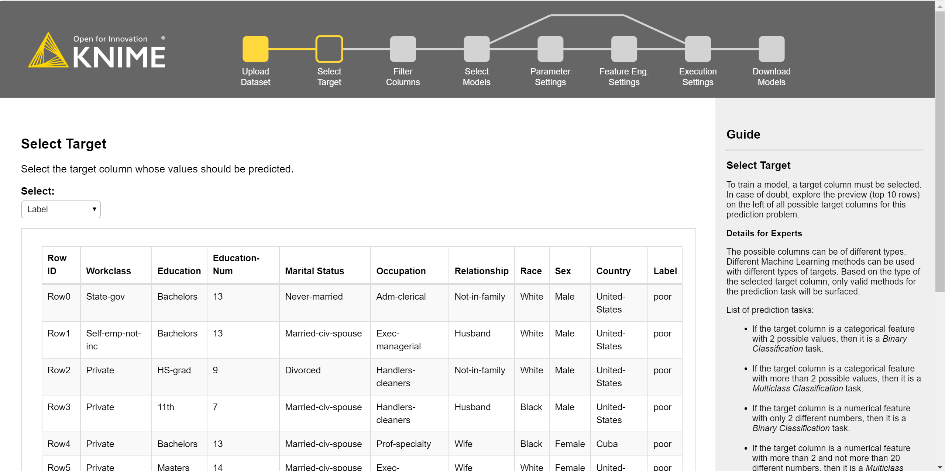
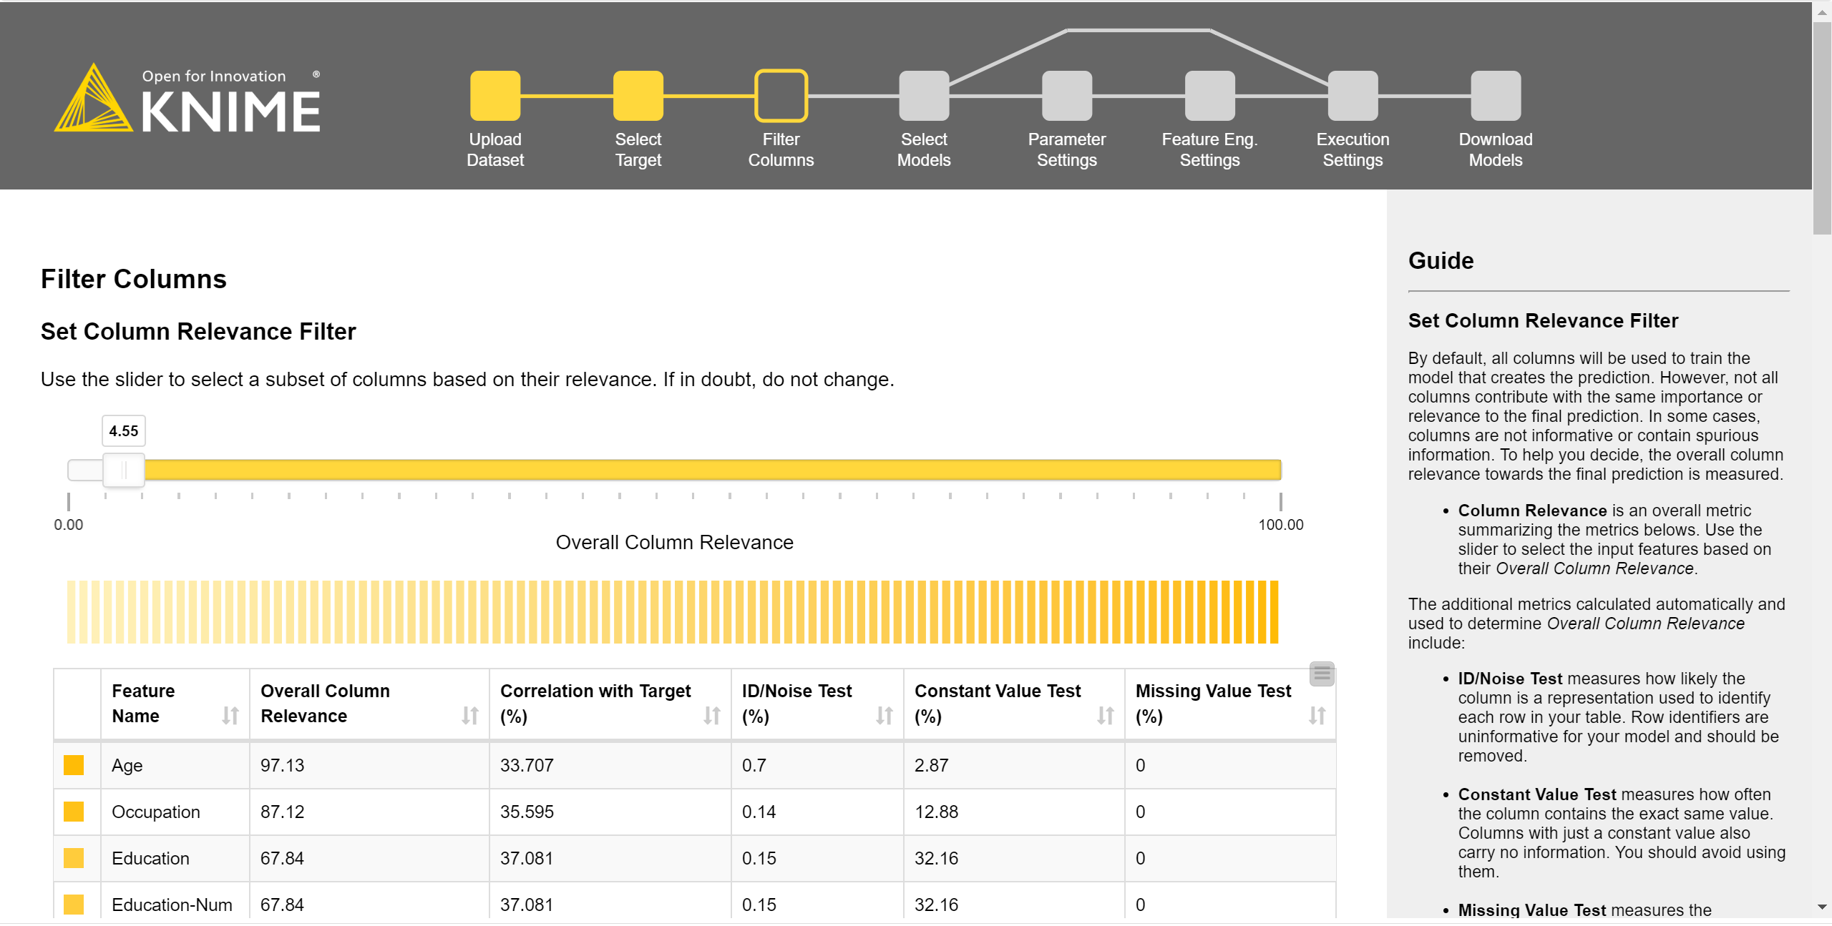
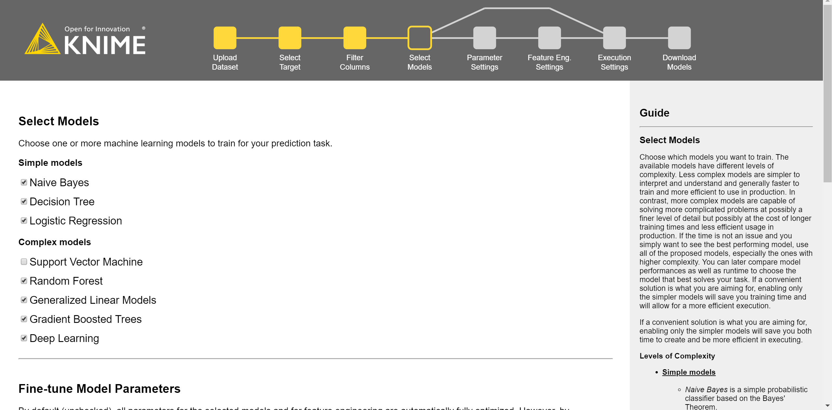
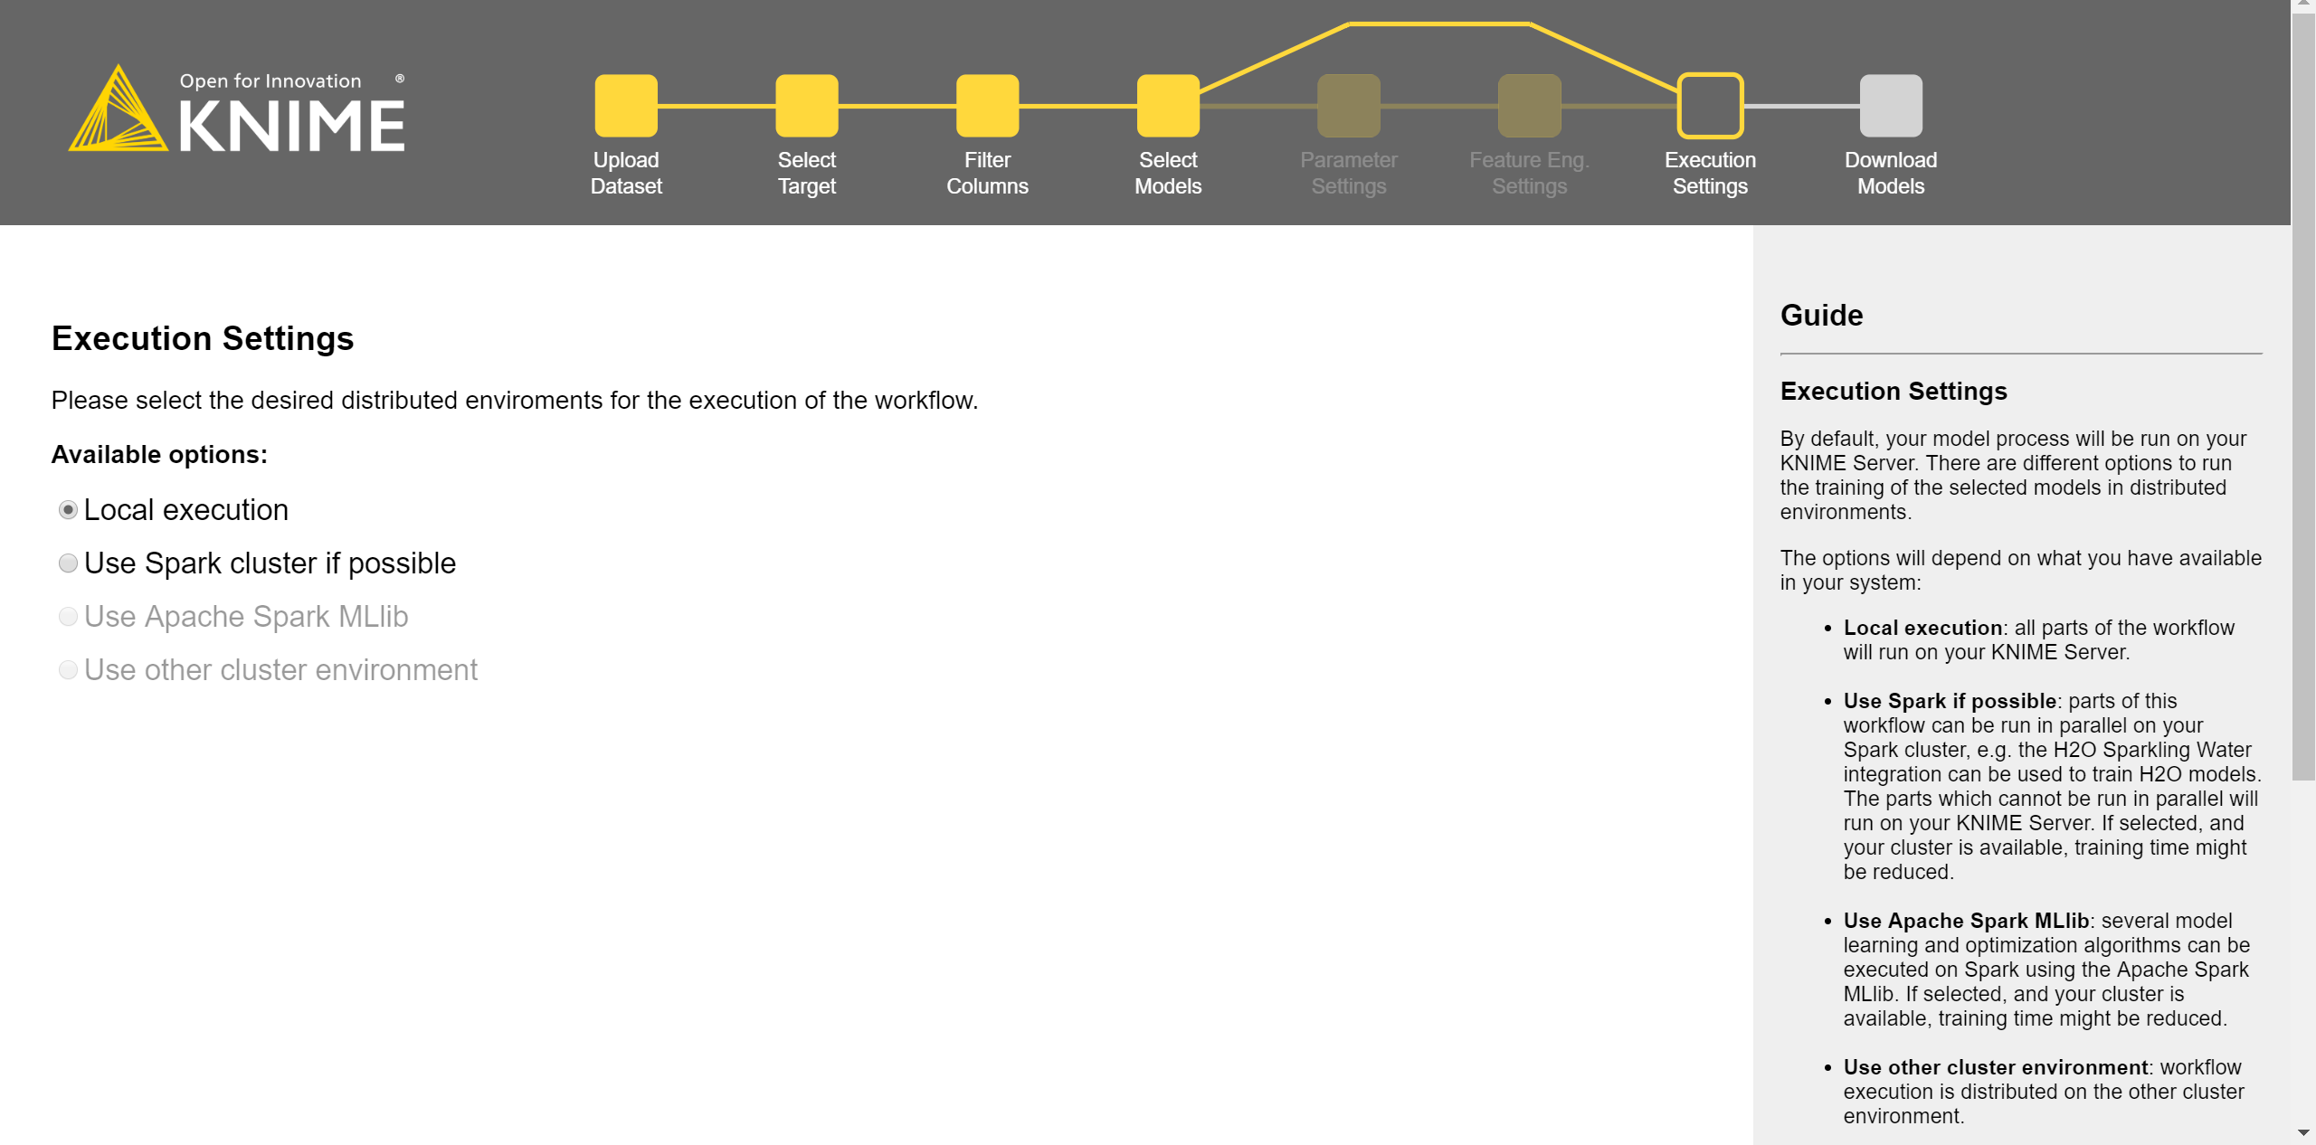
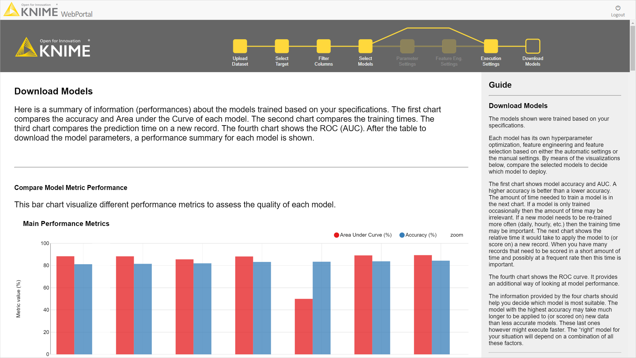
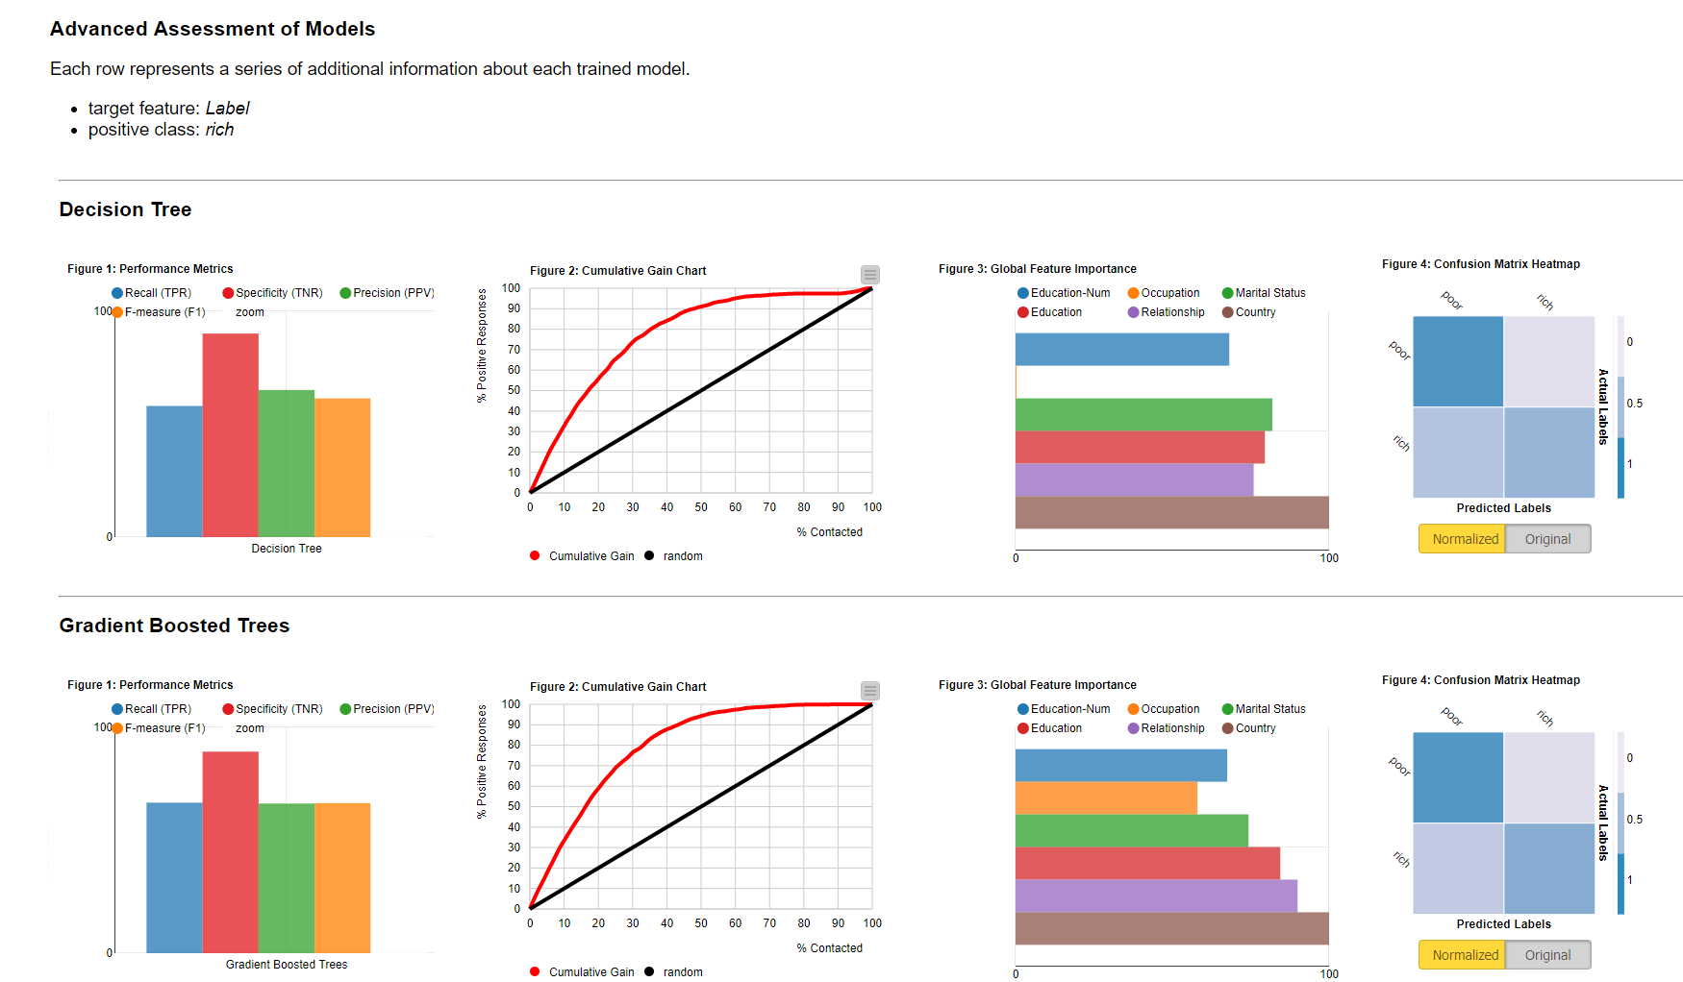
Guided Automation: An example
1. Load Data
2. Select Target
3. Filter Columns
4. Select Models
5. Select Execution Engine
6. Show Results

Slide 19
Building a Guided Automation Workflow
Interaction Required
Automated
Guide to Intelligent Data Science Second Edition, 2020

Slide 20
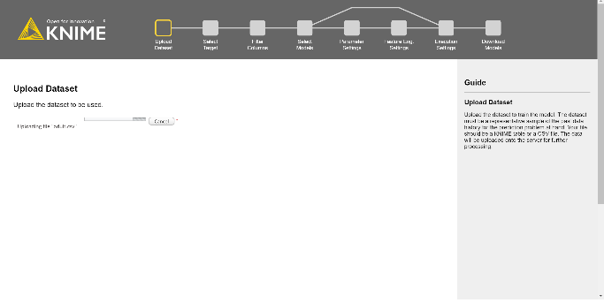
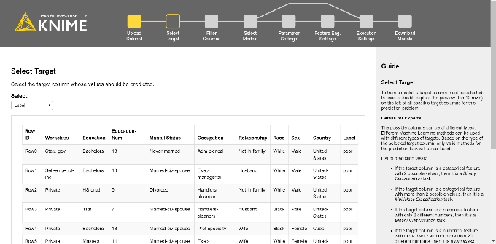
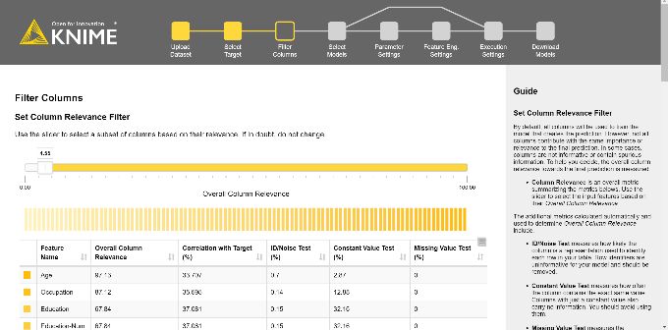
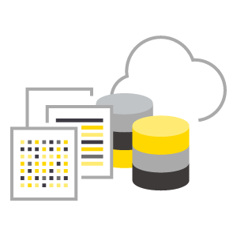
KNIME’s Guided Automation: Automation + Interaction
Interaction Required
http://myhub.com
Automated
analytical application
for business users
from web browser
KNIME Business Hub
Guide to Intelligent Data Science Second Edition, 2020

Slide 21
Deployment in a web service
A web service provides interoperability between computer systems
over the internet
through a web technology, such as HTTP
to transfer machine-readable file formats such as XML and JSON.
Web Services with REST architecture are the current state of the art
What is a REST architecture
Representational State Transfer (REST) is a software architectural style introducing a set of constraints for web services.
Web services that conform to the REST architectural style, are called RESTful (REST) web services.
REST services allow the requesting systems to access and manipulate representations of web resources by using a uniform and predefined set of stateless operations. You cannot make up your own arbitrary set of operations, as in SOAP web services.
Stateless protocol and standard operations => fast execution, easy to manage

Slide 22
Deployment in a web service
Operations in a REST web service (over HTTP)
GET
HEAD
POST
PUT
PATCH
DELETE
CONNECT
OPTIONS
TRACE
The Request and Response objects
Data is exchanged via a Request object and a Response object
The Request object sends data to the REST service, together with the required operation
The Response object passes the result back to the calling system

Slide 23
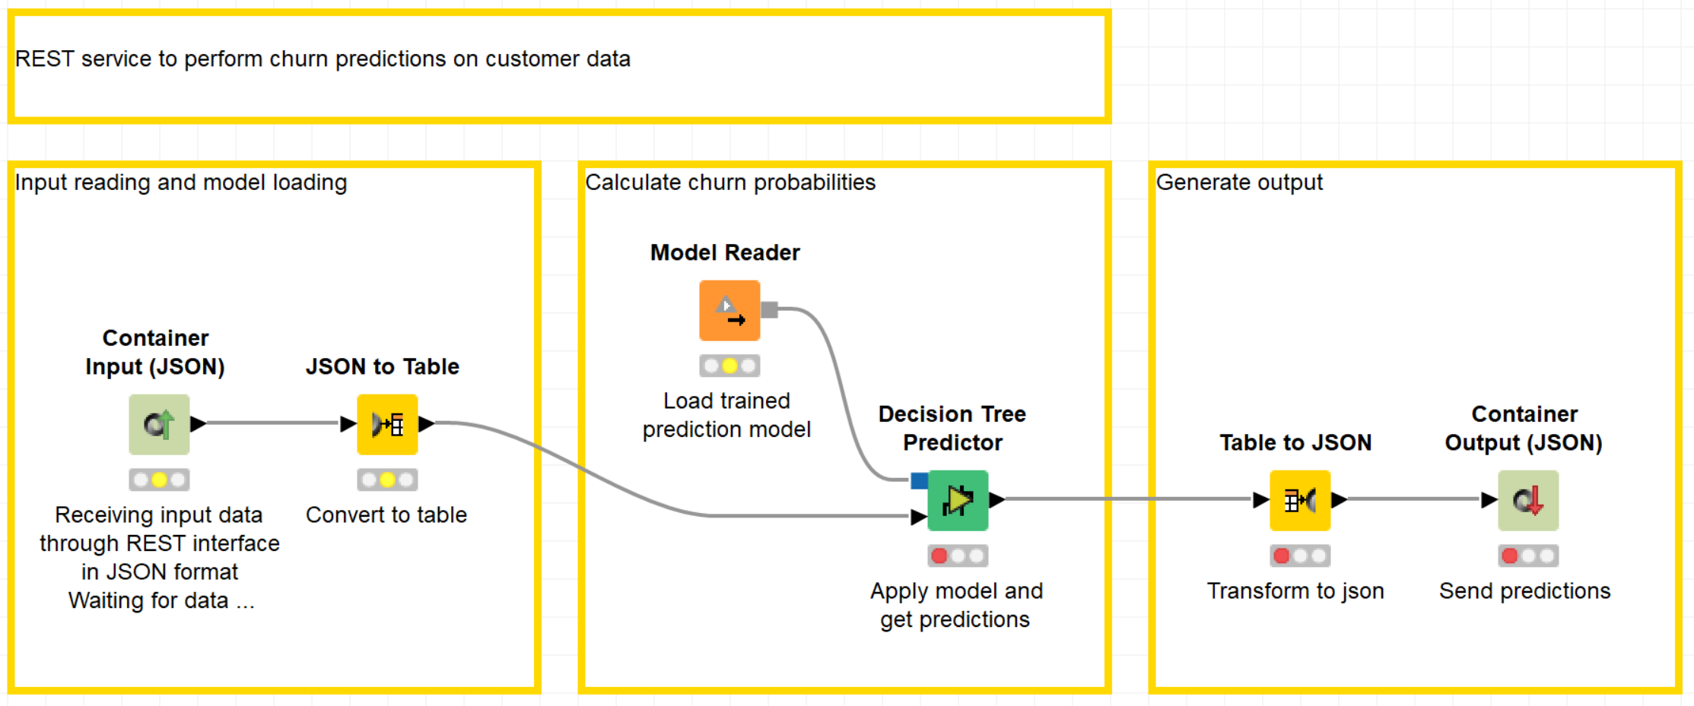
Building a web service
Building a REST service requires:
To shape the structures of the Request and Response objects
To enable the REST API
Solutions:
Container nodes shape the Request and Response objects
All workflows uploaded on the KNIME Server are available as REST services
Container nodes shape Request and Response structure
Other container nodes are available

Slide 24
Building a web service
1
Upload
KNIME Business Hub
REST Service
2
REST Service
KNIME Business Hub
External Application

Slide 25
Deployment as a file in standard format
Standard formats allow for external applications to consume the network/model
PMML
Predictive Model Markup Language (PMML) is based on XML
Embeds a wide range of predictive models along with aspects of the required pre-processing
Can be directly loaded into database systems and applied to data tables
PMML works well with standard ML models (decision tree, logistic regression)
Representation of new complex models (ensamble, deep learning…) is problematic, either because a standard representation has not been defined or because the size of the resulting file is too large
Less and less used
ONNX
ONNX = Open Neural Network for eXchange
Open standard dedicated to represent neural networks and deep learning networks
ONNX represented networks can then be stored into files
Standard ensures the portability of the represented network across systems
Note: Data processing (transformation/integration) must be part of the deployed model in production

Slide 26
Frequent Causes for Deployment Failures
Data Science projects often fail in deployment. Why?
Common reasons:
Bad project design: consequences can appear only in deployment phase. For example, a feature, transformation, or a data source that is not available in production.
Data leakage: data in the test set mixes up with data in the training set. Model scores do not reflect the performances in the real-world.
Dynamic domains: Features and target variable end up having different domains in the training data vs. the real-world. New values are not handled properly.
Change in Business Objectives: During or after deployment the business objectives of the project have changed for some reason. For example, the business strategy of the company has changed.
Invalidated assumptions. What we thought it was true about the data, it is not. Maybe we did not extract a representative sample from the world data.
Shift from inter- to extrapolation: atypical data (i.e. data not used during training). What to do? Shall we stop everything?
The world changes: e.g. if new products offered or customers change habits, the data used to build and optimize the model are no longer representative of the reality

Slide 27
Model Management

Slide 28
Model Management
The world change, the business requirement change
Model Management puts in place some mechanisms to ensure that the model keeps performing as expected
Model Management includes:
Model Monitoring
Model Update & Retraining
Model Factories

Slide 29
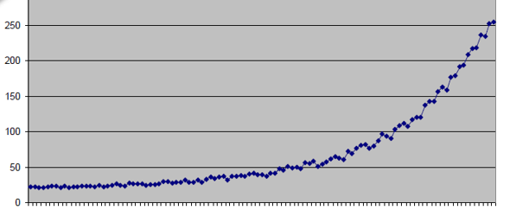
Data Drifts and Data Jumps
The world changes, the data change
Data Drift (data changing slowly over time)
Data Jump (Data changing suddenly at some point)
The state of a mechanical piece, the temperature going towards winter, the price of items due to inflation, etc ...
The breaking of a mechanical piece, the crash of the stock market, etc ...

Slide 30
Model Drift
A model with an accuracy of 90% in the past can slowly (or suddenly) degrade to a much lower accuracy over time.
This is called Model Drift
Periodically check model performance
On which data?
How often is periodically?
If model performance below threshold, retrain
What threshold value?

Slide 31
Model Performance Evaluation: On which Data?
To spot the Model Drift (due to an outdated model), you should use recent data
It is of course useless to test the model on data acquired at the time when the training data were collected.
At every run, production data are stored for monitoring purposes, till a sufficiently large dataset is collected.
Manually annotated data are also added to test border cases
The model is then tested again on this newly collected dataset.
No action is taken if performance drops within an acceptable interval. Contrarily, actions for model retraining must be taken, if performance goes below the acceptance threshold.

Slide 32
Model Performance Evaluation: How often?
What does “periodically” mean?
Shall I test my model performance once a week, once a month, or once a year?
It depends on the data and on the business case:
Stock prices change every minute ➔ model re-evaluation every few days
The taste of a customer segment will be the same for a few weeks ➔ model re-evaluation every few months
Same for the evaluation threshold: the value depends on the data and on the business case

Slide 33
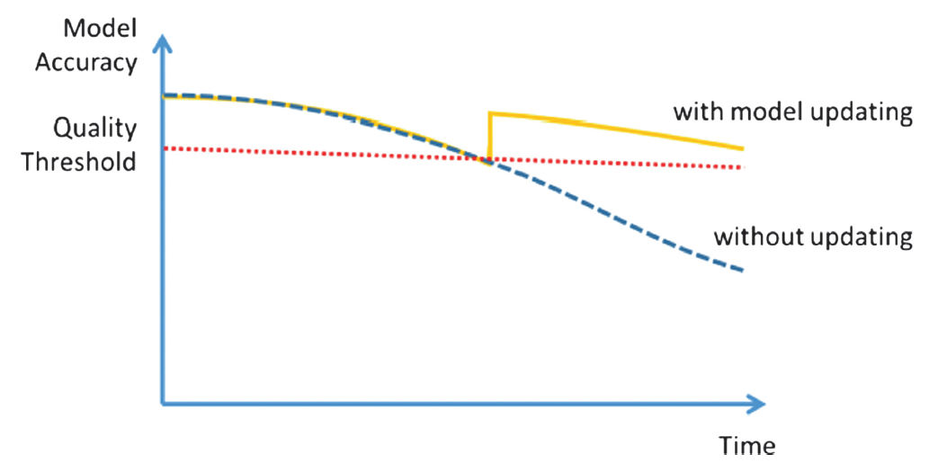
Model Updating and Retraining: Training Set
(Automatic) Model Updating
Feed new data points to be incorporated into the model
In this way old data are less important (are forgotten)
Retraining
Use sampling to provide the right mix of past and more recent data
Caveats:
Seasonality can be a problem. Specialized models or season knowledge manually injected
Pre-existing knowledge (e.g. border case handling) better incorporated using a separate rule model instead of manual knowledge injection

Slide 34
Model Updating and Retraining: Replacement
Model Replacement
We have retrained a new model. Are we sure it is better than the previous one?
New model is the challenger
Former model is the champion
IF challenger’s performance > champion’s performance THEN replace
OTHERWISE keep champion model
Caveats:
Resources and time demanded

Slide 35
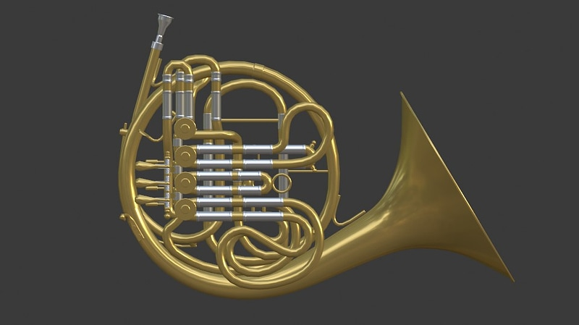
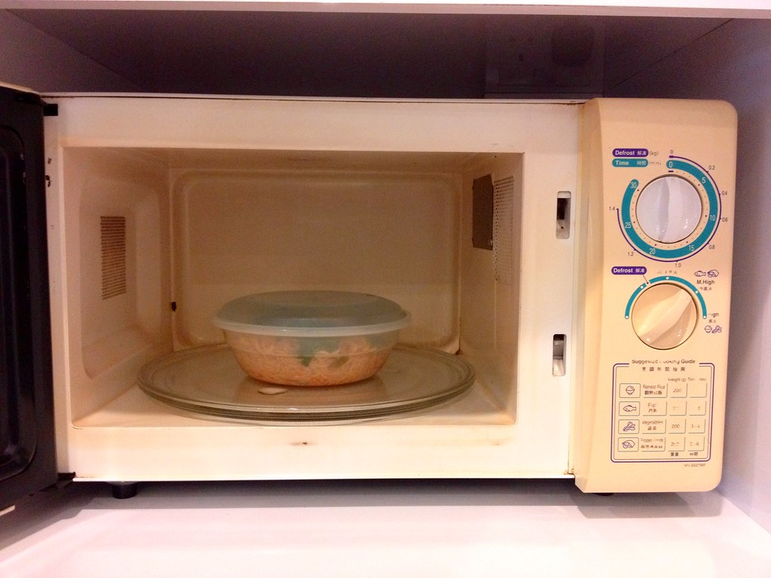
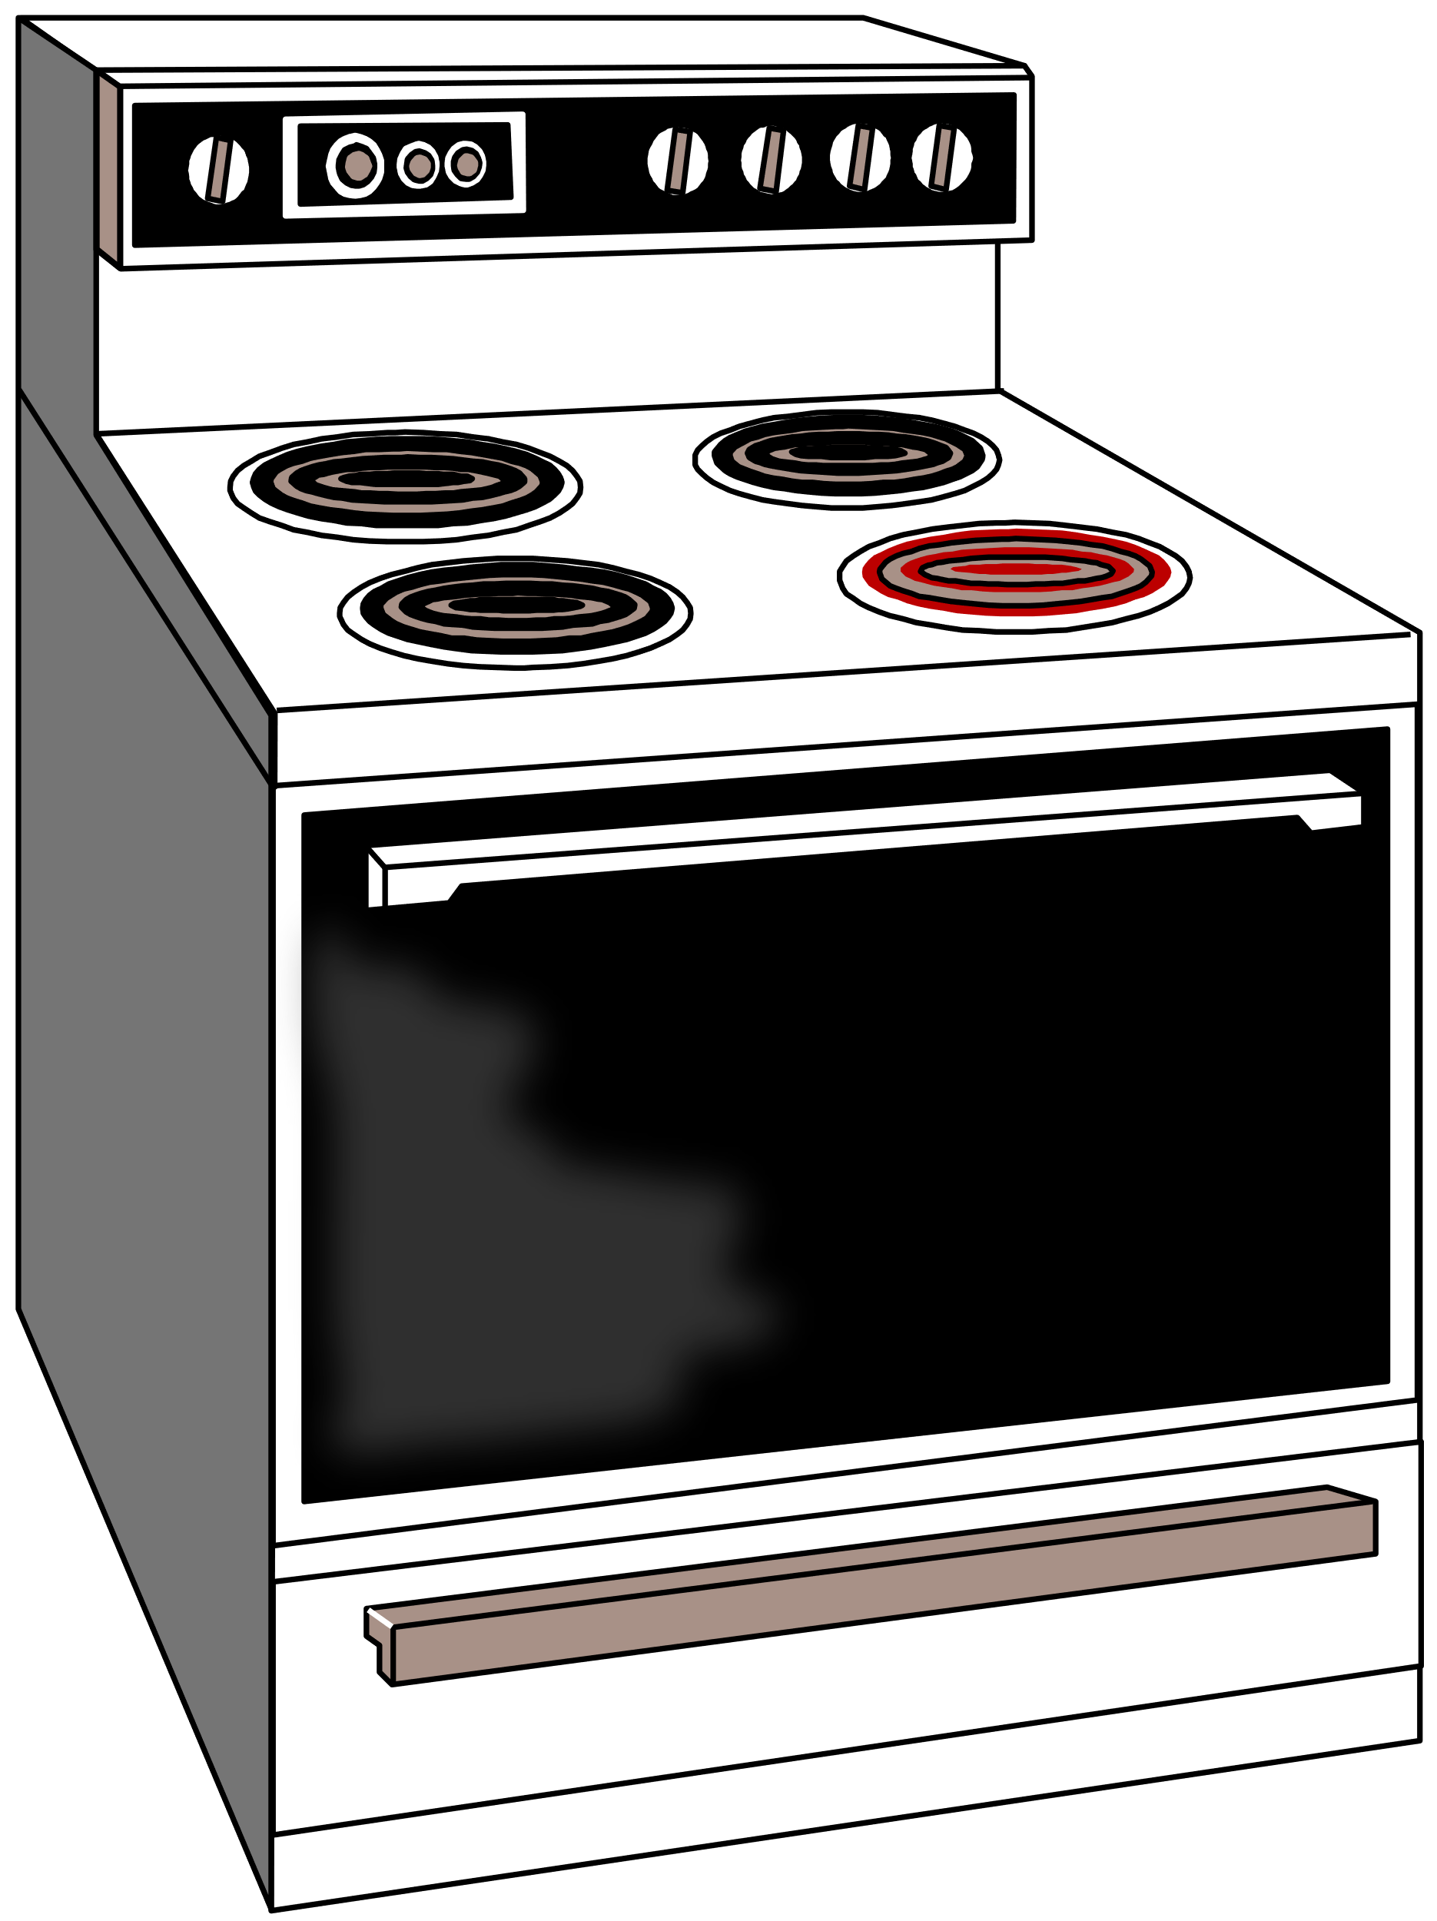
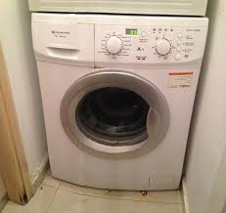
Model Factories
Orchestration of a set of models – e.g. predicting prices

Slide 36
Model Factories
How to manage a set of models?
Exploit grouping (families of similar models rather than single ones)
Initialize new models from the other similar models rather than from scratch
appliances
music
jewelry

Slide 37
Model Factories
How to communicate to the user the status of thousands of models?
An application for the frontend
Who controls the process and the dependencies?
A separate program that handles the management process in the correct order
category | music |  |  |  | jewelry |  |  | appliances
item | horn | trumpet | violin | harp | ring | Ear-rings | Neck-lace | fridge | wash. mach. | microwave | stove | Vacuum cleaner
Threshold on accuracy | 0.75 | 0.90 | 0.85 | 0.85 | 0.9 | 0.9 | 0.85 | 0.7 | 0.8 | 0.75 | 0.75 | 0.8
retrain | If 3 out of 4 perform below threshold |  |  |  | If all perform below threshold |  |  | If one performs below threshold

Slide 38
MLOps
The term MLOps (or DataOps or DSOps) refers to all those operations required to deploy, monitor, update/retrain a model and comply with the general company rules for auditing and data protection.
In a sense they are similar to DevOps for software applications in a production environment, only that they deal with Machine Learning models and data science operations in general.
MLOps Examples
Deployment and moving into production
Monitoring of Model Performance
Triggering of Retraining[s]
Storage of Information for Auditing Purposes

Slide 39
Model Deployment and Management in Practice with KAP and KNIME Business Hub

Slide 40
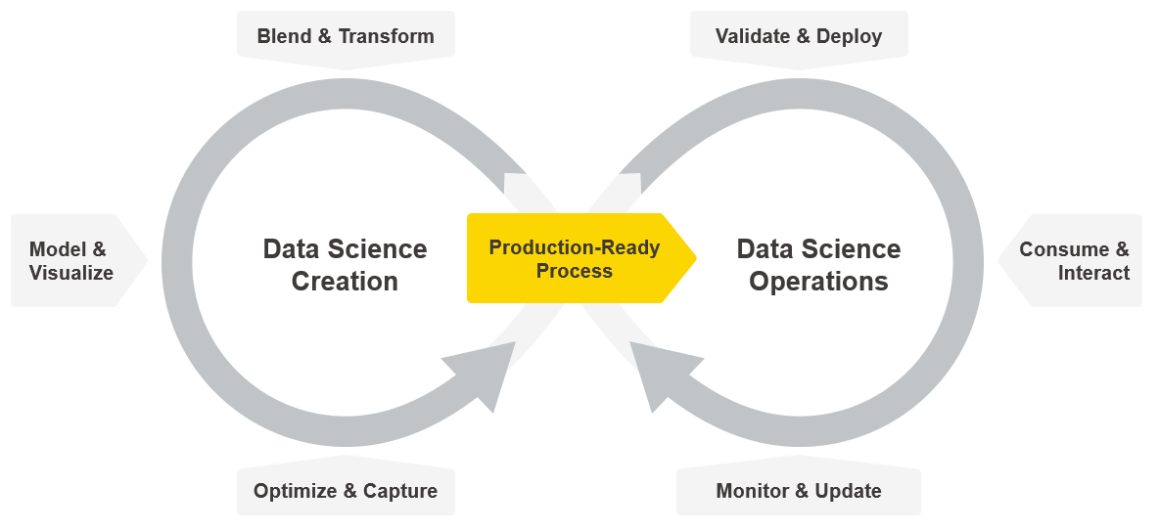
Creating and Productionizing Data Science

Slide 41
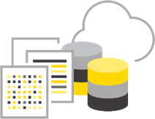
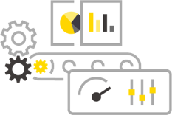
KNIME Software – One Ecosystem
Create
Productionize
Gather & Wrangle
Model & Visualize
Deploy & Manage
Consume & Optimize
Open Source KNIME Analytics Platform
Commercial
KNIME Business Hub
KNIME Extensions
KNIME Integrations
Community Extensions
Partner Extensions
Data apps
Data Science as a Service

Slide 42
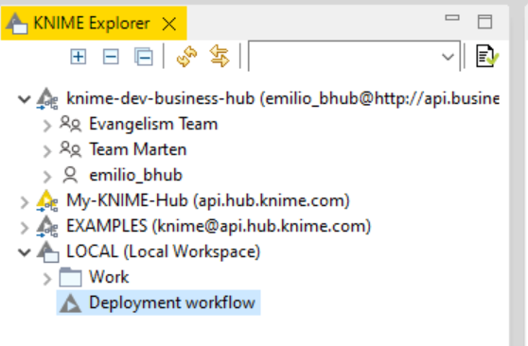
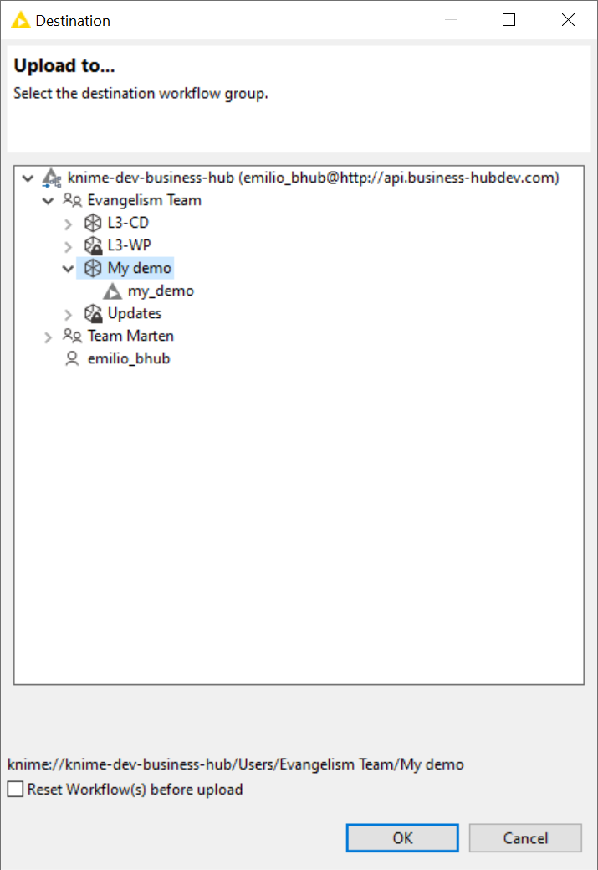
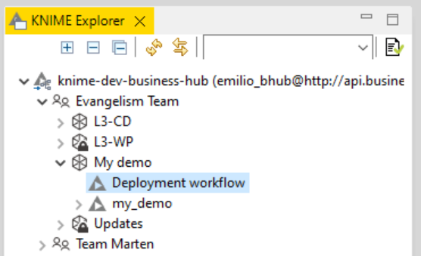
How does deployment actually look like in KNIME?

Slide 43
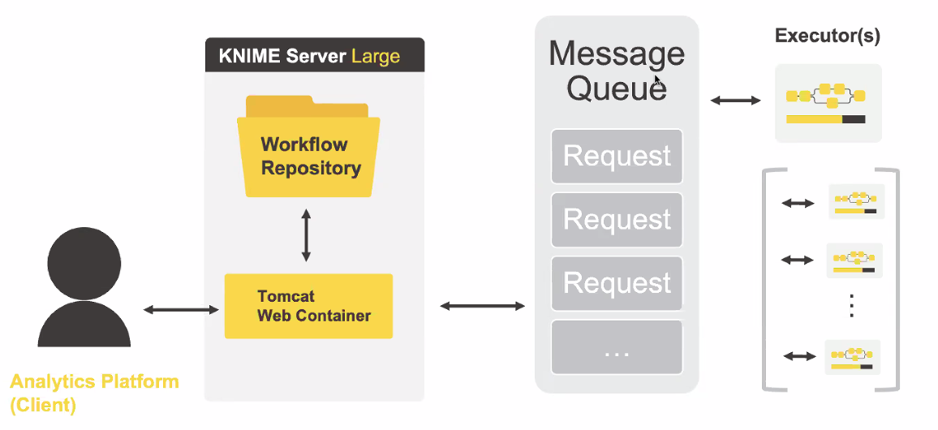
KNIME Server Architecture

Slide 44
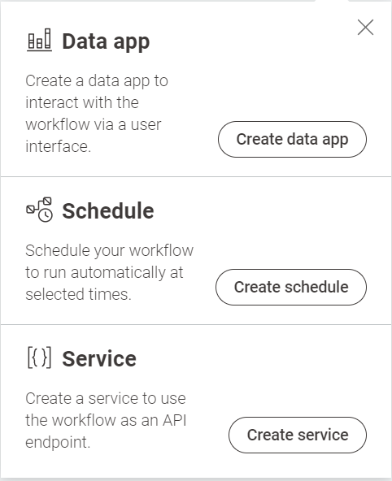
Usual ways to deploy a workflow on KNIME Business Hub

Slide 45
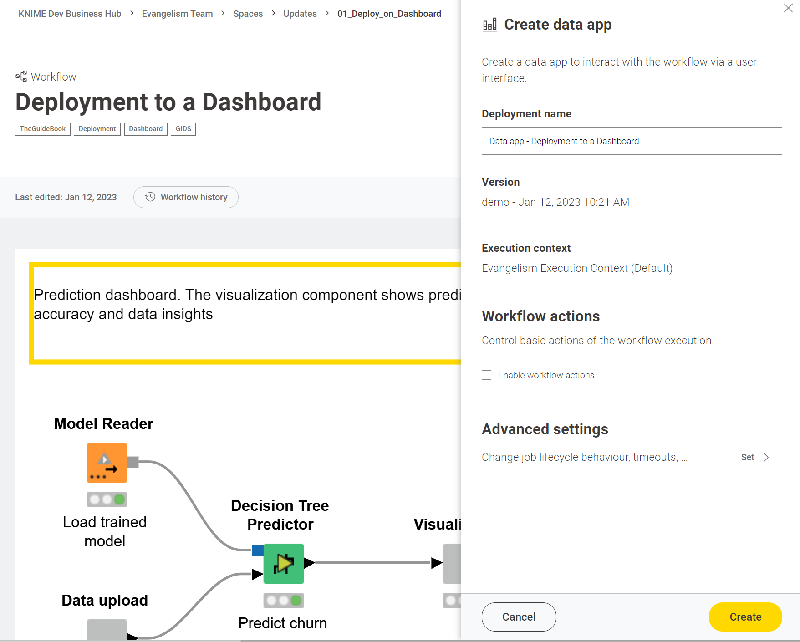
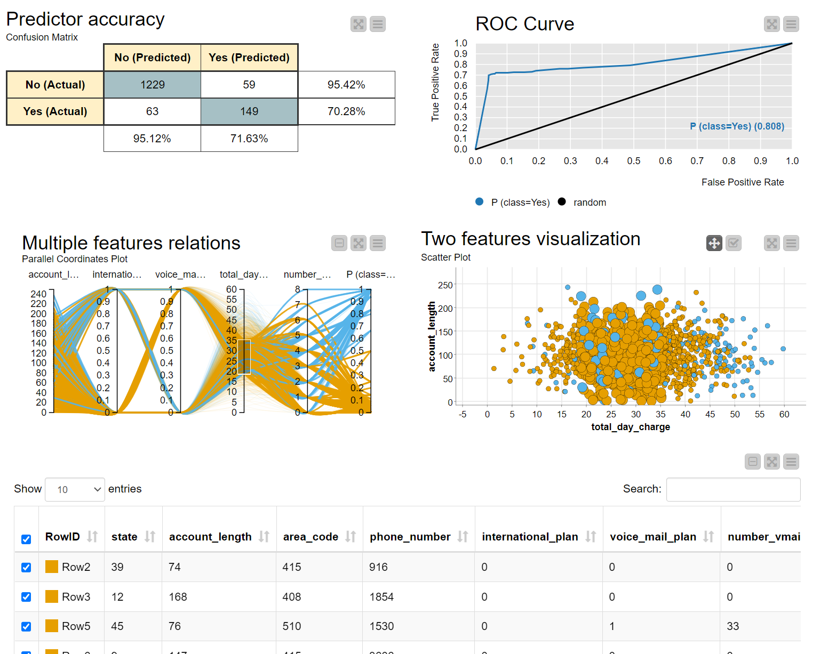
Deployment to Data App

Slide 46
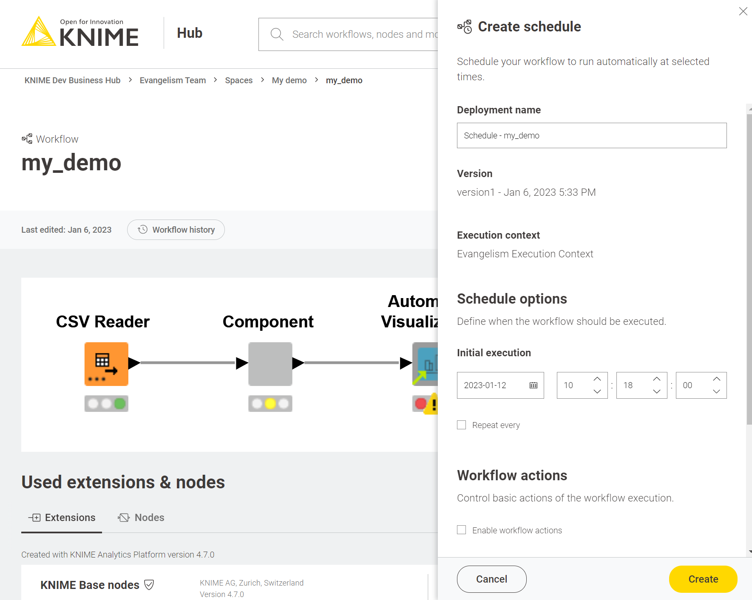
Deployment by Scheduling Automation

Slide 47
Deployment as a REST Service

Slide 48
Usual ways to deploy a workflow on KNIME Server
manually
Deployment to Data App
Deployment by Scheduling Automation
Deployment as a REST Service
Integrated Deployment
Deployment can be a repetitive task:
Monitor & Update (from cycle)
Automating deployment of any of the above, especially REST Service

Slide 49
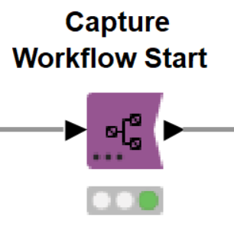
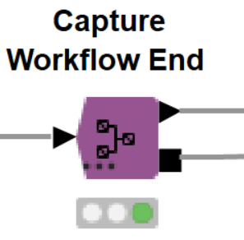
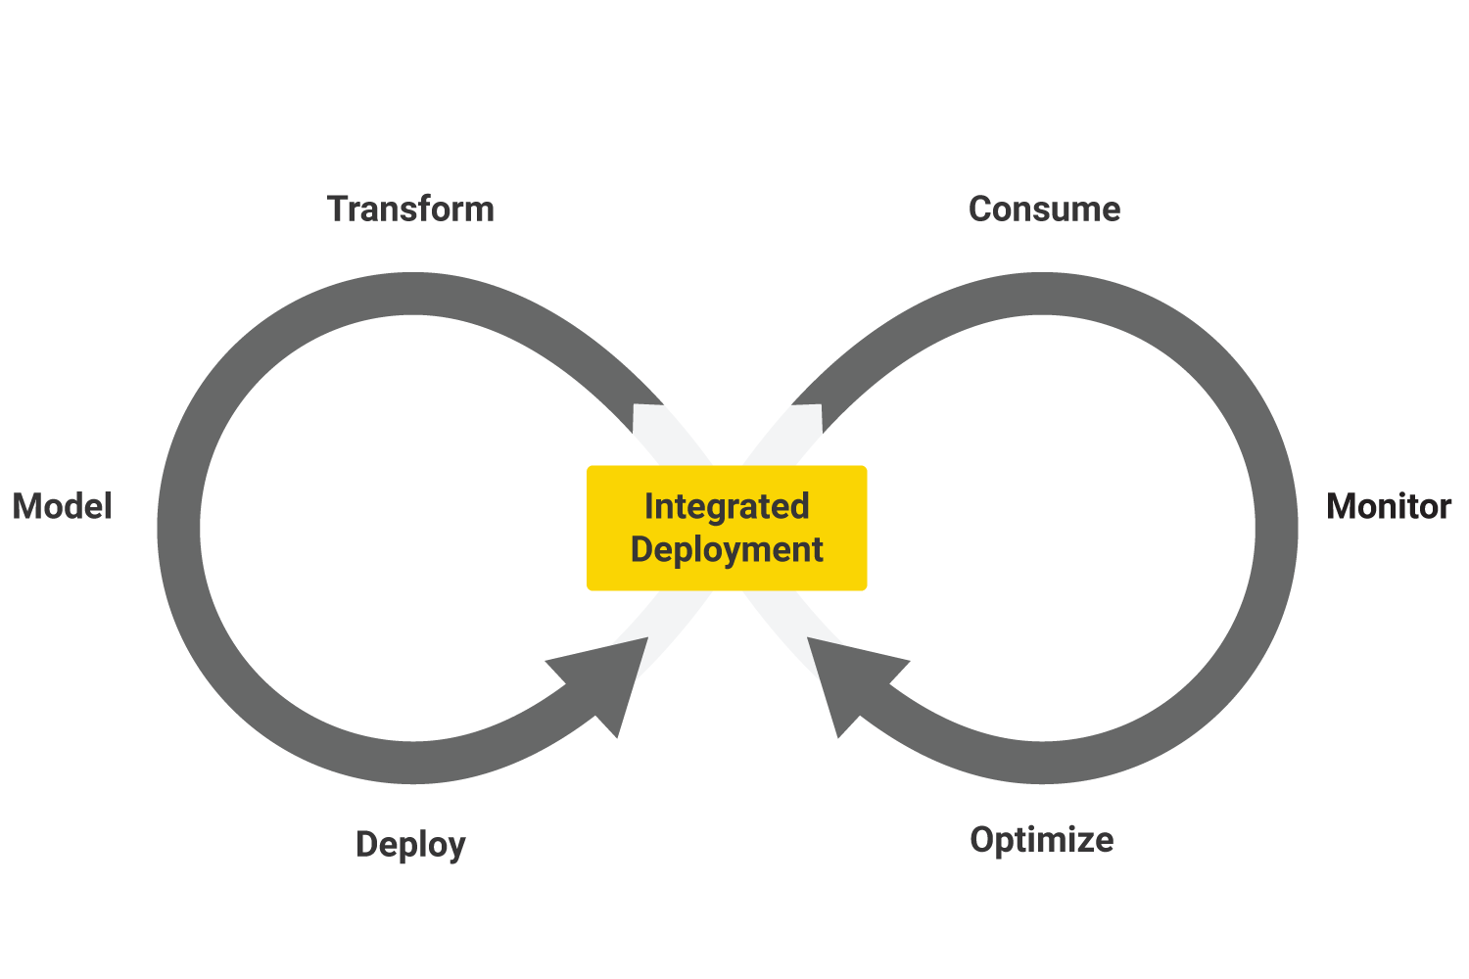
Integrated Deployment
Build an optimal model
Isolate core parts of the workflow (preprocessing, model building…) with the special nodes Capture Workflow Start and Capture Workflow End from the training workflow
Export the extracted pieces to build the deployment workflow

Slide 50
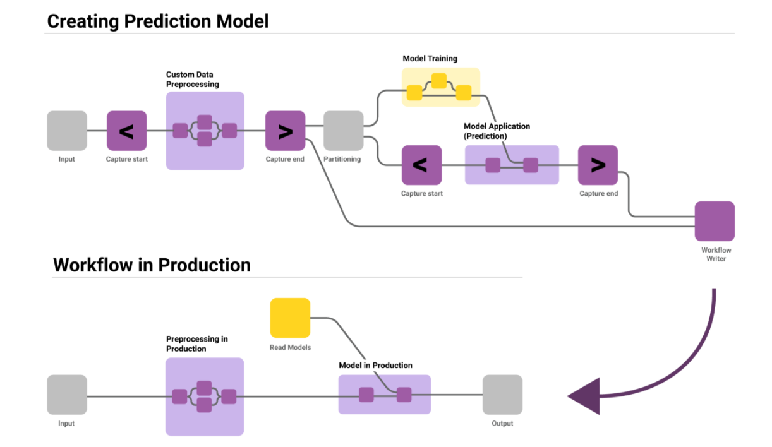
Integrated Deployment
Automatically build and deploy deployment workflows
Mostly used to automatically capture and deploy a model as REST API from the workflow which trains and validates the model

Slide 51
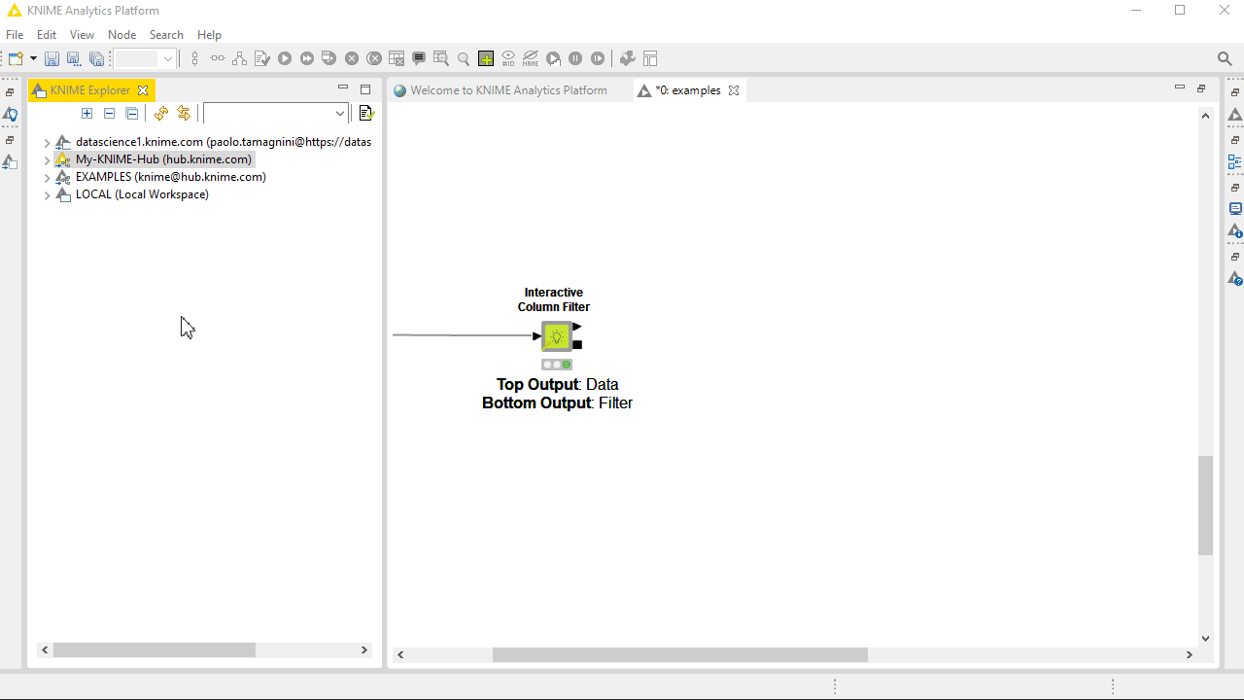
Component Sharing for Collaboration
Public Spaces
Sharing Components
Using and updating Components
Shared Component Link
Collaboration Spaces

Slide 52
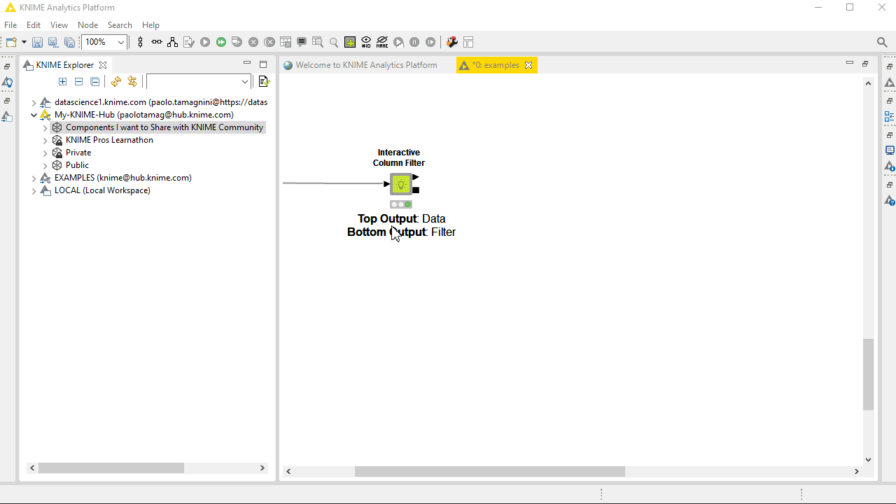
Component Sharing for Collaboration
Public Spaces
Sharing Components
Using and updating Components
Shared Component Link
Collaboration Spaces

Slide 53
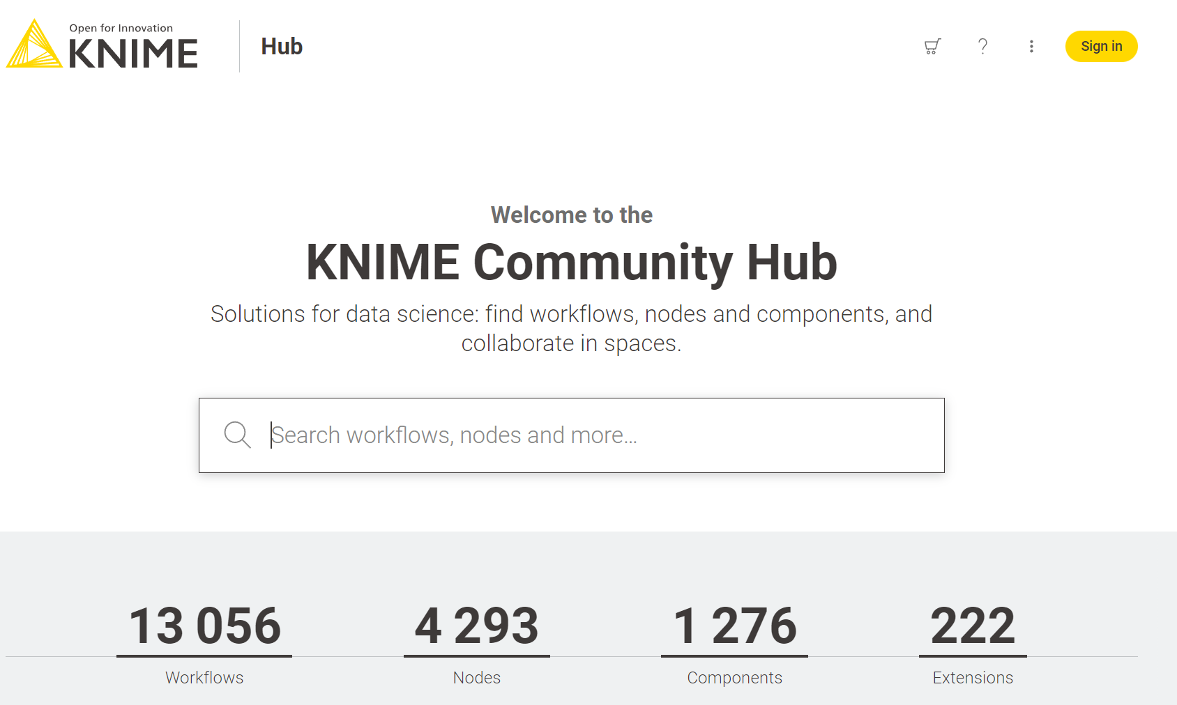
Component Sharing for Collaboration
Public Spaces
Sharing Components
Using others’ Components
Shared Component Link
Collaboration Spaces

Slide 54
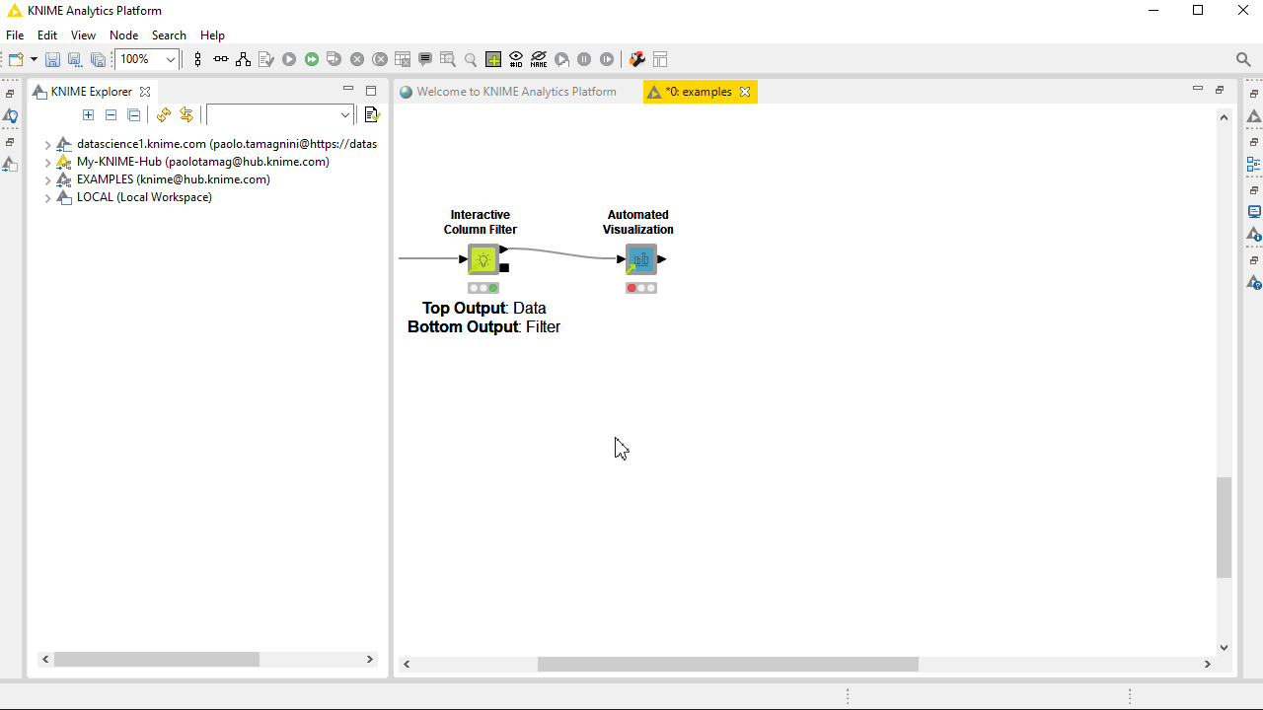
Component Sharing for Collaboration
Public Spaces
Sharing Components
Using others’ Components
Shared Component Link
Collaboration Spaces

Slide 55
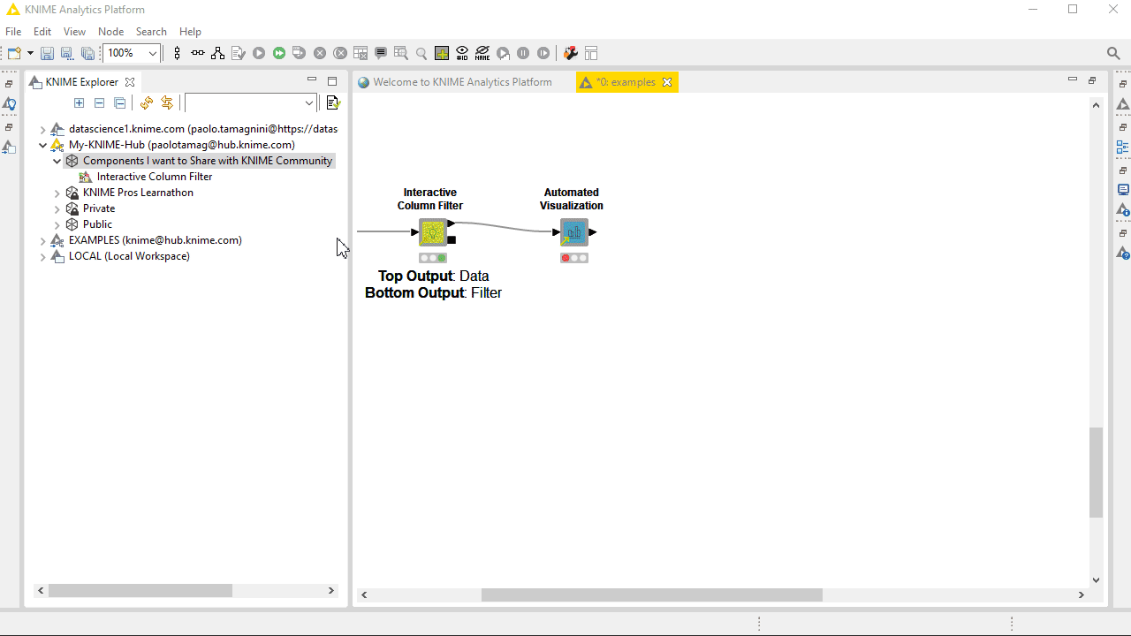
Component Sharing for Collaboration
Public Spaces
Sharing Components
Using others’ Components
Shared Component Link
Collaboration Spaces

Slide 56
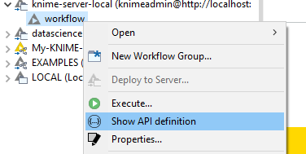
REST API Deployment – Live Demo
Define deployment workflow with Container Input / Output nodes
Deploy on KNIME Server (REST API service is automatically available)
Use Swagger to control how to control the REST API interface
Call Workflow from:
Another local workflow (Call Workflow node)
Python (knimepy package)
Any software able to perform HTTP requests using a URL and json data format

Slide 57
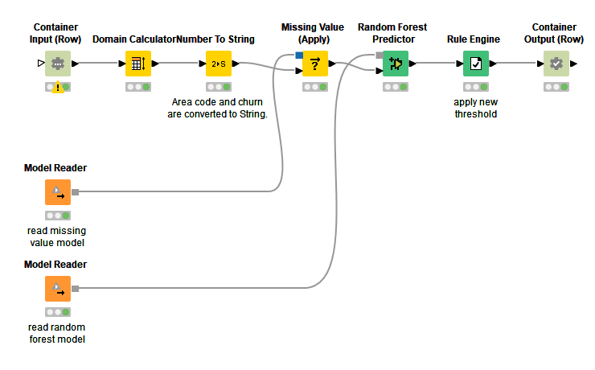
REST API Deployment – Live Demo

Slide 58
Integrated Deployment – Live Demo
Automatically build and deploy deployment workflows
Mostly used to automatically capture and deploy a model as REST API from the workflow which trains and validates the model

Slide 59
Integrated Deployment – Live Demo
CI / CD : Continuous Integration / Continuous Deployment
DevOps technique to continuously
develop, test, integrate, deploy, monitor software.
What about KNIME Workflows?

Slide 60
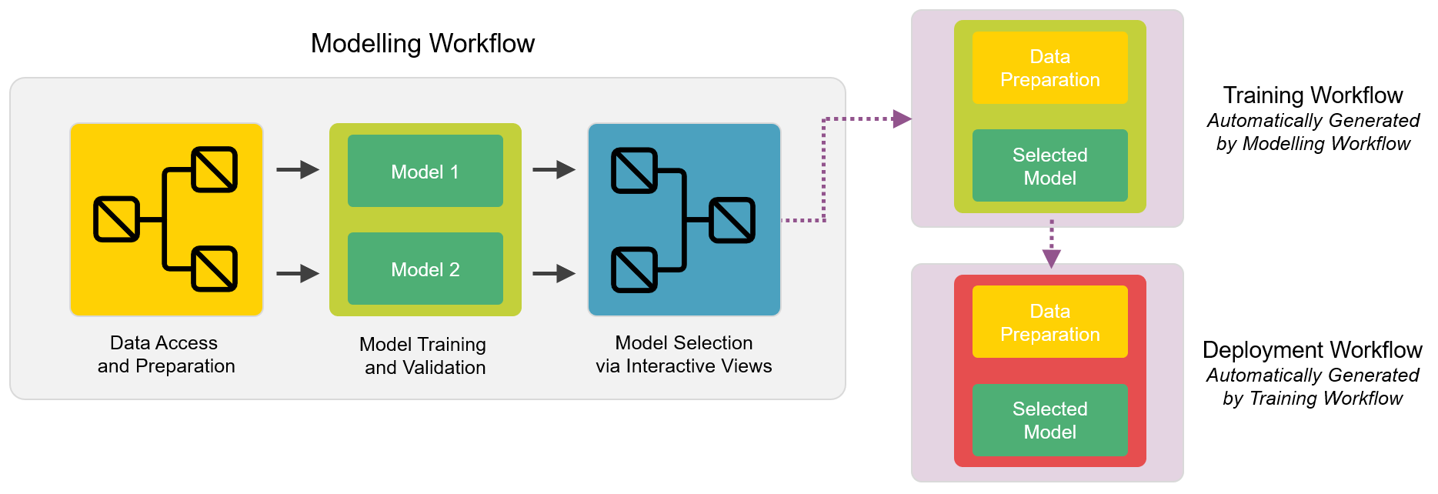
Integrated Deployment – Live Demo

Slide 61
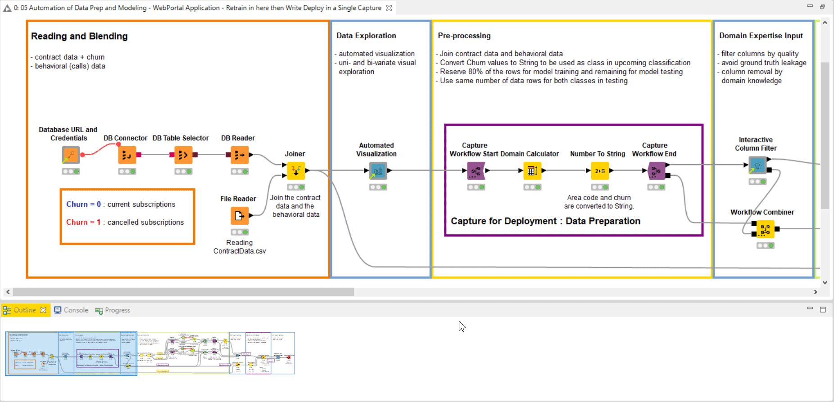
Integrated Deployment – Live Demo

Slide 62
AutoML and Guided Analytics : Guided Automation

Slide 63
AutoML and Guided Analytics : Guided Automation

Slide 64
AutoML and Guided Analytics : Guided Automation

Slide 65
AutoML and Guided Analytics : Guided Automation

Slide 66
AutoML and Guided Analytics : Guided Automation

Slide 67
AutoML and Guided Analytics : Guided Automation

Slide 68
AutoML and Guided Analytics : Guided Automation

Slide 69
Thank you

