Slide 1
Introduction to Data Science

Slide 2
Summary of this lesson
„We are drowning in information, but starving for knowledge”
-John Naisbett
What is knowledge?
*This lesson refers to chapters 1 and 2 of the GIDS book

Slide 3
Content of this lesson
What is Data Science?
The Data Science Process
Data Science: An Example

Slide 4
What is Data Science?

Slide 5
Data vs. Knowledge
Data
refer to single instances (single objects, people, events, points in time, etc.)
describe individual properties
are often available in large amounts (databases, archives)
are often easy to collect or to obtain (e.g., scanner cashiers in supermarkets, Internet)
do not allow us to make predictions or forecasts
Knowledge
refers to classes of instances (sets of objects, people, events, points in time, etc.)
describes general patterns, structures, laws, principles, etc.
consists of as few statements as possible
is often difficult and time consuming to find or to obtain (e.g., natural laws, education)
allows us to make predictions and forecasts

Slide 6
Criteria to assess knowledge
correctness (probability, success in tests)
generality (domain and conditions of validity)
usefulness (relevance, predictive power)
comprehensibility (simplicity, clarity, parsimony)
novelty (previously unknown, unexpected)

Slide 7
What is Data Science?
[Wikipedia quoting Dhar 13, Leek 13]
Data science is a multi-disciplinary field that uses scientific methods, processes, algorithms and systems to extract knowledge and insights from structured and unstructured data.
[Fayyad, Piatetsky-Shapiro & Smyth 96]
Knowledge discovery in databases (KDD) is the process of
(semi-)automatic extraction of knowledge from databases which is valid, previously unknown, and potentially useful.

Slide 8
Some Clarity about Words
(semi)-automatic: no manual analysis, though some user interaction required
valid: in the statistical sense
previously unknown: not explicit, no „common sense knowledge“
potentially useful: for a given application
structured data: numbers
unstructured data: everything else (images, texts, networks, chem. compounds, …)
Data Mining →
Data Science
Machine Learning
Data Preparation
Structured & Unstructured Data
Big Data

Slide 9
Valid?
Valid?
99.98%

Slide 10

Valid?
Valid?
customer age $∈$ [18, 150]
(in 9, 999 of 10, 000 cases)

Slide 11
Valid?
Previously Unknown?
A => B (in 100% of all cases)

Slide 12
Valid?
Previously Unknown?
Pregnant => Female

Slide 13
Valid?
Useful?
A => B
(with s =0.81% and c = 21.3%)

Slide 14
Valid?
Useful?
Beer => Diapers
(with s =0.81% and c = 21.3%)

Slide 15
Valid?
Valid, Interesting, and Useful?
Books A and B => Book C
(with s =0.81% and c = 21.3%)

Slide 16
The Data Science Process

Slide 17
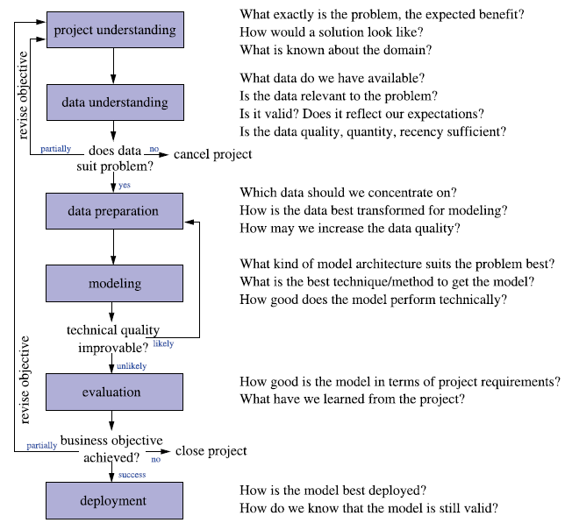
The Data Science Process
SEMMA
  Sample, Explore, Modify, Model, Assess
CRISP-DM
  Cross Industry Standard Process for Data Mining
KDD
  Knowledge Discovery in Databases

Slide 18
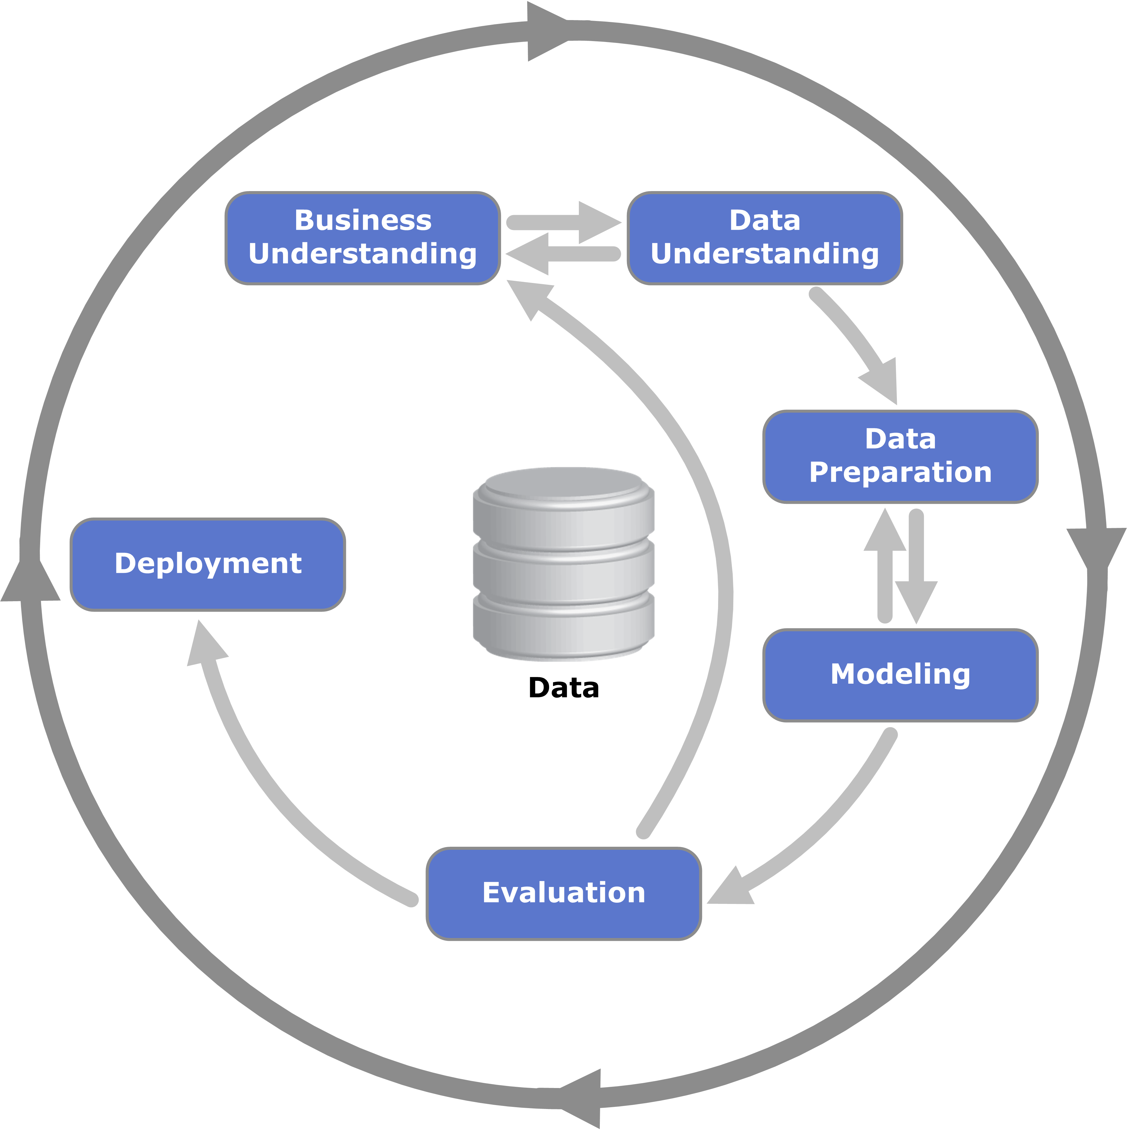
CRISP-DM

Slide 19

A Classic Data Science Project
It always starts with some data …
Data Preparation
Model Training
Model Optimization
Model Testing
Deployment
Data Manipulation
Data Blending
Missing Values Handling
Feature Generation
Dimensionality Reduction
Feature Selection
Outlier Removal
Normalization
Partitioning
…
Model Training
Bag of Models
Model Selection
Ensemble Models
Own Ensemble Model
External Models
Import Existing Models
Model Factory
…
Parameter Tuning
Parameter Optimization
Regularization
Model Size
No. Iterations
…
Performance Measures
Accuracy
ROC Curve
Cross-Validation
…
Files & DBs
Dashboards
REST API
SQL Code Export
Reporting
…
Notes:
A classic data science project always starts with some data, then data cleaning and data preparation to enhance the information to present to the model, then separation in test set and training set, then model training on training set, optionally some model optimization on an evaluation set, then model performance testing on a test set, and finally if the model quality is acceptable deployment otherwise we go back to improve one of the previous steps.
Change

Slide 20
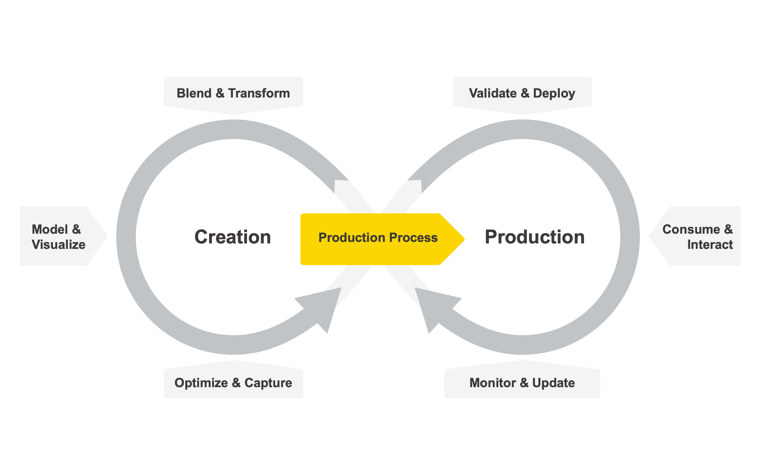
The Data Science Life Cycle

Slide 21
Problem Categories
Classification
  Predict experiment outcome falling into a finite number of possible results
  How credit-worthy is this customer ? Very / Enough / Not enough / Absolutely not
  Will this customer respond to our mailing? Yes / No
Regression
  Predict numeric values
  How will the EUR/USD exchange rate develop?
  What will be the price of this washing machine next week?
Clustering, Segmentation
  Group similar cases in order to get overview, detect outliers, or get insights on the data structure
  Do my customers separate into different groups?
  How many operating points does the machine have, and what do they look like?

Slide 22
Problem Categories
Association Analysis
  Find correlations to better understand the interdependencies of all the attributes
  Focus in the full record (all the attributes) rather than on a single target variable
  Which optional equipment of a car often goes together?
  How do the various qualities in a car influence each other?
Deviation Analysis
  Knowing the trend of the data, find subgroups that behave differently
  Under which circumstances does the system behave differently?
  Which properties do those customers - who do not follow the crowd - share?

Slide 23
Data Science: an Example

Slide 24
Example
Dataset from a hypotetical supermarket chain
  Customers
  Products
  Purchases
Three tasks
  Divide customers into different groups according to their purchase behaviour
  Identify connections between products to implement cross-selling campaigns
  Helping design a marketing campaign to increase purchases
Two approaches
  Naive approach lead by common sense
  Sound approach using DS techniques

Slide 25
Data Understanding and Pattern Finding: Customer Segmentation
Naive Approach
  Aggregate purchases to respective customer
  Join with the customer details
  No interesting relations highlighted
Cluster id | Age | Customer revenue
1 | 46.5 | € 1,922.07
2 | 39.4 | € 11,162.20
3 | 39.1 | € 7,279.59
4 | 46.3 | € 419.23
5 | 39.0 | € 4,459.30

Slide 26
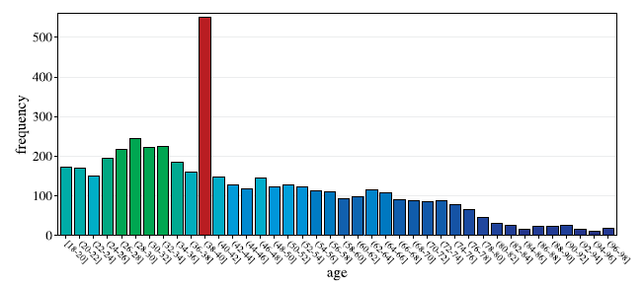
Data Understanding and Pattern Finding: Customer Segmentation
Sound Approach
  Check values for the string attributes (name, employment..)
  Check and add constraints to numeric attributes (e.g. Age between 18-100)
  Look for misleading information (e.g. In the dataset a missing birthdate was by default set to 1970. If not handled properly, this information can lead to errors)
  Use average basket price as estimator for the value of a customer
  Use average number of purchases per month as further estimator
  Apply normalization to average attributes magnitudes
Cluster | Age | Avg. cart price | Avg. purchase/month
1 | 75.3 | € 19.- | 5.6
2 | 42.1 | € 78.- | 7.8
3 | 38.1 | € 112.- | 9.3
4 | 30.6 | € 16.- | 4.8
5 | 44.7 | € 45.- | 3.7

Slide 27

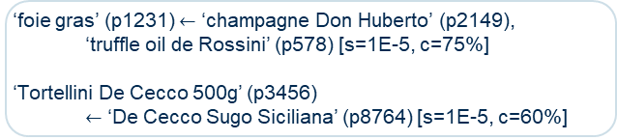
Explanation Finding: Find Product Dependencies
Naive Approach
  Run Association Rule Mining algorithm with default setting
  Consider Product ID (differenciating each product)
  Unintuitive and unuseful result
  Rules have high confidence but low support values
Sound Approach
  Consider product categories
  Rules match with well-known facts
  Monitor combinations on regular basis
‘foie gras’ (p1231) $←$ ‘champagne Don Huberto’ (p2149),
‘truffle oil de Rossini’ (p578) [s=1E-5, c=75%]
‘Tortellini De Cecco 500g’ (p3456)
$←$ ‘De Cecco Sugo Siciliana’ (p8764) [s=1E-5, c=60%]
tomatoes $←$ capers, pasta [s=0.007, c=32%]
tomatoes $←$ apples [s=0.013, c=22%]

Slide 28
Predicting the Future: Forecast customers reactions to coupon mailings
Naive Approach
  No detailed analysis
  Send coupon with discounts after a certain purchase amount
  Just monitor the results
  Fail: customers only combine shopping trips, no additional revenues
  The data analyst is in the end fired
Sound Approach
  Discriminate valuable customers => exploit earlier segmentation
  Derive meaningful attributes, e.g. Customers underperforming on specific category, distance
  Build black box classifier model

Slide 29
Thank you

