Slide 1
Project& Data Understanding

Slide 2
Summary of this lesson
„... the goal of the project understanding phase is to assess the main objective, the potential benefits, as well as the constraints, assumptions, and risks”
How do we identify the main objective of a project, and plan the approach?
*This lesson refers to chapter 3 and part of chapter 4 of the GIDS book

Slide 3
Content of this lesson
Some Classic Use Cases
Project Understanding
ETL: Extraction, Transformation Loading
Data Understanding
Describing your Data
Finding Patterns
Finding Models
Finding Predictors
A tiny bit of History
One final word of Warning: Correlation vs. Causality

Slide 4
Some Classic Use Cases

Slide 5




Churn Prediction
Churn Prediction: will a customer quit the contract?
CRM System
Data about your customer
Demographics
Behavior
Revenues
Churn Prediction
Upselling Likelihood
Product Propensity /NBO
Campaign Management
Customer Segmentation
…
Model

Slide 6

Customer Segmentation
Customer Segmentation: which groups of customers am I serving?
CRM System
Data about your customer
Demographics
Behavior
Revenues
Churn Prediction
Upselling Likelihood
Product Propensity /NBO
Campaign Management
Customer Segmentation
…
Model

Slide 7
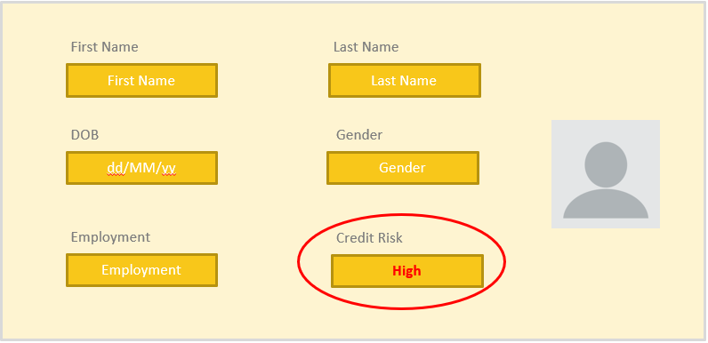
Risk Assessment
Risk Assessment: is this person going to repay the loan?
Customer History
Risk Prognosis
Oct 2015
Cvrerhfd
Vdsyh
dfgh
ddgd
Oct 2015
Cvrerhfd
Vdsyh
dfgh
ddgd
High Risk
Low Risk
High Risk
Very High Risk
Very Low Risk
Medium Risk
…
Nov 2016
Cvrerhfd
Vdsyh
dfgh
ddgd
Nov 2016
Cvrerhfd
Vdsyh
dfgh
ddgd
Oct 2015
Cvrerhfd
Vdsyh
dfgh
ddgd
Jun 2017
Cvrerhfd
Vdsyh
dfgh
ddgd
Nov 2016
Cvrerhfd
Vdsyh
dfgh
ddgd
Jun 2017
Cvrerhfd
Vdsyh
dfgh
ddgd
Apr 2018
Cvrerhfd
Vdsyh
dfgh
ddgd
Apr 2018
Cvrerhfd
Vdsyh
dfgh
ddgd
Oct 2015
Cvrerhfd
Vdsyh
dfgh
ddgd
Jun 2017
Cvrerhfd
Vdsyh
dfgh
ddgd
Nov 2016
Cvrerhfd
Vdsyh
dfgh
ddgd
Feb 2019
Cvrerhfd
Vdsyh
dfgh
ddgd
Feb 2019
Cvrerhfd
Vdsyh
dfgh
ddgd
Apr 2018
Cvrerhfd
Vdsyh
dfgh
ddgd
Feb 2019
Cvrerhfd
Vdsyh
dfgh
ddgd
Jun 2017
Cvrerhfd
Vdsyh
dfgh
ddgd
Apr 2018
Cvrerhfd
Vdsyh
dfgh
ddgd
Feb 2019
Cvrerhfd
Vdsyh
dfgh
ddgd
Model
Notes:
When asking for a loan or signing up for an insurance, you trigger a complex process, where your data are collected mainly to estimate your likelihood to default.
The likelihood to default is a metric that lenders use to assess risk on customers, group them into similar risk bands, and determine the interest rate to charge. A lender will use probability of default to calculate expected return or loss at the individual and portfolio level. The process of estimating the probability of default of a customer is called Risk Scoring.
The process of Risk Scoring involves data collection about the customer, group definition, consultation of look up tables, some gut feeling from the lender’s experience, and finally a number for the probability of default. Since the final result is a probability, we can automatize the process and probably improve the accuracy of the final result by turning to machine learning algorithms.

Slide 8
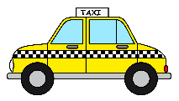
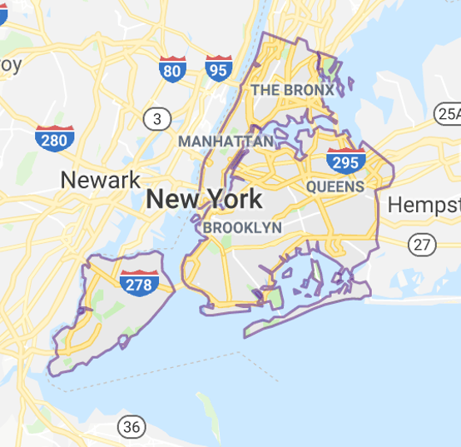
Demand Prediction
How many taxis do I need in NYC on Wednesday at noon?
Or how many kW will be required tomorrow at 6am in London?
Or how many customers will come tonight to my restaurant?
Model

Slide 9
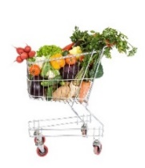


Recommendation Engines / Market Basket Analysis
Recommendation Engines: People who bought this item were often interested in this other items.
Recommendation
IF
➔
Model

Slide 10

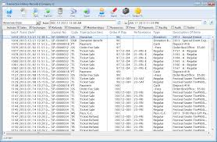
Fraud Detection
Fraud Detection: Is this transaction legitimate or is it a fraud?
Suspicious Transaction
Transactions
Trx 1
Trx 2
Trx 3
Trx 4
Trx 5
Trx 6
…
Model

Slide 11







Sentiment Analysis
Sentiment Analysis: how can I know what people are thinking?
Notes:
While making any purchase online consumer usually check opinions of others about the product. Manufacturer can gain insight into its products strength and weaknesses based on the sentiment of the customers.
Human language is elaborate, with nearly infinite grammatical variations, misspellings, slang and other challenges making accurate automated analysis of natural language quite difficult.
Traditional approaches to sentiment analysis are surprisingly simple in design, struggling with complicated language structures, and fail when contextual information is required to correctly interpret a phrase.

Slide 12
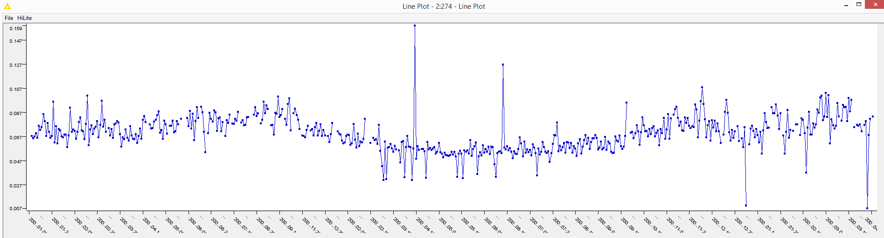
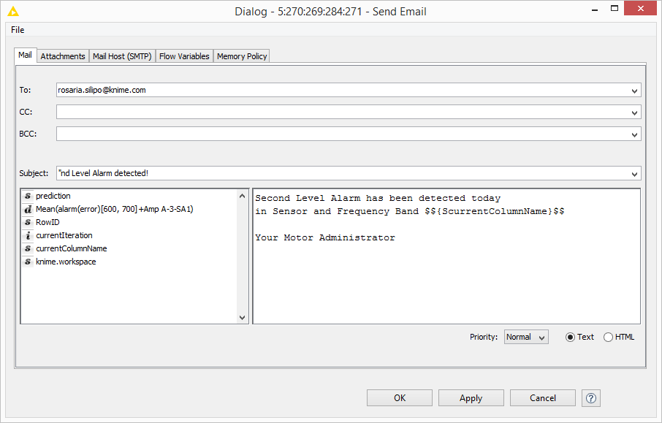
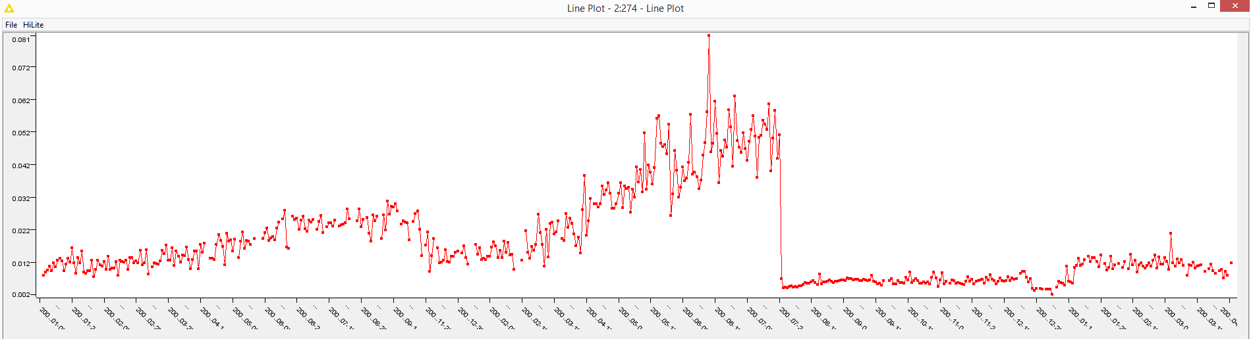


Anomaly Detection
Predicting mechanical failure as late as possible but before it happens
Only some Spectral Time Series show the break down
A1-SV3 [0, 100] Hz
31 August 2007
Predictive Maintenance
Breaking point
July 21, 2008
A1-SV3 [500, 600] Hz
Training Set
via REST
Notes:
1) The solution implemented a predictor for the normal functioning data using a linear regression on a number of past values to predict the current signal value. This was possible, as the data for normal functioning were available in abundance. Beware though that any model thus trained can only predict normal functioning values.
2) The second step consisted in calculating the difference between the signal values measured by sensors on the mechanical piece and the signal values predicted by the model. If the part was working normally, such differences would have been negligible. However, if something in the underlying system had changed, the difference would have been noticeable. In addition, if such a difference persisted over time, the system behavior could be interpreted as even more suspicious.

Slide 13
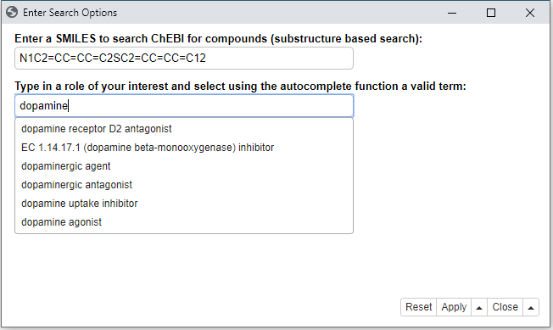
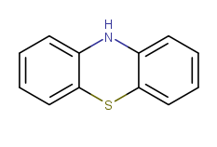
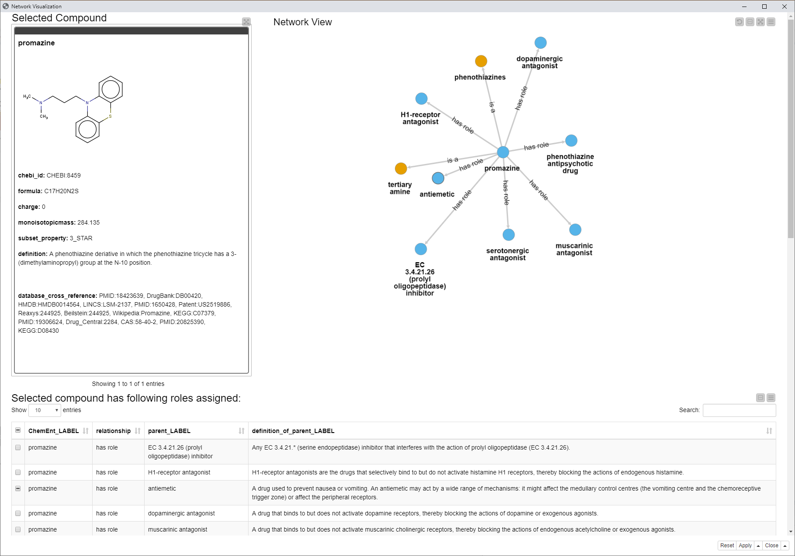
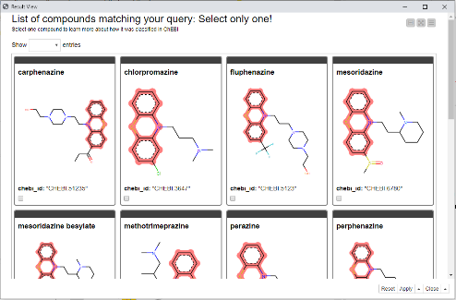
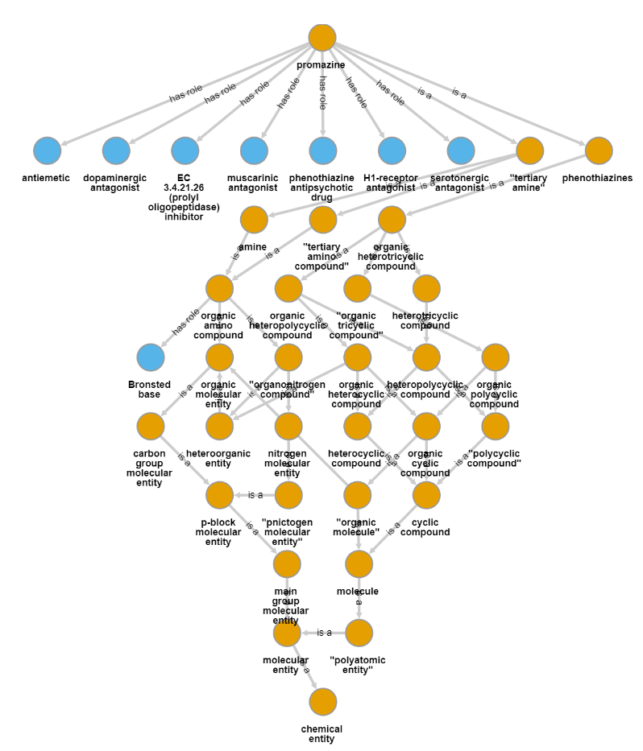

Compound Search
Are there other compounds having this
substructure and being a dopaminergic antagonist?
Notes:
Possible use case:
Imagine a toxicologist/scientist is investigating a new compound in the development and wants to learn more about a certain substructure of the new potential chemical.
He knows the structure -> and he knows the application/role of this compound.
We show how to use ontologies in KNIME for
Upload/ Query / Filter ontologies
Making use of hierarchies and graphs/networks
Using terminology for populating and supporting filter options in a GUI
Representing domain knowledge that can be reused and analyzed

Slide 14
Project Understanding

Slide 15
Determine the Project Objective
What is the primary objective?
What are the criteria for success?
These are difficult to define
  The project owner & the analysis speak different languages
Problem source | Project owner perspective | Analyst perspective
Communication | Project owner does not understand the technical terms of the analyst | Analyst does not understand the terms of the domain of the project owner
Lack of understanding | Project owner was not sure what the analyst could do or achieve Models of analyst were different from what the project owner envisioned | Analyst found it hard to understand how to help the project owner
Organization | Requirements had to be adopted in later stages as problems with the data became evident | Project owner was an unpredictable group (not so concerned with the project)

Slide 16
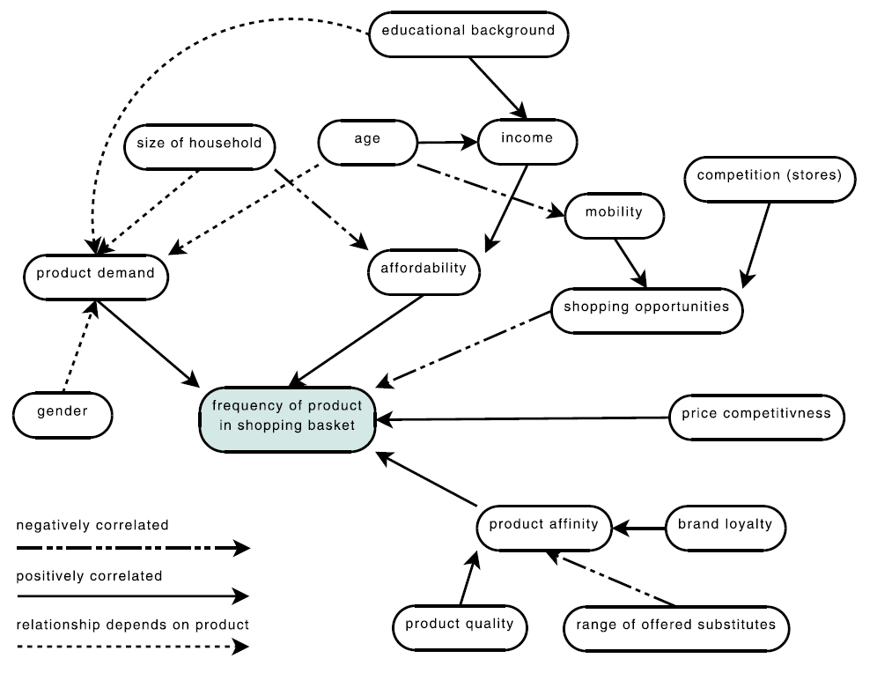
Cognitive maps
Tool to sketch
  Beliefs
  Experiences
  Known factors
  How they influence
    each other

Slide 17
Cognitive maps
How often will a certain product be found in a basket?
  Directly influenced by factors around it
    E.g., affordability
  Indirectly influenced by other factors
    E.g., size of household
  Postive or negative correlation

Slide 18
Clarifying the Primary Objectives
Once the solution is identified
  Explore advantages & disadvantages
Is the goal
  Precise enough?
  Actionable?
Objective | Increase revenues (per campaign and/or per customer) in direct mailing campaigns by personalized offer and individual customer selection
Deliverable | Software that automatically selects a specified number of customers from the database to whom the mailing shall be sent, runtime max. half-day for database of current size
Success criteria | Improve order rate by 5% or total revenues by 5%, measured within 4 weeks after mailing was sent, compared to rate of last 3 mailings

Slide 19
Assess the Situation
Will this be a successful data analysis project?
Examine the following:
Requirements and constraints
  Model requirements (e.g., explanatory model)
  Ethical, political, and legal issues (e.g., must exclude gender, race, and/or age)
  Technical constrains
Assumptions
  Representativeness (the sample represents the whole population)
  Informativeness (influencing factors should be included in the model)
  Good data quality
  Presence of external factors

Slide 20
Determine Analysis Goals
Select models and techniques with the following properties
  Interpretability
    The model can be understood / interpreted
  Reproducibility / stability
    Similar model performance every time the analysis is carried out
  Model flexibility / adequacy
    The model can adapt to more complicated situations
  Runtime
    Strict runtime requirements may limit computationally intensive approaches
  Interestingness / use of expert knowledge
    Experts may already know the finings from the analysis

Slide 21
ETL: Extraction, Transformation, Loading

Slide 22
ETL
Getting the data in not always easy:
Different resources: flat files, different databases, excel spreadsheets, ...
Integration is cumbersome: Missing/not unique IDs, wrong entries, ...
Sometimes also privacy concerns (not all data in one location)
Data needs to be transformed:
Type conversions
Missing value correction/clean up/imputation
Generation of new values (e.g. convert year of birth into age)

Slide 23
ETL
Three files:
  customers,
  products,
  shopping baskets.
Can we load these file and create a new attribute “age”?
Can we find out:
  how often each customer went shopping
  how much (s)he bought together (and on average)

Slide 24
Data Loading and Preprocessing
Database issues
More details regarding pre-processing later:
  Normalization
  Binning
  Feature (and Data!) Reduction
  ...
The 80% Rule
Over 80% of data analysts’ time is spent on loading and cleaning data.

Slide 25
Data Understanding

Slide 26
Data understanding
Goal of the Data Understanding phase
  Gain general insights about the data that will potentially be helpful for the further steps in the data analysis process
Reasons
  Never trust any data as long as you have not carried out some simple plausibility checks.
Results
  At the end of the data understanding phase, we know much better whether the assumptions we made during the project understanding phase concerning representativeness, informativeness, data quality, and the presence or absence of external factors are justified

Slide 27
Attribute Understanding
Attributes, features, variables…
No | Sex | Age | Blood pr. | Height | Drug
1 | male | 20 | normal | 175,0 | A
2 | female | 73 | normal | 172,2 | B
3 | female | 37 | high | 163,8 | A
4 | male | 33 | low | 171,4 | B
5 | female | 48 | high | 165,9 | A
6 | male | 29 | normal | 182,3 | A
7 | female | 52 | normal | 167,2 | B
8 | male | 42 | low | 177,2 | B
9 | male | 61 | normal | 168,4 | B
10 | female | 30 | normal | 174,9 | A
Instances, records, data objects, entries…
Data can usually be described in terms of table or matrices
Sometimes data are spread among different table that need to be joined

Slide 28
Attribute Understanding
Categorical
Ordinal
Numeric
Attributes differ for their scale type, according to the type of values that they can assume
Three scale types:
  Categorical / Nominal
  Ordinal
  Numeric
No | Sex | Age | Blood pr. | Height | Drug
1 | male | 20 | normal | 175,0 | A
2 | female | 73 | normal | 172,2 | B
3 | female | 37 | high | 163,8 | A
4 | male | 33 | low | 171,4 | B
5 | female | 48 | high | 165,9 | A
6 | male | 29 | normal | 182,3 | A
7 | female | 52 | normal | 167,2 | B
8 | male | 42 | low | 177,2 | B
9 | male | 61 | normal | 168,4 | B
10 | female | 30 | normal | 174,9 | A
Numeric
Categorical

Slide 29
Categorical Attributes
Categorical
Categorical (or Nominal) attributes have a finite set of possible values
Granularity must be taken into account
  Hierarchical structure of the categories
  e.g. shallow subdivision: food, non-food, drinks…
  further subdivision for drinks: water, beer, wine…
  Which level of granularity is appropriate?
Dynamic Domain
  Some attributes have a fixed domain (e.g. months)
  For other attributes the domain can change over time (e.g. the products in a catalogue)
  Those attributes must be identified and handled
No | Sex | Age | Blood pr. | Height | Drug
1 | male | 20 | normal | 175,0 | A
2 | female | 73 | normal | 172,2 | B
3 | female | 37 | high | 163,8 | A
4 | male | 33 | low | 171,4 | B
5 | female | 48 | high | 165,9 | A
6 | male | 29 | normal | 182,3 | A
7 | female | 52 | normal | 167,2 | B
8 | male | 42 | low | 177,2 | B
9 | male | 61 | normal | 168,4 | B
10 | female | 30 | normal | 174,9 | A
Categorical

Slide 30
Ordinal Attributes
Ordinal
Ordinal attributes have an additional linear ordering offered by the domain
The ordering does not provide the distance between two object
e.g. for an attribute containing university degrees, we can state that a Ph.D is an higher degree than a M.Sc. and that this is higher than a B.Sc..
No | Sex | Age | Blood pr. | Height | Drug
1 | male | 20 | normal | 175,0 | A
2 | female | 73 | normal | 172,2 | B
3 | female | 37 | high | 163,8 | A
4 | male | 33 | low | 171,4 | B
5 | female | 48 | high | 165,9 | A
6 | male | 29 | normal | 182,3 | A
7 | female | 52 | normal | 167,2 | B
8 | male | 42 | low | 177,2 | B
9 | male | 61 | normal | 168,4 | B
10 | female | 30 | normal | 174,9 | A

Slide 31
Attribute Understanding
The domain of numerical attributes are numbers. They can be
Discrete
  e.g. age, count…
  Represented as integer values
Continuous
  e.g. height, weight, distance…
  Represented as real values
  Precision (rounding) has to be handled
The scale of numeric attributes can be:
  Interval e.g. date
  Ratio Scale e.g. distance, with a canonical zero value
  Absolute Scale e.g. counting
Numeric continuous
No | Sex | Age | Blood pr. | Height | Drug
1 | male | 20 | normal | 175,0 | A
2 | female | 73 | normal | 172,2 | B
3 | female | 37 | high | 163,8 | A
4 | male | 33 | low | 171,4 | B
5 | female | 48 | high | 165,9 | A
6 | male | 29 | normal | 182,3 | A
7 | female | 52 | normal | 167,2 | B
8 | male | 42 | low | 177,2 | B
9 | male | 61 | normal | 168,4 | B
10 | female | 30 | normal | 174,9 | A
Numeric discrete

Slide 32

Data Quality
Garbage in, garbage out
Data quality refers to how well the data fit their intended use
There are various data quality dimensions
  Accuracy
  Completeness
  Unbalanced Data
  Timeliness

Slide 33
Accuracy
Accuracy is defined as the closeness between the value in the data and the true value.
Syntactic
The value might not be correct but it belongs at least to the domain of the corresponding attribute
Easy to spot: verify values lying in the domain
Semantic
The value might be in the domain of the corresponding attribute, but it is not correct
Hard or impossible to spot: double check with other sources or check “business rules”
e.g. “fmale” for the attribute Gender and “-15” for the attribute Weight violate the syntactic accuracy
e.g. “2090” for the attribute YearOfBirth is (at least at the moment) surely incorrect, therefore violates the semantic accuracy

Slide 34
Completeness
Completeness with respect to attributes
  All the attributes have a value associated
  i.e. Missing Values (coming soon in next lessons)
  Missing values might not always be explicitly marked
Completeness with respect to records
  The data set contains the necessary information required for the analysis
  Some rows might have been lost for various reasons (e.g. during DB migration)
  Sometimes data about a certain situation simply does not exist (e.g. data about a failure that has never –yet- occurred)
  It is hard to obtain a reasonably wide dataset containing all the possible combinations of data

Slide 35
Unbalanced Data and Timeliness
Unbalanced Data
Data regarding a certain situation might be underrepresented
E.g. machine quality control: parts produced with flaws are – hopefully – lower than the correct ones, therefore the corresponding data will be way less
Timeliness
Available data are too old to provide up to date information
Often a problem in dynamically changing domains, where older data might indicate trends that have vanished

Slide 36
Describing your Data

Slide 37
Looking at the Data
Familiarize yourself with the data
  Identify trends
  strange patterns
  outliers
  ...
Types of views
  Basic Statistics
  1D: Histograms
  2D: Scatterplots, Scatter Matrix, Multi Dimensional Scaling
  3D Scatterplots
  3D: Parallel Coordinates

Slide 38
Visual Inspection: Example
Let’s look at our data
Can we find some connections between age and shopping cart size?
Anything else that looks a bit odd? (...the age distribution, maybe?)
Visualizations are a good way for first sanity checks
Interactivity on a plot or among plots is very helpful

Slide 39
Simple Descriptors
Simple statistical descriptors, such as:
  range
  mean/median
  standard deviation
  nominal values and their frequencies
  ...
can help to sanity check your data (and find dependencies that otherwise might surprise you quite a bit afterwards!)
Can we look at the range and other simple 1D descriptors?
How about 2D correlations between attributes?

Slide 40
Finding Patterns

Slide 41
Finding Patterns
Finding (significant?) patterns in data may reveal interesting connections:
Global patterns: groups of customers or products
  Clusters
Local patterns: connections between products, sub populations of customers (recommendation engines!)
  Subgroups
  Association Rules

Slide 42
Example
Can we find groups of similar customers?
(and what does similarity mean, anyway?)
Similarity
Finding the right similarity metric is an art.
(and what is a cluster anyway?)
Distance based methods in high dimensions offer all sorts of interesting surprises...

Slide 43
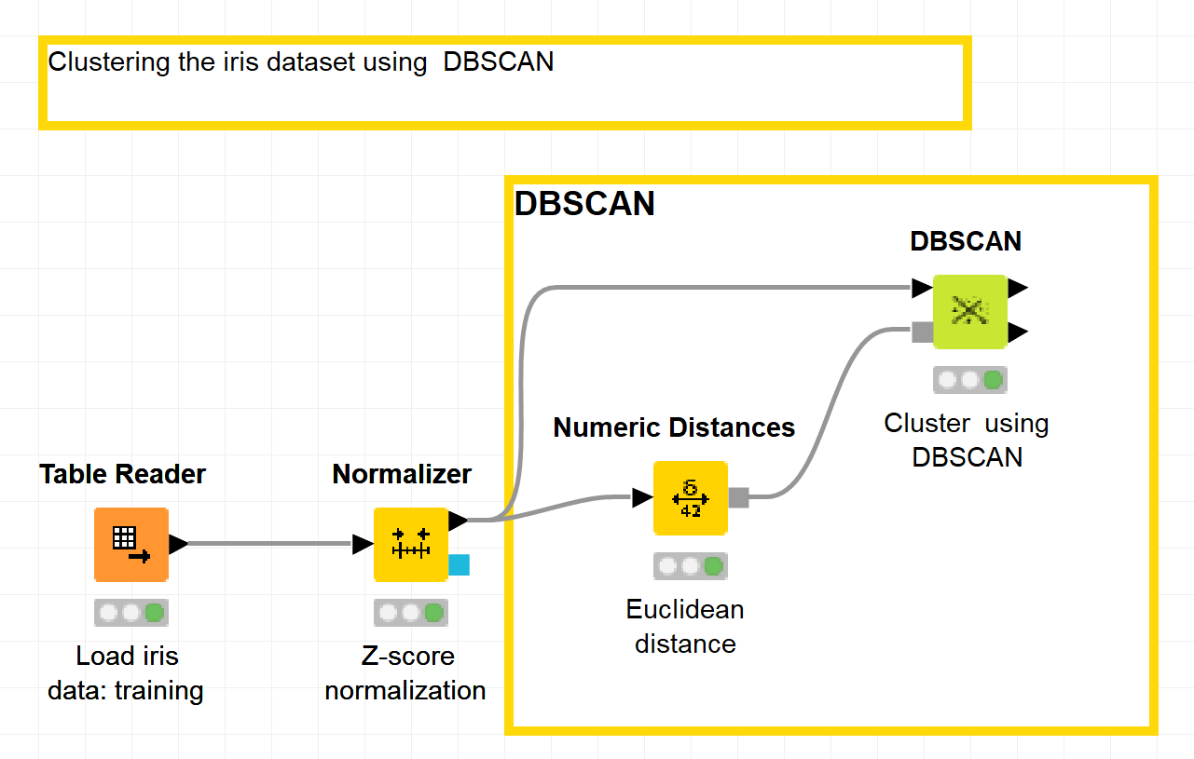
KNIME workflow
Screenshot of KNIME workflow with clustering

Slide 44
Finding Models

Slide 45
Finding Models
Deriving models that describe (aspects of) the data:
  Rules
  Trees
  Typical (or really odd!) examples
  ...
Models attempt to describe what is going on in the system that “generated” the data.
Example:
  Can we find a decision tree describing why certain customers buy so much?

Slide 46
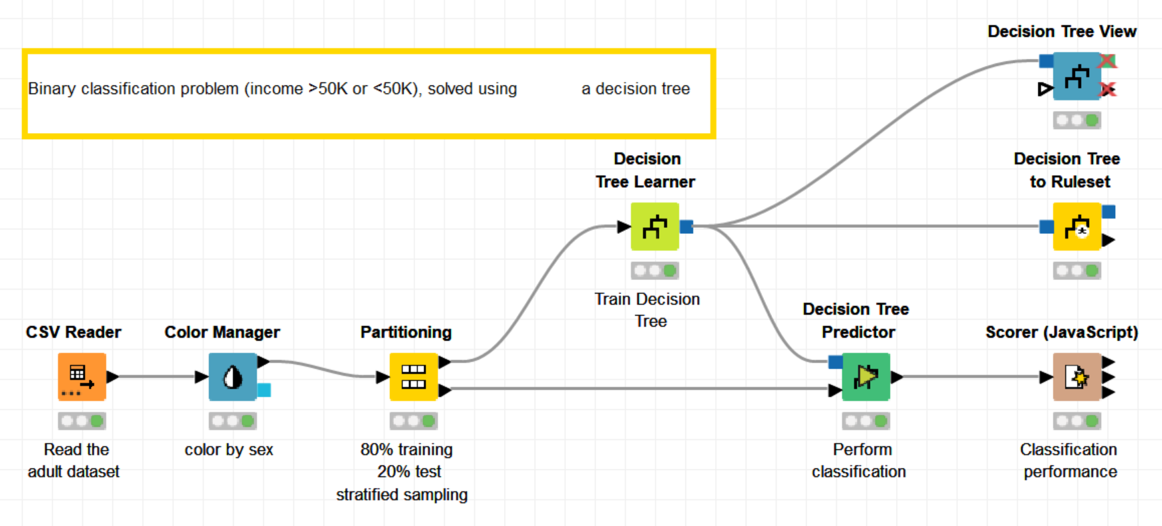
KNIME workflow
Screenshot of KNIME workflow with decision tree

Slide 47
Finding Predictors

Slide 48
Finding Predictors
Sometimes we want to find a model which we can use to later predict the target variable(s):
Predict future shopping behaviour
Predict credit risk
Predict activity of a chemical compound
Predict tomorrow’s weather, stock market, ...
And we may not care too much about actually understanding the model itself.

Slide 49
Brute Force Predictors
Brute Force Predictors
Very simple: look at your closest neighbour
  Case based reasoning works that way
  Depends heavily on your distance function
  Does not work well with outliers/noise
Slightly better: look at a few of your neighbors
  K Nearest Neighbor
  Works pretty well
  But pretty expensive to compute...
Even better: look at all neighbors, but weight them
  Weighted K Nearest Neighbor
  Works even better
  Even more expensive...

Slide 50
Other Predictors
Decision Trees, Rules, ... (all of our models!)
(Naïve) Bayes Classifiers
Regression
(Artificial) Neural Networks
Support Vector Machines (Kernel Methods)

Slide 51
Finding Predictors: Example
Can we predict the size of shopping-cart?
Brute force: look at a (few) neighbor(s).
Use our decision tree?...
What’s wrong with that approach?

Slide 52
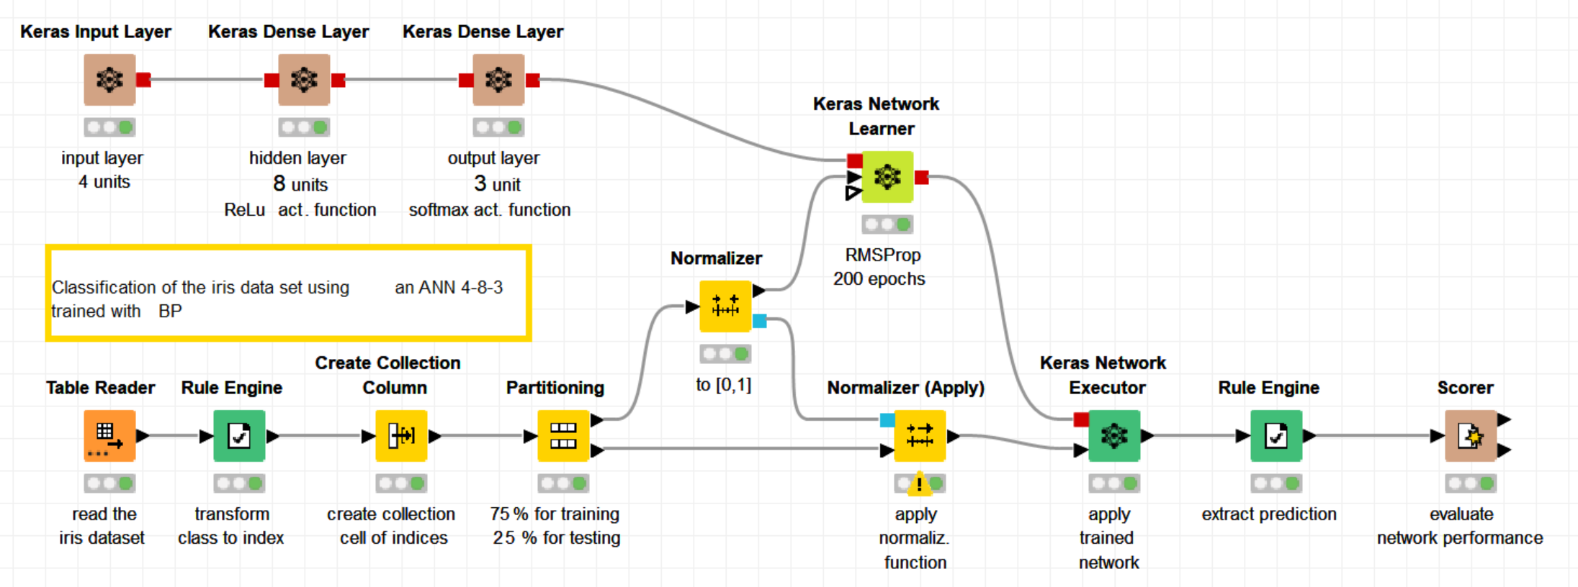
KNIME workflow
Screenshot of KNIME workflow with a neural network

Slide 53
Data Mining Systems
What kind of systems do we need?
easy to use (also by non Data Mining Expert!)
simple knowledge representation (understandable!)
mergers of disciplines (machine learning, stats, databases, ...)
(partial) automation of feedback (“Intelligent” Data Science!)
quick turn-around (interactive!)

Slide 54
A tiny bit of History

Slide 55
History: Classical Data Analysis
History: Classical Data Analysis
Small, usually manually recorded data sets
Calculation of correlation measures and statistical significance measures.
Calculations done with minimal to no compute support.
Calculations later supported by basic calculation equipment

Slide 56
History: Table based Analysis
History: Table based Analysis
Data points are stored in tables, often recorded in spread sheets
Simple analyses performed automatically on demand (calculate mean, add columns, ...)
Visicalc, ...

Slide 57
Today: Large Scale Mining
Today: Large Scale Mining
Data in various formats and from various sources
manual analysis impossible
efficient compute support essential
analysis still question driven:
  find patterns of this type
  check correlations
  build model to predict this behaviour

Slide 58
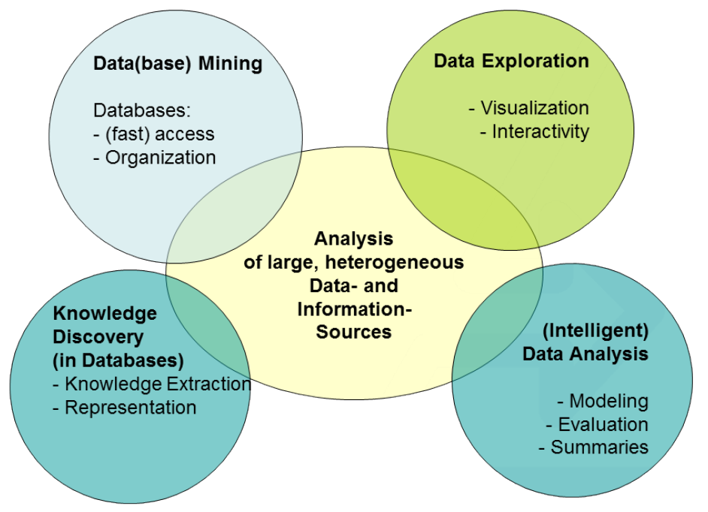
Terminology

Slide 59
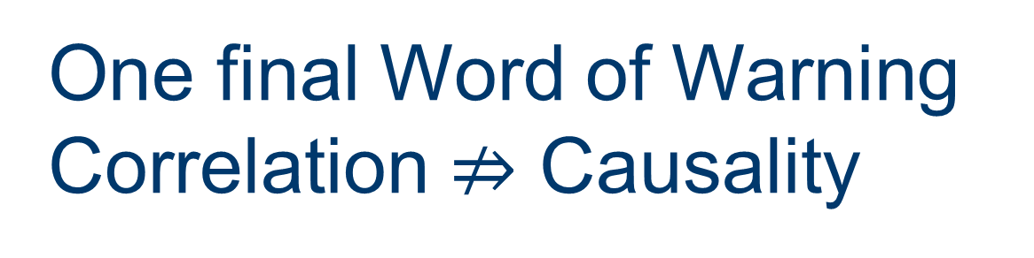
One final Word of Warning
Correlation $⇏$ Causality

Slide 60
Correlation vs. Causality
Hypothesis: Storks bring babies
And the data?

Slide 61
Correlation vs. Causality
Hypothesis: Storks bring babies
And the data?
Correlation is significant and positive!

Slide 62
Correlation vs. Causality
Hypothesis: Storks bring babies
And the data?
Correlation is significant and positive!

Slide 63
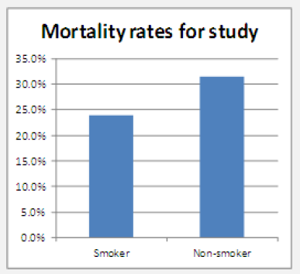
Simpson‘s Paradox
Should I start smoking to live longer?
Mortality Rate Study
 | Died | Survived | Total | Rate
Smokers | 139 | 443 | 582 | 23.9%
Non Smokers | 230 | 502 | 732 | 31.4%
Total | 369 | 945 | 1314 | 28.1%
Credit: http://www.significancemagazine.org/details/webexclusive/2671151/

Slide 64
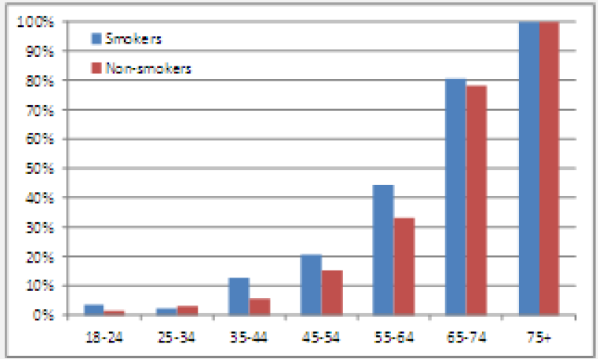
Simpson‘s Paradox
Mortality Rates by Age
Distribution of Age by Smoking Status
Credit: http://www.significancemagazine.org/details/webexclusive/2671151/
Simpsons-Paradox-A-Cautionary-Tale-in-Advanced-Analytics.html

Slide 65
Simpson‘s Paradox
 | Tax Rate |  | % of total income
Adjusted gross income | 1974 | 1978 | 1974 | 1987
Under $5000 | 0.054 | 0.035 | 4.73 | 1.60
$5000 - $9999 | 0.093 | 0.072 | 16.63 | 9.89
$10000 - $14999 | 0.111 | 0.100 | 21.89 | 13.83
$15000 - $99999 | 0.160 | 0.159 | 53.40 | 69.62
$100000 and more | 0.384 | 0.383 | 3.34 | 5.06
Total | 0.141 | 0.152 | 100 | 100
Table Credit: Counting for Something by William S. Peters
. . . does the overall tax rate go up, while all individual rates go down?

Slide 66
Correlation vs. Causality
and what about Chocolate and Nobel prices?
Image Credit: http://www.nejm.org/doi/full/10.1056/NEJMon1211064

Slide 67
Do not trust your numbers!
Tymans’s Law
Any statistic that appears interesting is almost certainly a mistake.

Slide 68
Summary
The different kind of projects
  Common Use Cases
  Search strategies
The steps in project understanding
The different kinds of datasets
The steps in data understanding
  ETL
  Describing your Data
  Finding Patterns
  Finding Models
  Finding Predictors
A tiny bit of History
Correlation vs. Causality

Slide 69
Thank you

