Slide 1
Data Visualization

Slide 2
Summary of this lesson
„There is no excuse for failing to plot and look“
What is the best way of plotting a dataset?
*This lesson refers to chapter 4 of the GIDS book

Slide 3
Content of this lesson
Methods for One and Two Attributes
  Barchart and Histogram
  Boxplot
  Scatter plot and density plot
Methods for Higher-dimensional Data
  Principal Component Analysis (PCA)
  Multidimensional Scaling (MDS)
  t-distributed Stochastic Neighbor Embedding (t-SNE)
  Parallel Coordinates
  Radar and Star Plots
  Sunburst Chart
  Correlation Analysis

Slide 4
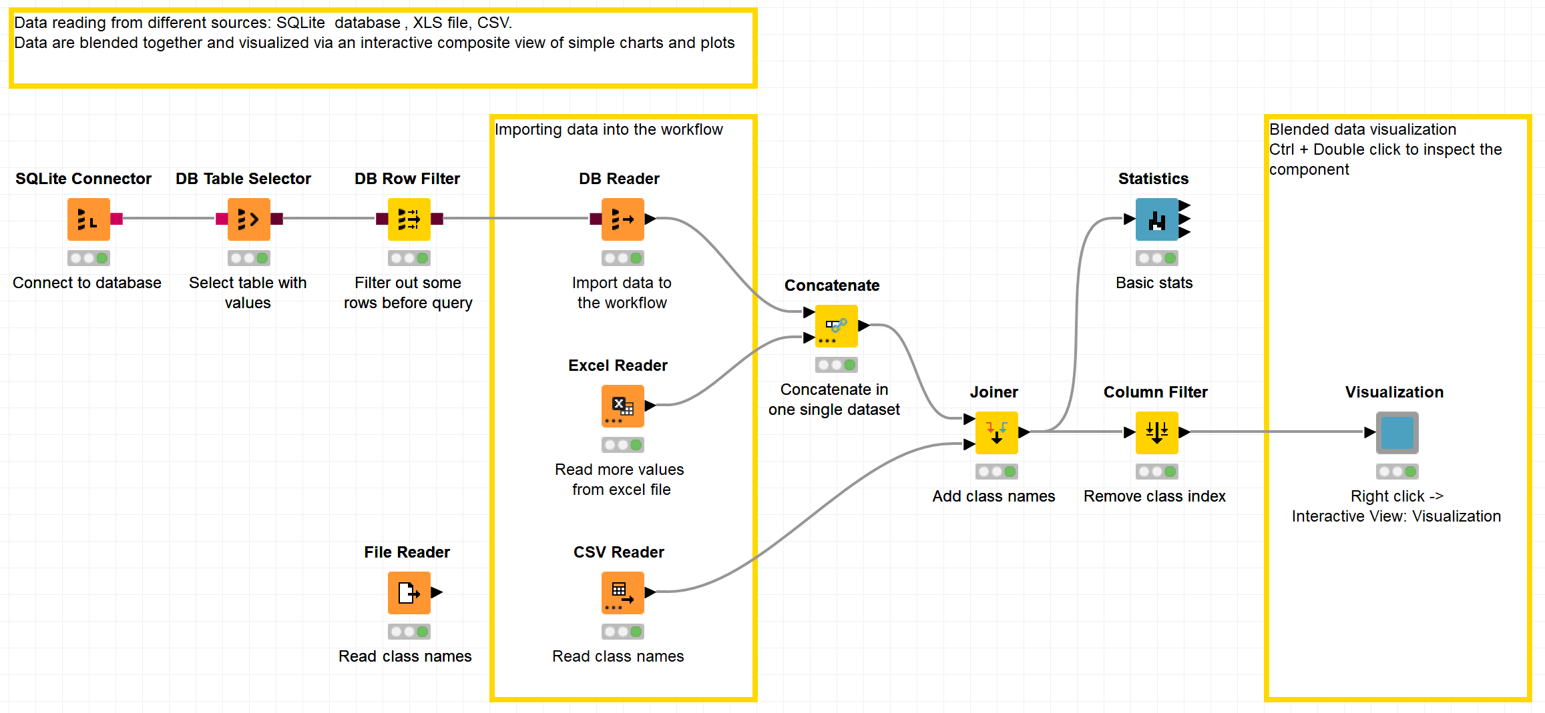
Datasets
Datasets used : adult dataset and outliers dataset
Example Workflows:
  „Simple Visualizations“ https://kni.me/w/dwugN1qYM2OOjzO4
    Read from CSV file, Excel file and SQLite.
    bar chart and histogram
    parallel coordinates
    box plot
    scatter plot
    table view.

Slide 5
Statistical Descriptors

Slide 6
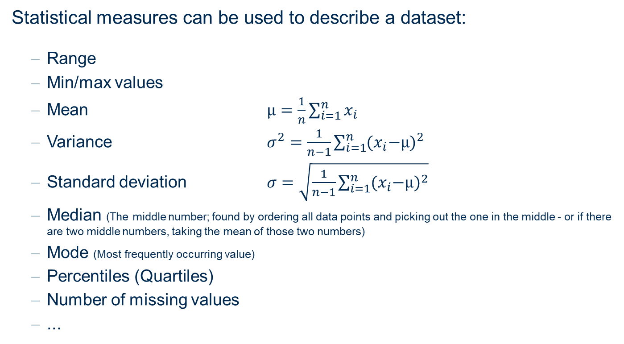
Descriptive Statistics
Statistical measures can be used to describe a dataset:
  Range
  Min/max values
  Mean $μ=\frac{1}{n}\sum_{i=1}^{n}{x_{i}}$
  Variance $σ^{2}=\frac{1}{n−1}\sum_{i=1}^{n}{{{(x}_{i}−μ)}^{2}}$
  Standard deviation $σ=\sqrt{\frac{1}{n−1}\sum_{i=1}^{n}{{{(x}_{i}−μ)}^{2}}}$
  Median (The middle number; found by ordering all data points and picking out the one in the middle - or if there are two middle numbers, taking the mean of those two numbers)
  Mode (Most frequently occurring value)
  Percentiles (Quartiles)
  Number of missing values
  ...

Slide 7
Visualization Methods for One Attribute

Slide 8
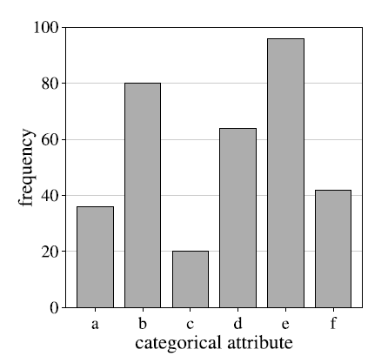
Bar chart
A bar chart is a simple way to depict the frequencies of the values of a categorical attribute.

Slide 9
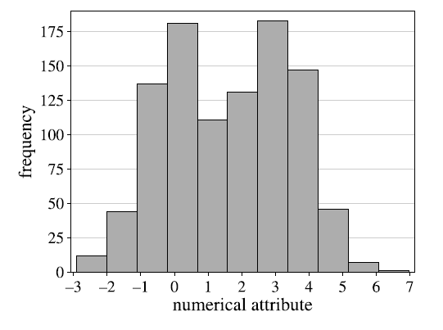
Histogram
A histogram shows the frequency distribution for a numerical attribute.
The range of the numerical attribute is discretized into a fixed number of intervals (bins), usually of equal length.
For each interval, the (absolute) frequency of values falling into it is indicated by the height of a bar.

Slide 10
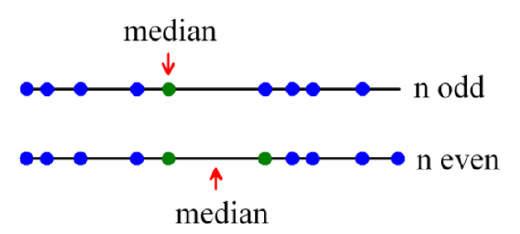
Median, quantiles, quartiles, interquartile ranges
Median: The value in the middle (for values sorted in increasing order)
q%-quantile (0 < q < 100): The value for which q% of the values are smaller and 100-q% are larger. The median is the 50%-quantile
Quartiles: 25%-quantile (1st quartile), median (2nd quantile), 75%-quantile (3rd quartile)
Interquartile range (IQR): 3rd quartile – 1st quartile

Slide 11
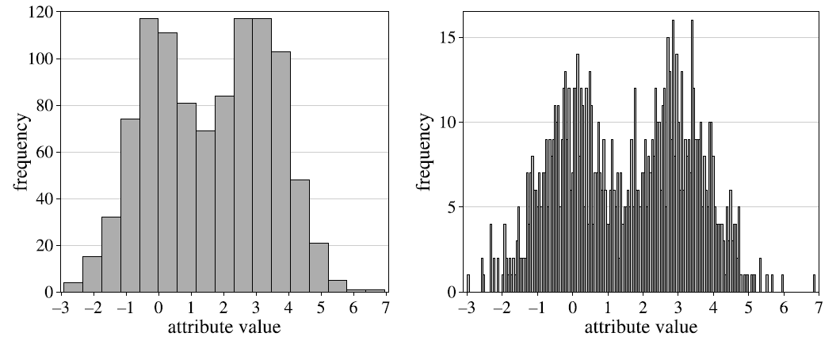
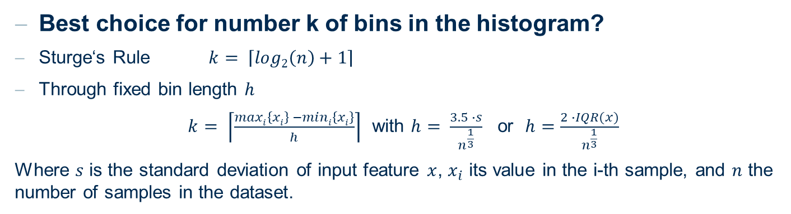

Choice of number of bins
Best choice for number k of bins in the histogram?
Sturge‘s Rule $k= \left\lceil log\text{2}\left(n\right)+1\right\rceil$
Through fixed bin length $h$
$k= \left\lceil \frac{maxi\left\{xi\right\} −mini\left\{xi\right\}}{h}\right\rceil$ with $h= \frac{3.5 ∙s}{n^{\frac{1}{3}}}$ or$h=\frac{2 ∙IQR(x)}{n^{\frac{1}{3}}}$
Where $s$ is the standard deviation of input feature $x$, $x_{i}$ its value in the i-th sample, and $n$ the number of samples in the dataset.
$x$,

Slide 12
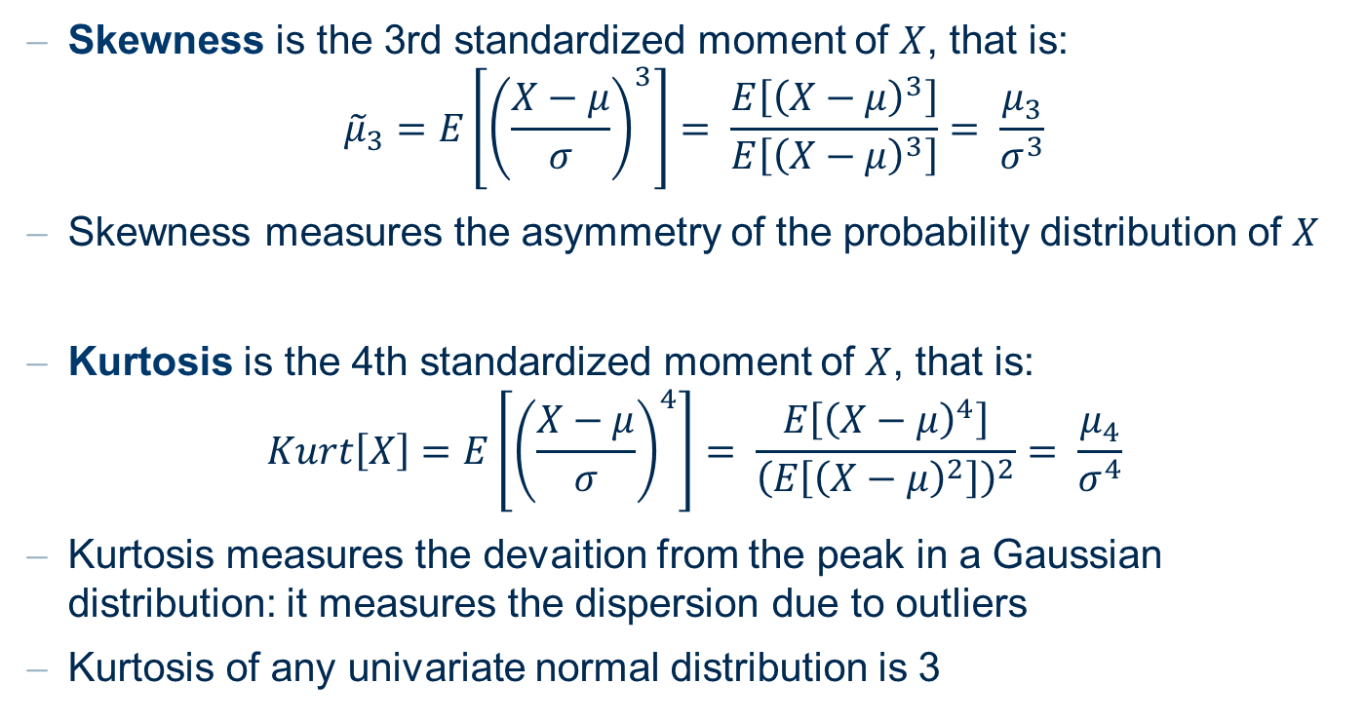
Kurtosis and Skeweness
Skewness is the 3rd standardized moment of $X$, that is:
$${\tilde{μ}}_{3}=E\left[{\left(\frac{X−μ}{σ}\right)}^{3}\right]= \frac{E\left[{\left(X−μ\right)}^{3}\right]}{E\left[{\left(X−μ\right)}^{3}\right]}= \frac{μ_{3}}{σ^{3}}$$
Skewness measures the asymmetry of the probability distribution of $X$
Kurtosis is the 4th standardized moment of $X$, that is:
$$Kurt\left[X\right]=E\left[{\left(\frac{X−μ}{σ}\right)}^{4}\right]= \frac{E\left[{\left(X−μ\right)}^{4}\right]}{{\left(E\left[{\left(X−μ\right)}^{2}\right]\right)}^{2}}= \frac{μ_{4}}{σ^{4}}$$
Kurtosis measures the devaition from the peak in a Gaussian distribution: it measures the dispersion due to outliers
Kurtosis of any univariate normal distribution is 3

Slide 13
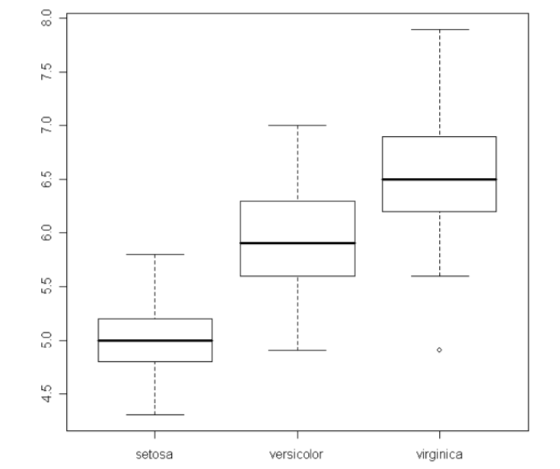
Boxplots
Boxplots are a very compact way to visualize and summarize the main characteristics of a numeric attribute, through the median, the IQR, and possible outliers
median

Slide 14
Boxplots
Boxplots are a very compact way to visualize and summarize the main characteristics of a numeric attribute, through the median, the IQR, and possible outliers
~ 50%
of data
IQR

Slide 15
Boxplots
Boxplots are a very compact way to visualize and summarize the main characteristics of a numeric attribute, through the median, the IQR, and possible outliers
Farthest point or ~1.5 IQR

Slide 16
Boxplots
Boxplots are a very compact way to visualize and summarize the main characteristics of a numeric attribute, through the median, the IQR, and possible outliers
outlier

Slide 17
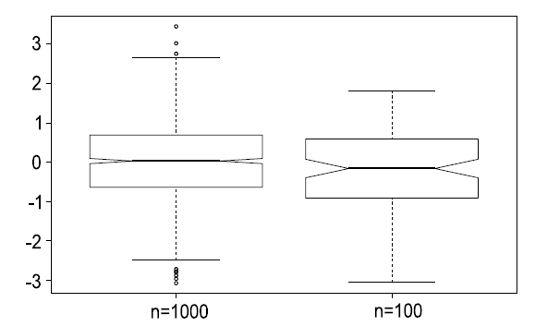
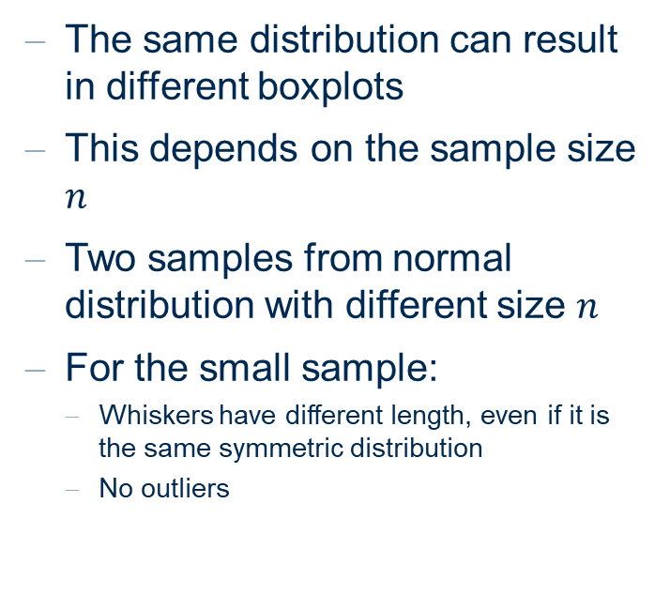
Boxplots from normal distributions
The same distribution can result in different boxplots
This depends on the sample size $n$
Two samples from normal distribution with different size $n$
For the small sample:
  Whiskers have different length, even if it is the same symmetric distribution
  No outliers
Boxplots from different samples from a standard normal distribution

Slide 18
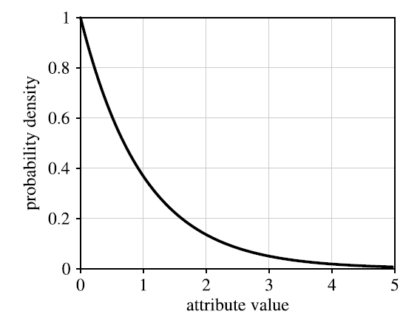
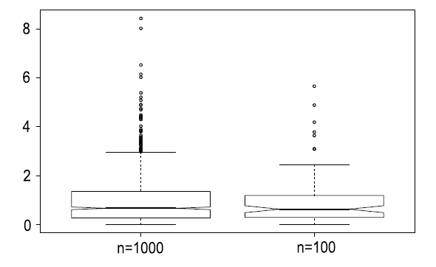


Boxplot of asymmetric distribution
Boxplots of different samples from exponential distribution with $λ=1$
Exponential distribution with $λ=1$
Boxplots from different samples from exponential distribution with $λ=1$

Slide 19
Visualization Methods for Two Attributes

Slide 20
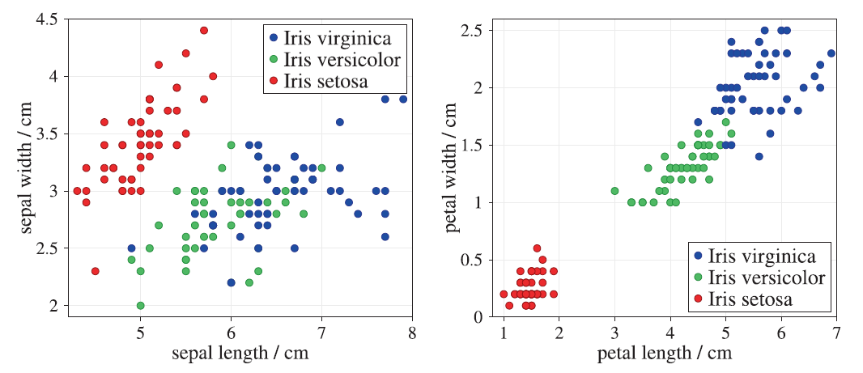
Scatter Plot
Petal length and width provide better class separation than sepal length and width
Scatter plots of the Iris data set for sepal length vs. sepal width (left) and for petal length vs. petal width (right). All quantities are measured in centimetres
In scatter plots two attributes are plotted against each other
Can be enriched with additional features (color, shape, size)
Suitable for small number of points; not suitable for large datasets
Points can hide each other -> add Jitter (a small random value to each point)

Slide 21
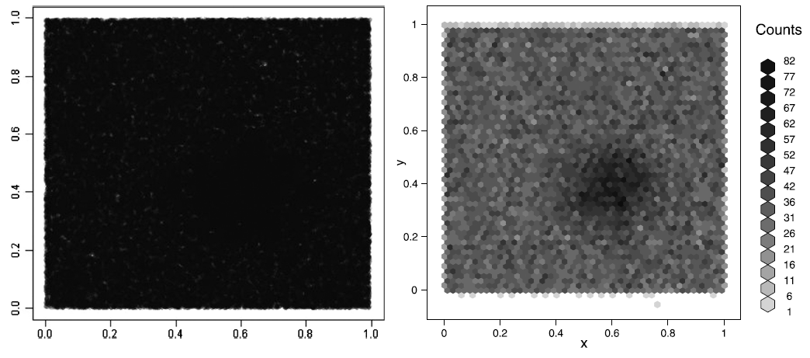
Scatter Plot
Density plot (left) and a plot based on hexagonal binning (right) for a dataset with n = 100,000 instances
Scatter plot is not suitable for large datasets
Alternatives:
  Density plot for example using semi-transparent points: the more points in the same place the less transparent
  Binning points into rectangles or hexagons and heat scale color

Slide 22
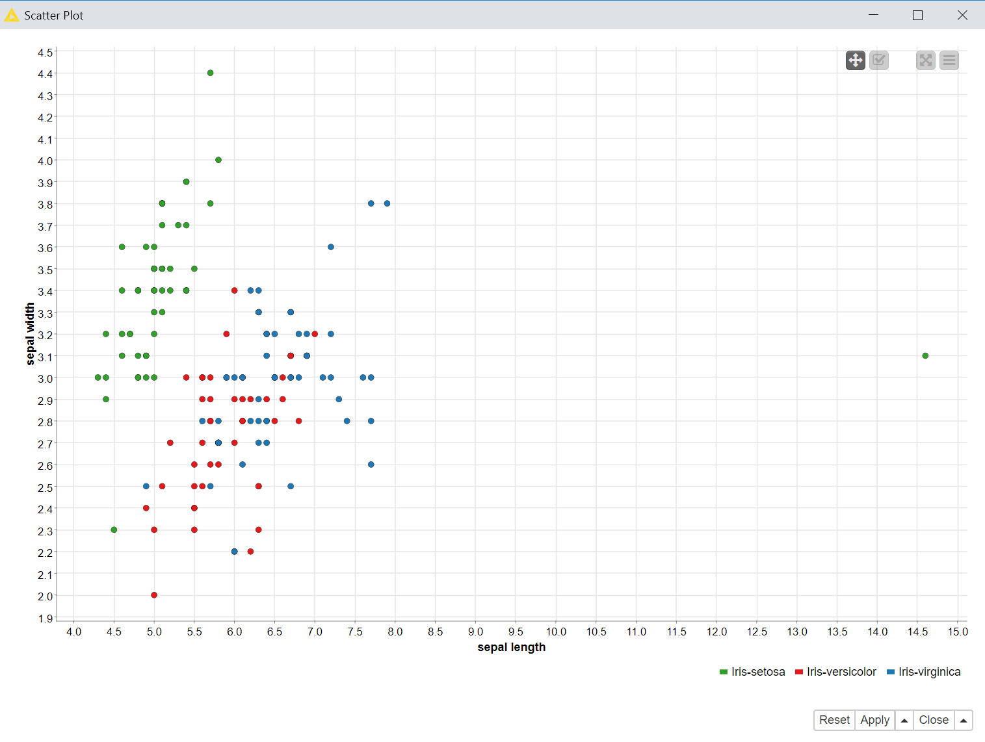
Scatter Plot to detect outliers
Scatter plots can be used to detect outliers
outlier
Notes:
There is no guarantee that a scatter plot or any visualization technique will automatically show all or even any interesting or deviating patterns in the data set.
A scatter plot with no outliers does not mean that there are no outliers in the data set. It only means that there are no outliers with respect to the combination of the attributes displayed in the scatter plot.

Slide 23
Scatter Plot as a test
Visualization can be used as a test
Good News
  Visualization reveals patterns or exceptions => there is something in the dataset
Bad News
  Visualization does not indicate anything specific => there might still be something in the dataset even if we do not see it
  For example, if we do not see outliers for that combination of features, that does not mean that outliers do not exist in the dataset.
Notes:
There is no guarantee that a scatter plot or any visualization technique will automatically show all or even any interesting or deviating patterns in the data set.
A scatter plot with no outliers does not mean that there are no outliers in the data set. It only means that there are no outliers with respect to the combination of the attributes displayed in the scatter plot.

Slide 24
Methods for Higher-Dimensional Data

Slide 25
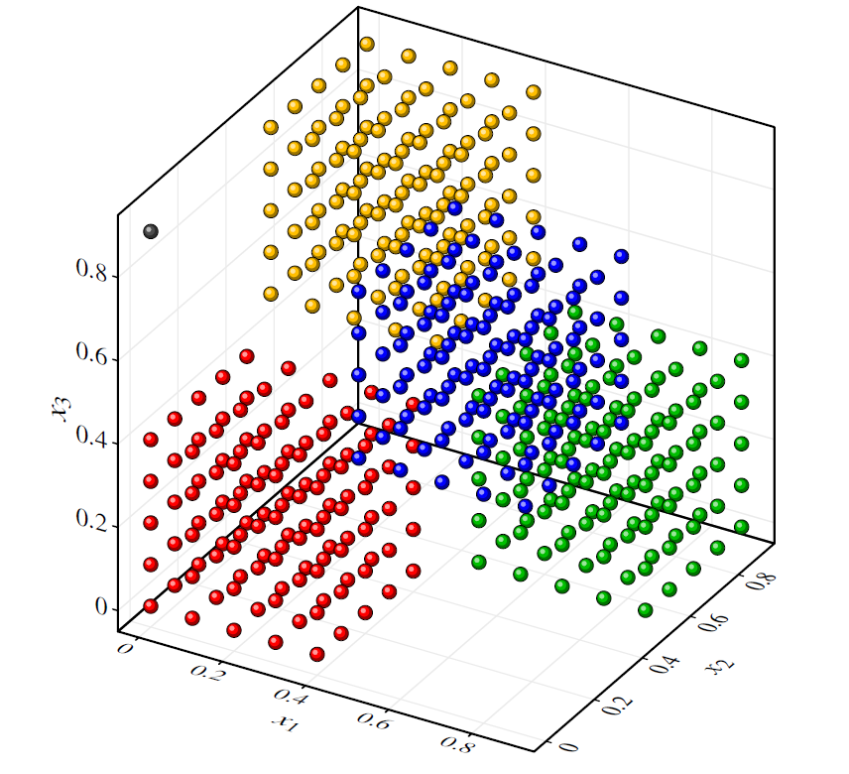
Visualization of three-dimensional data: 3D plot
A display or plot is by definition two-dimensional, so that only max. two axes (attributes) can be incorporated.
3D techniques can be used to incorporate three axes (attributes).
Example
A data set distributed over a cube in a chessboard-like pattern.
The colors are only meant to make the different cubes more easily discernible. They do not indicate classes.
Note the outlier in the upper left corner
3D scatter plot

Slide 26
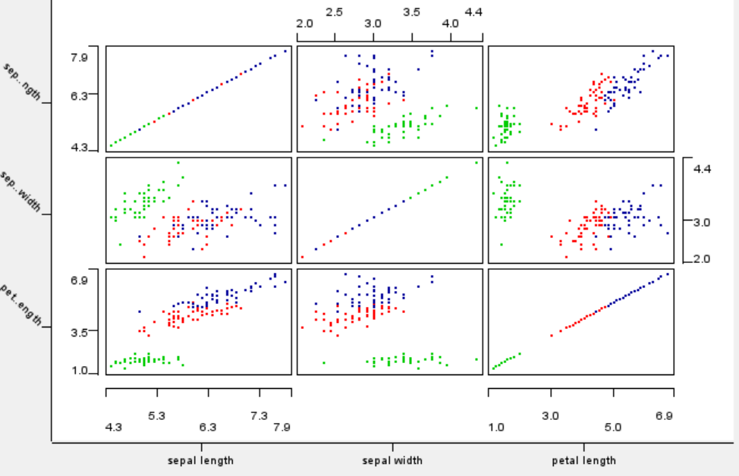
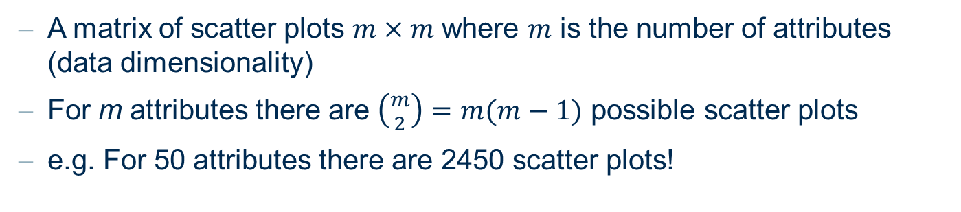
Visualization of three-dimensional data: Scatter Matrixes
A matrix of scatter plots $m×m$ where $m$ is the number of attributes (data dimensionality)
For m attributes there are $\left({m \atop 2}\right)=m(m−1)$ possible scatter plots
e.g. For 50 attributes there are 2450 scatter plots!
Scatter matrix
Notes:
What does it mean to preserve the structure?
No unique answer

Slide 27
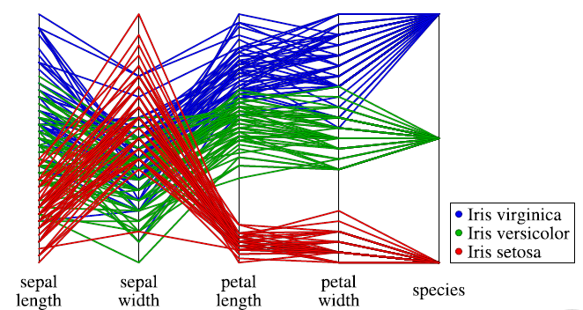
Parallel Coordinates Plot
Parallel coordinates draw the coordinate axes for each attribute parallel to each other, so that there is no limitation for the number of axes to be displayed.
For each data object, a polyline is drawn connecting the values of the attributes on the corresponding axes.
Maintains the original attributes
Limited number of entries
How do we spot correlation between features?
Parallel coordinates plot for the Iris data set

Slide 28
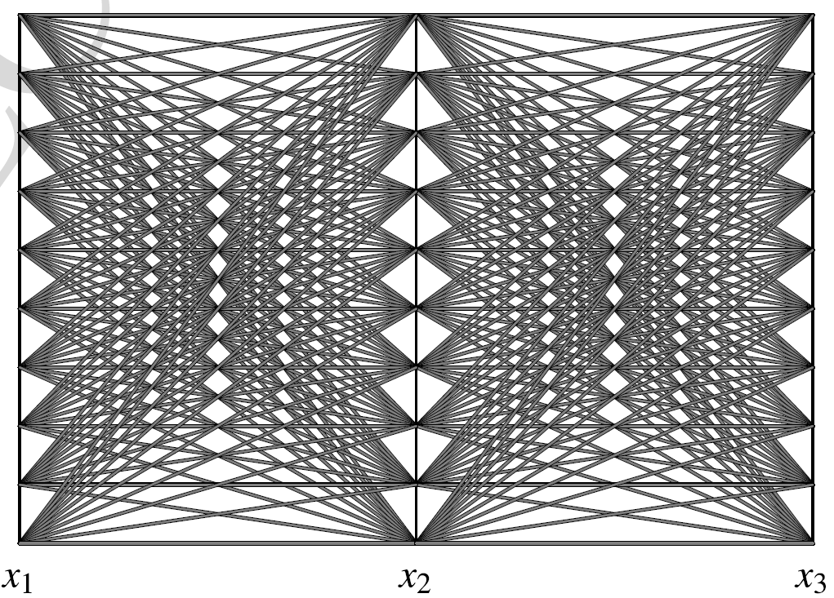
Parallel Coordinates Plot: „Cube Data“
Parallel coordinates plot for the Cube data

Slide 29
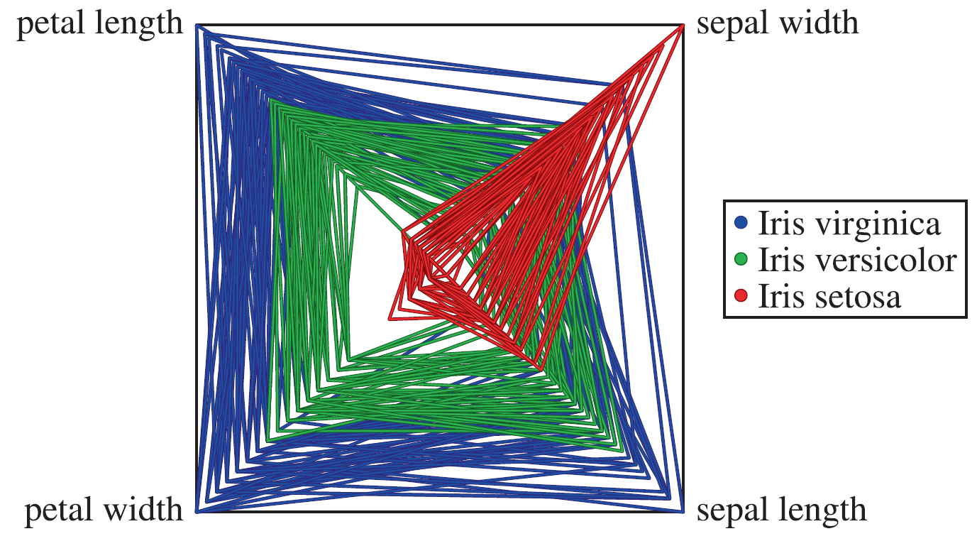
Radar Plot
Similar idea of the Parallel Coordinates plot
Axes are drawn in a star-like fashion intersecting in one point
Also called spider plots
Suitable for small datasets
Radar plot for the Iris data set

Slide 30
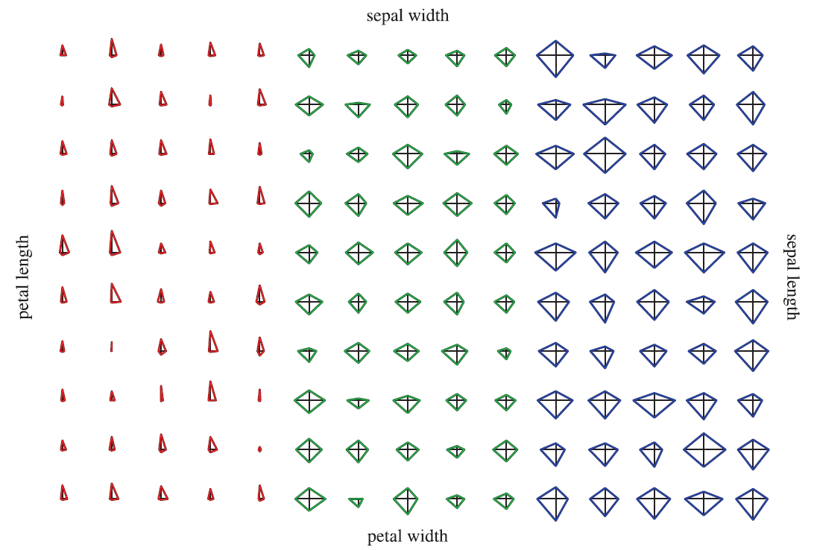
Star Plots
In a star plot each object is drawn separately
In a radar plot fashion
Star plot for the Iris data set

Slide 31
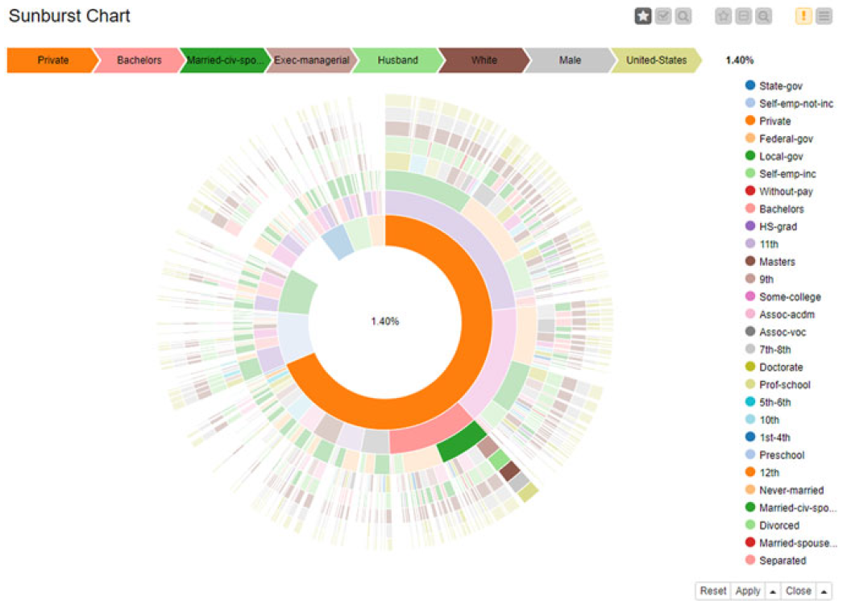
Sunburst Chart
Display multidimensional hierarchical nominal data in a radial layout
One section ⬄ one attribute
Root attribute in the center, external sections are attributes located deeper in the hierarchy
Area of a section represents the accumulated value of all descending sections

Slide 32
Visualization of higher-dimensional data
How can we transform a higher-dimensional data set to have two or three dimensions?
Preserve as much of the “structure” of the original data
Define a measure to evaluate how well the original structure of the high-dimensional dataset is preserved after transformation
Find the transformation that gives the best value for the given measure
Notes:
What does it mean to preserve the structure?
No unique answer

Slide 33
Correlation Analysis

Slide 34
Similarity in behavior
How can we measure the similarity in behavior of two attributes?
Pearson’s correlation coefficient
Spearman’s rank correlation coefficient (Spearman’s rho)

Slide 35
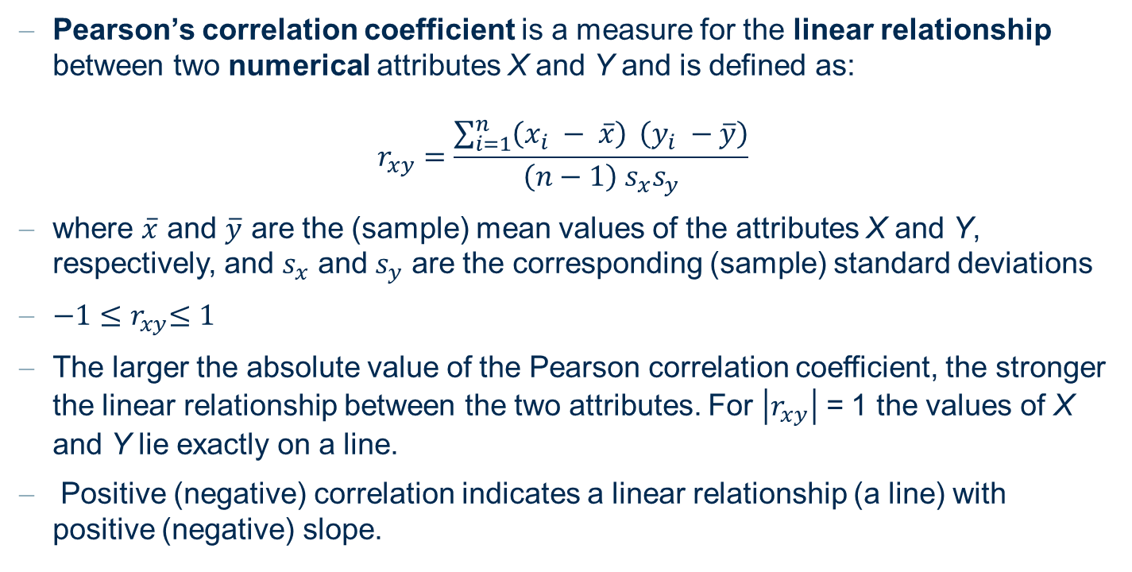
Pearson‘s correlation coefficient
Pearson’s correlation coefficient is a measure for the linear relationship between two numerical attributes X and Y and is defined as:
$$r_{xy}=\frac{\sum_{i=1}^{n}{\left(x_{i} − \overline{x}\right) }\left(y_{i} −\overline{y}\right)}{\left(n−1\right) s_{x}s_{y}}$$
where $\overline{x}$ and $\overline{y}$ are the (sample) mean values of the attributes X and Y, respectively, and $s_{x}$ and $s_{y}$ are the corresponding (sample) standard deviations
${−1≤r}_{xy}≤1$
The larger the absolute value of the Pearson correlation coefficient, the stronger the linear relationship between the two attributes. For $\left|r_{xy}\right|$ = 1 the values of X and Y lie exactly on a line.
Positive (negative) correlation indicates a linear relationship (a line) with positive (negative) slope.

Slide 36
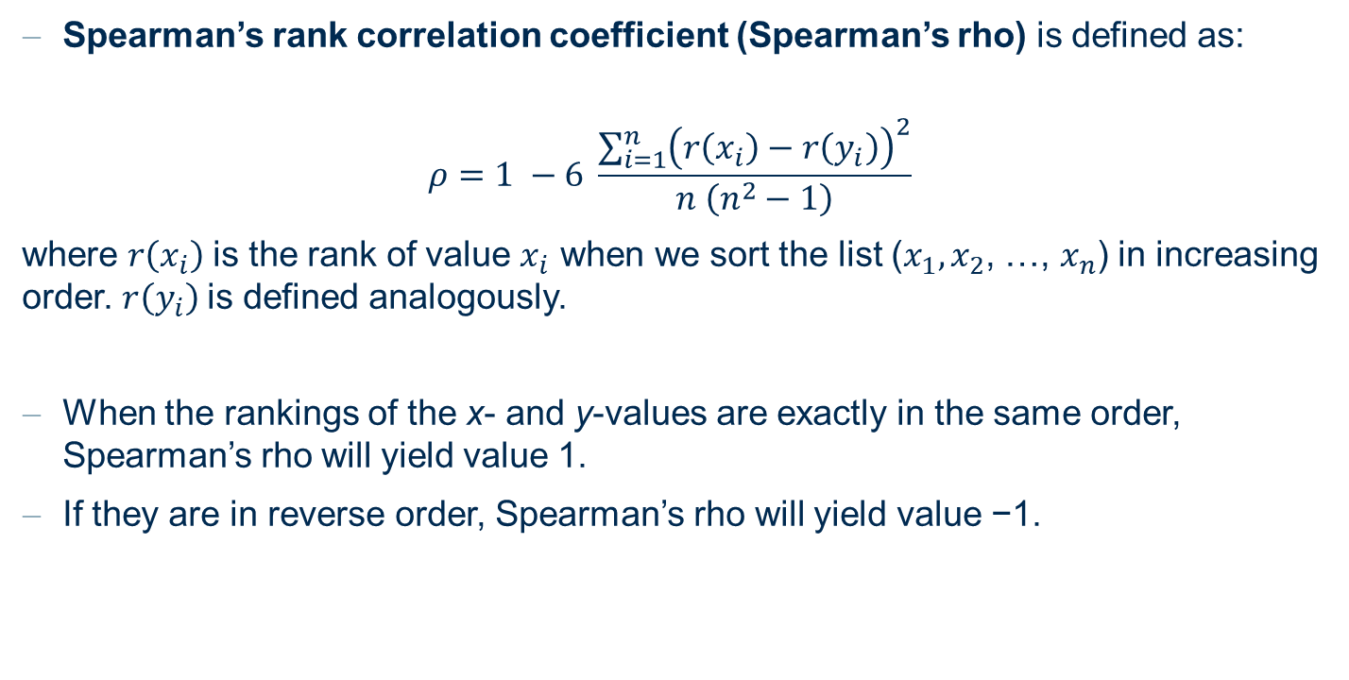
Spearman‘s rank correlation coefficient (Spearman‘s rho)
Spearman’s rank correlation coefficient (Spearman’s rho) is defined as:
$$ρ=1 −6 \frac{\sum_{i=1}^{n}{{\left(r\left(x_{i}\right)−r\left(y_{i}\right)\right)}^{2}}}{n \left(n^{2}−1\right)}$$
where $r\left(x_{i}\right)$is the rank of value $x_{i}$ when we sort the list ($x_{1},x_{2}$, …, $x_{n}$) in increasing order. $r\left(y_{i}\right)$is defined analogously.
When the rankings of the x- and y-values are exactly in the same order, Spearman’s rho will yield value 1.
If they are in reverse order, Spearman’s rho will yield value −1.

Slide 37
Practical Examples with KNIME Analytics Platform

Slide 38
KNIME Workflow
Simple visualization

Slide 39
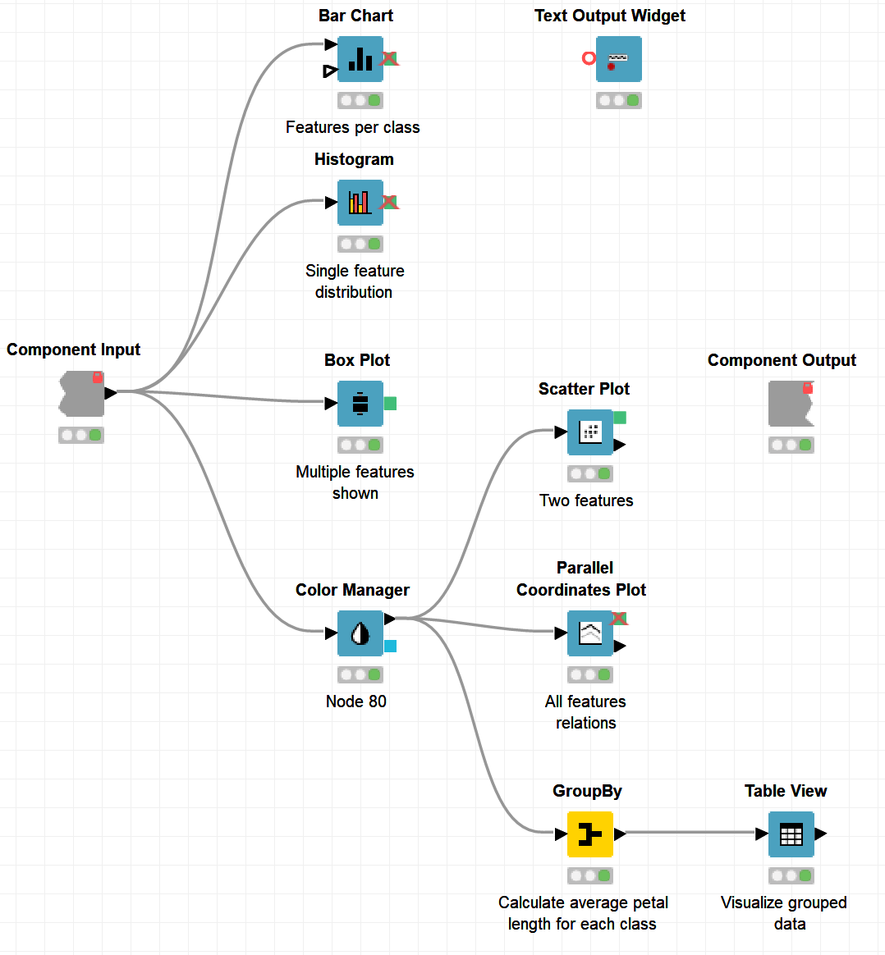
KNIME Workflow
Inner workings of the visualization component

Slide 40
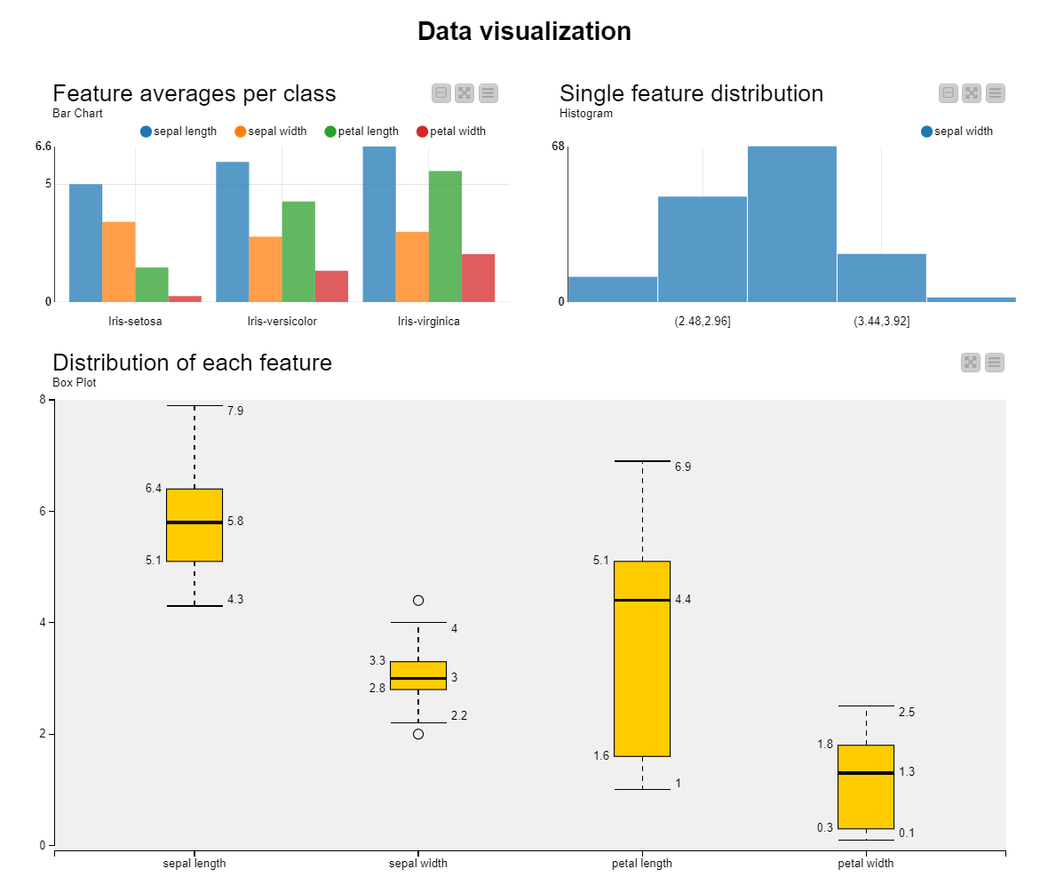
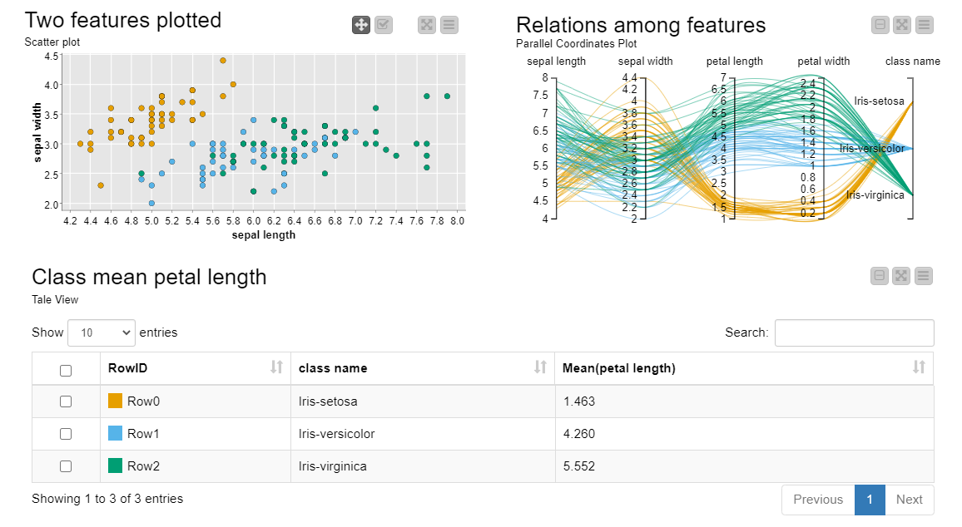
KNIME Workflow
Interactive view

Slide 41
Summary
Methods for One and Two Attributes
  Barchart and Histogram
  Boxplot
  Scatter plot and density plot
Methods for Higher-dimensional Data
  Principal Component Analysis (PCA)
  Multidimensional Scaling (MDS)
  t-distributed Stochastic Neighbor Embedding (t-SNE)
  Parallel Coordinates
  Radar and Star Plots
  Sunburst Chart
  Correlation Analysis

Slide 42
Thank you

