Slide 1
Data Preparation

Slide 2
Summary of this lesson
„Success is where preparation and opportunity meets“ -Bobby Unser
How can we prepare our data for analysis?
*This lesson refers to chapter 6 of the GIDS book

Slide 3
Content of this lesson
Data Preparation
Feature Selection
Dimensionality Reduction
Record Selection and Sampling
Missing Values Imputation
Outlier Detection
Data Cleaning and Standardization
Normalization
Data Engineering
Data Integration

Slide 4
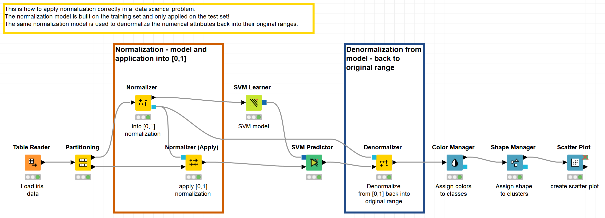
Datasets
Datasets used: adult dataset and iris dataset
Example Workflows:
„Dimensionality Reduction & Outlier Detection“ https://kni.me/w/3eRugmiCNg6uSmOz
Manual flter
Missing and constant value column filter
Missing value handling
Outliers handling
“How to use normalization in a data science solution” https://kni.me/w/l9AcqvFQbXp3AfNS
Build normalization model
Apply normalization model
Denormalization

Slide 5
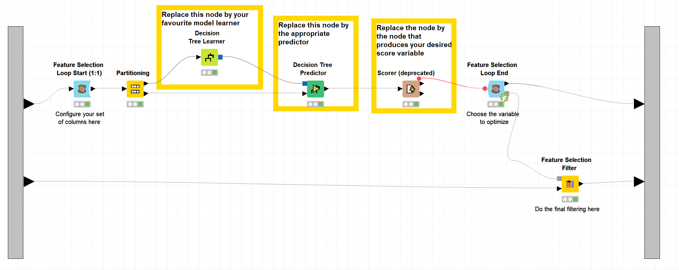
Datasets
Datasets used: adult dataset and iris dataset
Example Workflows:
„Backward Feature Elimination“ https://kni.me/w/Cim28Kbg7Rt2EsE8

Slide 6
Data Preparation

Slide 7
Data Understanding vs Data Preparation
Data understanding
Provides general information about the data, such as
the existence and partly also about the character of missing values,
outliers,
the characteristics of attributes
dependencies between attributes
Data preparation
Uses information from the data understanding process to
select attributes,
reduce the dimensionality of the data set,
select records,
(try to) handle missing values,
(try to) handle outliers,
integrate, unify and transform data
improve data quality.
Notes:
We are going to modify our data set so that the modeling techniques are best supported but least biased

Slide 8
Motivation
Real world data is „dirty“
➔ Contains missing values, noises, outliers, inconsistencies
Comes from different information sources
➔ Different attribute names, values expressed differently, related tuples
Different value ranges and hierarchies
➔ One attribute range may overpower another
Huge amount of data
➔ Makes analyis difficult and time consuming

Slide 9
Types of Data Processing
Data cleaning
Fill in missing values, smooth noisy data, identify or remove outliers, resolve inconsistencies
Data integration
Integration of multiple databases, data cubes, or files
Data transformation
Normalization and aggregation
Data reduction
Reduce number of attributes

Slide 10
Data Preparation
Feature Selection
Dimensionality Reduction
Sampling
Outlier Detection
Missing Value Imputation
Data Cleaning & Standardization (domain dependent)
Aggregations (often domain dependent)
Normalization
Feature Engineering
Integration of multiple Data Sources

Slide 11
Feature Selection

Slide 12
Select Data: Feature Selection
Feature Selection: choose a subset of the features (attributes) that is as small as possible and sufficient for the data analysis (= still informative!)
Feature Selection includes:
Removing (more or less) irrelevant features and
Removing redundant features
Evaluation function to compare sets of attributes
Strategy (heuristic) to select the possible feature subsets to be compared against each other with this measure
Notes:
Example P 129

Slide 13
Feature Selection Techniques
Selecting the top-ranked features.
Choose the features with the best evaluation when single features are evaluated.
Selecting the top-ranked subset.
Choose the subset of features with the best performance. This requires exhaustive search and is impossible for larger numbers of features. (For 20 features there are already more than one million possible subsets.)
Forward selection.
Start with the empty set of features and add features one by one. In each step, add the feature that yields the best improvement of the performance.
Backward elimination.
Start with the full set of features and remove features one by one. In each step, remove the feature that results in the smallest decrease in performance.

Slide 14
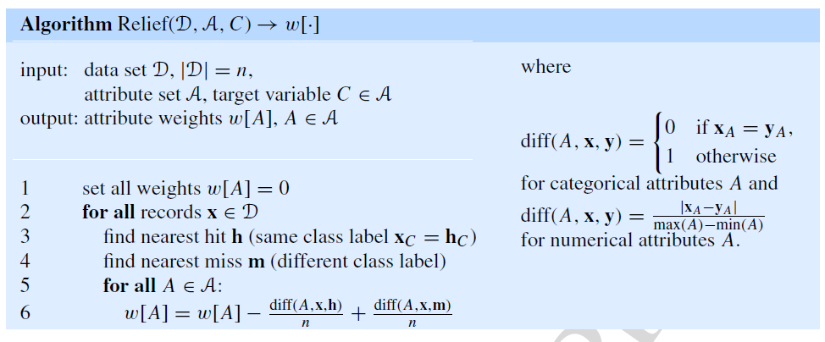
Select Data: Feature Selection
Selecting the k Top-Ranked features
Rank only the single feature rather than the full subsets
Pearson’s χ²-test (categorical values) or information gain
Straightforward approach using Relief family algorithms

Slide 15
Select Data: Feature Selection
Selecting the Top-Ranked subsets
Recognizes the power of complementing attributes rather than individuals contribution only
Computationally more expensive
How can we evaluate the attribute subset?

Slide 16
Top-Ranked subset selection evaluation methods
Cross-product of all attributes in the subset
Wrapper: build and evaluate a model for each subset
Filter based on correlation: remove redundant attributes using heuristic:
$$\frac{k{\overline{r}}_{ci}}{\sqrt{k+k\left(k−1\right){\overline{r}}_{ii}}}$$
Filter based on missing values: remove attributes with missing value ratio higher than a given treshold
Filter based on variance: remove attributes with variance lower than a given treshold
${\overline{r}}_{ci}$ the average correlation of the target attribute with all other attributes in the set
${\overline{r}}_{ii}$ the average attribute-attribute correlation between different attributes (except the target)
$k$ the number of attributes

Slide 17
Subset selection
Standard strategies to select the minimal optimal subset of features
Forward selection (greedy bottom-up)
Start with empty set of features and add one by one the feature that yeld the best improvements
Backward elimination (greedy top-down)
Startwith full set of features and remove one by one the feature that result in the smallest decrease in performances

Slide 18
Backward Feature Elimination (greedy top-down)
First train one model on n input features
Then train n separate models each on $n−1$ input features and remove the feature whose removal produced the least disturbance
Then train $n−1$ separate models each on $n−2$ input features and remove the feature whose removal produced the least disturbance
And so on. Continue until desired maximum error rate on training data is reached.

Slide 19
Forward Feature Construction (greedy bottom-up)
First, train n separate models on one single input feature and keep the feature that produces the best accuracy.
Then, train $n−1$ separate models on 2 input features, the selected one and one more. At the end keep the additional feature that produces the best accuracy.
And so on … Continue until an acceptable error rate is reached.

Slide 20
Dimensionality Reduction

Slide 21
Is there such a thing as “too much data”?
“Too much data”:
Consumes storage space
Eats up processing time
Is difficult to visualize
Inhibits ML algorithm performance
Beware of the model: Garbage in ➔ Garbage out

Slide 22
Feature Selection vs. Dimensionality Reduction
Both methods are used for reducing the number of features in a dataset. However:
Feature selection is simply selecting and excluding given features without changing them.
Dimensionality reduction might transform the features into a lower dimension.
Feature selection is often a somewhat more aggressive and more computationally expensive process.
Backward Feature Elimination
Forward Feature Construction

Slide 23
Dimensionality Reduction Techniques
Measure based
Ratio of missing values
Low variance
High Correlation
Transformation based
Principal Component Analysis (PCA)
Linear Discriminant Analysis (LDA)
t-SNE
Machine Learning based
Random Forest of shallow trees
Neural auto-encoder

Slide 24
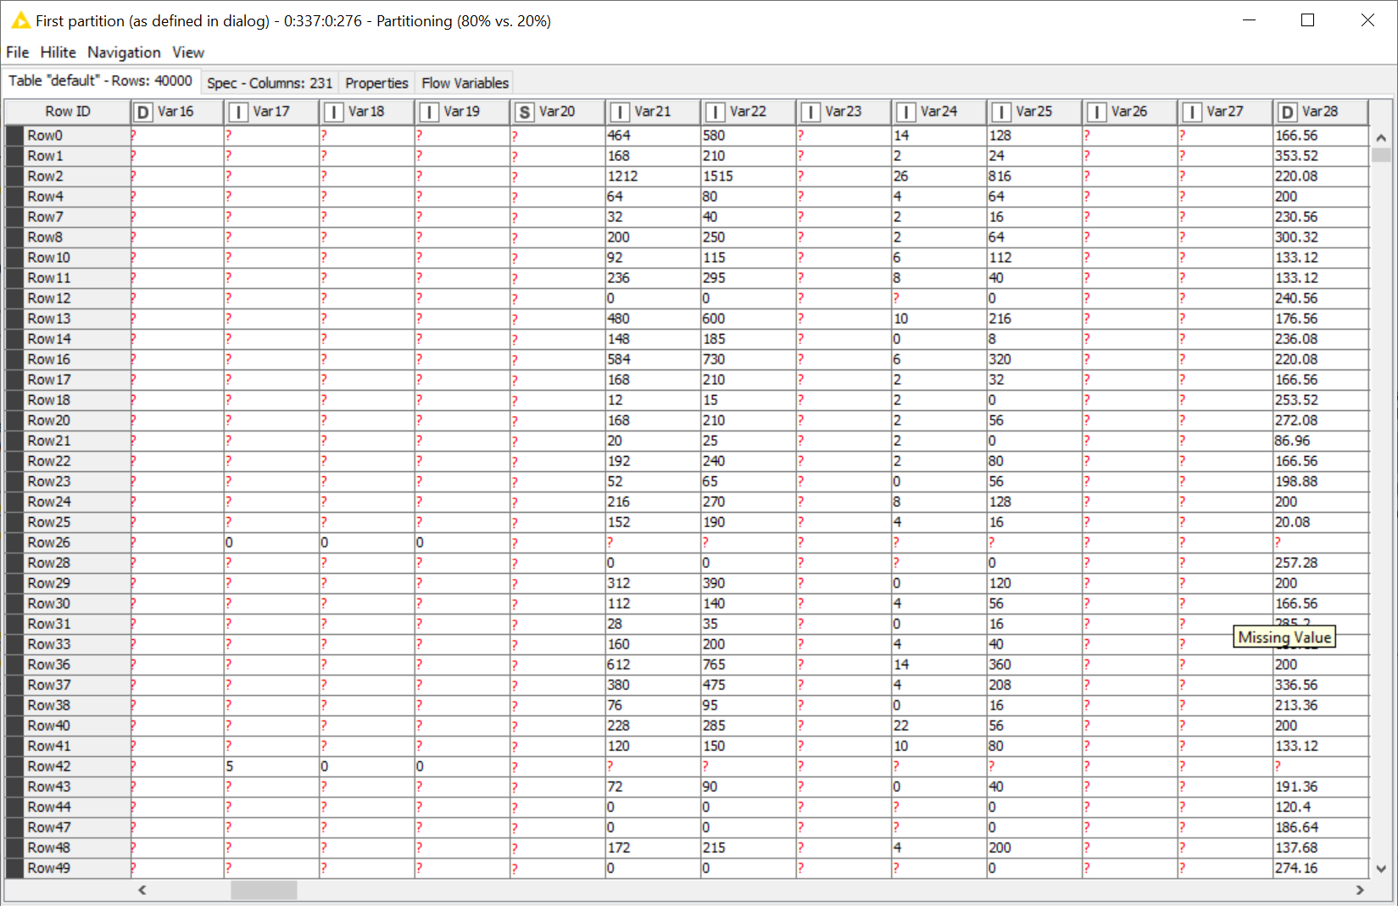
Missing Values Ratio
IF (% missing value > threshold ) THEN remove column

Slide 25
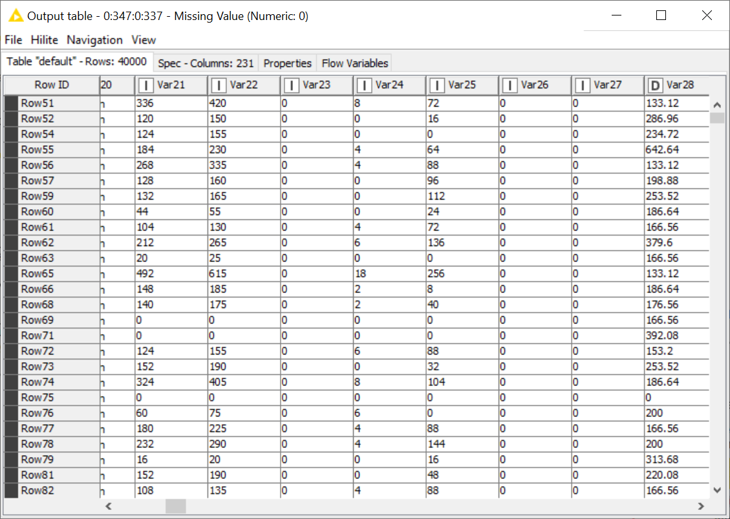
Low Variance
If column has constant value (variance = 0), it contains no useful information
In general: IF (variance < threshold ) THEN remove column
Note: requires min-max-normalization, and only works for numeric columns

Slide 26
High Correlation
Two highly correlated input variables probably carry similar information
$$IF (corr\left(var1, var2\right)>threshold ⇒remove var1$$
Note: requires min-max-normalization of numeric columns

Slide 27
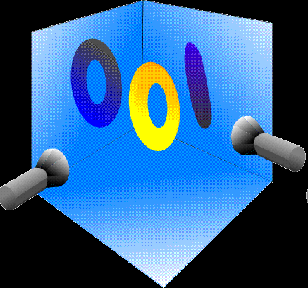
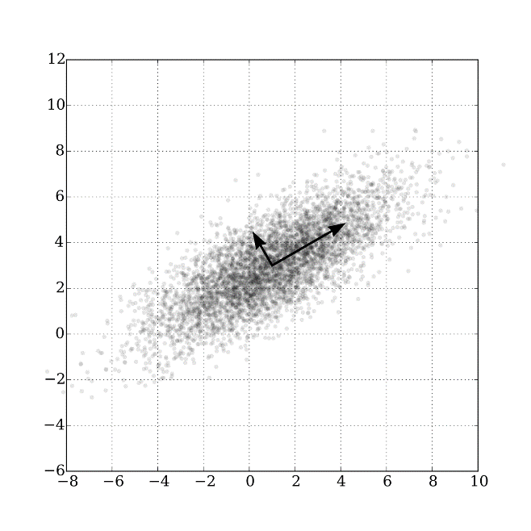
Principal Component Analysis (PCA)
PCA is a statistical procedure that orthogonally transforms the original n coordinates of a data set into a new set of n coordinates, called principal components.
$$\left({PC}_{1},{PC}_{2},⋯{PC}_{n}\right)=PCA\left(X_{1},X_{2},⋯X_{n}\right)$$
The first principal component ${PC}_{1}$ follows the direction (eigenvector) of the largest possible variance (largest eigenvalue of the covariance matrix) in the data.
Each succeeding component ${PC}_{k}$ follows the direction of the next largest possible variance under the constraint that it is orthogonal to (i.e., uncorrelated with) the preceding components $\left({PC}_{1},{PC}_{2},⋯{PC}_{k−1}\right)$.
If you’re still curious, there’s LOTS of different ways to think about PCA: https://stats.stackexchange.com/questions/2691/making-sense-of-principal-component-analysis-eigenvectors-eigenvalues
x₂
Image from Wikipedia
PC₂
PC₁
x₁

Slide 28
Principal Component Analysis (PCA)
${PC}_{1}$ describes most of the variability in the data, ${PC}_{2}$ adds the next big contribution, and so on. In the end, the last PCs do not bring much more information to describe the data.
Thus, to describe the data we could use only the top $m<n$ (i.e., ${PC}_{1},{PC}_{2},⋯{PC}_{m}$) components with little - if any - loss of information
Caveats:
Results of PCA are quite difficult to interpret
Normalization required
Only effective on numeric columns
Dimensionality Reduction

Slide 29
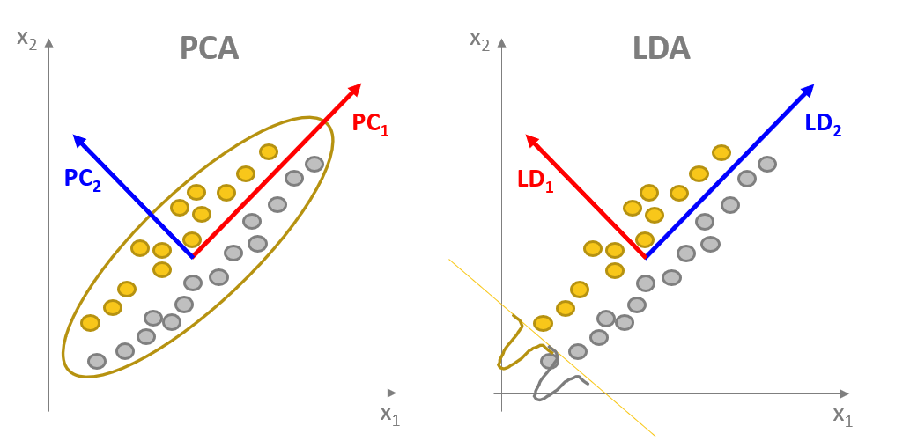
Linear Discriminant Analysis (LDA)
LDA is a statistical procedure that orthogonally transforms the original n coordinates of a data set into a new set of n coordinates, called linear discriminants.
$$\left({LD}_{1},{LD}_{2},⋯{LD}_{n}\right)=LDA\left(X_{1},X_{2},⋯X_{n}\right)$$
Here, however, discriminants (components) maximize the separation between classes
PCA : unsupervised
LDA : supervised

Slide 30
Linear Discriminant Analysis (LDA)
${LD}_{1}$ describes best the class separation in the data, ${LD}_{2}$ adds the next big contribution, and so on. In the end, the last LDs do not bring much more information to separate the classes.
Thus, for our classification problem we could use only the top $m<n$ (i.e., ${LD}_{1},{LD}_{2},⋯{LD}_{m}$) discriminants with little - if any - loss of information
Caveats:
Results of LDA are quite difficult to interpret
Normalization required
Only effective on numeric columns
Dimensionality Reduction

Slide 31
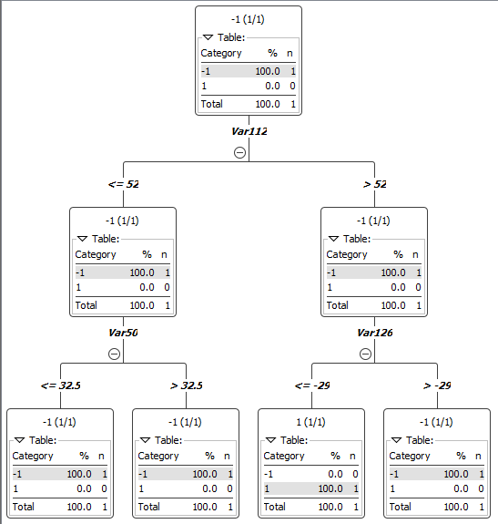
Ensembles of Shallow Decision Trees
Often used for classification, but can be used for feature selection too
Generate a large number (we used 2000) of trees that are very shallow (2 levels, 3 sampled features)
Calculate the statistics of candidates and selected features. The more often a feature is selected in such trees, the more likely it contains predictive information
Compare the same statistics with a forest of trees trained on a random dataset.

Slide 32
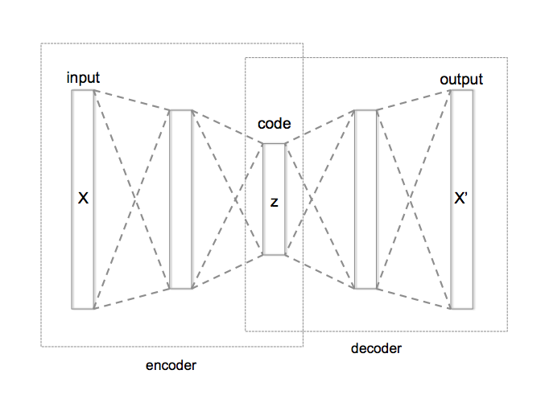
Autoencoder
Image: Wikipedia
Feed-Forward Neural Network architecture with encoder / decoder structure. The network is trained to reproduce the input vector onto the output layer.
That is, it compresses the input vector (dimension n) into a smaller vector space on layer “code” (dimension m<n) and then it reconstructs the original vector onto the output layer.
If the network was trained well, the reconstruction operation happens with minimal loss of information.

Slide 33
Record Selection and Sampling

Slide 34
Select Data: Record Selection
Record Selection: Select a subsample of the data that is still representative of the whole population
Reasons for using subsamples:
Faster Computation
Cross-Validation with training and test set
Timeliness: use more recent data to predict future events
Representativeness: Is the given sample matching the whole population? If not and we do have information about the true distribution, select a representative subsample. Choose under-represented cases more frequently.
Rare events: as above, rare events can be increased artificially by sampling with higher probability (over-sampling)

Slide 35
Select Data: Record Selection
Size of the subsample: Hoeffding inequality
$$P\left(\left|\overline{x}−E\left[x\right]\right|≥ε\right)≤2 exp\left(−\frac{2nε^{2}}{{\left(b−a\right)}^{2}}\right)$$
Instance selection: reduce data set to those cases that are really important for the modeling technique
Support Vector Machines: data close to boundaries are more relevant than internal ones
Clustering extension: attribute weight indicating how many similar records can be replaced

Slide 36
Missing Value Imputation

Slide 37
Missing Value Imputation: Motivation
Data is not always available
E.g., many tuples have no recorded value for several attributes, such as weight in a people database
Missing data may be due to:
Equipment malfunctioning (broken sensors)
Inconsistency with other recorded data and thus deleted
Data not entered (manually)
Data not considered important at the time of collection
Data format / contents of database changes
Refusal to answer a question
Irrelevant attribute for the corresponding object (pregnant (yes/no) for men)
Missing value might not necessarily be indicated as missing (instead: zero or default values).

Slide 38
Missing Values: Types
Types of missing values:
Example: Suppose you are modeling weight Y as a function of sex X
Missing Completely At Random (MCAR): the probability that a value for X is missing does neither depend on the value of X nor on other variables. There may be no particular reason why some people told you their weights and others didn’t.
Missing At Random (MAR): the probability that Y is missing depends only on the value of X. One sex X may be less likely to disclose its weight Y.
Not Missing At Random (NMAR): the probability that Y is missing depends on the unobserved value of Y itself. Heavy (or light) people may be less likely to disclose their weight.

Slide 39
Clean Data: Missing values
Some methods cannot deal with empty fields
Ignorance/Deletion
Can distort the data
Imputation
Estimate with regression, classification or domain knowledge
Mean, variance, variability of the data will be affected
Explicit Value or Variable
Introduce a special global constant (e.g. MISSING)

Slide 40
Missing Values Imputation
How to handle missing values?
Ignore/delete the record
Fill in (impute) missing value as:
Fixed value: e.g., “unknown”, -9999, -1 when only positive numbers in the domain, etc.
Attribute mean / median / mode
Attribute most frequent value
Next / previous /avg interpolation / moving avg value (in time series)
A predicted value based on the other attributes (inference-based such as Bayesian, Decision Tree, ...)

Slide 41
Outlier Detection

Slide 42
Clean Data: Outlier Detection
What are outliers?
Errors in measurements or exceptional conditions that don‘t describe the common functioning of the underlying system
Outliers are supposed to be rare: removing them affects the system less than a wrong value
Completely drop the case
Only remove/impute the suspicious values

Slide 43
Clean Data: Outlier Detection
An outlier is a value or data object that is far away or very different from all or most of the other data.
Causes for outliers:
Data quality problems (erroneous data coming from wrong measurements or typing mistakes)
Exceptional or unusual situations/data objects.
Outlier handling :
Outliers coming from erroneous data should be excluded from the analysis.
Even if the outliers are correct (exceptional data), it is sometimes useful to exclude them from the analysis.
For example, a single extremely large outlier can lead to completely misleading values for the mean value.

Slide 44
Outlier Detection: Single Attribute
Categorical Attributes
An outlier is a value that occurs with a frequency extremely lower than the frequency of all other values.
Example: Automatic quality control system
Goal: Train a classifier, classifying the parts as correct or with failures based on measurements of the produced parts.
The frequency of the correct parts will be so high that the parts with failure might be considered as outliers.
Numerical Attributes
Outliers in boxplots.
Statistical tests, for example Grubb’s test

Slide 45
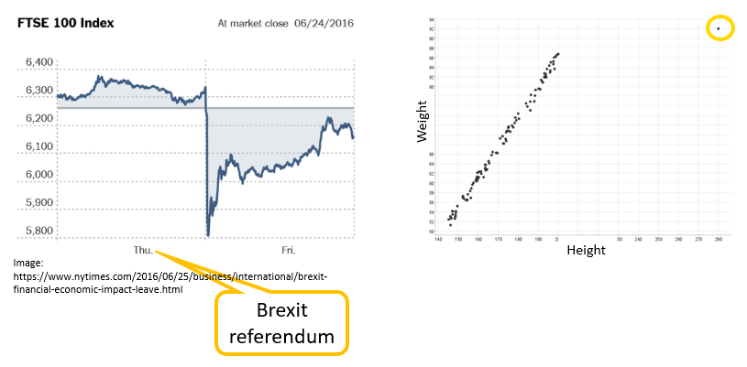
Outlier Detection
An outlier could be, for example, a rare behaviour, a system defect, a measurement error, or a reaction to an unexpected event

Slide 46
Outlier Detection: Motivation
Why finding outliers is important?
Summarize data by statistics that represent the majority of the data
Train a model that generalizes to new data
Finding the outliers can also be the focus of the analysis and not only data cleaning

Slide 47
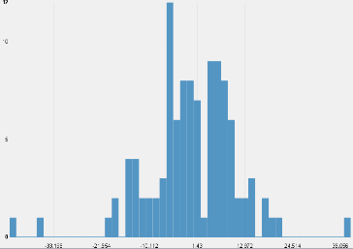
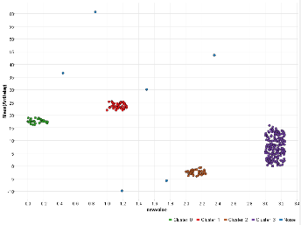
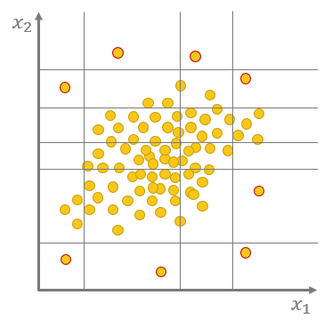
Outlier Detection Techniques
Knowledge-based
We know that a 200 year old person must be a mistake
We know that “A” in a number corpus is an outlier
Statistics-based
Distance from the median
Position in the distribution tails
Distance to the closest cluster center
Error produced by an autoencoder
Number of random splits to isolate a data point from other data

Slide 48
Outlier Detection Techniques
Quantile-based: Box plot
Distribution-based: Z-Score
Cluster-based: DBSCAN
Neural Autoencoder
Isolation Forest
…
Notes:
For credit card companies it is important to be able to recognize fraudulent credit card transactions so that customers are not charged for items that they did not purchase.
They could do so by using domain knowledge and using a rule based approach. The goal of this tutorial is to find out how we can train a model to support the credit card companies with a machine learning model to detect fraudulent transaction.
To train a model we can use transaction data from the past. If we are lucky we are in the first situation that eventhough most transaction are legitimate we have a dataset that has enough fraud examples so that we can train a classification model. This model can support credit card companies detecting fraud patterns that occured in the past. Here we could use then every supervised classification algorithm, like for example logistic regression or a random forest.
On the other hand we could also have a dataset with no or just a negligilble number of fraud examples. In this case we need to get more creative. If we assume, that the data describung a fraudulent transaction is different from the a legitimate transaction we can use anomaly or outlier detection techniques, for example a neural autoencoder or an isolation forest.
Let‘s find out how we can train these models.

Slide 49
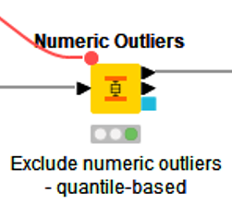
Quartile based (Box Plots)
Challenges:
Outliers in the data expand the quantiles
Skewed data might require different k to detect upper and lower outliers
One-dimensional
Median (Q2)
Q1
Q1-k*(Q3-Q1)
Flag data points outside the upper and lower whiskers of a box plot as outliers
Outlier

Slide 50
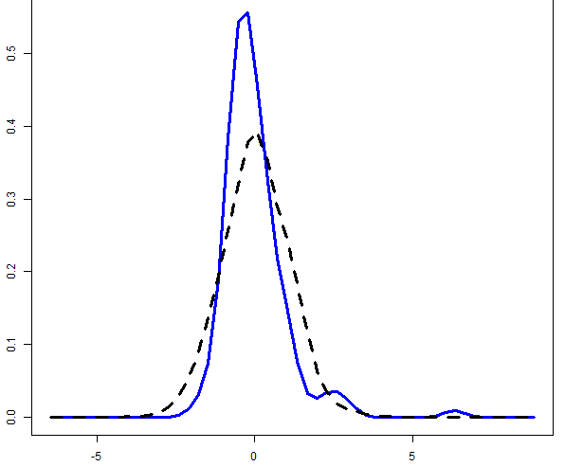
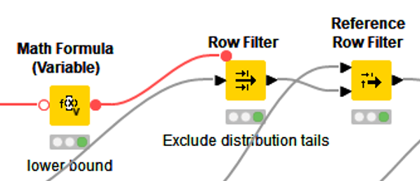
Statistics-based methods: z-score
Challenges:
Normality assumption
The parameters of the distribution are sensitive to outliers
Doesn’t work for data with a trend and seasonality
Standard Normal Distribution
$$z_{threshold}$$
Flag data points in the distribution tails as outliers
Outliers

Slide 51
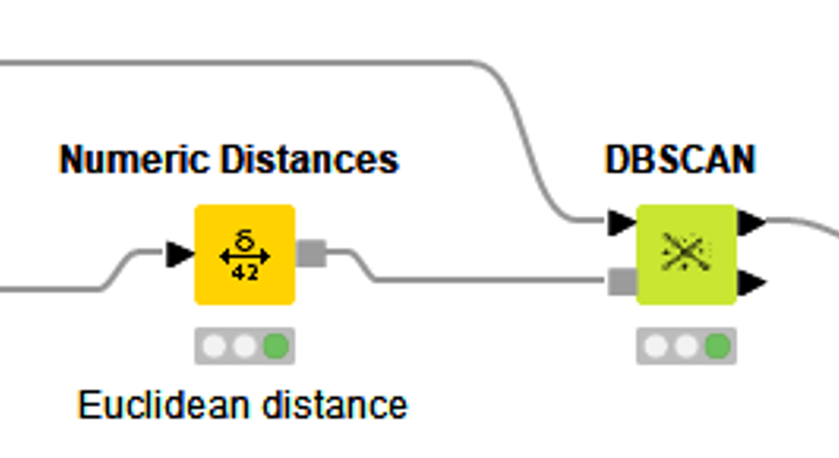
Clustering-based methods: DBSCAN
Challenges:
Quadratic runtime
Sensitive to the parameter values MinPts and $ε$
Clusters with varying densities are difficult to detect
Flag noise points outside the clusters as outliers
Density based clustering method that defines all data points as
Core points: at least MinPts neighbors within $ε$
Border points: within $ε$ from a core point
Noise points: all other data points
Outlier
Clusters

Slide 52
Neural Autoencoder
Distance between $x$ and $x‘$
→ possible outlier
Input Layer
Hidden Layers
Output Layer
Input $x$
Output $x‘$
Challenges:
Low interpretability
Requires large amounts of data
Notes:
$x^{′}=f_{4}({W_{4}f}_{3}\left(W_{3}f_{2}\left(W_{2}f_{1}\left(W_{1}x\right)\right)\right)$)

Slide 53
Isolation Forest
Idea: Outlier can be isolated with less random splits
$$x_{2}$$
$$x_{1}$$
$$x_{1}$$
$$x_{2}$$
$$x_{1}$$
$$x_{1}$$
$$x_{2}$$
$$x_{1}$$
$$x_{1}$$
$$x_{2}$$
$$x_{2}$$
$$x_{2}$$
$$x_{2}$$
$$x_{2}$$
$$x_{2}$$
$$x_{2}$$
$$x_{2}$$
$$x_{1}$$
$$x_{1}$$
$$x_{2}$$
$$x_{2}$$
$$x_{2}$$
$$x_{2}$$
$$x_{2}$$
$$x_{2}$$
$$x_{2}$$
$$x_{2}$$
$$x_{2}$$
$$x_{2}$$
$$x_{2}$$
$$x_{2}$$
$$x_{2}$$
$$x_{2}$$
$$x_{2}$$
$$x_{2}$$
$$x_{2}$$
$$x_{2}$$
$$x_{1}$$
$$x_{1}$$
$$x_{1}$$
$$x_{1}$$
$$x_{1}$$
$$x_{1}$$
$$x_{1}$$
$$x_{1}$$
$$x_{1}$$
$$x_{1}$$
$$x_{2}$$
$$x_{2}$$
$$x_{2}$$
$$x_{2}$$
$$x_{1}$$
$$x_{1}$$
$$x_{1}$$
$$x_{1}$$
$$x_{1}$$
$$x_{2}$$
$$x_{2}$$
$$x_{2}$$
$$x_{2}$$
$$x_{2}$$
$$x_{2}$$
$$x_{1}$$
$$x_{1}$$
$$x_{1}$$
$$x_{1}$$
$$x_{1}$$
$$x_{2}$$
$$x_{2}$$
$$x_{2}$$
$$x_{2}$$
$$x_{2}$$
$$x_{2}$$
$$x_{2}$$
$$x_{2}$$
$$x_{2}$$
$$x_{2}$$
$$x_{2}$$
$$x_{2}$$
$$x_{1}$$
$$x_{1}$$
$$x_{1}$$
$$x_{1}$$
$$x_{1}$$
$$x_{1}$$
$$x_{1}$$
$$x_{1}$$
$$x_{1}$$
$$x_{1}$$
$$x_{1}$$
$$x_{1}$$
$$x_{2}$$
$$x_{1}$$
$$x_{2}$$
$$x_{1}$$
$$x_{2}$$
$$x_{2}$$
$$x_{2}$$
$$x_{2}$$
$$x_{1}$$
$$x_{1}$$
$$x_{1}$$
$$x_{1}$$
$$x_{1}$$
$$x_{1}$$
$$x_{1}$$
$$x_{1}$$
$$x_{2}$$
$$x_{2}$$
$$x_{2}$$
$$x_{2}$$
$$x_{2}$$
$$x_{2}$$
$$x_{2}$$
$$x_{2}$$
Challenges:
Low interpretability
$$x_{2}$$
$$x_{2}$$
$$x_{2}$$
$$x_{2}$$
$$x_{2}$$
$$x_{1}$$
$$x_{2}$$
$$x_{1}$$
$$x_{2}$$
$$x_{1}$$
$$x_{2}$$
$$x_{1}$$
$$x_{1}$$
$$x_{1}$$
$$x_{1}$$
$$x_{2}$$
$$x_{2}$$
$$x_{2}$$
$$x_{2}$$
$$x_{2}$$
$$x_{2}$$
$$x_{2}$$
$$x_{2}$$

Slide 54
Data Cleaning and Standardization

Slide 55
Clean Data: Improve Data Quality
Single record investigation
Correct values in order to recognise differently spelled but semantically identical values
Converting capital letters into lower case
Removing spaces and void character
Fixing the mormat of numbers, date and time
Splitting fields containing mixed information (field overloading)
Using spell-checker or stemming
Replacing abbreviations with their long form
Normalizing the writing of addresses and names
Converting numerical values into standard units
Using dictionaries to check if all values map to domain knowledge
Multiple records investigation
Reduce redundance by merging records that are variant of the same entity
Record linkage (or entity resolution): merge records identified to be similar

Slide 56
Data Transformation: From Categorical to Numerical
From Categorical to Numerical
Binary attribute: numerical attribute with the values 0 and 1.
Ordinal attribute (“sortable”): enumerate in the correct order 1, . . . , k
Categorical attribute (not ordinal) with more than two values, say $a_{1}, …,a_{k}$, should not be converted into a single numerical attribute instead: convert to k attributes $A_{1}, …,A_{k}$with values 0 and 1.
$a_{i}$ is represented by $a_{i}=1$ and $a_{j}=0$for $i≠j$(1−of−n encoding).

Slide 57
Data Transformation: Discretization Techniques
From Numerical to Categorical
Splitting a numerical range into a number of bins
Equi-width discretization
Splits the range into intervals (bins) of the same length.
Equi-frequency discretization
Splits the range into intervals such that each interval (bin) contains (roughly) the same number of records.
V-optimal discretization
Minimizes $\sum_{i}{n_{i}V_{i}}$where $n_{i}$ is the number of data objects in the ith interval and $V_{i}$ is the sample variance of the data in this interval.
Minimal entropy discretization
Minimizes the entropy. (Only applicable in the case of classification problems.)

Slide 58
Normalization

Slide 59
Normalization: Motivation
For some data analysis techniques (e.g. PCA, MDS; cluster analysis) the influence of an attribute depends on the scale or measurement unit.
To guarantee impartiality, some kind of standardization or normalization should be applied.
Example:
Lengths in cm (100 – 200) and weights in kilogram (30 – 150) fall both in approximately the same scale
What about lengths in m (1-2) and weights also in gram (30000 – 150000)? → The weight values in mg dominate over the length values for the similarity of records!

Slide 60
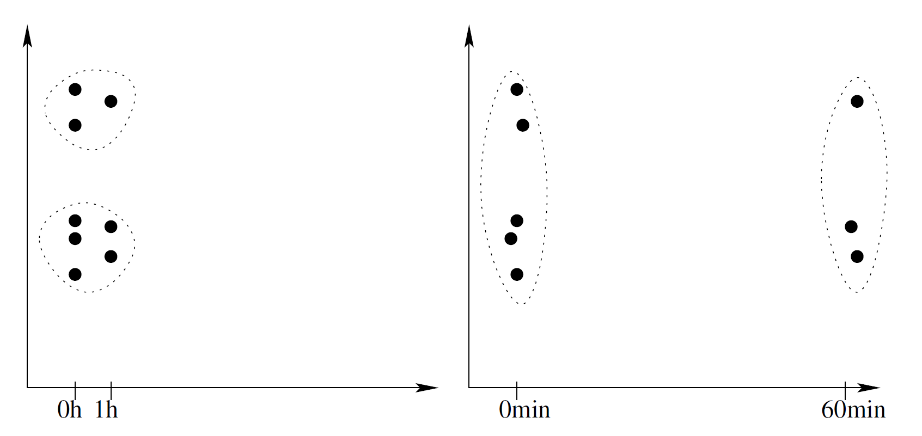
Normalization: Motivation
0h vs 1h can be expressed as 0min vs 60min
Goal of normalization:
Transformation of attributes to make record ranges comparable

Slide 61
Construct Data: Assure Impartiality
In absence of domain knowledge, different techniques can be applied
min–max normalization $n :dom X→\left[0,1\right], x⟼\frac{x−minX}{maxX−minX}$
z-score standardization $s :dom X →ℝ, x⟼ \frac{x − \hat{μ}X}{\hat{σ}X}$
robust z-score standardization $s :dom X →ℝ, x⟼ \frac{x − \tilde{x}}{IQR_{X}}$
decimal scaling $d :dom X → \left[0,1\right], x⟼\frac{x}{{10}^{s}}$
Both sensitive to outliers!

Slide 62
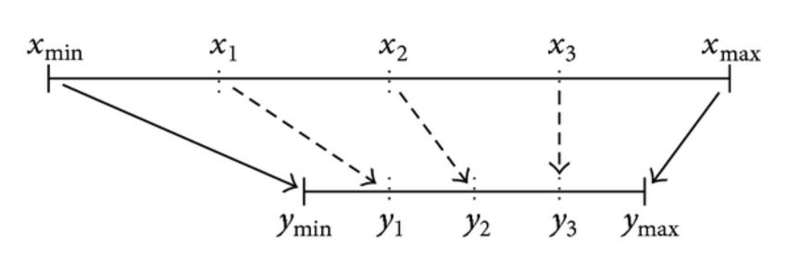
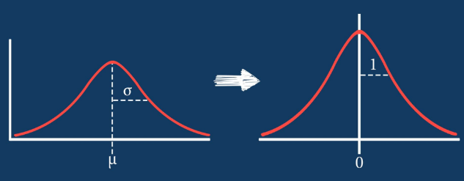
Normalization: Techniques
min-max normalization
z-score normalization
normalization by decimal scaling
$$n:dom\left(X\right)→[0,1]$$
$y=\frac{x−x_{min}}{x_{max}− x_{min}} \left(y_{max}− y_{min}\right)$ + $y_{min}$
$$s:dom\left(X\right)→ℝ$$
$$y=\frac{x −\hat{μ} (X)}{\hat{σ} (X)}$$
$$d:dom\left(X\right)→[0,1]$$
$y=\frac{x}{{10}^{j}}$ where j is the smallest integer value larger than $\log_{10}(max⁡(X))$

Slide 63
Feature Engineering

Slide 64
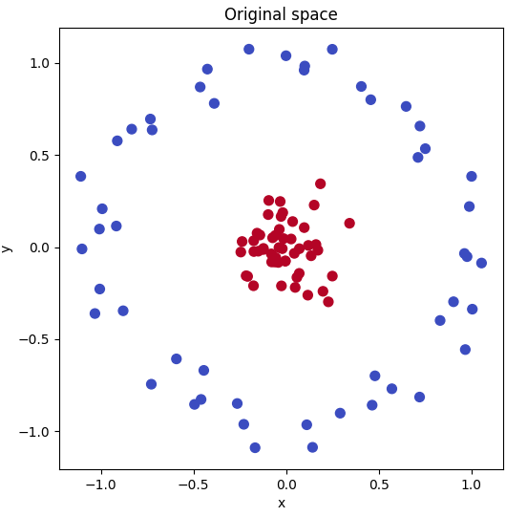
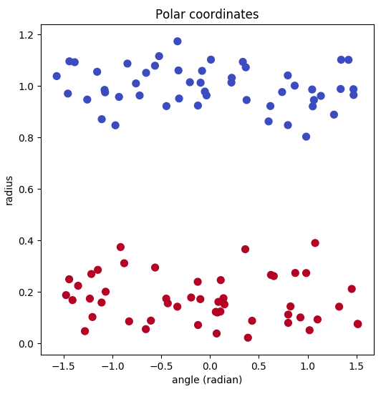
Feature Engineering: Motivation
Sometimes transforming the original data allows for better discrimination by ML algorithms.
Euclidean to polar coordinates
Radius $r=\sqrt{x^{2}+y^{2}}$
Angle $θ={Tan}^{−1}\left(y/x\right)$

Slide 65
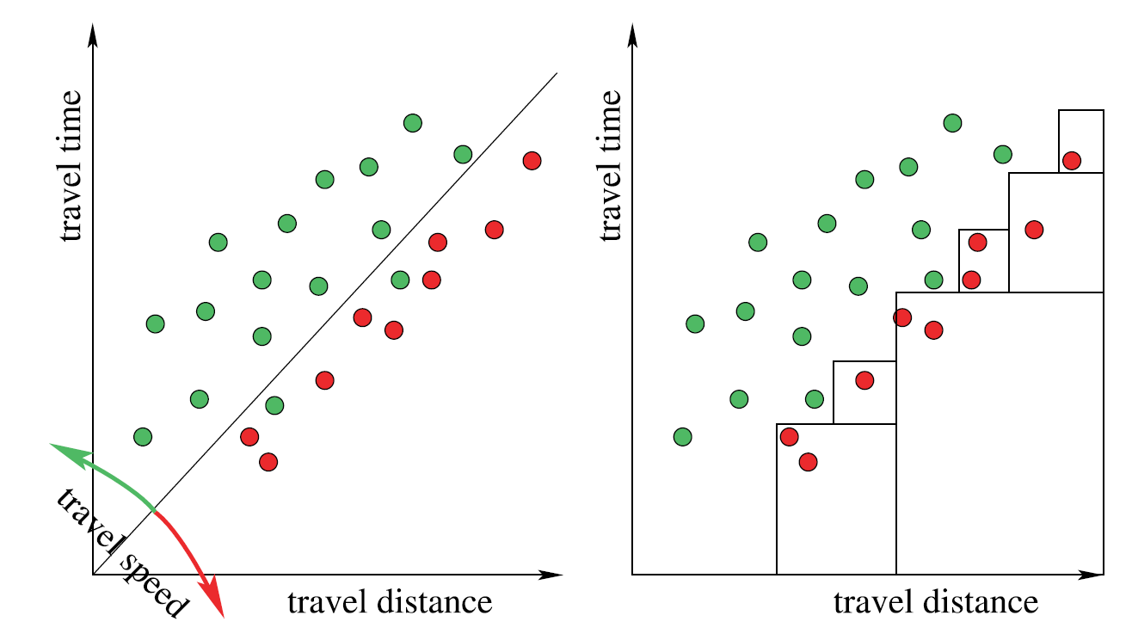
Construct Data: Maximize efficiency
Idea: Offering new features that were difficult to represent by the original model
Simple example for the usefulness of derived features: for a number of journeys, the travel time and distance are shown; the color indicates whether the driver was ticketed or not. Discriminating both classes with axis-parallel rectangles is laborious, but easy with a new attribute for travel speed
Notes:
Example P 145

Slide 66
Construct Data
Transformation of existing and construction of new attributes that may replace the original attributes
Provide operability
Data transformation is required by the model
Assure impartiality
Every attribute affects the model equally
Maximize efficiency
Exploit domain knowledge to improve the model results

Slide 67
Construct Data: Provide operability
Scale Conversion
Categorical $→$ Numerical: map categorical and ordinal values to a set of binary values
Numerical $→$ Categorical: Discretization (equal-width, equal-depth, V-optimal)
Dynamic Domains
Map original values to more abstract or general values
Newly occurring entries can be as well mapped to the generalized terms
Problem Reformulation
Reformulate a problem so that the range of applicable techniques is enlarged

Slide 68
Feature Engineering: Techniques
Coordinate Transformations
Remember PCA and LDA?
Polar coordinates , …
Distances to cluster centres, after data clustering
Simple math transformations on single columns
($ex$, $x2$, $x3$, $tanh⁡(x)$, $log⁡(x)$ , …)
Combining together multiple columns in math functions
($f(x1, x2, … xn)$, $x2 – x1$, …)
The whole process is domain dependent

Slide 69
Construct Data: Assure Impartiality
Some measures (e.g. Information gain) tend to prefere attributes with a large number of values. This can lead to overfitting
Reduce granularity of the data (e.g. ZIP code reduced to regional info)
Typical assumption: some variables obey a certain distribution (e.g. Gaussian)
Transform the data to better approximate the distribution using the power transform
$$y⟼\left\{\begin{aligned}\frac{y^{λ}−1}{λ{\overline{y}}^{(λ−1)}} if λ≠0 \\ \overline{y}\log{y if λ=0}\end{aligned}\right.$$

Slide 70
Construct Data: Maximize efficiency
Derived features (e.g. Average speed from travel time and travel distance)
Change the baseline (e.g. Define income „per household“ instead of „income per head“)
Grouping: add the attribute „group label“ after clustering analysis
Hyperplanes (e.g. Binary attribute that becomes true if n out m preselected features hold)
Level of granularity: test for dependencies at various level of detail
Nonlinearities: transform beforehand non linearly dependent variables in order to build a more complex linear model
Add metadata (e.g.indicating when data were altered)

Slide 71
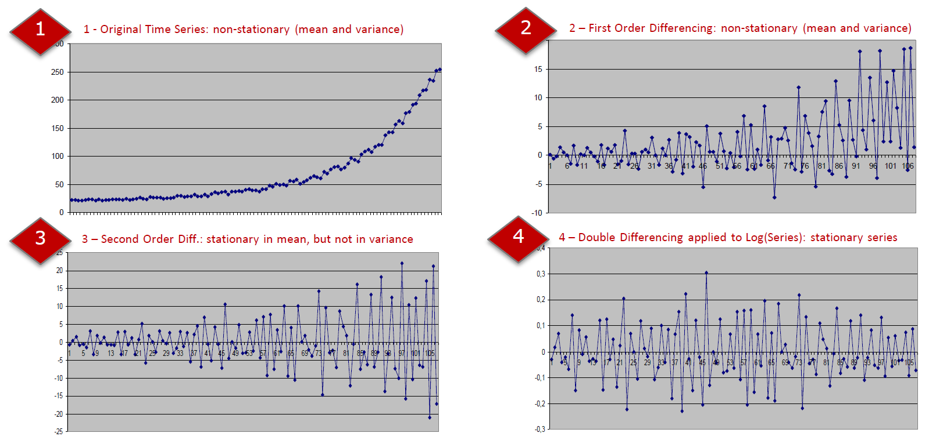
Feature Engineering in Time Series Analysis
Second order differences: $y= x(t) – x(t−1)$ & $y‘(t) = y(t) – y(t−1)$
Logarithm: $log⁡(y‘(t))$

Slide 72
Feature Construction: Example
Feature Construction refers to generating new features from the existing ones
Example: Find the best workers in a company.
Attributes :
the tasks, a worker has finished within each month,
the number of hours he has worked each month,
the number of hours that are normally needed to finish each task.
These attributes do contain information about the efficiency of the worker.
But instead of using these three “raw” attributes, it might be more useful to define a new attribute efficiency.
$$efficiency=\frac{hours actually spent to finish the tasks}{hours usually spent to finish the tasks}$$

Slide 73
Complex Data Types
Texts
Graphs
Images
Molecules
Other Objects

Slide 74
Feature Extraction
Especially for complex data types, feature extraction is required
Text data analysis. Frequency of keyword, . . .
Time series data analysis. Fourier or wavelet coefficients, . . .
Image data analysis. Fourier or wavelet coefficients, . . .
Graph data analysis. Number of vertices, number of edges, . . .

Slide 75
Data Integration

Slide 76
Data Integration
Shopper id | Item id | Price
p2 | i254 | 12.50
p5 | i4245 | 1.99
p5 | i32123 | 1.29
p5 | i254 | 12.50
p5 | i21435 | 5.99
p7 | i254 | 12.50
… | … | …
Vertical Data Integration (Concatenation)
Unify database structures
Remove duplicates
Horizontal Data Integration (Join)
Overrepresentation of items
Data explosion
id | Last name | First name | Gender
p2 | Mayer | Susan | F
p5 | Smith | Walter | M
p7 | Brown | Jane | F
… | … | … | …
+
Item id | Price | Last name | First name | Gender
i254 | 12.50 | Mayer | Susan | F
i4245 | 1.99 | Smith | Walter | M
i32123 | 1.29 | Smith | Walter | M
i254 | 12.50 | Smith | Walter | M
i21435 | 5.99 | Smith | Walter | M
i254 | 12.50 | Brown | Jane | F
… | … | … | … | …
The two data sets on top contain information about customers and product purchases. The joint data set at the bottom combines these two tables. Note how we loose information about individual customers and how a lot of duplicate information is introduced. In reality this effect is, of course, far more dramatic

Slide 77
Summary
Data Preparation
Feature Selection
Dimensionality Reduction
Record Selection and Sampling
Missing Values Imputation
Outlier Detection
Data Cleaning and Standardization
Normalization
Data Engineering
Data Integration

Slide 78
Practical Examples with KNIME Analytics Platform

Slide 79
Practical Example
Visual data-flow-oriented tool advantages
Intuitive Data Preparation
Easy repeatability and reproducibility
Steps:
Remove (almost) empty attributes and records
Normalization and Denormalization
Backward Feature Elimination

Slide 80
Practical Example
Remove (almost) empty attributes and records
Filtering columns and rows by manually inserted rules; then columns by missing value percentage and by constant value check; rows by outlier detection or missing values in any column

Slide 81
Practical Example
Normalization and Denormalization
This is how to apply normalization correctly in a data science problem. The normalization model is built on the training set and only applied on the test set! The same normalization model is used to denormalize the numerical attributes back into their original ranges

Slide 82
Practical Example
Backward Feature Elimination
Content of the Backward Feature Elimination metanode implementing the backward feature elimination procedure

Slide 83
Thank you

