Slide 1
Clustering

Slide 2
Summary of this lesson
„Data are becoming the new raw material of business”
-Craig Mundie
How do we find clusters of similar data objects?
*This lesson refers to chapter 7 of the GIDS book

Slide 3
Content of this lesson
Clustering
Similarity Measures
Hierarchical Clustering
  DIANE
  AGNES
Prototype or Model –based Clustering
  K-Means
Quality Measures
Gaussian Mixture Model
Density based Clustering
  DBScan

Slide 4
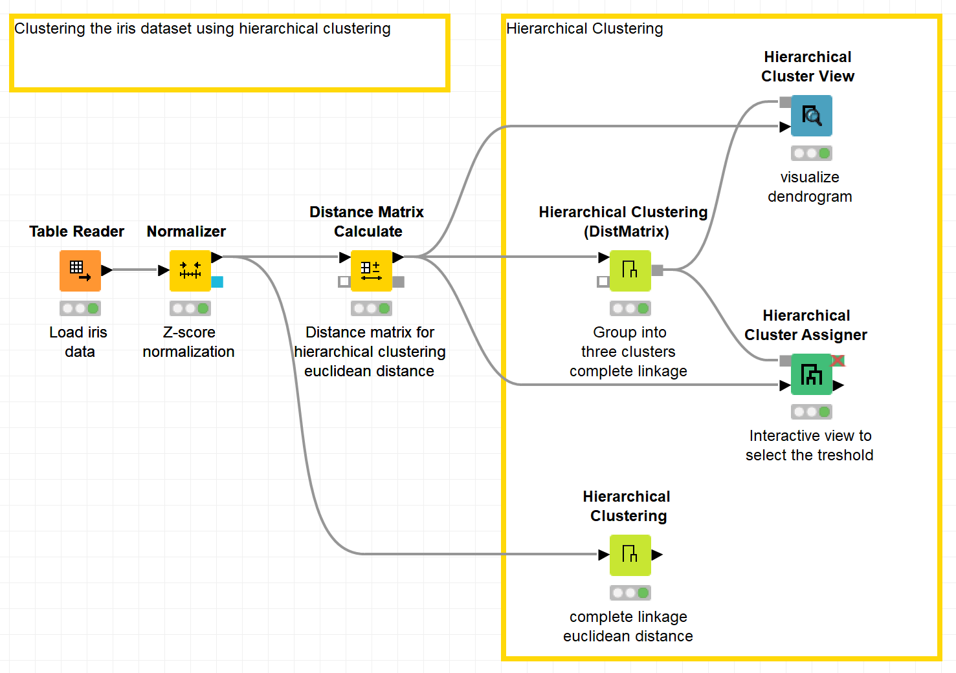
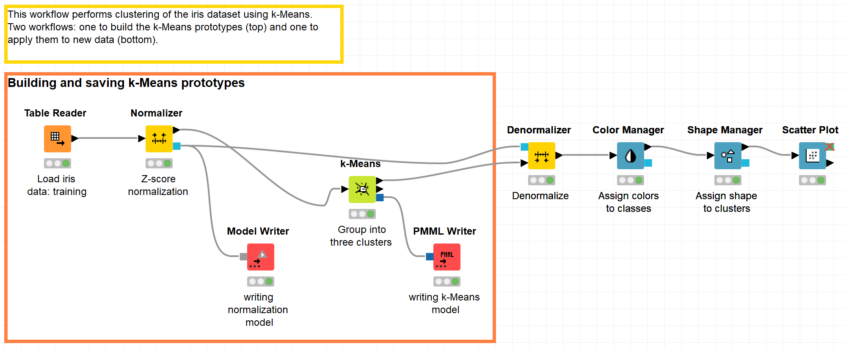
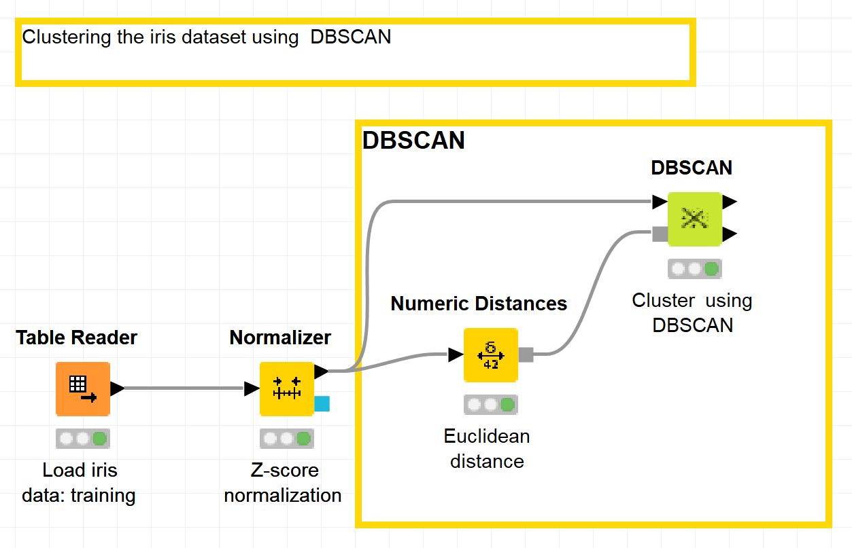
Datasets
Dataset used : iris dataset
Example Workflows:
  „Hiearchical Clustering“ https://kni.me/w/rlXFxYxQmbgNgSsM
    Normalization
    Distance calculation
    Hiearachical clustering
  „K-means clustering“ https://kni.me/w/t8UVEQH1sTTkus_w
    Partitioning
    Numeric error measures
  „DBSCAN“ https://kni.me/w/WgQVjVJugr9Nu24W
    Normalization
    Distance caluclation
    Clustering

Slide 5
Unsupervised Learning

Slide 6
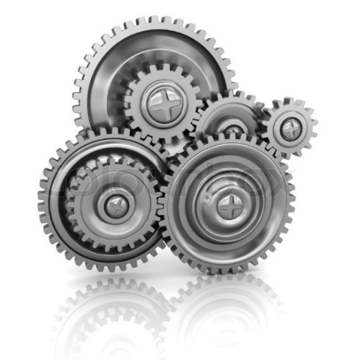



What is a Learning Algorithm?
Class
Label
Target
Output feature/attribute
Dependent variable
Input features
Input attributes
Independent variables
$$X = (x1, x2, … , xn)$$
$$y$$
Model
Model parameters
$y=f( β, X )$ $with β=[β1, β2, …, βm]$
A learning algorithm adjusts (learns) the model parameters $β$ throughout a number of iterations to maximize/minimize a likelihood/error function on $y$.

Slide 7
Algorithm Training / Learning
The model learns / is trained during the learning / training phase to produce the right answer y (a.k.a., label)
That is why machine learning ☺
Many different algorithms for three ways of learning:
  Supervised
  Unsupervised
  Semi-supervised

Slide 8

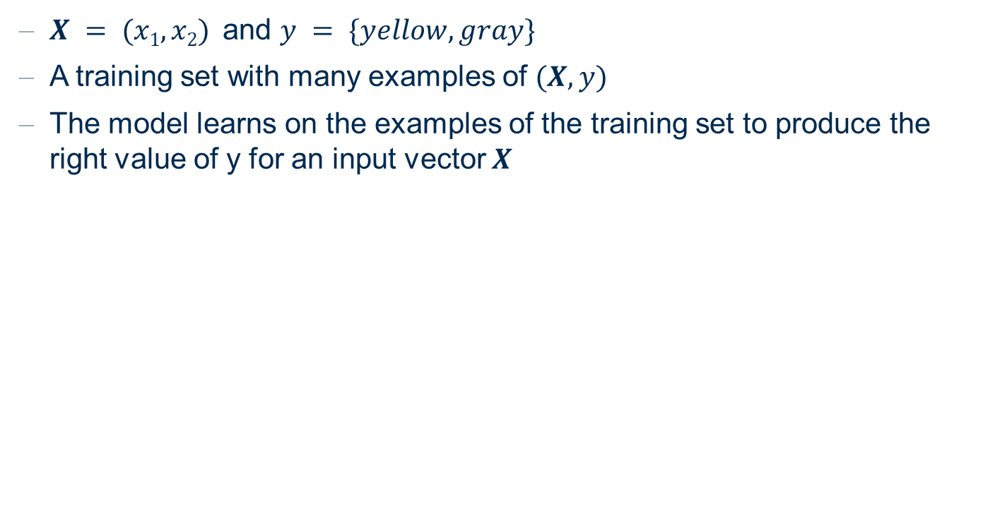

Supervised Learning
$X = (x1, x2)$and $y = \{yellow, gray\}$
A training set with many examples of $(X, y)$
The model learns on the examples of the training set to produce the right value of y for an input vector $X$
x₂
$$X$$
Age
Money
Temperature
Speed
Number of taxi
...
model
$$y$$
Sunny vs. Cloudy
Healthy vs. Sick
Churn vs. Remain
Increase vs. Deacrease
...
x₁

Slide 9
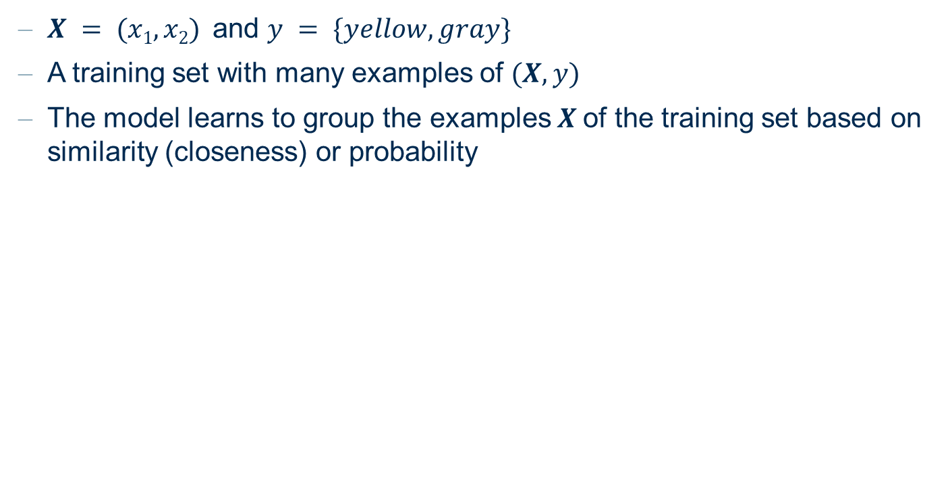
Unsupervised Learning
$X = (x1, x2)$and $y = \{yellow, gray\}$
A training set with many examples of $(X, y)$
The model learns to group the examples $X$of the training set based on similarity (closeness) or probability
model
x₂
$$X$$
Age
Money
Temperature
Speed
Number of taxi
...
x₁

Slide 10
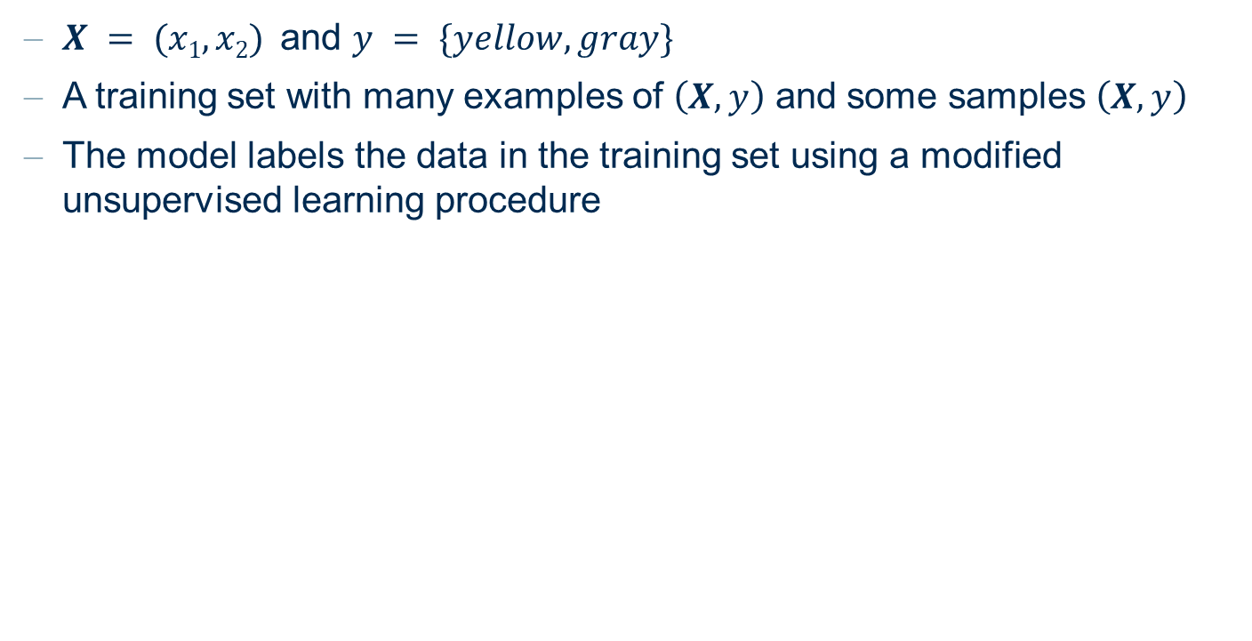
Semi-Supervised Learning
$X = (x1, x2)$and $y = \{yellow, gray\}$
A training set with many examples of $\left(X, y\right)$ and some samples $\left(X, y\right)$
The model labels the data in the training set using a modified unsupervised learning procedure
x₂
X
Age
Money
Temperature
Speed
Number of taxi
...
x₁

Slide 11
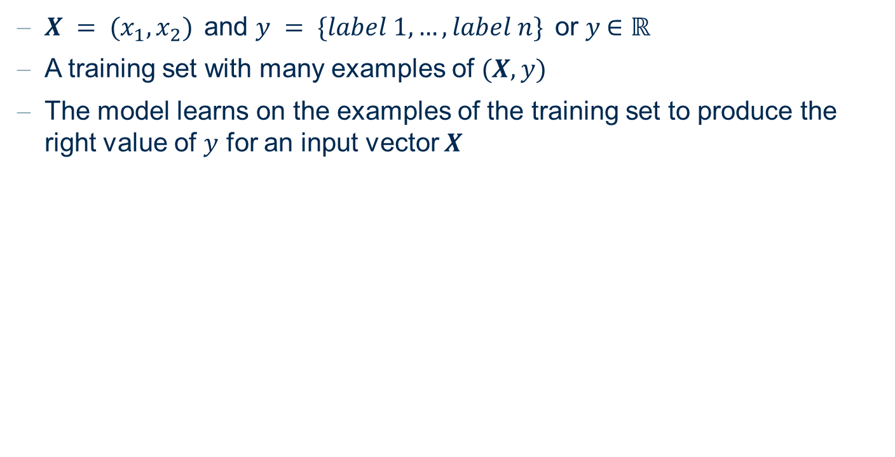
Supervised Learning: Classification vs. Numerical Predictions
$X = (x_{1}, x_{2})$and $y = \{label 1, …, label n\}$or $y$∈ ℝ
A training set with many examples of $(X, y)$
The model learns on the examples of the training set to produce the right value of $y$ for an input vector $X$
Classification
y = {yellow, gray}
y = {churn, no churn}
y = {increase, unchanged, decrease}
y = {blonde, gray, brown, red, black}
y = {job 1, job 2, ... , job n}
Numerical Predictions
y = temperature
y = number of visitors
y = number of kW
y = price
y = number of hours

Slide 12
Training vs. Testing: Partitioning
Training phase: the algorithm trains a model using the data in the training set
Testing phase: a metric measures how well the model is performing on data in a new dataset (the test set)
Training Set
Evaluation Set*
Test Set
* sometimes

Slide 13



Data Science: Process Overview
Train and apply model
Evaluate
performance
Partition data
Training Set
Train Model
Original
Data Set
Apply Model
Score Model
Test Set
Guide to Intelligent Data Science Second Edition, 2020

Slide 14
Supervised vs. Unsupervised Learning
Supervised Learning
Data with labels
Model with “information”

Slide 15
Supervised vs. Unsupervised Learning
Unsupervised Learning
Data without labels
Data with “information”

Slide 16
Finding Patterns

Slide 17
Finding Patterns
Patterns describe or summarize the data set or parts of it.
Finding patterns is an exploratory data analysis task. There is no specific target attribute whose values should be predicted as in supervised learning.
Methods that have already been discussed in the context of data understanding:
  Visualisation techniques like scatter plots or MDS are methods for finding patterns by visual inspection.
  Correlation analysis can find patterns in the form of dependencies of pairs of variables.

Slide 18
Finding Patterns
Cluster analysis. Identifying groups of “similar” data objects.
Association rules. Finding associations between attributes or typical combinations of values like:
IF Demand=high and Supply=low THEN Price=high.

Slide 19
Clustering

Slide 20
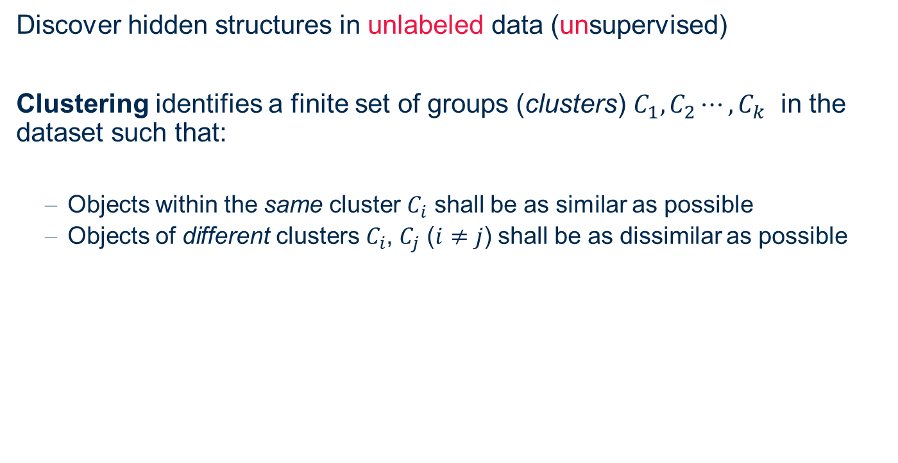
Goal of Cluster Analysis
Discover hidden structures in unlabeled data (unsupervised)
Clustering identifies a finite set of groups (clusters) $C_{1},C_{2}⋯, C_{k}$ in the dataset such that:
  Objects within the same cluster $C_{i}$ shall be as similar as possible
  Objects of different clusters $C_{i}$, $C_{j}$ ($i≠j$) shall be as dissimilar as possible

Slide 21
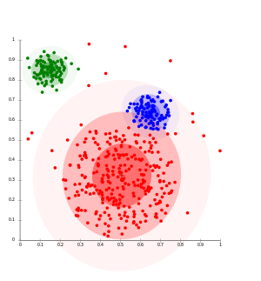
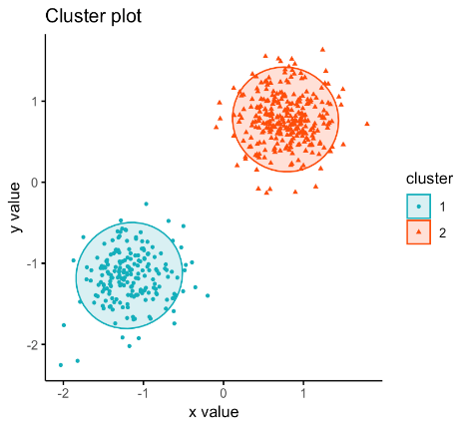
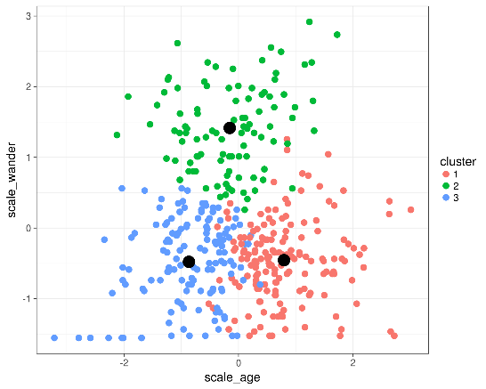
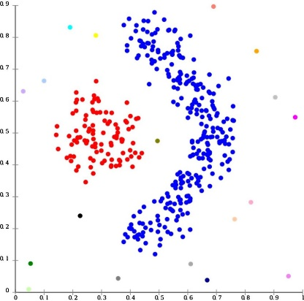
Cluster Properties
Clusters may have different sizes, shapes, densities
Clusters may form a hierarchy
Clusters may be overlapping or disjoint

Slide 22
Clustering Applications
Find “natural” clusters and desc
→ Data understanding
Find useful and suitable groups
→ Data Class Identification
Find representatives for homogenous groups
→ Data Reduction
Find unusual data objects
→ Outlier Detection
Find random perturbations of the data
→ Noise Detection

Slide 23
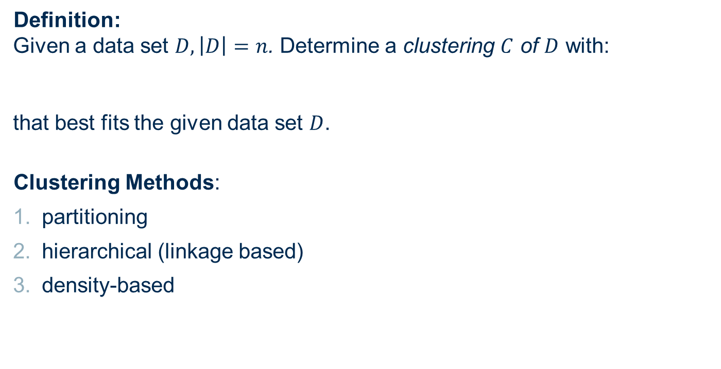
Clustering as Optimization Problem
Definition:
Given a data set $D, \left|D\right|=n$. Determine a clustering $C$ of $D$ with:
that best fits the given data set $D$.
Clustering Methods:
partitioning
hierarchical (linkage based)
density-based
where
and
$$\bigcup_{1≤i≤k}{C_{i}=D}$$
$$C=\left\{\begin{matrix}C_{1}\end{matrix},\begin{matrix}C_{2}, ⋯,\begin{matrix}C_{k}\end{matrix}\end{matrix}\right\}$$
$$C_{i}⊆D$$
Inside the space
Cover the whole space

Slide 24
Application Examples
Customer segmentation
  Find groups of customers with similar behaviour; find customers with unusual behavior
Molecule search
  Find molecules with similar structure to already working ones
Anomaly detection
  Find unusual patterns in data from sensors monitoring mechanical engines
Determining user groups on the WWW
  Clustering of activities in web-logs
  Find groups of social media users with similar attitude.
Structuring large sets of text documents
  hierarchical clustering of the text documents
Generating thematic maps from satellite images
  clustering sets of raster images of the same area (feature vectors)

Slide 25
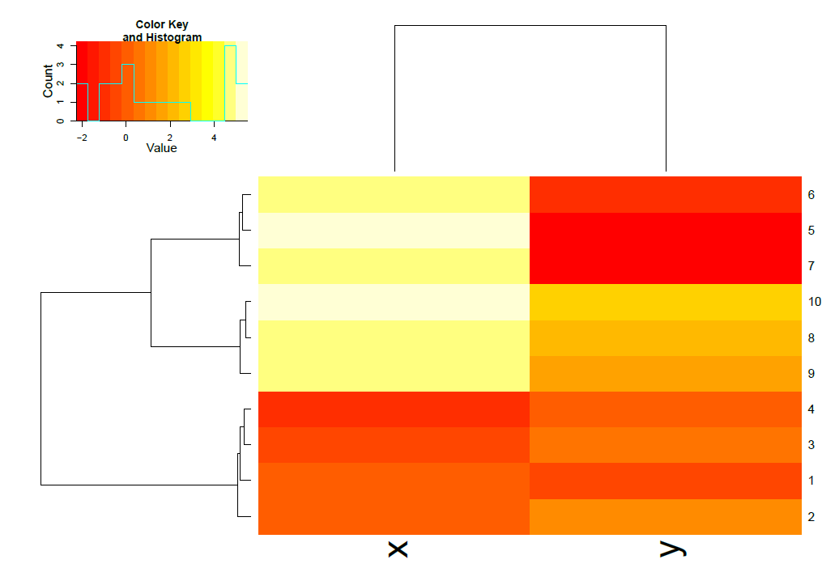
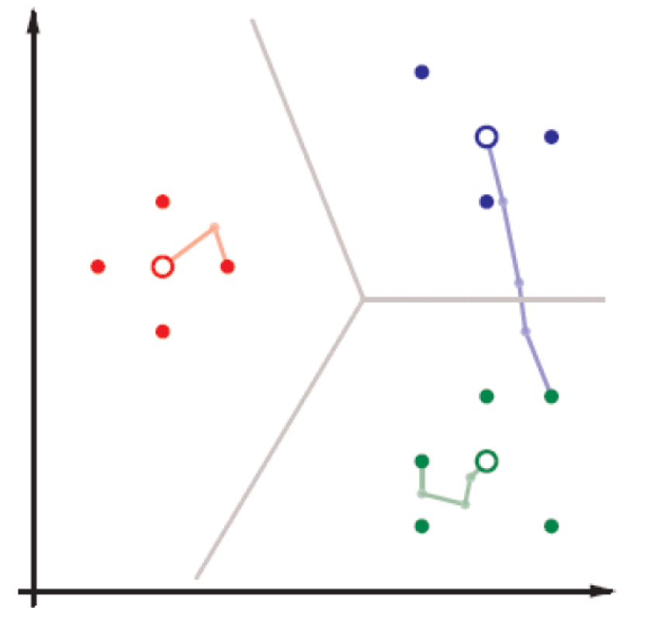
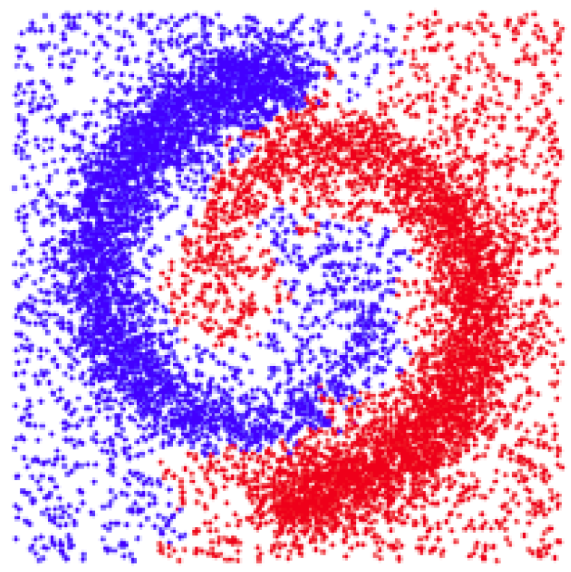
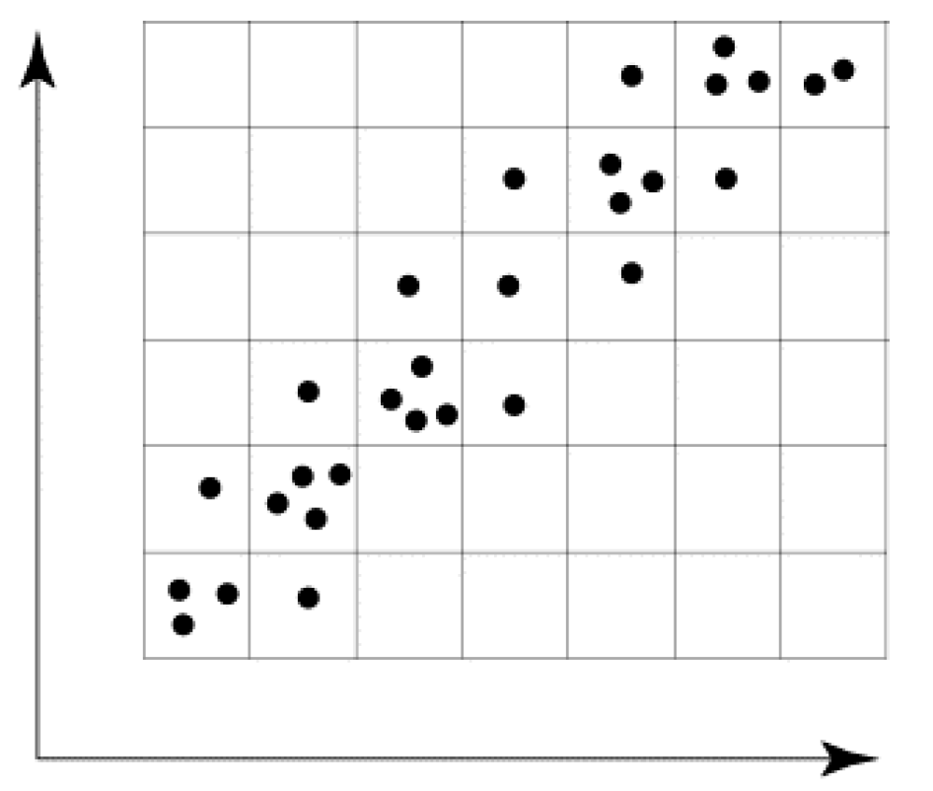
Types of Clustering Approach
Linkage Based
e.g. Hierarchical Clustering
Clustering by Partitioning
e.g. k-Means
Density based Clustering
e.g. DBSCAN
Grid based Clustering

Slide 26
Similarity Measures

Slide 27

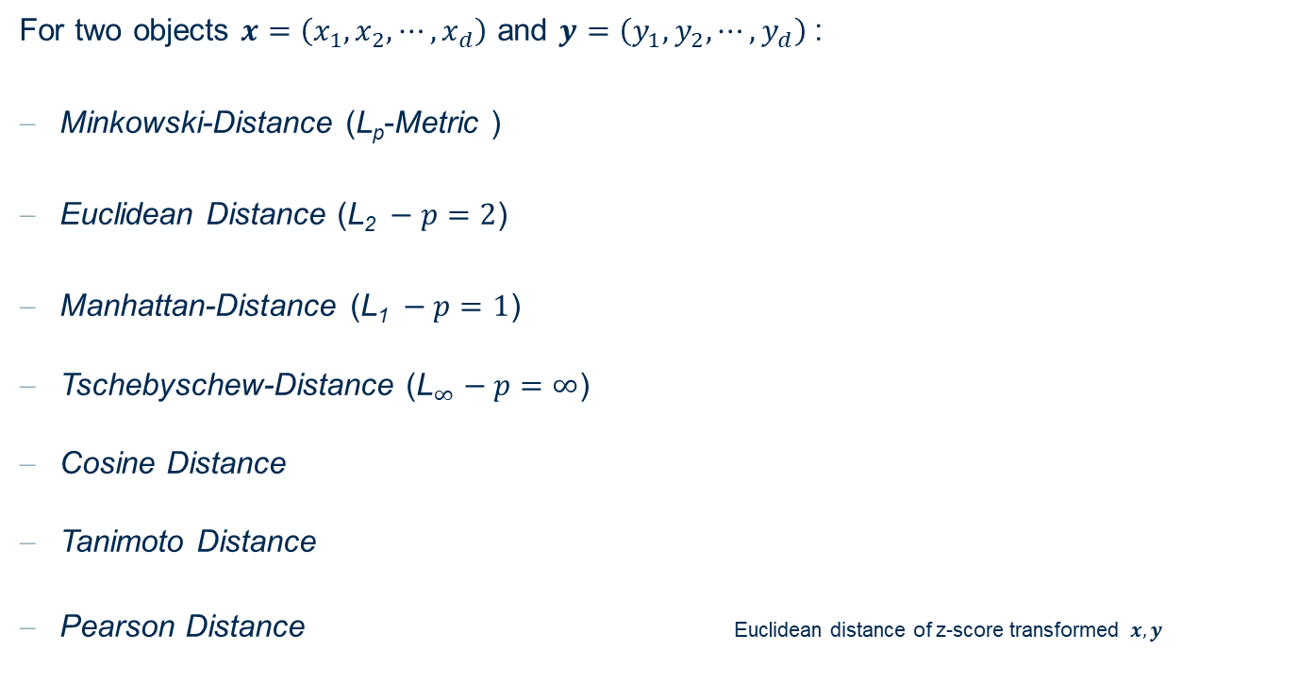

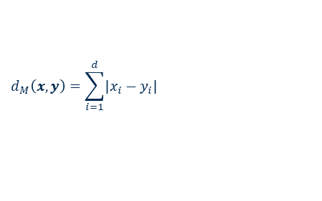
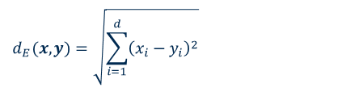
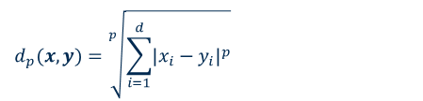

(Dis-)similarity Functions for Numeric Attributes
For two objects $x=\left(x_{1},x_{2},⋯,x_{d}\right)$ and $y=\left(y_{1},y_{2},⋯,y_{d}\right)$:
Minkowski-Distance (L_{p}-Metric )
Euclidean Distance ($\text{L}\text{2} −p=2$)
Manhattan-Distance ($\text{L}\text{1} −p=1$)
Tschebyschew-Distance (${\text{L}}_{∞}−p=∞$)
Cosine Distance
Tanimoto Distance
Pearson Distance Euclidean distance of z-score transformed $x,y$
$$d_{p}(x,y)=\sqrt[p]{\sum_{i=1}^{d}{{\left|x_{i}−y_{i}\right|}^{p}}}$$
$$d_{E}(x,y)=\sqrt{\sum_{i=1}^{d}{{\left(x_{i}−y_{i}\right)}^{2}}}$$
$$d_{M}\left(x,y\right)=\sum_{i=1}^{d}{\left|x_{i}−y_{i}\right|}$$
$$d_{∞}\left(x,y\right)=\max_{1≤i≤d}\left\{\left|x_{i}−y_{i}\right|\right\}$$
$$d_{C}\left(x,y\right)=1 − \frac{x^{T}y}{\left\|x\right\|\left\|y\right\|}$$
$$d_{T}\left(x,y\right)=1 − \frac{x^{T}y}{{\left\|x\right\|}^{2}+{\left\|y\right\|}^{2}−x^{T}y}$$

Slide 28
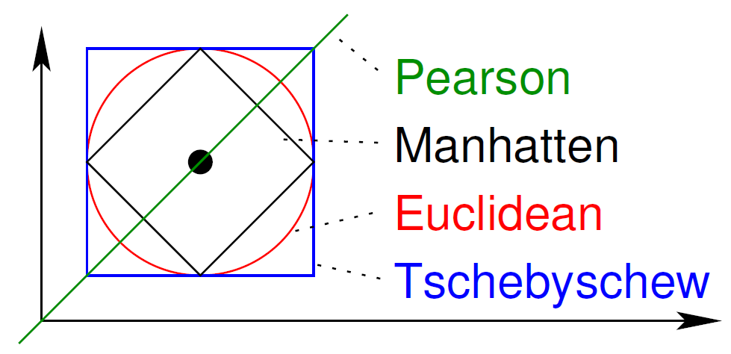
(Dis-)similarity Functions for Numeric Attributes
Various choice of dis-similarity between two numerical vectors

Slide 29
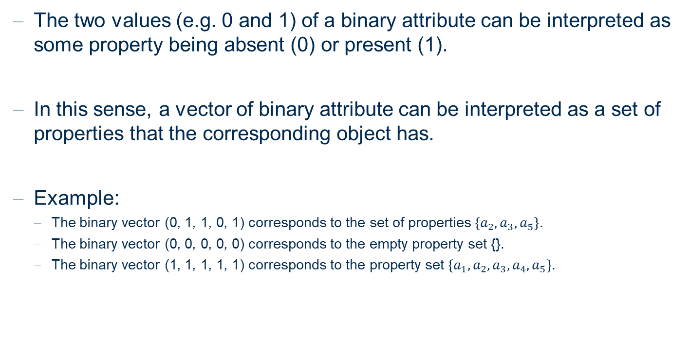
(Dis-)similarity Functions for Binary Attributes
The two values (e.g. 0 and 1) of a binary attribute can be interpreted as some property being absent (0) or present (1).
In this sense, a vector of binary attribute can be interpreted as a set of properties that the corresponding object has.
Example:
  The binary vector (0, 1, 1, 0, 1) corresponds to the set of properties $\left\{a_{2}, a_{3}, a_{5}\right\}$.
  The binary vector (0, 0, 0, 0, 0) corresponds to the empty property set {}.
  The binary vector (1, 1, 1, 1, 1) corresponds to the property set $\left\{{a_{1},a}_{2}, a_{3},a_{4},a_{5}\right\}$.

Slide 30

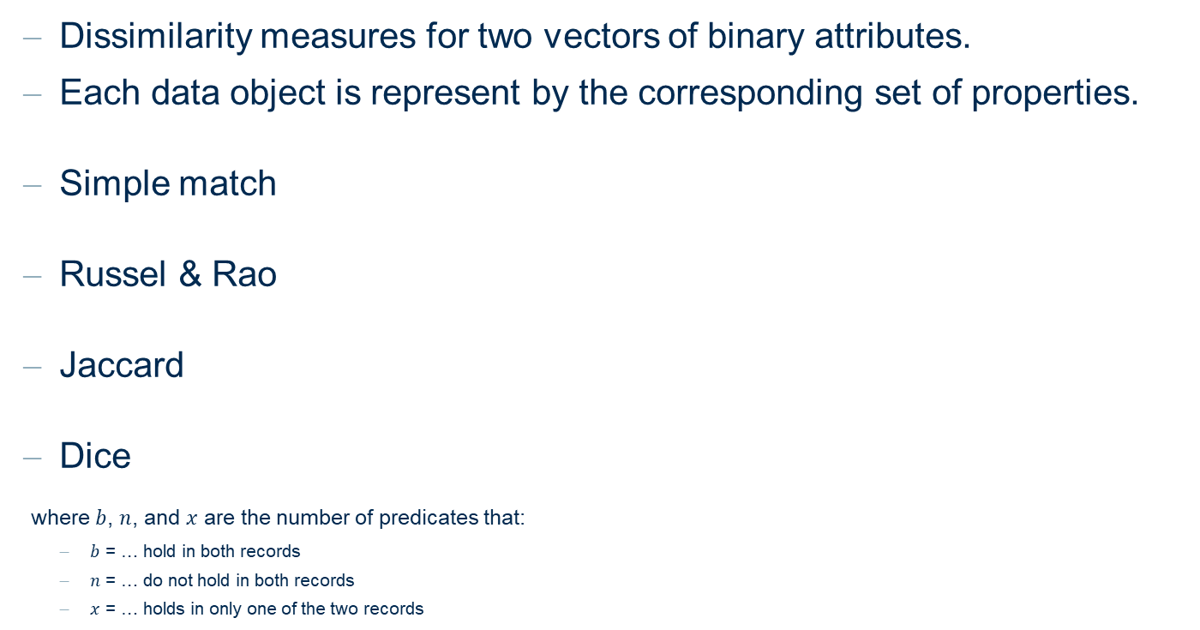



(Dis-)similarity Functions for Binary Attributes
Dissimilarity measures for two vectors of binary attributes.
Each data object is represent by the corresponding set of properties.
Simple match
Russel & Rao
Jaccard
Dice
where $b$, $n$, and $x$ are the number of predicates that:
  $b$ = … hold in both records
  $n$ = … do not hold in both records
  $x$ = … holds in only one of the two records
$$d_{S}=1− \frac{b+n}{b+n+x}$$
$$d_{R}=1− \frac{b}{b+n+x}$$
$$d_{J}=1− \frac{b}{b+x}$$
$$d_{D}=1− \frac{2b}{2b+x}$$

Slide 31
Defining Distance – Text Data & Time Series
For text data, convert to bag-of-words
Word frequency vectors are normalized according to the text length
Cosine measures to assess similarity between documents
For time series or text data, apply z-score transformation to the data
Euclidean distance ➔ Pearson metric
Invariant to shifting – useful for embedded time series with different offsets

Slide 32
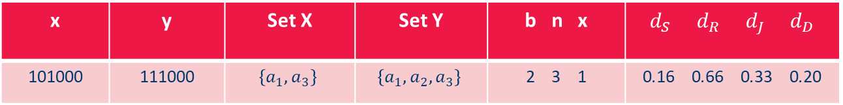
(Dis-)similarity Functions for Binary Attributes
Example:
x | y | Set X | Set Y | b n x | $d_{S}$ $d_{R}$ $d_{J}$ $d_{D}$
101000 | 111000 | $$\left\{a_{1}, a_{3}\right\}$$ | $$\left\{a_{1}, a_{2},a_{3}\right\}$$ | 2 3 1 | 0.16 0.66 0.33 0.20

Slide 33
(Dis-)similarity Functions for Ordinal Attributes
Convert to a binary vector – similar in closer categories
Convert to a numerical rank
Example:
Number of previous owners | Binary Vector
1 previous owner | 100
2 previous owners | 110
More than 2 previous owners | 111
Number of previous owners | Rank
1 previous owner | 1
2 previous owners | 2
More than 2 previous owners | 3

Slide 34
(Dis-)similarity Functions for Nominal Attributes
Nominal attributes may be transformed into a set of binary attributes, each of them indicating one particular feature of the attribute (1-of-n encoding).
Example:
  Attribute “Manufacturer” with 6 possible values BMW, Chrysler, Dacia, ... .
  Then one of the dissimilarity measures for binary attribute can be applied.
Manufacturer | Binary Vector
Volkswagen | 000001
Dacia | 000010
Ford | 100000

Slide 35
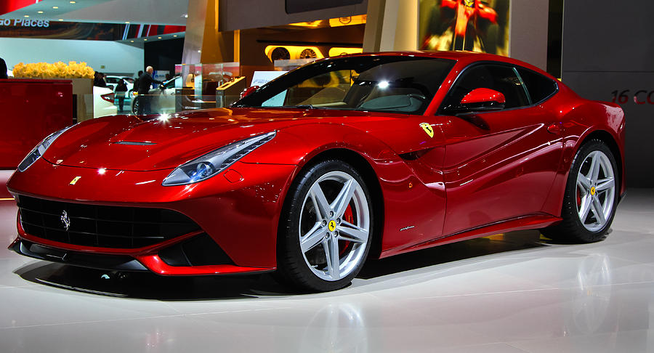
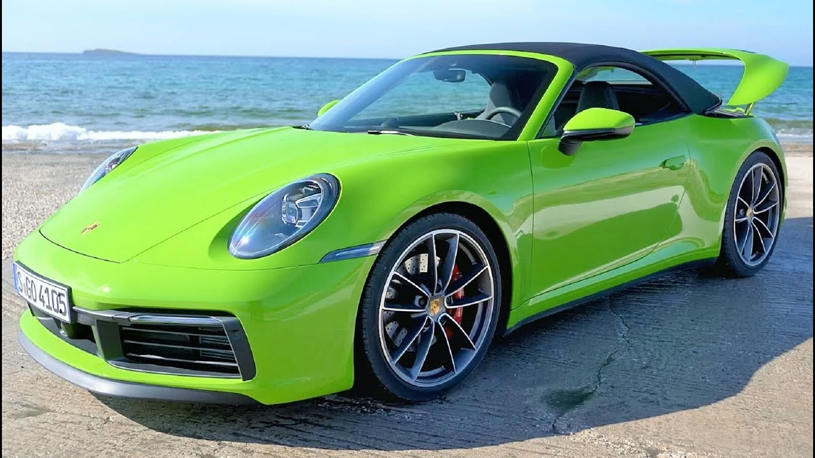
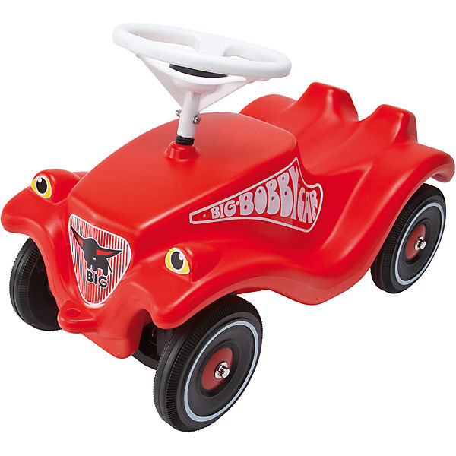
Influence of Distance Function / Similarity
Clustering vehicles:
  red Ferrari
  green Porsche
  red Bobby car
Distance Function based on maximum speed
(numeric distance function):
  Cluster 1: Ferrari & Porsche
  Cluster 2: Bobby car
Distance Function based on color
(nominal attributes):
  Cluster 1: Ferrari and Bobby car
  Cluster 2: Porsche
The distance function affects the shape of the clusters

Slide 36
Hierarchical Clustering

Slide 37
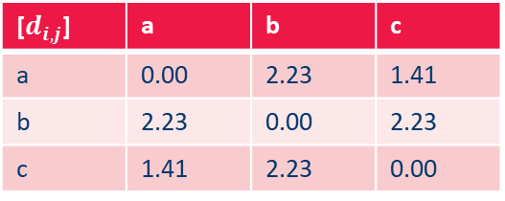
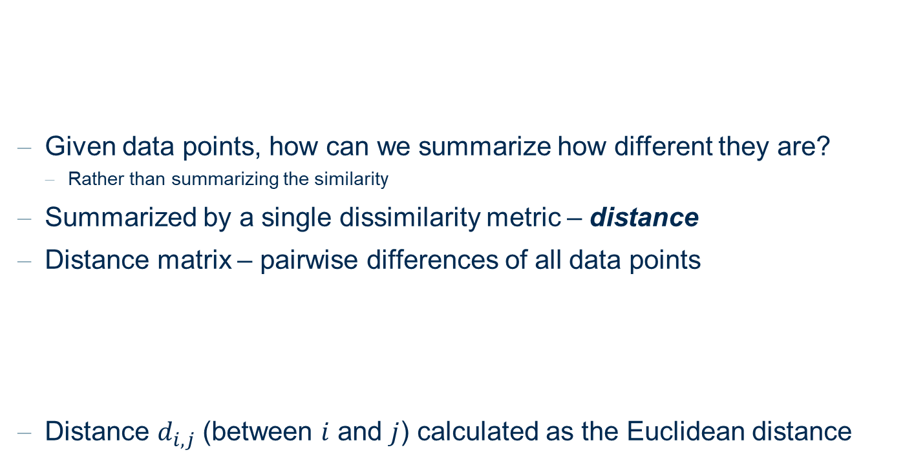
Similarities, Dissimilarities, and Distances
id | X | Y
a | 1 | 2
b | 3 | 3
c | 2 | 1
b
Given data points, how can we summarize how different they are?
  Rather than summarizing the similarity
Summarized by a single dissimilarity metric – distance
Distance matrix – pairwise differences of all data points
Distance $d_{i,j}$ (between $i$ and $j$) calculated as the Euclidean distance
a
c
[$d_{i,j}$] | a | b | c
a | 0.00 | 2.23 | 1.41
b | 2.23 | 0.00 | 2.23
c | 1.41 | 2.23 | 0.00

Slide 38
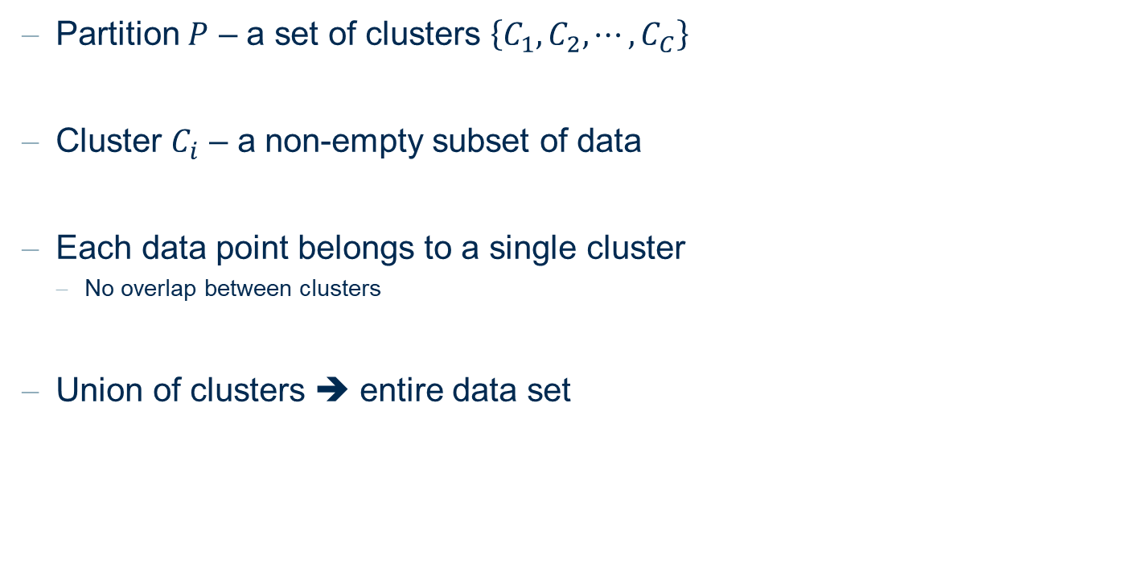
Partitions and Clusters
Partition $P$ – a set of clusters $\left\{C_{1}, C_{2}, ⋯, C_{C}\right\}$
Cluster $C_{i}$ – a non-empty subset of data
Each data point belongs to a single cluster
  No overlap between clusters
Union of clusters ➔ entire data set

Slide 39
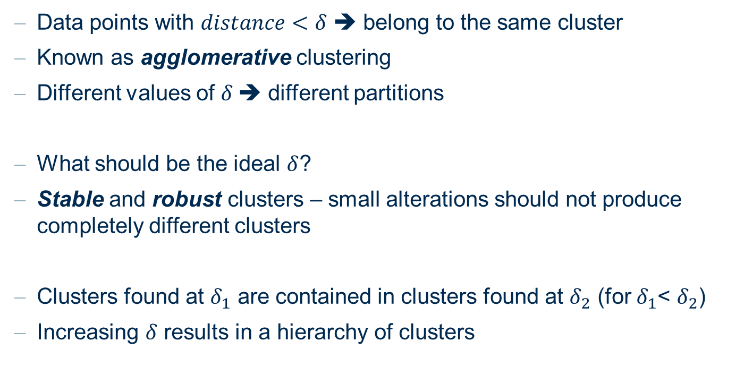
Agglomerative Hierarchical Clustering
Data points with $distance<δ$ ➔ belong to the same cluster
Known as agglomerative clustering
Different values of $δ$➔ different partitions
What should be the ideal $δ$?
Stable and robust clusters – small alterations should not produce completely different clusters
Clusters found at $δ_{1}$ are contained in clusters found at $δ_{2}$ (for $δ_{1}$< $δ_{2}$)
Increasing $δ$ results in a hierarchy of clusters

Slide 40
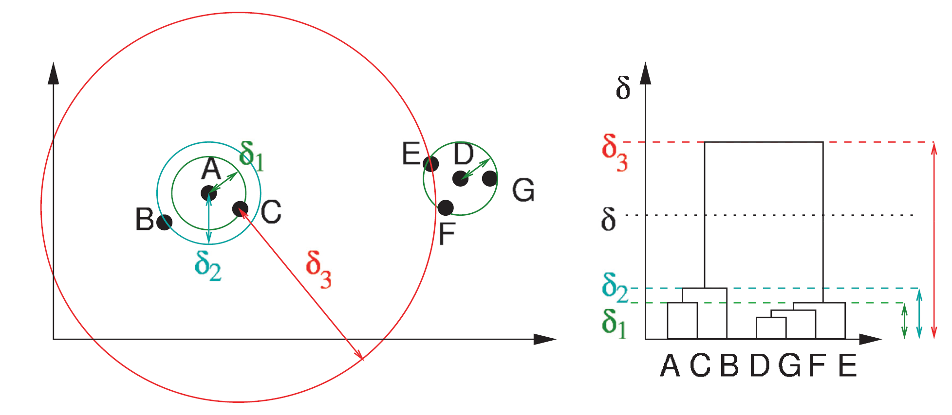

Hierarchy of Clusters
Described by a dendrogram
  At $δ=0$ ➔ 7 clusters of singletons
  At $δ=d\left(D,G\right)$ ➔ D & G form a cluster, all others are singleton clusters
  At $δ=d\left(A,C\right)$ ➔ A & C form a cluster, B remains a singleton, D, E, F, & G is another cluster
  And so on

Slide 41
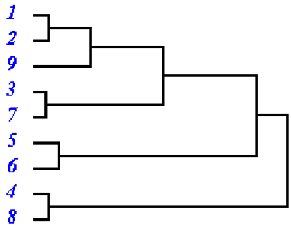
Linkage Hierarchies: Basics
Goal
Construction of a hierarchy of clusters (dendrogram)
by merging/separating clusters with minimum/maximum distance
Dendrogram:
A tree representing a hierarchy of clusters,
with the following properties:
  Root: single cluster with the whole data set.
  Leaves: clusters containing a single object.
  Branches: merges / separations between larger
  clusters and smaller clusters / objects
Distance

Slide 42
Linkage Hierarchies: Basics
Example dendrogram
Types of hierarchical methods
  Bottom-up construction of dendrogram (agglomerative)
  Top-down construction of dendrogram (divisive)
distance between
clusters

Slide 43
Agglomerative vs. Divisive Hierarchical Clustering
step 1
step 2
step 3
step 4
step 5
AGlomerative NESting
(AGNES)
A
A,B
B
A,B,C,D,E
C
C,D,E
D
D,E
E
DIvisive ANAlysis
(DIANA)
step 5
step 4
step 3
step 2
step 1

Slide 44
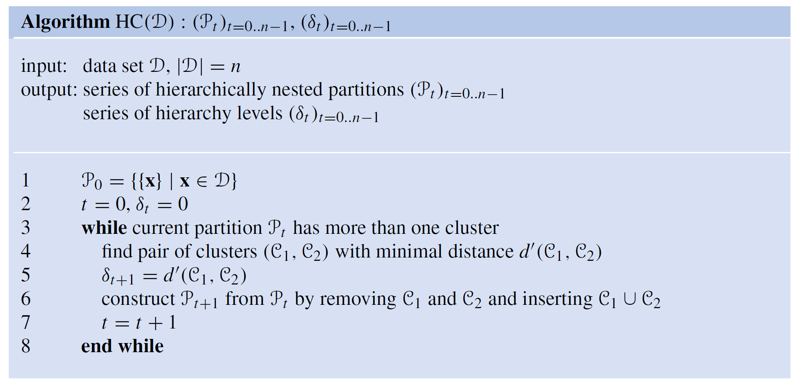

Clustering algorithm
Start at $δ=0$, with each data point as a cluster
Calculate the distance matrix between all clusters
Merge the two clusters with smallest distance
Go back to re-calculate the distance matrix
Repeat until there is only a single cluster

Slide 45
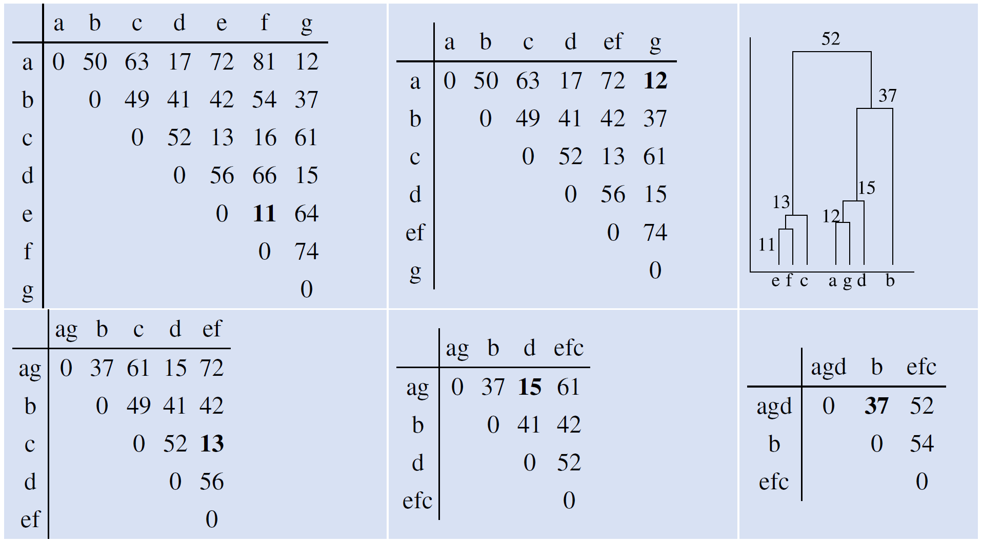
Clustering algorithm
Example: Distance matrix at each iteration of cluster forming

Slide 46
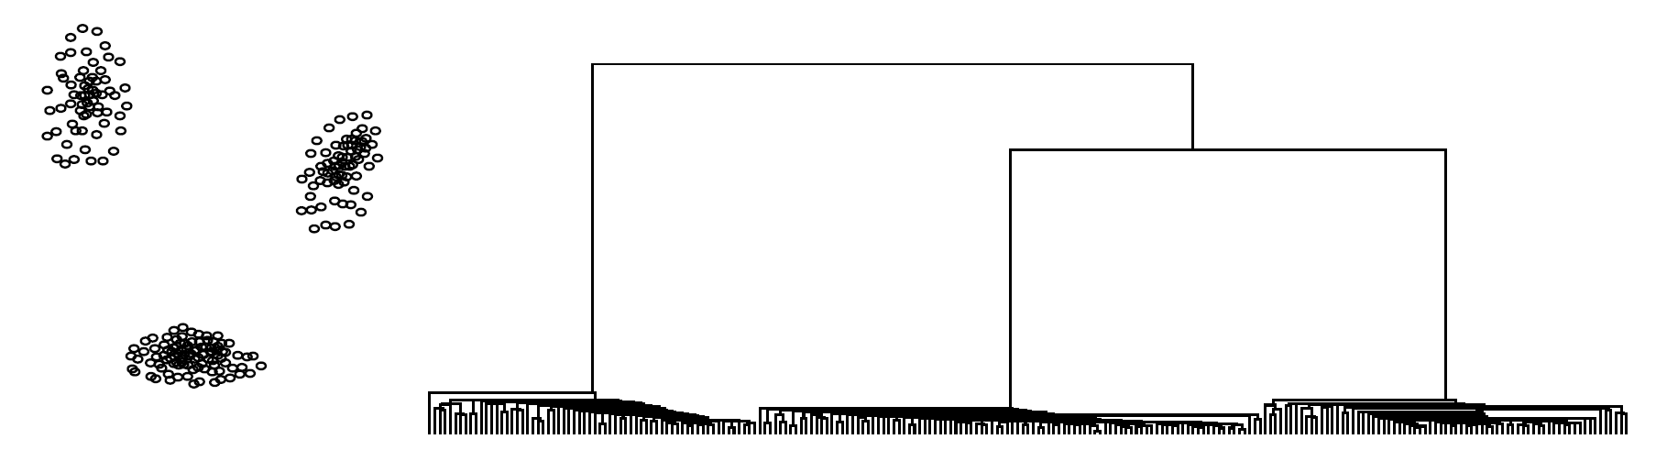

Hierarchy of Clusters (Examples)
Three well-separated clusters
Formed with small $δ$
Remains stable for a wide range of $δ$ (until large $δ$)

Slide 47
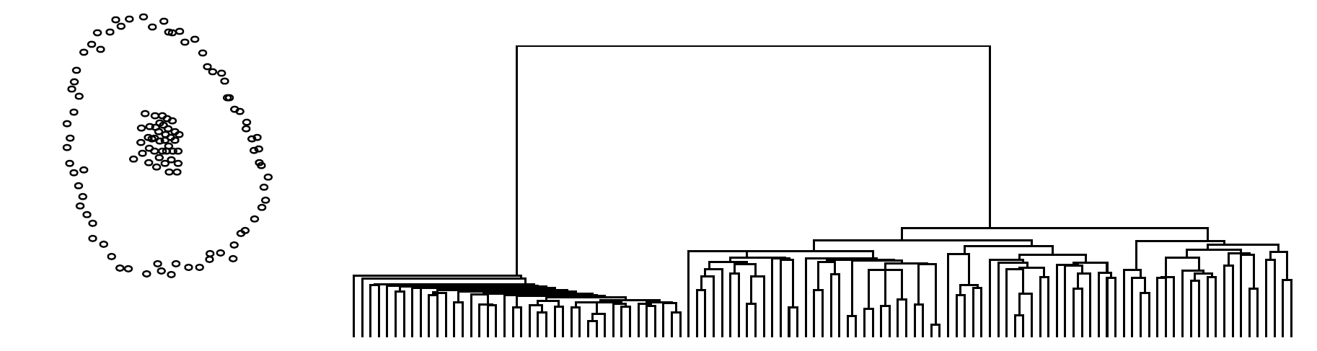
Hierarchy of Clusters (Examples)
Two well-separated clusters
Clusters differ in sizes and shapes

Slide 48
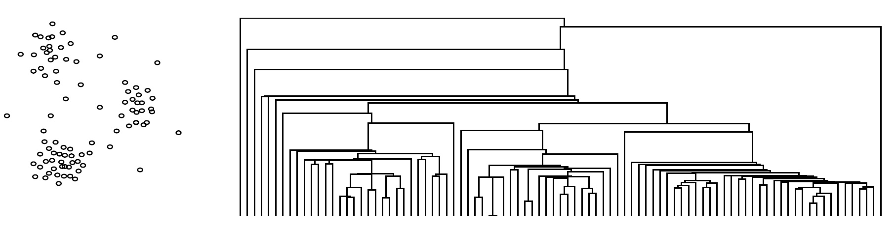

Hierarchy of Clusters (Examples)
Small noises to clusters
Isolated noise points are chained – forming clusters with small $δ$
No clearly defined robust clusters
Hierarchical clustering (esp. single-linkage) is susceptible to noises

Slide 49
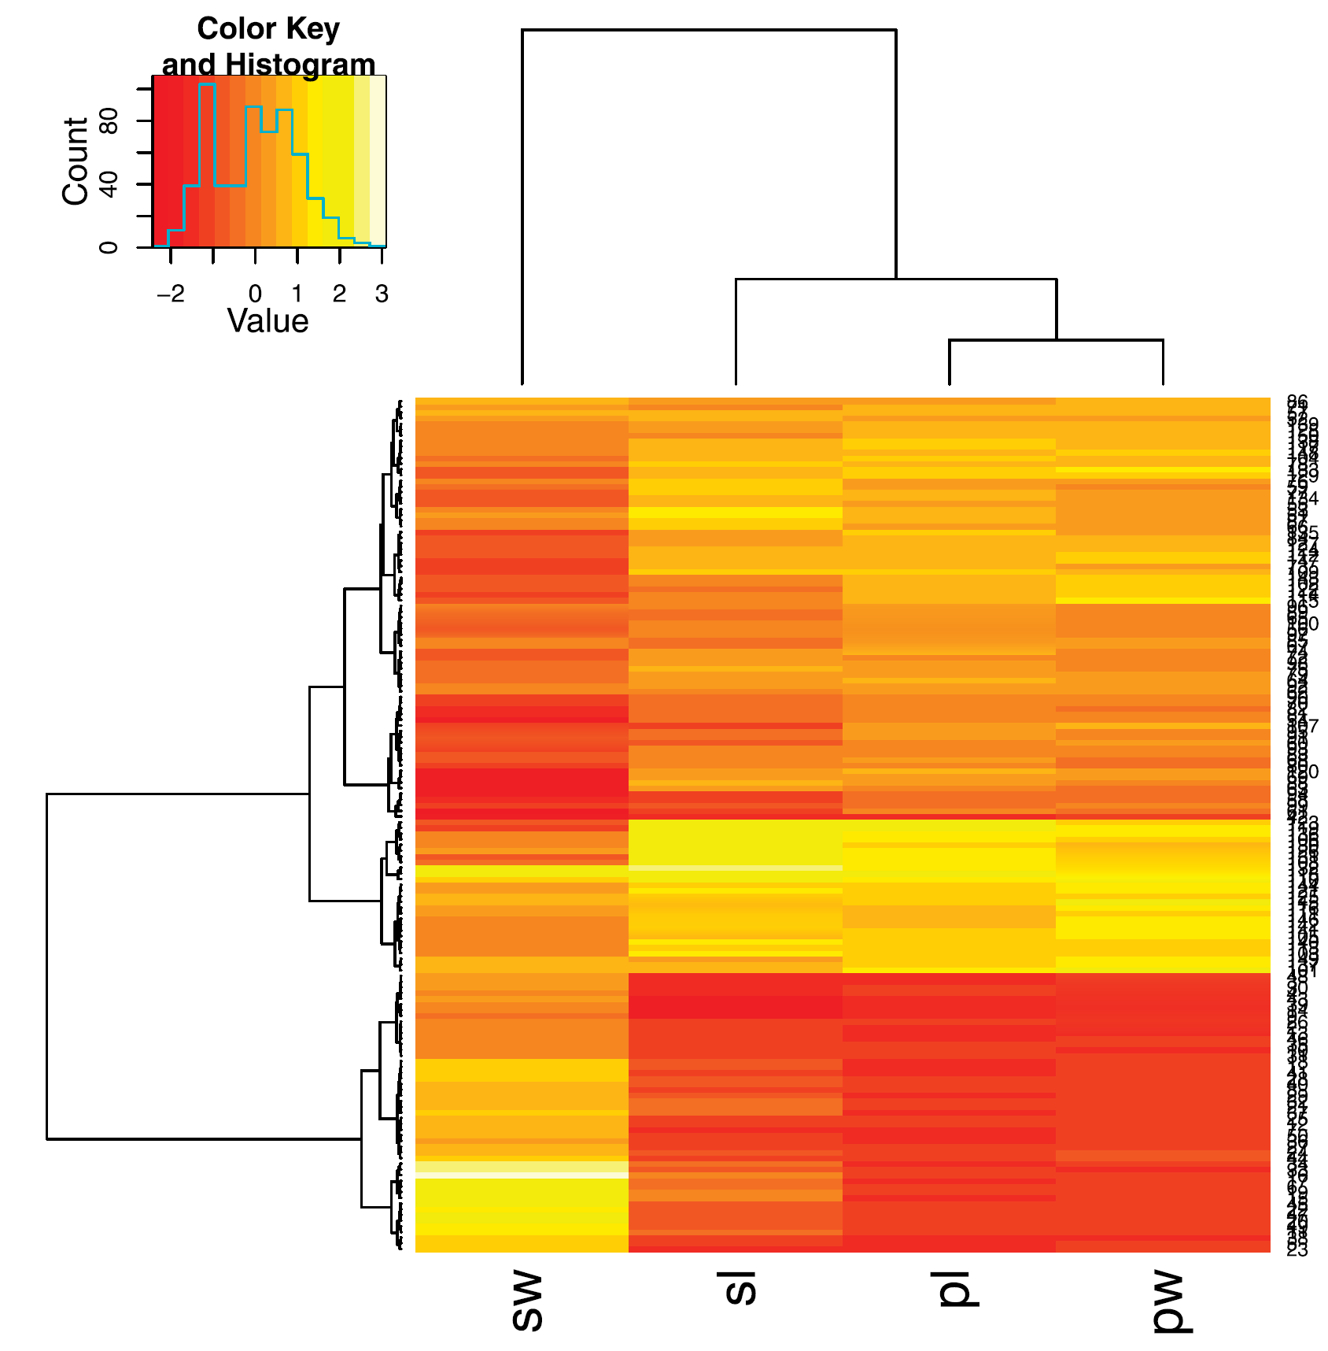
Heatmap
Clustering on observations (rows)
As well as clustering on columns (features)
Color scale to represent numerical values
  Show similarities in features within clusters

Slide 50

Single Linkage
Distance between clusters ≡ distance between two closest points
Distance of the closest two points, one from each cluster
Merge Step: Union of two subsets of data points
$$d\left(C_{i},C_{j}\right)=\min_{x,y}\left\{d\left(x,y\right)| x∈C_{i}, y∈C_{j}\right\}$$
C_{j}
C_{i}

Slide 51

Complete Linkage
Distance between clusters ≡ distance between two farthest points
Distance of the farthest two points, one from each cluster
Merge Step: Union of two subsets of data points
$$d\left(C_{i},C_{j}\right)=\max_{x,y}\left\{d\left(x,y\right)| x∈C_{i}, y∈C_{j}\right\}$$
C_{j}
C_{i}

Slide 52
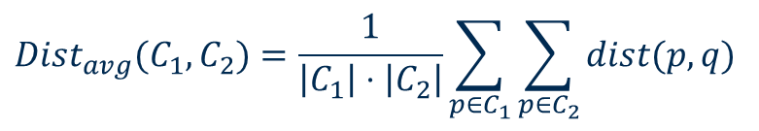
Average Linkage / Centroid Method
Distance between clusters (nodes):
Merge Step:
  union of two subsets of data points
  construct the mean point of the two clusters
$$Dist_{avg}(C_{1},C_{2})=\frac{1}{\left|C_{1}\right|⋅\left|C_{2}\right|}\sum_{p∈C_{1}}{\sum_{p∈C_{2}}{dist(p,q)}}$$
Average distance of all possible pairs of points between $C_{1}$ and $C_{2}$
$$Dist_{mean}\left(C_{1},C_{2}\right)=dist\left(mean\left(C_{1}\right),mean\left(C_{2}\right)\right)$$
Distance between two centroids

Slide 53
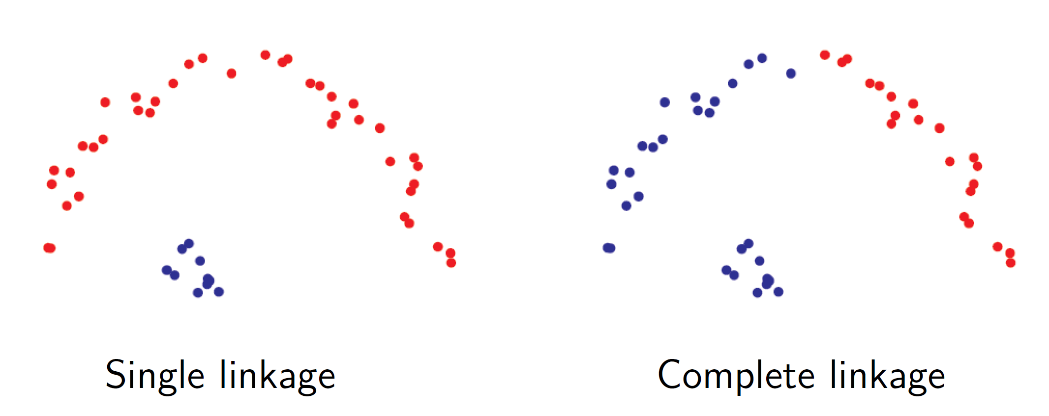
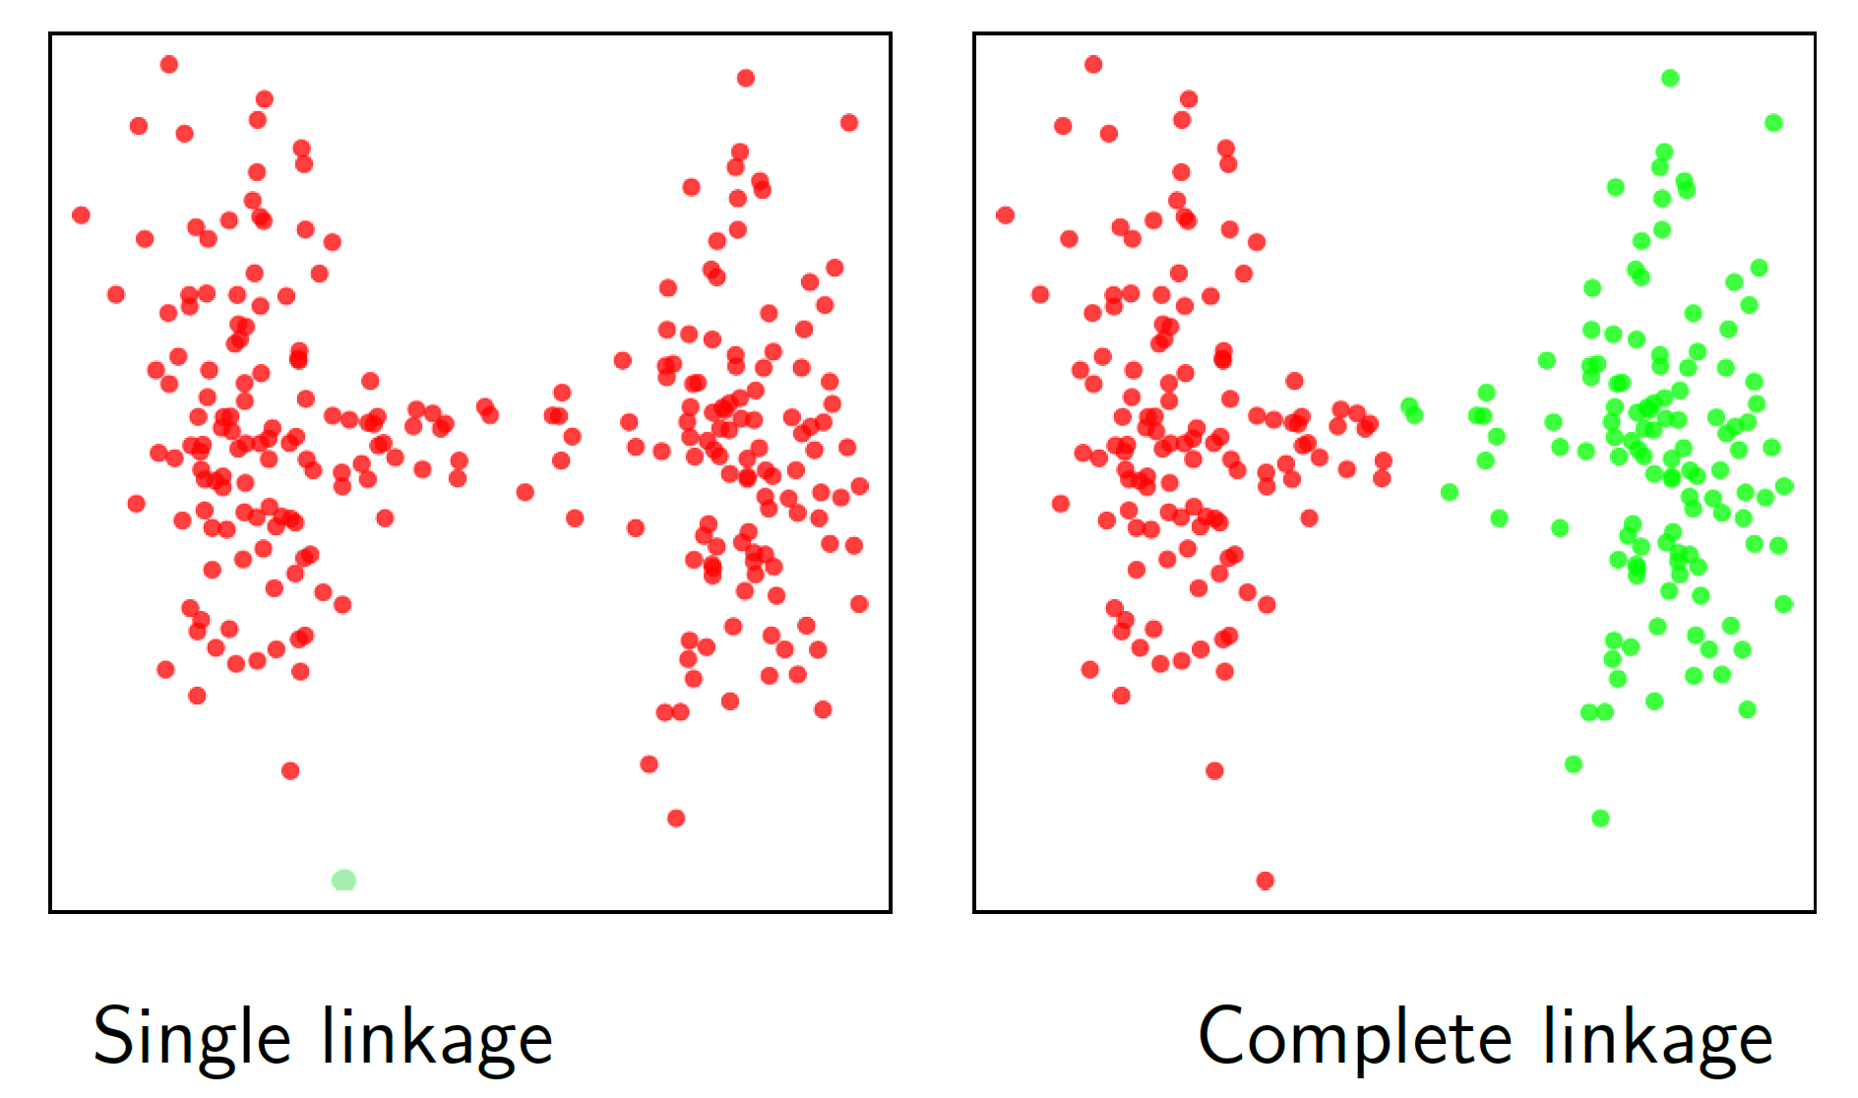
Single Linkage vs. Complete Linkage

Slide 54

Single vs. Complete vs. Average Linkage
Clustering of the 1-dimensional data set {2, 12, 16, 25, 29, 45}.
All three approaches to measure the distance between clusters lead to different dendrograms.

Slide 55

Linkage Based Clustering
Single Linkage:
  Prefers well-separated clusters
Complete Linkage:
  Prefers small, compact clusters
Average Linkage:
  Prefers small, well-separated clusters…

Slide 56
Comments on Single Linkage and Variants
Advantages:
  Finds not only a „flat“ clustering, but a hierarchy of clusters (dendrogram)
  A single clustering can be obtained from the dendrogram
  (e.g., by performing a horizontal cut)
Weaknesses:
  Decisions (merges/splits) cannot be undone
  Sensitive to noise (Single-Link)
  (a „line“ of objects can connect two clusters)
  Inefficient
  ➔ Runtime complexity at least O(n²) for n objects
Distance

Slide 57
Attribute Weighting
Magnitude difference
  Some attributes are larger in magnitude, thus dominates in calculation of dissimilarity
  E.g, Horsepower (50-300) compared to mileage (5-25)
Normalize the data – all numerical attributes have a unit variance
Which features should weigh more?
  E.g., cup holders or air conditioning? How do they affect car’s value
  Additional weighting of attributes may be needed to reflect this

Slide 58


Curse of Dimensionality
A unit sphere centered in a unit cube ${\left[−1, 1\right]}^{d}$ in d-dimensional space
➔ The higher the dimension, the smaller the coverage by the sphere
High dimensional space → likelihood of finding a data point
Known as the curse of dimensionality

Slide 59
Prototype- and Model-Based Clustering

Slide 60

Overview
Each cluster is represented by a model or prototype (representative data point)
Works well when the assumption is true (i.e. closest prototype represents a cluster)
But does not work all cases – e.g., circular clusters

Slide 61
Partitioning
Goal:
A (disjoint) partitioning into k clusters with minimal costs
Local optimization method:
  choose k initial cluster representatives
  optimize these representatives iteratively
  assign each object to its most similar cluster representative
Types of cluster representatives:
  Mean of a cluster (construction of central points)
  Median of a cluster (selection of representative points)
  Probability density function of a cluster (expectation maximization)

Slide 62

Construction
Cluster partition is described by a membership matrix $[p_{i|j}]$
  $p_{i|j}$: membership belongingness of data point j to cluster i.
  $p_{i|j}$can be binary or real-valued
The number of clusters k must be known beforehand
Data points are assigned to the closest model or prototype
Update the prototype based on the new cluster partition
Repeat until the model / prototype stops moving

Slide 63

k-Means
Given k, the k-Means algorithm is implemented in four steps:
Partition objects into $k$ non-empty subsets, calculate their centroids (i.e., mean point, of the cluster)
Assign each object to the cluster with the nearest centroid (Euclidean distance)
Compute the centroids from the current partition as $p_{i}=\frac{\sum_{j=1}^{n}{p_{i|j}{ x}_{j}}}{\sum_{j=1}^{n}{p_{i|j}}}$
Go back to Step 2, repeat until the updated centroids stop moving significantly
Note: Each data point can only belong to a single cluster
  $p_{i|j}=1$ for the cluster with closest prototype, 0 otherwise

Slide 64
k-Means Algorithm
Calculation of
new centroids
Cluster assignment
Calculation of
new centroids

Slide 65

Comments of the k-Means Method
Advantages:
  Relatively efficient: $O(tkn)$ where $n$ is #objects, $k$ is #clusters, and $t$ is #iterations; usually, $k,t≪n$ ($t$ typically 5 − 10)
  Simple implementation
  k-means is the most popular partitioning clustering method!
Weaknesses:
  Often terminates at a local optimum. A better local optimum may be found using techniques such as: deterministic annealing and genetic algorithms.
  Applicable only when mean is defined (what about categorical data?)
  Need to specify $k$, the number of clusters, in advance
  Unable to handle noisy data and outliers
  Not suitable to discover clusters with non-convex shapes

Slide 66
Outliers: k-Means vs k-Medoids
Problem with K-Means
  An object with an extremely large value can substantially distort the distribution of the data.
One solution: K-Medoids
  Instead of taking the mean value of the objects in a cluster as a reference point, medoids can be used, which are the most centrally located objects in a cluster.
10
10
9
9
8
8
7
7
6
6
5
5
4
4
3
3
2
2
1
1
0
0
1
2
3
4
5
6
7
8
9
10
0
0
1
2
3
4
5
6
7
8
9
10

Slide 67



Fuzzy c-Means Model
Cluster belongingness can be a real value [0,1]
Prototype is calculated as
where the power 2 of $p_{i|j}^{2}$ is referred as fuzzifier.
$$p_{i|j}=\frac{1}{\sum_{k=1}^{C}{\frac{{\left\|x_{j}−p_{i}\right\|}^{2}}{{\left\|x_{j}−p_{k}\right\|}^{2}}}}$$
$$p_{i}=\frac{\sum_{j=1}^{n}{p_{i|j}^{2}x_{j}}}{\sum_{j=1}^{n}{p_{i|j}^{2}}}$$

Slide 68
Gaussian Mixture Decomposition
Each cluster follows a Gaussian distribution centered at the prototype
Data follows a Gaussian mixture distribution of multiple clusters
Cluster membership – given by a Gaussian probability
Iterative updating of:
  The mean and the variance of Gaussian for each cluster
  Prototypes

Slide 69
Clustering:
Quality Measures

Slide 70
How Many Clusters
You need to know the number of clusters k beforehand
But you may not know – estimate from the data
Run clustering algorithm multiple times with different k
Plot the validity measures against the number of clusters
  Silhouette coefficient
  Separation index
Find the k that produces the optimum result

Slide 71
Optimal Clustering: Example
Within-Cluster Variation
Bad
Clustering
Good
Clustering
Between-Cluster Variation

Slide 72

Cluster Quality Measures
Centroid $μ_{C}$: mean vector of all objects in clustering C
Within-Cluster Variation:
$${TD}^{2}= \sum_{i=1}^{k}{\sum_{p∈C_{i}}{{dist(p, μ_{C_{i}})}^{2}}}$$
Between-Cluster Variation:
$${BC}^{2}=\sum_{j=1}^{k}{\sum_{i=1}^{k}{{dist(μ_{C_{j}}, μ_{C_{i}})}^{2}}}$$
Clustering Quality (one possible measure):
$$CQ=\frac{{BC}^{2}}{{TD}^{2}}$$

Slide 73

Silhouette-Coefficient for object $x$
Silhouette-Coefficient [Kaufman & Rousseeuw 1990] measures the quality of clustering
$a(x)$: distance of object $x$ to its cluster representative
$b(x)$: distance of object $x$ to the representative of the „second-best“ cluster
Silhouette $s(x)$of $x$
$s\left(x\right)= \frac{b\left(x\right)−a(x)}{max⁡\{a\left(x\right),b(x)\}}∈ \left[−1, 1\right]$
Average of $s\left(x\right)$ is calculated for each cluster
Good clusters → high silhouette coefficient

Slide 74




Silhouette-Coefficient
Good clustering…
Cluster 1
Cluster 2
$$a(x)$$
$$b(x)$$
$$a\left(x\right)≪ b(x)$$
$$s(x)=\frac{b(x)−a(x)}{\max{\{}a(x),b(x)\}}≈\frac{b(x)}{b(x)}=1$$

Slide 75




Silhouette-Coefficient
…not so good…
Cluster 1
Cluster 2
$$a(x)$$
$$b(x)$$
$$a(x)≈b(x)$$
$$s(x)=\frac{b(x)−a(x)}{\max{\{}a(x),b(x)\}}≈\frac{0}{b(x)}=0$$

Slide 76




Silhouette-Coefficient
…bad clustering.
Cluster 1
$$a(x)$$
Cluster 2
$$b(x)$$
$$a(x)≫b(x)$$
$$s(x)=\frac{b(x)−a(x)}{\max{\{}a(x),b(x)\}}≈\frac{−a(x)}{a(x)}=−1$$

Slide 77

Silhouette-Coefficient for Clustering C
Silhouette coefficient $s_{c}$for clustering $C$ is the average silhouette over all objects $x∈C$
$$s_{c}=\frac{1}{n} \sum_{x∈C}{s(x)}$$
Interpretation of silhouette coefficient:
  $s_{c}>0.7$: strong cluster structure,
  $s_{c}>0.5$: reasonable cluster structure,
  . . .

Slide 78

Choice of Parameter $k$
Method
For $k=2, 3, …, n−1$, determine one clustering each
Choose 𝑘 resulting in the highest clustering quality
Measure of clustering quality
Uncorrelated with 𝑘
for k-means and k-medoid:
$TD^{2}$ and $TD$ decrease monotonically with increasing $k$

Slide 79
Summary: Clustering by Partitioning
Scheme always similar:
  Find (random) starting clusters
  Iteratively improve cluster positions
  (compute new mean, swap medoids, compute new distribution parameters,…)
Important:
  Number of clusters k
  Initial cluster position influences (heavily):
    quality of results
    speed of convergence
Problems for iterative clustering methods:
  Clusters of varied size, density and shape

Slide 80


Separation Index
Separation index
Designed to identify compact and well-separated clusters
where ${diam}_{k}$ expresses the extent of a cluster
$$D=\min_{i=1,⋯,C}{\min_{j=i+1,⋯,C}{\frac{\min_{x∈C_{i}, y∈C_{j}}{d(x_{i},x_{j})}}{\min_{k=1,⋯,C}{{diam}_{k}}}}}$$

Slide 81

Cluster Shape
Clusters found with prototype-based clustering tend to be spherical
Unrealistic in many situations
Solutions:
Use of non-Euclidean distance
Subdivide the data into many small clusters first, then cluster the resulting prototypes

Slide 82
Gaussian Mixture Models

Slide 83

Gaussian Mixture Models
Two normal
distributions
Mixture Model: both normal distributions contribute 50%
Mixture Model: one normal distribution contributes 10%, the other 90%

Slide 84

Gaussian Mixture Models

Slide 85

Gaussian Mixture Models
First, draw a random integer $i$ between $1$ and $k$ with probability $p_{i}$ of drawing $i$. The data generated next will belong to cluster $\#i$.
Second, draw a random sample from the Gaussian distribution $g(x;μ_{i},σ_{i})$with the parameters $μ_{i}$, $σ_{i}$ taken from model $\#i$.
Overall density function is:
$$f\left(x; θ\right)= \sum_{i=1}^{k}{p_{i}} g(x;μ_{i},σ_{i})$$
$$θ= \left(θ_{1}, θ_{2}, …, θ_{k}\right) and θ_{i}=(p_{i},μ_{i},σ_{i})$$
Given a mixture $θ$, the likelihood of the full data set being generated by this model is:
$$L=\prod_{j=1}^{n}{f\left(x_{j}; θ\right)}$$

Slide 86
Gaussian Mixture Model – EM Clustering
Assumption: Data were generated by sampling a set of normal distributions. (The probability density is a mixture of normal distributions.)
Aim: Find the parameters for the normal distributions and how much each normal distribution contributes to the data.
Algorithm: EM clustering (expectation maximisation).
Alternating scheme in which the parameters of the normal distributions and the likelihoods of the data points to be generated by the corresponding normal distributions are estimated.

Slide 87
Density-Based Clustering

Slide 88
Density-based Clustering
For numerical data, density-based clustering algorithm often yield the best results.
Principle: A connected region with high data density corresponds to one cluster.
DBScan is one of the most popular density-based clustering algorithms.
However...
There are no representatives. The clusters can mostly not be investigated, only assigned (or, in few-D, visualized).

Slide 89


Overview
In a grid, identify a square with more than 3 points (green)
Problem: the grid is shifted slightly, then no longer 3+ points in a square (blue)
Solution: a circle centered at each point (neighborhood). Identify a point with 3+ neighbors

Slide 90

Overview
Continue expanding the cluster as long as dense cells are within a neighborhood
➔ DBScan algorithm

Slide 91


Construction
At some location $x$, the $ε$-neighborhood is defined as
If the neighborhood contains at least MinPts elements
  $x$ is located withing a cluster
  $x$ is referred to as a core object
There may be other core objects withing $N_{ε}\left(x\right)$
These points are density reachable from $x$
Clusters are expanded until all density reachable points are included
$$N_{ε}(x)=\left\{y : \left\|x−y\right\|≤ε\right\}$$

Slide 92

Clustering: DBSCAN
DBSCAN - a density-based clustering algorithm - defines five types of points in a dataset.
  Core Points are points that have at least a minimum number of neighbors (MinPts) within a specified distance ($ε$).
  Noise Points are neither core points nor border points.
  Border Points are points that are within $ε$ of a core point, but have less than MinPts neighbors.
  Directly Density Reachable Points are within $ε$ of a core point.
  Density Reachable Points are reachable with a chain of Directly Density Reachable points.
Clusters are built by joining core and density-reachable points to one another.

Slide 93
Example with MinPts = 3
Note: t is not density reachable from s, because s is not a Core point
t = Core point
s = Boarder point
n = Noise point
Core Point
vs. Border Point
vs. Noise
s
n
t
Directly Density Reachable
vs. Density Reachable
s
z is directly density reachable from t
s is not directly density reachable from t, but density reachable via z
z
t

Slide 94
DBSCAN - Density Based Spatial Clustering of Applications with Noise
For each point, DBSCAN determines the ε-environment and checks whether it contains more than MinPts data points ➔ core point
Iteratively increases the cluster by adding density-reachable points

Slide 95

DBSCAN - Density Based Spatial Clustering of Applications with Noise
Clustering:
A density-based clustering $C$ of a dataset D w.r.t. $ε$ and MinPts is the set of all density-based clusters $C_{i}$w.r.t. $ε$ and MinPts in D.
The set $NoiseCL$ („noise“) is defined as the set of all objects in D which do not belong to any of the clusters.
Property:
Let $C_{i}$be a density-based cluster and $pC_{i}$ be a core object.
$C_{i}= \left\{o∈D \right| o$ density-reachable from $p$ w.r.t. $ε$ and MinPts$\}$.

Slide 96


DBSCAN - Density Based Spatial Clustering of Applications with Noise
DBSCAN uses (spatial) index structures for determining the ε-environment:
➔ computational complexity $O(n log⁡n)$ instead of $O(n2)$
Arbitrary shape clusters found by DBSCAN
Parameters: $ε$ and $MinPts$

Slide 97
Summary
Clustering
Similarity Measures
Hierarchical Clustering
  DIANE
  AGNES
Prototype or Model –based Clustering
  K-Means
Quality Measures
Gaussian Mixture Model
Density based Clustering
  DBScan

Slide 98
Practical Examples with KNIME Analytics Platform

Slide 99
Hierarchical Clustering
Workflow implementing hierarchical clustering with the simple Hierarchical Clustering node and with the more complex sequence of nodes, including the Distance Matrix Calculate node

Slide 100

Hierarchical Clustering
A dendrogram for the iris data obtained with Euclidean distance and complete linkage. Moving the threshold line changes the number of clusters and the assignment for the input rows.

Slide 101

K-Means Clustering
Building of k-Means prototypes (top) and cluster assignment (bottom)

Slide 102
DBSCAN
This workflow implements a DBSCAN clustering on the iris data set. Notice the possibility to choose the distance metric in the Numeric Distances node

Slide 103
Thank you

