Slide 1
Decision and Regression Trees

Slide 2
Summary of this lesson
“Numbers have an important story to tell. They rely on you to give them a voice” -Stephen Few
Can we explain the data?
*This lesson refers to chapter 8 of the GIDS book

Slide 3
Content of this lesson
Decision Trees
How to grow a decision tree
Possible evaluation measures
How to deal with numerical attributes
How to deal with Missing Values
Pruning
Reduced Error Pruning
Pessimistic Pruning
Confidence Level Pruning
Minimum description length
Regression Trees
Decision trees with numerical target

Slide 4
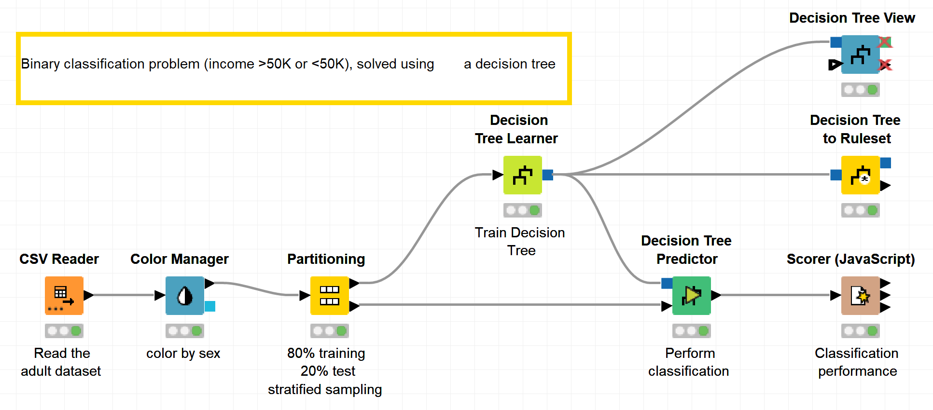
Datasets
Datasets used : adult dataset
Example Workflows:
„Decision tree“ https://kni.me/w/PV-3WZ-ZquINMsI_
confusion matrix
accuracy measures

Slide 5
Classification vs. Regression
Supervised Learning
A target attribute is predicted based on other attributes
Assumption: in addition to the object description x, we have also the value for the target attribute y
Classification
Categorical target attribute
Which category does a customer belong to?
Regression
Numerical target attribute
How much will a customer spend next month?

Slide 6
Decision Trees

Slide 7
A bit of History of Decision Trees
CART^{[1]}
(Classification and Regression Trees)
The leaves contain numeric constants
Selection is based on the Gini index
Produces only binary trees
Can handle outliers
C4.5^{[3]}
ID3-based with improvements:
Allowing continuous data
Using missing values
Using attributes with different weights
Pruning tree after creation
Gain ratio as selection measure
1983
1993
1986
1997
ID3^{[2]}
(Iterative DiChaudomiser 3)
Greedy algorithm
Chosen attributes and splits are based on the information gain
Only nominal attributes allowed
Missing values not supported
See5/C5^{[3]}
C4.5 improved
Better performances
Memory efficiency
Smaller decision trees
Breiman, L., Friedman, J.H., Olshen, R.A., Stone, C.J.: CART: Classification and Regression Trees. Wadsworth, Belmont (1983)
Quinlan, J.R.: Induction of decision trees. Mach. Learn. 1(1), 81–106 (1986)
Quinlan, J.R.: C4.5: Programs for Machine Learning. Morgan Kaufmann, San Mateo (1993)
Is See5/C5.0 Better Than C4.5? - https://www.rulequest.com/see5-comparison.html.

Slide 8
Decision Tree Algorithms comparison
 | Splitting | Attributes | Missing values | Pruning | Outliers
ID3 | Information Gain | Only Categorical | Not handled | No pruning | Susceptible
CART | Gini index / Towing Criteria | Categorical and Numeric | Handled | Cost-complexity pruning | Handled
C4.5 | Gain Ratio | Categorical and Numeric | Handled | Error-based pruning | Susceptible
Source: https://citeseerx.ist.psu.edu/viewdoc/download?doi=10.1.1.685.4929&rep=rep1&type=pdf

Slide 9
What is a Decision Tree
Decision trees aim to find a hierarchical structure to explain how different areas in the input space correspond to different outcomes.
Useful for data with a lot of attributes of unknown importance
The final decision tree often only uses a small subset of the available set of attributes $⇒$ Easy interpretation
They tend to be insensitive to normalization issues and tolerant toward many correlated or noisy attributes.
Decision trees can reveal unexpected dependencies in the data which would otherwise be hidden in a more complex model.

Slide 10
Simple Decision Tree Example
A simple example for a decision tree to classify animals
has wings?
yes
no
Bird
number of legs?
$$≤2$$
$$>2$$
…
color of fur?
white
other
Polar bear
brown
…
…

Slide 11
Simple Decision Tree Example
A simple example for a decision tree to classify animals
has wings?
root node
yes
no
Bird
number of legs?
node/split
$$≤2$$
$$>2$$
…
color of fur?
white
other
Polar bear
brown
…
…
branch
leave

Slide 12
Splits
There are three options for splits in a Decision Tree
Boolean splits: e.g. married? yes/no
Nominal splits based on categorical attributes e.g. color? red/blue/brown…
Continuous attributes splits based on numerical attributes e.g. age? $≤$25 / $>$ 25
Each split divides the remaining space in two or more disjoint sub-partitions
The resulting hierarchical structure is easy to read and interpret

Slide 13
Decision tree structure: Construction
Top-down construction approach
Build the decision tree from top to bottom, from root to leaves
Greedy Selection of a test attribute
Compute an evaluation measure for all attributes
Select the attribute with the best evaluation
Recursive Partitioning
Divide the example cases according to the values of the test attribute
Apply the procedure recursively to subsets
Terminate the recursion if:
All cases belong to the same class
No more test attributes are available

Slide 14
Partitioning example
Temperature [C]
comfortable | unbearable
 | comfortable
cold
$$≤20$$
$>20$
Temperature [C]
cold
Humidity [%]
35
$$≤50$$
$$>50$$
comfortable
Temperature [C]
20
$$≤35$$
$$>35$$
comfortable
unbearable
50
Humidity [%]
A simple example for a decision tree (left) using two numerical attributes and the corresponding partitioning (right) of the underlying feature space

Slide 15
Decision Trees: An Example

Slide 16
Another Example: Assignment of Drug to a Patient
Let‘s see how we constructed this tree
Blood Pressure
high
low
normal
Drug A
Age
Drug B
≤ 40
> 40
Drug A
Drug B

Slide 17
Building a tree: the baseline
No | Sex | Age | Blood pr. | Drug
1 | male | 20 | normal | A
2 | female | 73 | normal | B
3 | female | 37 | high | A
4 | male | 33 | low | B
5 | female | 48 | high | A
6 | male | 29 | normal | A
7 | female | 52 | normal | B
8 | male | 42 | low | B
9 | male | 61 | normal | B
10 | female | 30 | normal | A
11 | female | 26 | low | B
12 | male | 54 | high | A
Patient Database
12 example cases
3 descriptive attributes
1 class target

Slide 18
Building a tree: the baseline
No | Sex | Age | Blood pr. | Drug | Assigned
1 | male | 20 | normal | A | A
2 | female | 73 | normal | B | A
3 | female | 37 | high | A | A
4 | male | 33 | low | B | A
5 | female | 48 | high | A | A
6 | male | 29 | normal | A | A
7 | female | 52 | normal | B | A
8 | male | 42 | low | B | A
9 | male | 61 | normal | B | A
10 | female | 30 | normal | A | A
11 | female | 26 | low | B | A
12 | male | 54 | high | A | A
Patient Database
12 example cases
3 descriptive attributes
1 class target
Assignment of drug
(without attributes)
Always assign majority drug
50% correct (6 /12 cases)

Slide 19
Building a tree: selecting test attributes
Sex of the patient
Male vs. Female
Assignment of Drug
Male: 50% correct (3/6 cases)
Female: 50% correct (3/6 cases)
Total: 50% correct (6/12 cases)
No | Sex | Drug | Assigned
1 | male | A | A
6 | male | A | A
12 | male | A | A
4 | male | B | A
8 | male | B | A
9 | male | B | A
3 | female | A | B
5 | female | A | B
10 | female | A | B
2 | female | B | B
7 | female | B | B
11 | female | B | B
Not that much of an improvement

Slide 20
Building a tree: selecting test attributes
Let‘s try with Blood Pressure
High vs. Normal vs. Low
Assignment of Drug
High: 100% correct (3/3 cases)
Normal: 50% correct (3/6 cases)
Low: 100% correct (3/3 cases)
Total: 75% correct (9/12 cases)
No | Blood pr. | Drug | Assigned
3 | high | A | A
5 | high | A | A
12 | high | A | A
2 | normal | B | A
7 | normal | B | A
9 | normal | B | A
1 | normal | A | A
6 | normal | A | A
10 | normal | A | A
11 | low | B | B
4 | low | B | B
8 | low | B | B
Better!

Slide 21
Building a tree: selecting test attributes
Let‘s try with Age
Sort according to Age
Find best split on Age (ca. 40 years)
Assignment of Drug
<40: 67% correct (4/6 cases)
>40: 67% correct (4/6 cases)
Total: 67% correct (8/12 cases)
No | Age | Drug | Assigned
1 | 20 | A | A
11 | 26 | B | A
6 | 29 | A | A
10 | 30 | A | A
4 | 33 | B | A
3 | 37 | A | A
8 | 42 | B | B
5 | 48 | A | B
7 | 52 | B | B
12 | 54 | A | B
9 | 61 | B | B
2 | 73 | B | B
Better, but not so much

Slide 22
Another Example: Assignment of Drug to a Patient
Let‘s stick to
Blood Pressure ...
Blood Pressure
How do we determine which of the attributes is the “best” one?
high
low
normal
Drug A
?
Drug B
Here we use Class Frequency as Evaluation Measure
Simple to compute, easy to understand
It works well only on two classes
... and so on on the remaining data
We can do better ...

Slide 23
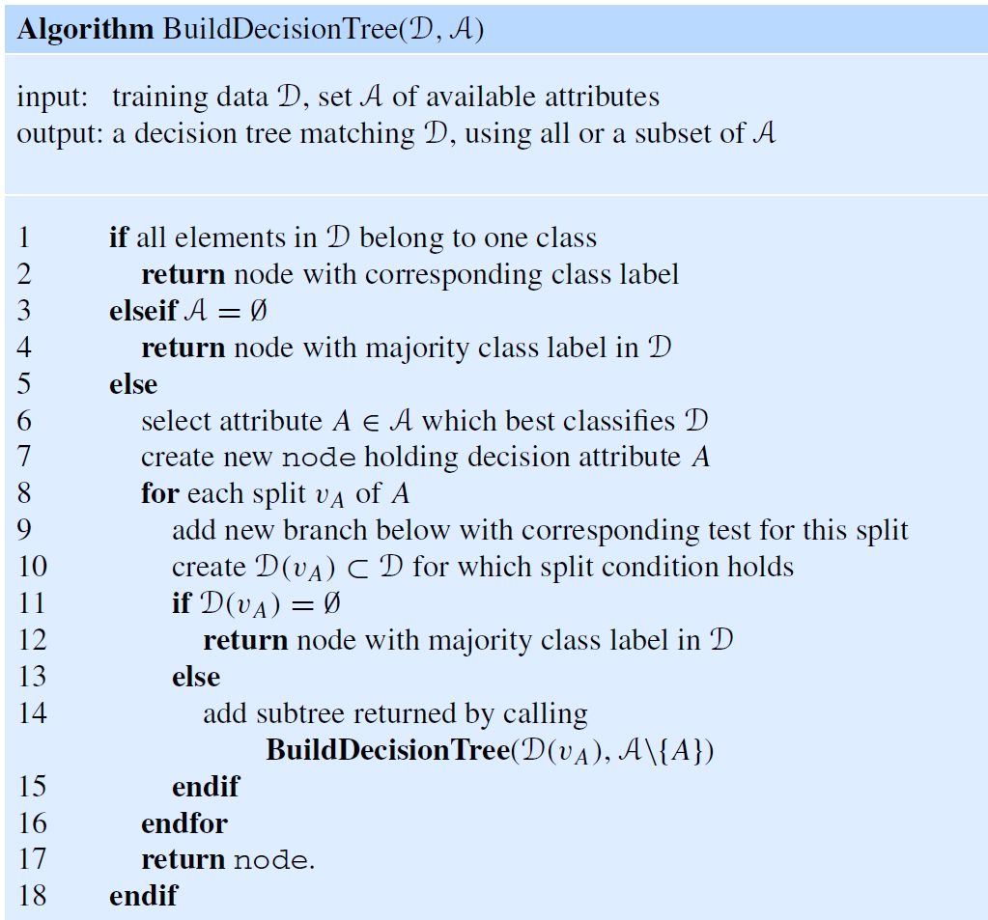
Decision Tree construction algorithm
Greedy strategy
Starting from the root node (top-down approach), recursively find the best split at each point
The recursion stops if:
a subset of only one class objects is encountered, or
no further attributes for splits are available $⇒$ in this case the leaf node is labelled with the majority class
How do we determine which of the attributes is the “best” one?
Which kind of splits are possible?

Slide 24
ID3 Learning Algorithm
Which kind of splits are possible?
For nominal values:
Binary splits, some attributes on one side some on the other side
N-splits, ultimately creating as many branches as there exist attribute values
ID3 learning algorithm:
Considers only nominal attributes
Only N-splits into all possible values of an attribute within a single node
Each node has only one cut choice for splitting -> easier to implement

Slide 25
Decision Trees: Evaluation Measures

Slide 26
Evaluation Measures
How do we determine which of the attributes is the “best” one?
Information Gain (Kullback/Leibler 1951, Quinlan 1986)
Gain Ratio (Quinlan 1986 / 1993)
Gini Index
$χ^{2}$ Measure

Slide 27
Shannon Entropy
Intuition: the best split lets us create leaves as soon as possible
Leaves are created if all the patterns of a branch belong to the same class
We have to create subsets containing mostly data from one class $⇒$ measure of impurity of the subset using the Shannon entropy
$$H_{𝒟}\left(𝒞\right)=−\sum_{k∈dom\left(𝒞\right)}{\frac{\left|𝒟_{𝒞=k}\right|}{\left|𝒟\right|}}\log_{2}\frac{\left|𝒟_{𝒞=k}\right|}{\left|𝒟\right|}$$
where $𝒟_{𝒞=k}$ is the number of data in class $𝒞=k$, with $0\log{0=0}$

Slide 28
Another Example: Predicting sex
ID | Height | Weight | Long Hair | Sex
1 | medium | normal | no | male
2 | short | low | yes | female
3 | tall | high | no | male
4 | short | normal | yes | female
5 | tall | normal | yes | female
6 | short | low | no | female
7 | short | high | no | male
8 | medium | normal | no | female
9 | medium | low | yes | female
10 | tall | normal | no | male

Slide 29
Shannon Entropy
Based on Shannon entropy = measure for information / uncertainty
$Entropy \left(p\right)=−\sum_{i=0}^{n}{p_{i} }\log_{2}{p_{i}}$ for $p∈ℚ^{n}$
$p_{1}=6/{10}$
$p_{2}=4/{10}$
$p_{1}={10}/{10}=1$
$p_{2}=0/{10}=0$
$Entropy \left(p\right)=−\left(6/{10}log_{2}\left(6/{10}\right) \text{ + }4/{10} \log_{2}\left(4/{10}\right)\right)$
$Entropy \left(p\right)=−\left({10}/{10}log_{2}\left({10}/{10}\right) \text{ + }0/{10} \log_{2}\left(0/{10}\right)\right)$
$$\sim 0,9710$$
$$=0$$

Slide 30
Information Gain
Note. Shannon entropy ranges between 0 and 1
0 when all data points belong to one class
1 when data points are evenly distributed across all classes
$H_{𝒟}\left(sex\right) \sim 0.9710$
The best attribute to split on, is the attribute producing the biggest reduction in entropy from the original set.
This reduction is called Information Gain
$$I_{𝒟}\left(𝒞, A\right)=H_{𝒟}\left(𝒞\right)−H_{𝒟}(𝒞, A)$$
Entropy Reduction
Expected Entropy after split on A
Entropy original dataset

Slide 31
Information Gain
$H_{𝒟}\left(𝒞, A\right)$ is the entropy left after the split on attribute $A$, as the weighted sum of the entropy in the generated subsets
$$H_{𝒟}\left(𝒞, A\right)=\sum_{a∈dom(A)}{\frac{\left|𝒟_{𝒜=a}\right|}{\left|𝒟\right|}H_{𝒟_{A=a}}(𝒞)}$$
$𝒟_{𝒜=a}$ are the subsets of $𝒟$ where attribute $A$ has value $a$
$a∈dom(A)$ are all values in attribute A

Slide 32
Another Example: Predicting sex
ID | Height | Weight | Long Hair | Sex
1 | medium | normal | no | male
2 | short | low | yes | female
3 | tall | high | no | male
4 | short | normal | yes | female
5 | tall | normal | yes | female
6 | short | low | no | female
7 | short | high | no | male
8 | medium | normal | no | female
9 | medium | low | yes | female
10 | tall | normal | no | male
$Entropy_{1}=Entropy\left(\frac{3}{4}, \frac{1}{ 4}\right)$ $w_{1}=4/{10}$

Slide 33
Another Example: Predicting sex
ID | Height | Weight | Long Hair | Sex
1 | medium | normal | no | male
2 | short | low | yes | female
3 | tall | high | no | male
4 | short | normal | yes | female
5 | tall | normal | yes | female
6 | short | low | no | female
7 | short | high | no | male
8 | medium | normal | no | female
9 | medium | low | yes | female
10 | tall | normal | no | male
$Entropy_{2}=Entropy\left(\frac{2}{3},\frac{1}{3}\right)$ $w_{2}=3/{10}$

Slide 34
Another Example: Predicting sex
ID | Height | Weight | Long Hair | Sex
1 | medium | normal | no | male
2 | short | low | yes | female
3 | tall | high | no | male
4 | short | normal | yes | female
5 | tall | normal | yes | female
6 | short | low | no | female
7 | short | high | no | male
8 | medium | normal | no | female
9 | medium | low | yes | female
10 | tall | normal | no | male
$Entropy_{3}=Entropy\left(\frac{1}{3},\frac{2}{3}\right)$ $w_{3}=3/{10}$

Slide 35
Split Criterion: Information Gain
$H\left(Sex | Height\right)=\frac{4}{10} Entropy_{1}+\frac{3}{10}Entropy_{2}+\frac{3}{10}Entropy_{3} \sim 0.8755$
$Entropy_{Before}$ $=Entropy\left(\frac{6}{10 },\frac{4}{10}\right)$
$Inf. Gain=Entropy_{Before}−Entropy_{After}$
Height
$Inf. Gain=0.9710 −0.8755=0.0955$
short
medium
tall
$$\text{Ne}\text{xt} \text{splitting}\text{:} \text{Feature} \text{with} \text{highest} Inf. Gain$$
$Entropy_{1}=Entropy\left(\frac{3}{4}, \frac{1}{ 4}\right)$
$Entropy_{2}=Entropy\left(\frac{2}{3},\frac{1}{3}\right)$
$Entropy_{3}=Entropy\left(\frac{1}{3},\frac{2}{3}\right)$
$w_{1}=4/{10}$
$w_{2}=3/{10}$
$w_{3}=3/{10}$

Slide 36
Another Example: Predicting sex
ID | Height | Weight | Long Hair | Sex
1 | medium | normal | no | male
2 | short | low | yes | female
3 | tall | high | no | male
4 | short | normal | yes | female
5 | tall | normal | yes | female
6 | short | low | no | female
7 | short | high | no | male
8 | medium | normal | no | female
9 | medium | low | yes | female
10 | tall | normal | no | male
0
0
$H\left(Sex | Weight\right)=\frac{3}{10} Entropy_{1}+\frac{5}{10}Entropy_{2}+\frac{2}{10}Entropy_{3} \sim 0.4855$
$Inf. Gain=0.9710 −0.4855=0.4855$

Slide 37
Feature with highest information gain: Weight
$H\left(Sex | Weight\right)=\frac{3}{10} Entropy_{1}+\frac{5}{10}Entropy_{2}+\frac{2}{10}Entropy_{3} \sim 0.4855$
$Entropy_{Before}$ $=Entropy\left(\frac{6}{10 },\frac{4}{10}\right)$
$Inf. Gain=Entropy_{Before}−Entropy_{After}$
Weight
$Inf. Gain=0.9710 −0.4855=0.4855$
low
normal
high
$\text{Feature} \text{with} \text{highest} Inf. Gain$: Weight
$Entropy_{1}=Entropy\left(\frac{0}{3}, \frac{3}{ 3}\right)$
$Entropy_{2}=Entropy\left(\frac{2}{5},\frac{3}{5}\right)$
$Entropy_{3}=Entropy\left(\frac{0}{2},\frac{2}{2}\right)$
$w_{1}=3/{10}$
$w_{2}=5/{10}$
$w_{3}=2/{10}$

Slide 38
Another Example: Predicting sex
ID | Height | Weight | Long Hair | Sex
1 | medium | normal | no | male
2 | short | low | yes | female
3 | tall | high | no | male
4 | short | normal | yes | female
5 | tall | normal | yes | female
6 | short | low | no | female
7 | short | high | no | male
8 | medium | normal | no | female
9 | medium | low | yes | female
10 | tall | normal | no | male
0
$H\left(Sex | Long Hair\right)=\frac{4}{10} Entropy_{1}+\frac{6}{10}Entropy_{2} \sim 0.5510$
$Inf. Gain=0.9710 −0. 5510=0.4200$

Slide 39
Root node splitting on Weight
Weight
low
high
normal
female
?
male
Repeat for
Weight = „normal“

Slide 40
Remaining Table to be considered
ID | Height | Weight | Long Hair | Sex
1 | medium | normal | no | male
4 | short | normal | yes | female
5 | tall | normal | yes | female
8 | medium | normal | no | female
10 | tall | normal | no | male
$H\left(Sex | Weight=normal\right)=−\left(2/5log_{2}\left(2/5\right) \text{ + }3/5 \log_{2}\left(3/5\right)\right)\sim 0.9710$

Slide 41
Find best split for Weight=„normal“
ID | Height | Long Hair | Sex
1 | medium | no | male
4 | short | yes | female
5 | tall | yes | female
8 | medium | no | female
10 | tall | no | male
$H\left(Sex | Weight=normal, Height\right)=\frac{1}{5} Entropy_{1}+\frac{2}{5}Entropy_{2}+\frac{2}{5}Entropy_{3}= 0.8$
$Inf. Gain=0.9710 −0. 8=0.1710$

Slide 42
Remaining Table to be considered
ID | Height | Long Hair | Sex
1 | medium | no | male
4 | short | yes | female
5 | tall | yes | female
8 | medium | no | female
10 | tall | no | male
$H\left(Sex | Weight=normal, Long Hair\right)=\frac{2}{5} Entropy_{1}+\frac{3}{5}Entropy_{2}= 0.5510$
$Inf. Gain=0.9710 −0. 5510=0.4200$

Slide 43
One more node on Long Hair
Weight
low
high
normal
female
Long Hair
male
no
yes
?
female
Repeat for
Weight = „normal“,
Long Hair = „no“

Slide 44
Remaining Table to be considered
For the remaining node, only the attribute Height is left with the
remaining data table:
ID | Height | Long Hair | Sex
1 | medium | no | male
8 | medium | no | female
10 | tall | no | male
Therefore the resulting decision tree is:

Slide 45
Final Decision Tree
Weight
low
high
normal
female
Long Hair
male
no
yes
female
Height
short
tall
medium
?
?
male

Slide 46
Other Evaluation Measures from Information Theory
Problem: Information Gain favors attributes with many unique values, i.e. of two attributes having about the same information content it tends to select the one having more values.
What happens if we use a unique ID attribute for the splits?
The information gain is maximized for the ID feature
Each ID results in its own branch (one split per value/object)
In most application this result is useless
Solutions
Gain Ratio
Gini Index

Slide 47
Gain Ratio
Normalization removes this bias towards attributes with many values
Compute the split information
$${SI}_{𝒟}\left(A\right)=−\sum_{a∈dom\left(A\right)}{\frac{\left|𝒟_{A=a}\right|}{\left|𝒟\right|}} log\frac{\left|𝒟_{A=a}\right|}{\left|𝒟\right|}$$
Normalize information gain with ${SI}_{𝒟}\left(A\right)$to obtain the gain ratio for a given split
$$GR_{𝒟}\left(𝒞, A\right)= \frac{I_{𝒟}\left(𝒞, A\right)}{{SI}_{𝒟}\left(A\right)}$$
Entropy distribution for subset $𝒟_{A=a}$
Information Gain
Maximizing GR favors splits on few values
Normalization by Split Information

Slide 48
Gini Index
Gini Index is based on Gini Impurity:
$Gini\left(C\right)=1 − \sum_{i=1}^{n}{p_{i}^{2}}$
where $p_{i}∈ℚ^{n}$ is the frequency of class i and $n$ is the number of classes
Gini Index can be interpreted as the expected error rate
$${Gini}_{Gain}\left(C\right)=Gini\left(C\right) −Gini\left(C|A\right)$$
$${Gini}_{Gain}\left(C,A\right)=\left(1 − \sum_{i=1}^{n_{C}}{p_{i.}^{2}}\right)− \sum_{j=1}^{n_{A}}{p_{.j}^{2}\left(1 − \sum_{i=1}^{n_{C}}{p_{i|j}^{2}}\right)}$$

Slide 49
Possible Split Criterion: Gini Index
Gini index is based on Gini impurity:
$p_{1}=7/{13}$
$p_{2}=6/{13}$
$Gini(p)=1−\sum_{i=1}^{n}{p_{i}^{2}}$ for $p∈ℚ^{n}$
$Gini\left(p\right)=1−\frac{7^{2}}{{13}^{2}}−\frac{6^{2}}{{13}^{2}}$ = 0.51
Split criterion:
$Gini_{before}=\sum_{i=1}^{n}{w_{i}Gini_{i}}$
$Gini_{after}=\frac{6}{13}Gini_{1}+\frac{7}{13}Gini_{2}$= 0.13 +0.22 = 0.35
$Gini_{Gain}=Gini_{before} −Gini_{after}$
$Gini_{1}=Gini\left(5/{6,}1/6\right)$
$Gini_{2}=Gini\left(2/{7,}5/7\right)$
$$\text{Next} \text{splitting} \text{feature}\text{:}$$ $\text{Feature} \text{with} \text{highest} Gini_{Gain}$ that produces subsets with lowest Gini Index
$w_{1}=6/{13}$
$w_{2}=7/{13}$
Notes:
The Gini Index is a bit easier to understand. According to Wikipedia, the goal is to “measure how often a randomly chosen element from the set would be incorrectly labeled

Slide 50
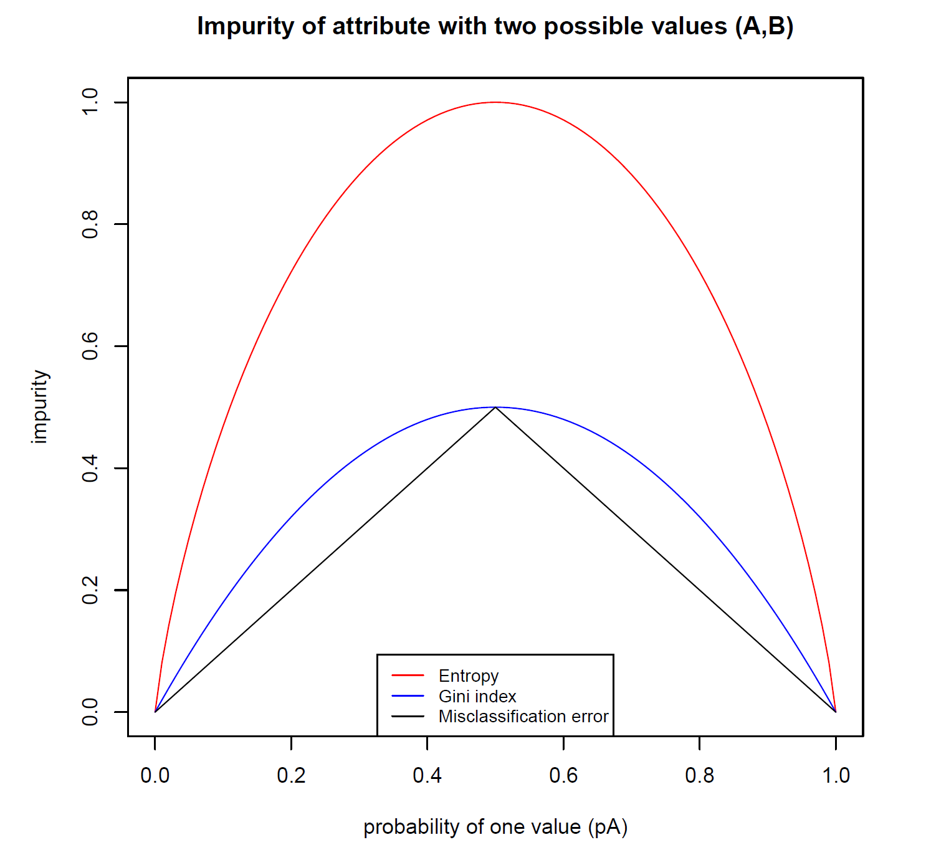
Comparison of Impurity Measures

Slide 51
$χ^{2}$ Measure
Compares the actual joint distribution with a hypothetical independent distribution
Uses absolute comparison
Can be interpreted as a difference measure
$$χ^{2}\left(C|A\right)=\sum_{i=1}^{n_{C}}{\sum_{j=1}^{n_{A}}{N_{..}\frac{{\left({p_{i.}p}_{.j}−p_{ij}\right)}^{2}}{p_{i.}p_{.j}}}}$$

Slide 52
Decision Trees: Numerical Attributes

Slide 53
Treatment of Numerical Attributes
Discretization
Preprocessing I
Form equally sized or equally populated intervals (binning)
Preprocessing II / Multi-splits during tree construction
Build a decision tree using only the numeric attribute.
Flatten the tree to obtain a multi-interval discretization.
Let’s see …

Slide 54
Splitting on Numerical Attributes
ID3 only focuses on nominal values
Introduce splits on numeric values
We only care about splits occurring within class boundaries (i.e. it makes no sense to split a uniform subset into smaller ones)
Instances are sorted by temperature values
Three classes: A, B, C
temperature | 30 | 33 | 37 | 37 | 41 | 41 | 43 | 50
class | A | A | B | B | B | C | C | A

Slide 55
Splitting on Numerical Attributes
Possible splits over temperature numerical values at boundary points
Note that we cannot split on the dashed line since the same value holds for both classes.
Define a binary variable for each possible split
Temp <= 35
Temp <= 39
Temp <= 42
Temp <= 46.5
temperature | 30 | 33 | 37 | 37 | 41 | 41 | 43 | 50
class | A | A | B | B | B | C | C | A
A
B
?
C
A

Slide 56
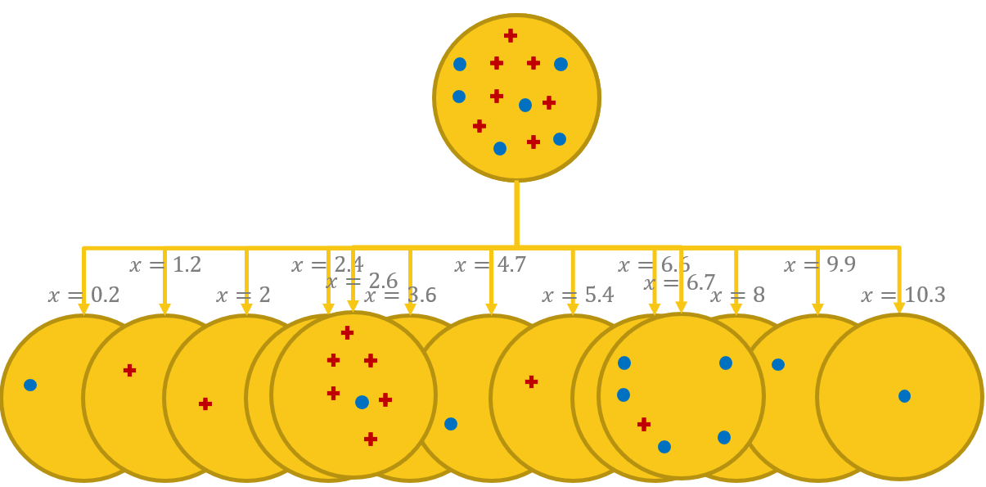
Splitting on Numerical Attributes
Splits at boundary points minimize entropy.
For binary splits (only one cut point) all boundary points are considered and the one with the smallest entropy is chosen.
For multiple splits a recursive procedure is applied.
Better restrict splits on numerical attributes to binary splits

Slide 57
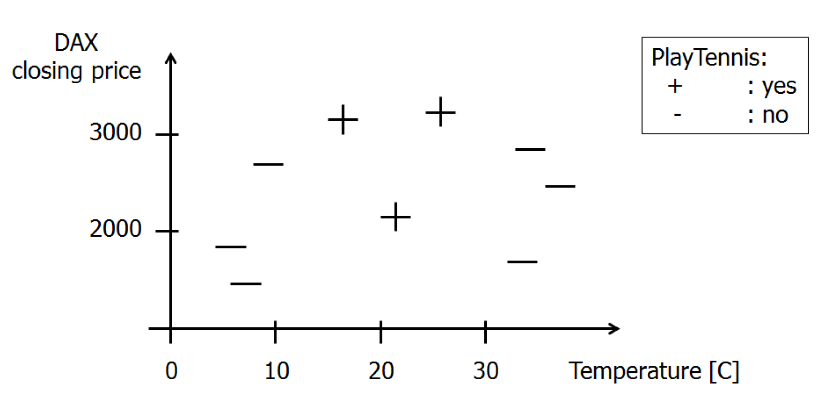
Example of Greedy Approach
The Data

Slide 58
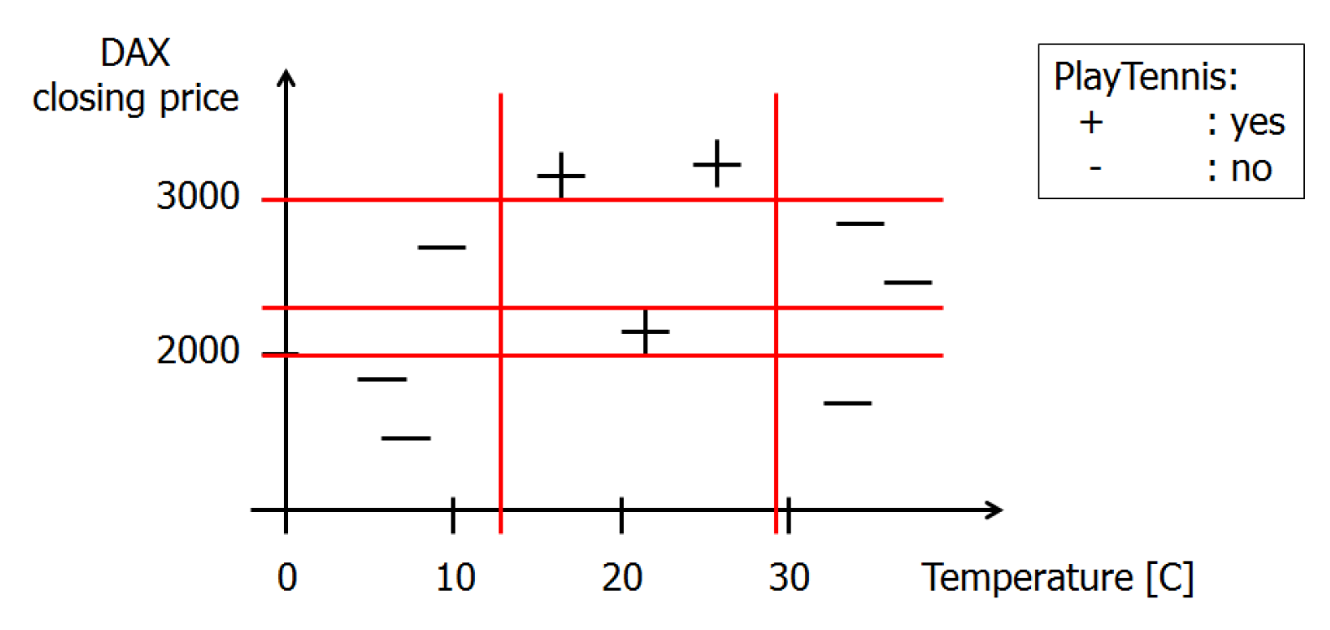
Example of Greedy Approach
The Solution

Slide 59
Example of Greedy Approach
$H(S) = H(3+, 6−) = 0.918$
$I_{Gain}\left(DAX>3000\right)=H\left(S\right) − \left(\frac{2}{9} H\left(2+, 0−\right)+\frac{7}{9}H\left(1+, 6−\right)\right)=0.918 − \left(\frac{2}{9}∗0.0+\frac{7}{9}∗0.592\right)=0.458$
$I_{Gain}\left(DAX>2250\right)=H\left(S\right) − \left(\frac{5}{9} H\left(2+, 3−\right)+\frac{4}{9}H\left(1+, 3−\right)\right)=0.918 − \left(\frac{5}{9}∗0.971+\frac{4}{9}∗0.811\right)=0.018$
$I_{Gain}\left(DAX>2000\right)=H\left(S\right) − \left(\frac{6}{9} H\left(3+, 3−\right)+\frac{3}{9}H\left(0+, 3−\right)\right)=0.918 − \left(\frac{6}{9}∗1.0+\frac{3}{9}∗0.0\right)=0.251$
$I_{Gain}\left(temp>12\right) =H\left(S\right) − \left(\frac{6}{9} H\left(3+, 3−\right)+\frac{3}{9}H\left(0+, 3−\right)\right)=0.918 − \left(\frac{6}{9}∗1.0+\frac{3}{9}∗0.0\right)=0.251$
$I_{Gain}\left(temp>29\right) =H\left(S\right) − \left(\frac{6}{9} H\left(3+, 3−\right)+\frac{3}{9}H\left(0+, 3−\right)\right)=0.918 − \left(\frac{6}{9}∗1.0+\frac{3}{9}∗0.0\right)=0.251$
1
2
3

Slide 60
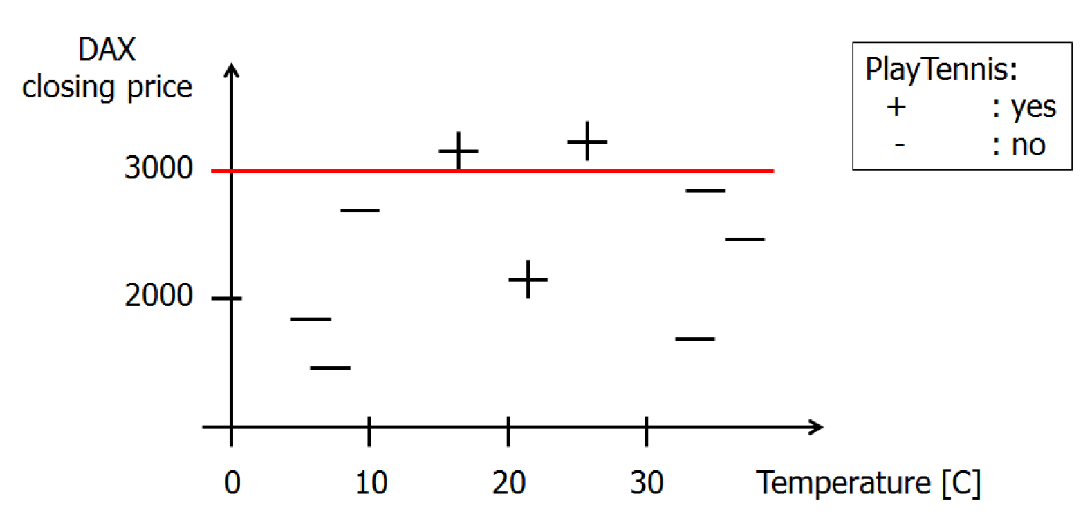
Example of Greedy Approach
First best split
DAX > 3000

Slide 61
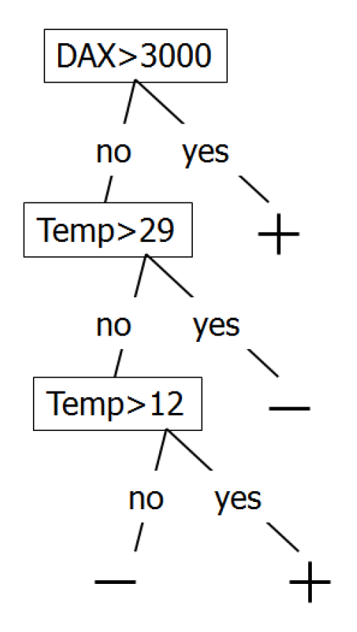
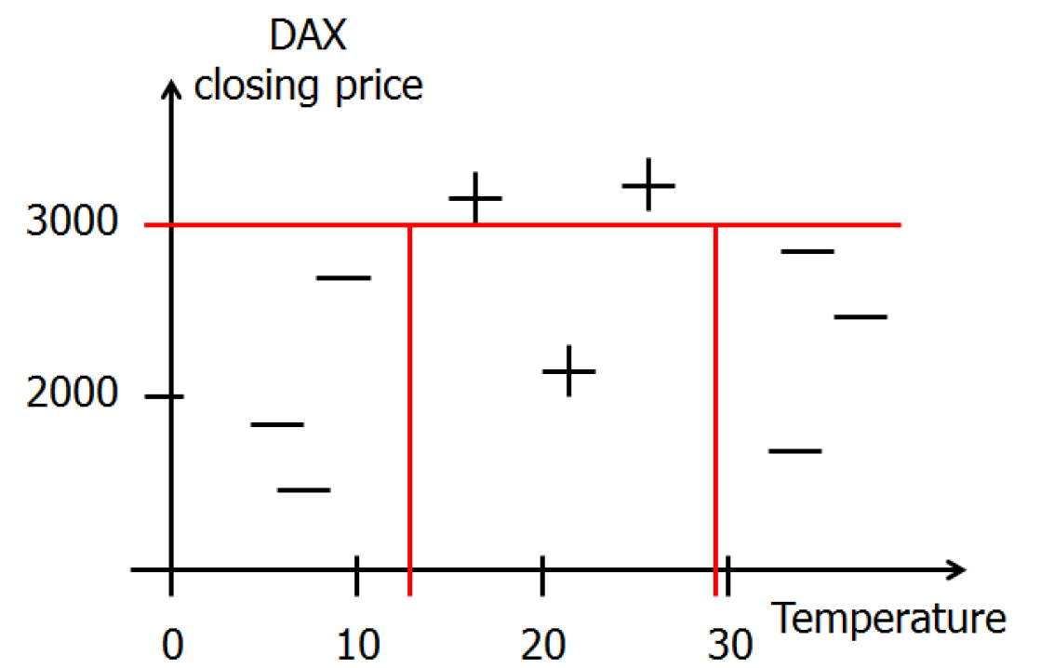
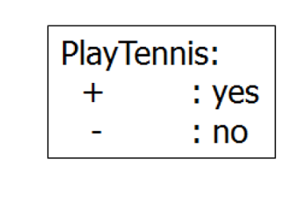
Example of Greedy Approach
Second and third best split and final decision tree
temp > 12, temp > 29

Slide 62
Decision Tree construction: Summary
Greedly investigate all possible splits
Weight possible splits by the evaluation measure and the respective size of the subsets
Choose the split, resulting in the biggest reduction of error

Slide 63
Missing Values

Slide 64
Missing Values
Dealing with missing values in decision trees is quite trivial
During training
Estimate the impact of the missing value on the information gain measure
e.g. add a fraction of each class to each partition
During classification
During the tree traversal, the node relies on a value missing for that record
Follow both branches
In the end, merge the results encountered in the two (or more) leaves
Fuzzy Decision Tree can handle degrees of membership

Slide 65
Missing Value Strategies during Training
ID | ... | Temp. | ... | Play Tennis
ID1 |  | Hot |  | No
ID2 |  | Hot |  | No
ID3 |  | Hot |  | Yes
ID4 |  | Mild |  | Yes
ID5 |  | ??? |  | Yes
ID6 |  | Cool |  | No
ID7 |  | Cool |  | Yes
ID8 |  | ??? |  | No
ID9 |  | Cool |  | Yes
ID10 |  | Mild |  | Yes
ID11 |  | Mild |  | Yes
ID12 |  | Mild |  | Yes
ID13 |  | Hot |  | Yes
ID14 |  | Mild |  | Yes

Slide 66
Missing Value Strategies during Training
ID | ... | Temp. | ... | Play Tennis
ID1 |  | Hot |  | No
ID2 |  | Hot |  | No
ID3 |  | Hot |  | Yes
ID4 |  | Mild |  | Yes
ID5 |  | Mild |  | Yes
ID6 |  | Cool |  | No
ID7 |  | Cool |  | Yes
ID8 |  | Mild |  | No
ID9 |  | Cool |  | Yes
ID10 |  | Mild |  | Yes
ID11 |  | Mild |  | Yes
ID12 |  | Mild |  | Yes
ID13 |  | Hot |  | Yes
ID14 |  | Mild |  | Yes
Alternative 1 Replace with most frequent value
4* Hot
5* Mild
3* Cool

Slide 67
Missing Value Strategies during Training
ID | ... | Temp. | ... | Play Tennis
ID1 |  | Hot |  | No
ID2 |  | Hot |  | No
ID3 |  | Hot |  | Yes
ID4 |  | Mild |  | Yes
ID5 |  | Mild |  | Yes
ID6 |  | Cool |  | No
ID7 |  | Cool |  | Yes
ID8 |  | Hot |  | No
ID9 |  | Cool |  | Yes
ID10 |  | Mild |  | Yes
ID11 |  | Mild |  | Yes
ID12 |  | Mild |  | Yes
ID13 |  | Hot |  | Yes
ID14 |  | Mild |  | Yes
Alternative 2 Replace with most frequent value of the same class
PlayTennis = Yes
2* Hot
4* Mild
2* Cool
PlayTennis = No
2* Hot
1* Mild
1* Cool

Slide 68
Missing Value Strategies during Training
ID | ... | Temp. | ... | Weight | Play Tennis
ID1 |  | Hot |  | 1.0 | No
ID2 |  | Hot |  | 1.0 | No
ID3 |  | Hot |  | 1.0 | Yes
ID4 |  | Mild |  | 1.0 | Yes
ID5a |  | Hot |  | 0.33 | Yes
ID5b |  | Mild |  | 0.42 | Yes
ID5c |  | Cool |  | 0.25 | Yes
ID6 |  | Cool |  | 1.0 | No
ID7 |  | Cool |  | 1.0 | Yes
ID8a |  | Hot |  | 0.33 | No
ID8b |  | Mild |  | 0.42 | No
ID8c |  | Cool |  | 0.25 | No
ID9 |  | Cool |  | 1.0 | Yes
... |  | ... |  | ... | ...
Fuzzy Decision Trees
Alternative 3 Replace with all possible values and propagate with corresponding weights:
4* Hot -> w = 4/12 = 0.33
5* Mild -> w = 5/12 = 0.42
3* Cool -> w = 3/12 = 0.25

Slide 69
Decision Trees: Pruning

Slide 70
How deep should the tree be?
Training set
Test set
wind
$$≥4$$
$$<4$$
$$temp$$
$$30$$
temp
temp
$$≥10$$
$$<10$$
$$≥25$$
$$<25$$
$$25$$
temp
wind
$$20$$
$$≥6$$
$$<6$$
$$≥22$$
$$<22$$
$$15$$
temp
$$10$$
$$≥26$$
$$<26$$
5
wind
The Deeper the Better?!
$$≥6$$
$$<6$$
$$1$$
$$2$$
$$3$$
$$4$$
$$5$$
$$6$$
$$7$$
$$wind$$

Slide 71
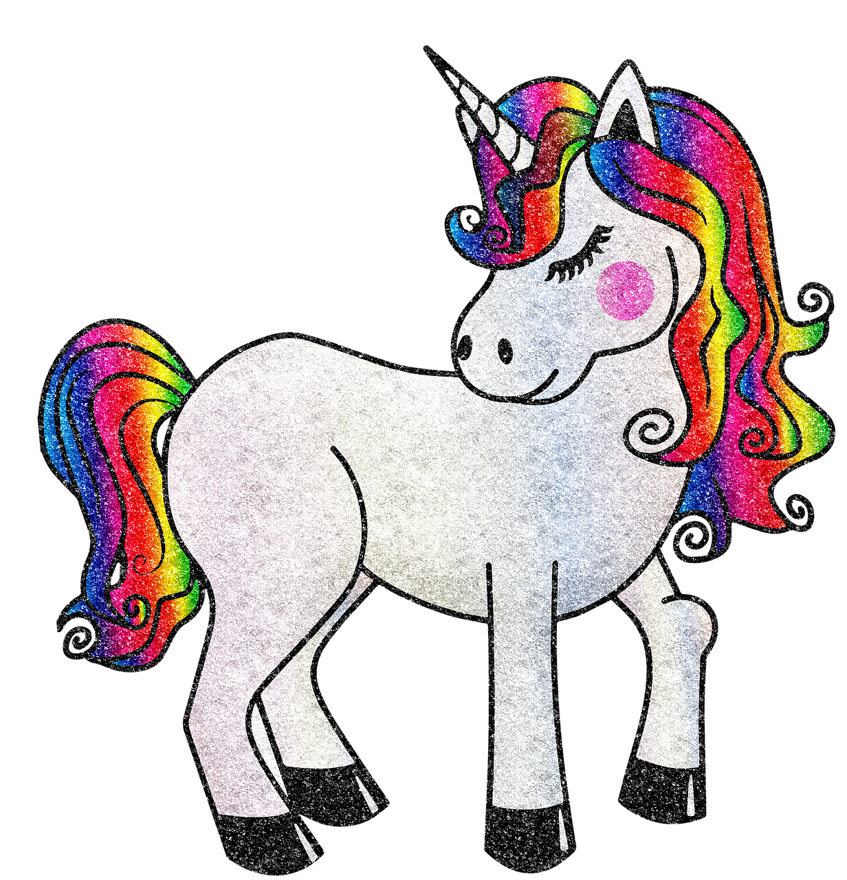
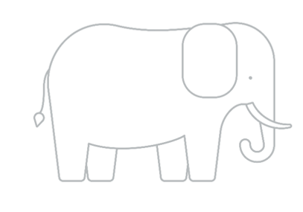
Overfitting vs Underfitting
Underfitted
Generalized
Overfitted
Model memorizes the training set rather then finding underlying patterns
Model overlooks underlying patterns in the training set
Model captures correlations in the training set

Slide 72
Overfitting vs Underfitting
Overfitting | Underfitting
Model that fits the training data too well, including details and noise Negative impact on the model’s ability to generalize | A model that can neither model the training data nor generalize to new data
Underfitted
Generalized
Overfitted

Slide 73
Pruning
Why should we avoid overgrown trees?
Overfitting
Unnecessary complexity
Harder interpretation
Two approaches:
Pre-pruning: stop the construction of the tree during training
Post-pruning: reduce the dimensions of an overgrown tree
Basic ideas of post-pruning:
Replace “bad” branches (subtrees) by leaves
Replace a subtree by its largest branch if it is better
The base algorithm would only stop if one node contains one pattern or there are no further attributes to be used for splits

Slide 74
Controlling the Tree Depth
Goal: Tree that generalizes to new data and doesn’t overfit
Early stopping
Idea: Define a minimum size for the tree leaves
Pruning
Idea: Cut branches that seem to overfit
Techniques
Reduced Error Pruning
Pessimistic Pruning
Confidence Level Pruning
Minimum description length

Slide 75
Reduced Error Pruning
Classify a set of new example cases with the decision tree. ➔ These cases must not have been used for the learning!
Determine the number of errors for all leaves.
The number of errors of a subtree is the sum of the errors of all of its leaves.
Determine the number of errors for leaves that replace subtrees.
If such a leaf leads to the same or fewer errors than the subtree, replace the subtree by the leaf.
If a subtree has been replaced, recompute the number of errors of the subtrees it is part of.

Slide 76
Reduced Error Pruning
Advantage:
Very good pruning, effective avoidance of overfitting.
Disadvantage:
Additional example cases needed. Number of cases in a leaf has no influence.

Slide 77
Pessimistic Pruning
Classify a set of example cases with the decision tree. (These cases may or may not have been used for the learning.)
Determine the number of errors for all leaves and increase this number by a fixed, user-specified amount r.
The number of errors of a subtree is the sum of the errors of all of its leaves.
Determine the number of errors for leaves that replace subtrees (also increased by r).
If such a leaf leads to the same or fewer errors than the subtree, replace the subtree by the leaf and recompute subtree errors.

Slide 78
Pessimistic Pruning
Advantage:
No additional example cases needed.
Disadvantage:
Number of cases in a leaf has no influence.

Slide 79
Confidence Level Pruning
Like pessimistic pruning, but the number of errors is computed as follows:
See classification in a leaf as a Bernoulli experiment (error/no error): p, p(1 − p)
Expected success rate: $f = \frac{no error}{error + no error}$
For a large enough number of classifications $f$ follows a normal distribution
Estimate an interval for the error probability p(1 − p) based on a user-specified confidence level $α$. (use approximation of the binomial distribution by a normal distribution)
Increase error number to the upper level of the confidence interval times the number of cases assigned to the leaf.
Formal problem: Classification is not a random experiment.

Slide 80
Confidence Level Pruning
Advantage:
No additional example cases needed. Good pruning.
Disadvantage:
Statistically dubious foundation.

Slide 81
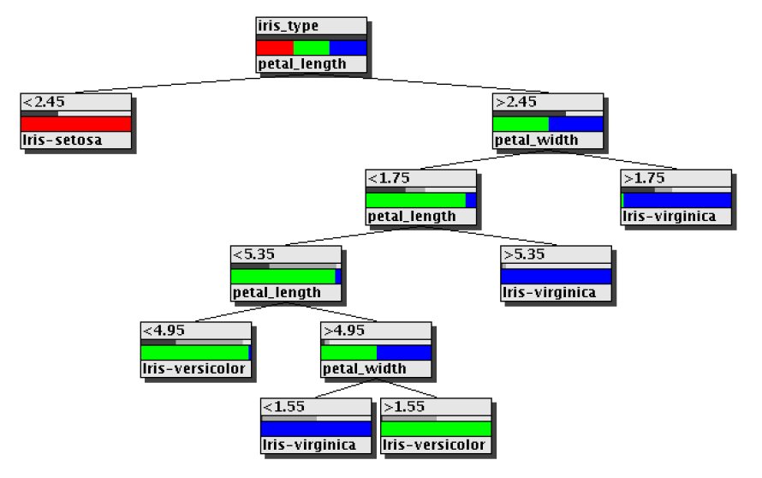
Decision tree pruning: An Example
A decision tree for iris data (induced with information gain ratio, unpruned)

Slide 82
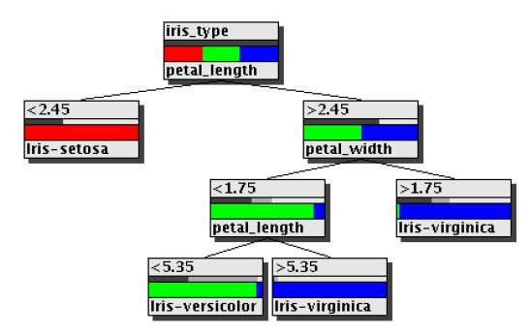
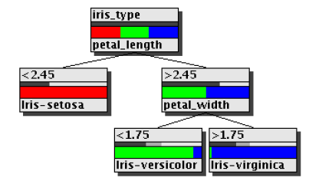
Decision tree pruning: An Example
Pruned with confidence
level pruning $α$=0.8
Pruned with pessimistic pruning $r$=2
5 instead of 11 nodes, 6 instead of 2 misclassifications.
This tree is “minimal” for the three classes.
7 instead of 11 nodes, 4 instead of 2 misclassifications.

Slide 83
Minimum Description Length Pruning (MDL)
Description length = #bits(tree) + #bits(misclassified samples)
Tree 1
Tree 2
Note
wind
wind
Many misclassified in samples in tree 1
➔ DL(Tree 1) > DL(Tree 2)
➔ Select Tree 2
Example 1
temp
12
0
6
7
12
0
wind
wind
Only 1 misclassified sample in tree 1
➔ DL(Tree 1) < DL(Tree 2)
➔ Select Tree 1
Example 2
temp
12
0
1
13
12
0
Notes:
Removing a branch with a small improvement in performance
→ A smaller tree is preferred

Slide 84
Minimum Description Length Pruning (MDL)
Advantage:
No additional example cases needed. Good pruning.
Disadvantage:
Additional calculation needed.

Slide 85
Predictive vs. Descriptive Tasks
Predictive tasks:
The decision tree (or more generally, the classifier) is constructed in order to apply it to new unclassified data.
Descriptive tasks:
The purpose of the tree construction is to understand, how classification has been carried out so far.

Slide 86
Regression Trees

Slide 87
Numerical Target: Regression Trees
Numerical Target = Predicting a continuous target value
CART (Classification And Regression Trees) described by Breiman
Leaves contain numerical values instead of class labels
Entropy-based measurements no longer needed
Fit measure of the tree is the sum of squared errors for each node $n$:
$$SME\left(𝒟_{n}\right)=\frac{1}{\left|𝒟_{n}\right|}\sum_{\left(X,Y\right)∈𝒟_{n}}{{\left(Y−c_{n}\right)}^{2}}$$
$c_{n}$ is the constant value assigned to the node $n$,
$𝒟_{n}$ are the data points ending up at the node $n$,
$X$ is the input feature vector
$Y$ is the target value

Slide 88
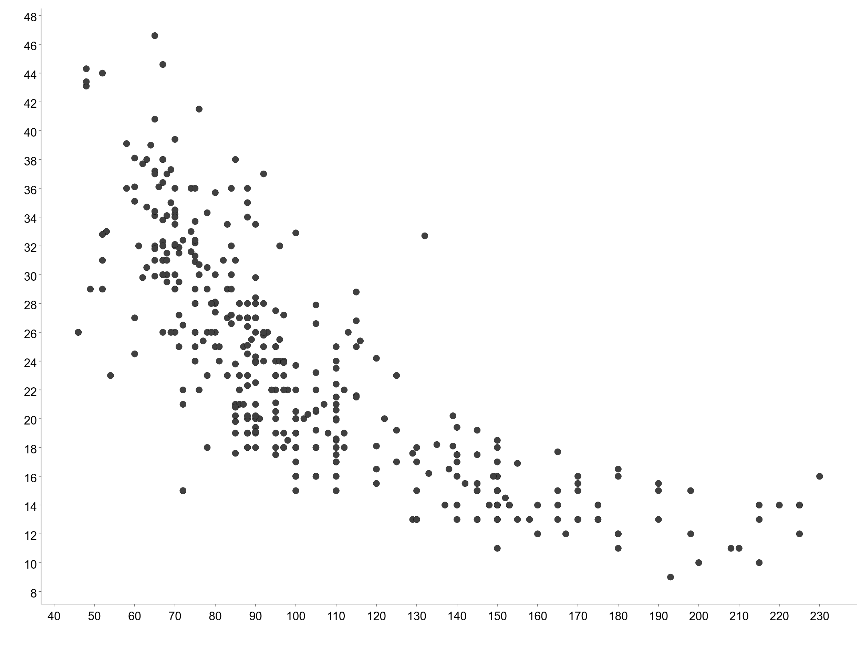
Regression Tree: Goal
y
We want to model the target variable with piecewise lines
➔ No knowledge of functional form required
x

Slide 89
Regression Tree: Initial Split
y
Squared sum of errors:
Local mean:
$$E_{m}=\sum{{\left(y_{i} − c_{m}\right)}^{2}}$$
$$c_{m}=\frac{1}{n}\sum{y_{i}}$$
Optimal boundary S should minimize the total squared sum:
For observations in segment m
$$\sum{E_{m}}$$
For all segments m
s
x

Slide 90
Regression Tree: the algorithm
Split a feature $x_{j}$ at threshold $s$:
$R_{1}\left(j,s\right)=\left\{x | x_{j}≤s\right\}$ and $R_{2}\left(j,s\right)=\left\{x | x_{j}>s\right\}$
Search for s that minimizes error of:
$$E_{j,s}=\sum_{x ∈ R_{1}(j,s)}{{\left(y_{i} − c_{1}\right)}^{2}}+\sum_{x ∈ R_{2}(j,s)}{{\left(y_{i} − c_{2}\right)}^{2}}$$
Where $c_{k}=\frac{1}{n}\sum_{x ∈ R_{k}(j,s)}{y_{i}}$ where $\left(y_{i}| x ∈ R_{k}, k=1, 2\right)$

Slide 91
Regression Tree: Initial Split
y
$x≤93.5$?
Y
N
$$C_{1}=28.9$$
$$C_{2}=17.8$$
s
x

Slide 92
Regression Tree: Growing the Tree
Repeat the splitting process within each segment
y
$x≤93.5$?
Y
N
$$x≤70.5\text{?}$$
$$C_{3}=17.8$$
Y
N
$$C_{1}=33.9$$
$$C_{2}=26.4$$
s
x

Slide 93
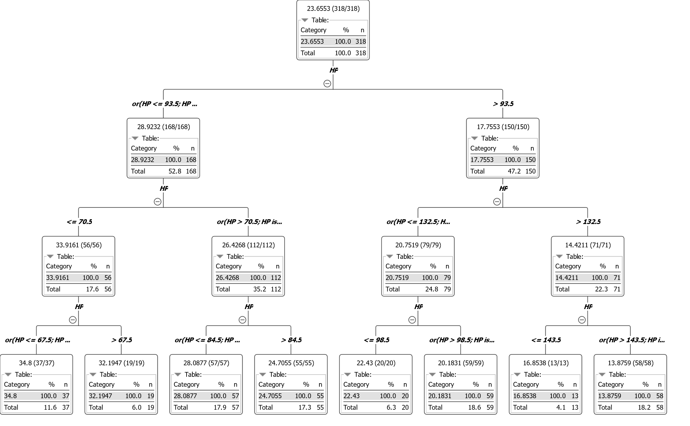
Regression Tree: Final Model
y
x

Slide 94
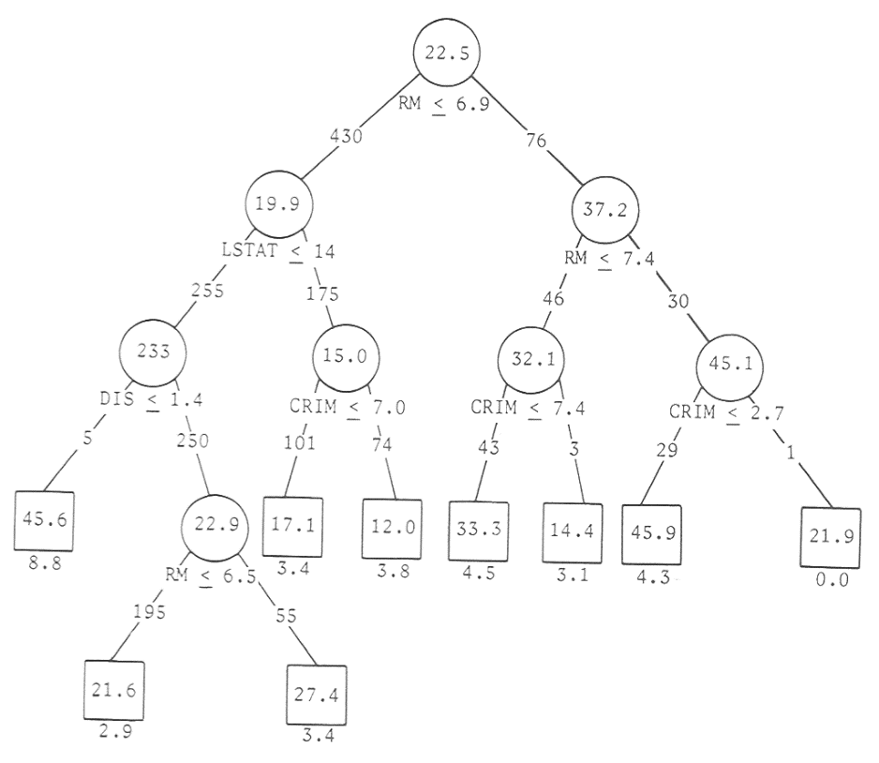
Regression Tree: The Tree
Response in each leaf is a constant:
$$c_{m}=\frac{1}{n}\sum{y_{i}}$$
Where $\left(y_{i}| x ∈Leaf m\right)$
$$E_{m}=\sum{{\left(y_{i} − c_{m}\right)}^{2}}$$
More complex regression trees have functions in the leaves rather than constant values. Rarely used due to harder interpretation

Slide 95
Regression Tree: Algorithm
Start with a single node containing all points.
Calculate $c_{i}$ and $E_{i}$.
If all points have the same value for feature $x_{j}$, stop.
Otherwise, find the best binary splits that reduces $E_{j,s}$ as much as possible.
$E_{j,s}$ doesn’t reduce as much ➔ stop
A node contains less than the minimum node size ➔ stop
Otherwise, take that split, creating two new nodes.
In each new node, go back to step 1.

Slide 96
Regression Trees: Summary
Differences to decision trees:
Splitting criterion: minimizing intra-subset variation (error)
Pruning criterion: based on numeric error measure
Leaf node predicts average target values of training instances reaching that node
Can approximate piecewise constant functions
Easy to interpret

Slide 97
Regression Trees: Pros & Cons
Finding of (local) regression values (average)
Problems:
No interpolation across borders
Heuristic algorithm: unstable and not optimal.
Extensions:
Fuzzy trees (better interpolation)
Local models for each leaf (linear, quadratic)
Guide to Intelligent Data Science Second Edition, 2020

Slide 98
Additional Notes
Despite their wide application, Decision Trees are notoriously unstable
Small changes in the training data can heavily change the resulting decision tree
Forests of decision trees
Build a number of smaller, differently initialized decision trees
Compute the classification by committee voting
Can solve the stability problem
Lead to less interpretability
This is due to the underlying greedy algorithm

Slide 99
Summary
What is a decision tree and what is it used for?
How is a decision tree built from data?
Which kind of splitting measurements exist?
How can we handle missing values in the data?
Why are decision trees pruned and how?
What is a regression tree?

Slide 100
Practical Examples with KNIME Analytics Platform

Slide 101
KNIME Workflow
Decision Tree

Slide 102
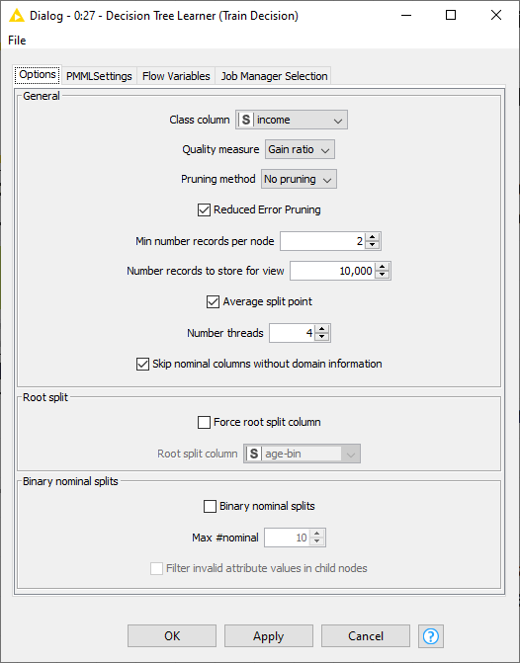
KNIME Workflow
Decision tree learner configuration window

Slide 103
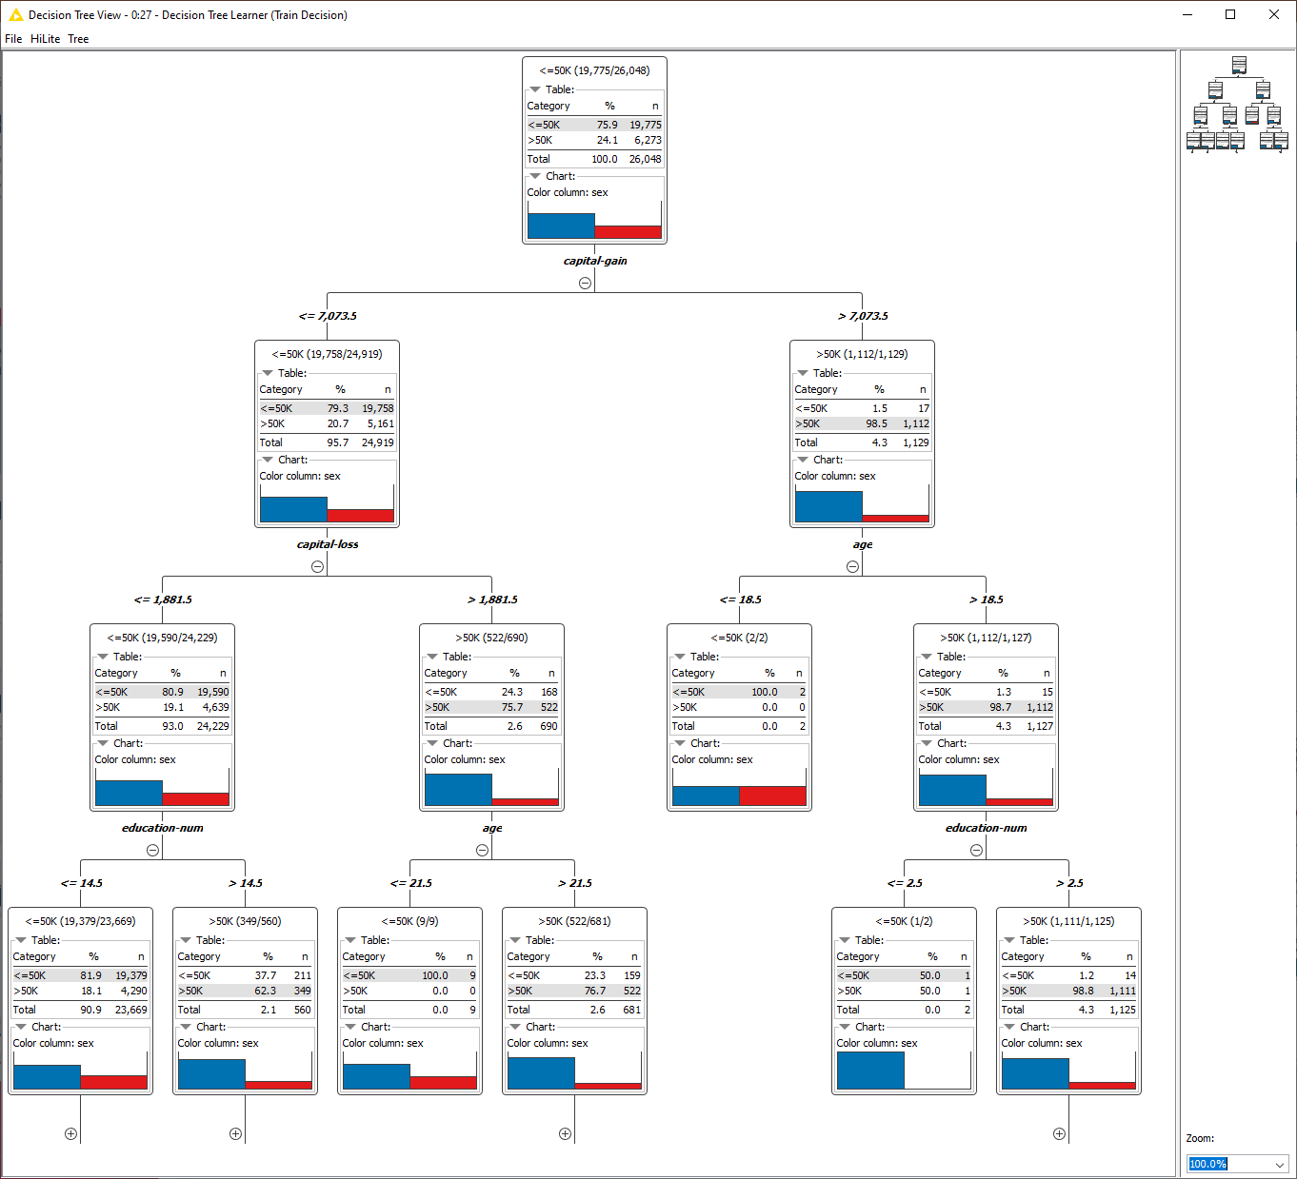
KNIME Workflow
Trained tree with the tree view

Slide 104
Thank you

