Slide 1
Regressions

Slide 2
Summary of this lesson
“All models are approximations. Essentially, all models are wrong, but some are useful.” -George Box
How can we model the data?
*This lesson refers to chapter 8 of the GIDS book

Slide 3
Content of this lesson
The Regression Task
Linear Regression
Other Regressions
Logistic Regression
Robust Regression
Regression for Classification
Practical Example

Slide 4
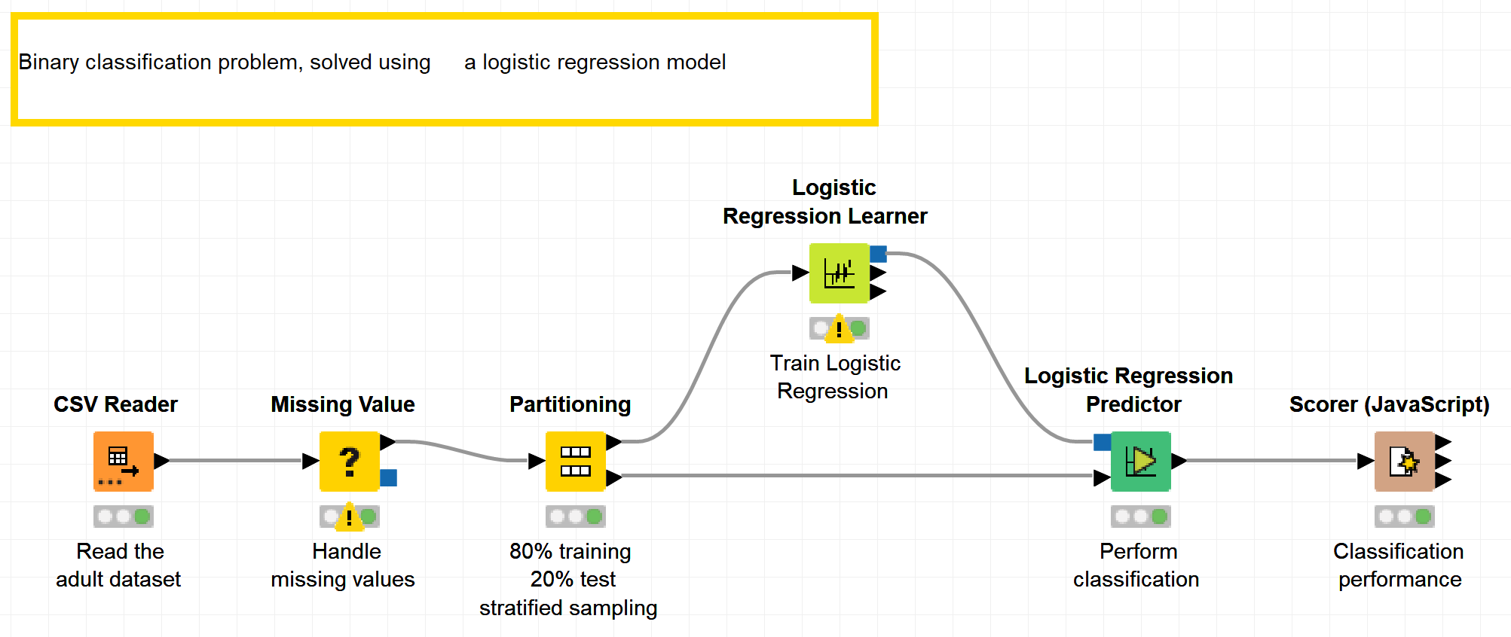
Datasets
Datasets used : adult dataset
Example Workflow:
„Logistic regression“ https://kni.me/w/LWHdcrt_DFIepk0p
Missing value handling
Logistic regression

Slide 5
The Regression Task

Slide 6
Note
We are focusing on methods that find explanations for an unknown dependency within the data.
Supervised (because we know the desired outcome)
Descriptive (because we care about explanation)

Slide 7
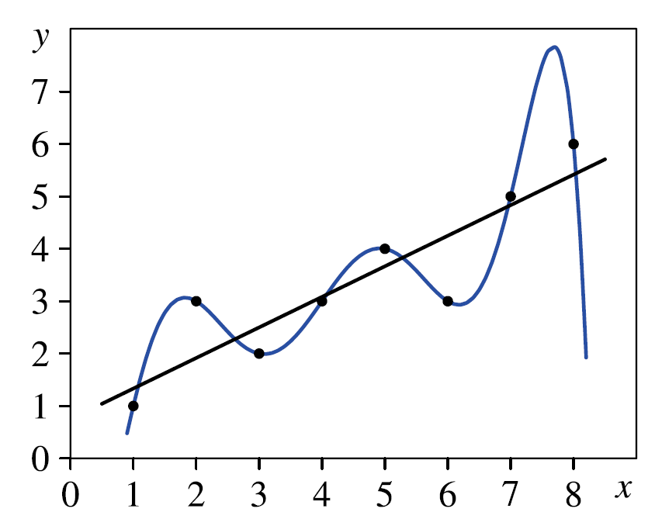
The Regression Task
Goal: Explain how target attribute depends on descripitive attributes
Target attributes ➔ Response variable
Descriptive attributes ➔ Regressor variables
As a parameterized function class f
Estimate parameters to describe the
relationship
Must be simple enough for interpolation and
extrapolation purposes
Example: Line (black) v.s. Polynomial (blue) with degree 7

Slide 8
The Regression Task: formally
Given a dataset $D=\left\{\left(x_{i}, y_{i}\right) | i=1, …, n\right\}$ with $n$ tuples
$x$: Object description $\left[x_{1}, …,x_{k}\right]$
$y$: Numerical target attribute
Find a function
$f:dom\left(x_{1}\right)\text{×} …\text{×} dom\left(x_{k}\right) →y ∈ℝ$
minimizing the error
$$E\left(f\left(x_{1}, …,x_{k}\right), y\right)$$
for all given $n$ data objects $\left(x_{i}, y_{i}\right)$.

Slide 9
Linear Regression

Slide 10
Regression Line
Given a data set with two continuous attributes, $x$ and $y$
There is an approximate linear dependency between $x$ and $y$
We find a regression line (i.e., determine the parameters $a$ and $b$) such that the fits the data as well as possible
Examples:
Trend estimation (e.g., oil price over time)
Epidemiology (e.g., cigarette smoking vs. lifespan)
Finance (e.g., return on investment vs. return on all risky assets)
Economics (e.g., spending vs. available income)
$$y≈a+bx$$

Slide 11
Regression Line
What is a good fit?
y
Regresion Line
$\hat{y}=$ $a_{0}+a_{1}x$
y_{i}
x

Slide 12
Cost Function
The error, or the residual, is calculated at each data point
The sum of square errors (SSE) is chosen as cost function (to be minimized)
Referred as the least square method
y
Regresion Line
$\hat{y}=$ $a_{0}+a_{1}x$
$\sum_{i=1}^{n}{e_{i}^{2}}=$ $\sum_{i=1}^{n}{{\left(\hat{y_{i}}−y_{i}\right)}^{2}}$
Residual
e_{i}
y_{i}
x

Slide 13
Cost Functions
Sum of square errors
Other reasonable cost functions
mean absolute distance
mean Euclidean distance
maximum absolute distance in y-direction (or equivalently: the
maximum squared distance in y-direction)
maximum Euclidean distance
. . .

Slide 14
Construction
Think of a straight line $\hat{y}=f\left(x\right)=a+bx$
Find $a$ and $b$ to model all observations $(x_{i},y_{i})$ as close as possible
➔ SSE $F\left(a,b\right)=\sum_{i=1}^{n}{{(f\left(x\right)−y_{i})}^{2}}=\sum_{i=1}^{n}{{(a+bx_{i}−y_{i})}^{2}}$ should be minimal
Goal: The y-values that are computed with the linear equation should (squared and in total) deviate as little as possible from the measured values.

Slide 15
Construction
SSE
$F\left(a,b\right)=\sum_{i=1}^{n}{{(f\left(x\right)−y_{i})}^{2}}=\sum_{i=1}^{n}{{(a+bx_{i}−y_{i})}^{2}}$
is minimal if the partial derivatives w.r.t. $a$ and $b$ are 0
That is:
$$\frac{∂F}{∂a}=\sum_{i=1}^{n}{2\left(a+bx_{i}−y_{i}\right)}=0$$
$$\frac{∂F}{∂b}=\sum_{i=1}^{n}{2\left(a+bx_{i}−y_{i}\right){ x}_{i}}=0$$

Slide 16
Construction
As a consequence, we obtain the so-called normal equations
$$na+\left(\sum_{i=1}^{n}{x_{i}}\right) b= \sum_{i=1}^{n}{y_{i}}$$
$$\left(\sum_{i=1}^{n}{x_{i}}\right) a+\left(\sum_{i=1}^{n}{x_{i}^{2}}\right) b= \sum_{i=1}^{n}{x_{i} y_{i}}$$
that is, a two-equation system with two unknowns a and b which has a unique solution (if at least two different x-values exist).
➔ A unique solution exists for $a$ and $b$

Slide 17
Example – Regression Line
Example: data
Resulting regression line: $y=\frac{3}{4}+\frac{7}{12}x$
x | 1 | 2 | 3 | 4 | 5 | 6 | 7 | 8
y | 1 | 3 | 2 | 3 | 4 | 3 | 5 | 6

Slide 18
Least Squares and MLE
The straight line determined in this way is called regression line for the data set D.
A regression line can be interpreted as a maximum likelihood estimator (MLE):
Assumption: The data generation process can be described by the model
$$f\left(x\right)=a+bx+ξ$$
where $ξ$ is a normally distributed random variable with mean 0 and (unknown) variance $σ^{2}$.
The parameters that minimize the sum of squared deviations (in y-direction) from the data points maximizes the probability of the data given this model class.

Slide 19
Least Squares and MLE
Therefore:
$$f\left(y | x\right)=\frac{1}{2πσ^{2}} exp⁡\left(−\frac{{\left(y−\left(a+bx\right)\right)}^{2}}{2σ^{2}}\right)$$
Leading to the likelihood function:
$$L\left(\left(x_{1}, y_{1}\right),…,\left(x_{n}, y_{n}\right);a, b,σ^{2}\right)=\prod_{i=1}^{n}{f\left(y_{i} | x_{i}\right)}$$
$$=\prod_{i=1}^{n}{\frac{1}{2πσ^{2}} exp⁡\left(−\frac{{\left(y_{i}−\left(a+bx_{i}\right)\right)}^{2}}{2σ^{2}}\right)}$$

Slide 20
Least Squares and MLE
To simplify the calculation of the derivatives to find the maximum, we compute the logarithm.
After computing the derivatives w.r.t. the parameters a and b, we realize that maximizing the likelihood function is equivalent to minimizing
$$F\left(a,b\right)=\sum_{i=1}^{n}{{(f\left(x\right)−y_{i})}^{2}}=\sum_{i=1}^{n}{{(a+bx_{i}−y_{i})}^{2}}$$
$$ln\left(L\left(\left(x_{1}, y_{1}\right),…,\left(x_{n}, y_{n}\right);a, b,σ^{2}\right)\right)$$
$$=ln\left(\prod_{i=1}^{n}{\frac{1}{2πσ^{2}} exp⁡\left(−\frac{{\left(y_{i}−\left(a+bx_{i}\right)\right)}^{2}}{2σ^{2}}\right)}\right)$$
$$=\sum_{i=1}^{n}{ln\left(\frac{1}{\sqrt{2πσ^{2}}}\right)}− \frac{1}{2σ^{2}}\sum_{i=1}^{n}{{\left(y_{i}−\left(a+bx_{i}\right)\right)}^{2}}$$

Slide 21
Other Regressions

Slide 22
Polynomial Regression
Least square method can be extended to polynomials of degree $m$
Find $a_{i}$’s that minimize the error function
We form the partial derivatives of this function w.r.t. the parameters $a_{k}, k=1, 2,⋯,m$, and equate them to zero
$$y=p\left(x\right)=a_{0}+a_{1}+a_{2}x^{2}+…+a_{m}x^{m}$$
$$F\left(a_{0},a_{1},…,a_{m}\right)=\sum_{i=1}^{n}{{(p\left(x\right)−y_{i})}^{2}}=\sum_{i=1}^{n}{{(a_{0}+a_{1}+a_{2}x^{2}+…+a_{m}x^{m}−y_{i})}^{2}}$$

Slide 23
Multivariate Regression
Given a dataset $D=\left\{\left(x_{i}, y_{i}\right) | i=1, …, n\right\}$ with $n$ tuples
Input vector $x_{i}=(x_{i1},x_{i2},…,x_{im})$ with multiple regressors
And corresponding response $y_{i}$
For which we want to determine the linear regression function
Examples:
Price of a house ($y$) depending on its size ($x_{1}$) and age ($x_{2}$)
Ice cream consumption ($y$) based on the temperature ($x_{1}$), the price ($x_{2}$), and the family income ($x_{3}$)
Electric consumption ($y$) based on the number of flats with one ($x_{1}$), two ($x_{2}$), three ($x_{3}$) and four or more persons ($x_{4}$) living in them
$$y=f\left(x_{1},x_{2},…,x_{m}\right)=a_{0}+\sum_{k=1}^{m}{a_{k}x_{k}}$$

Slide 24
Multivariate Regression
The cost function can be written as:
$$F\left(a_{0},a_{1},…,a_{m}\right)=\sum_{i=1}^{n}{{\left(f\left(x_{i}\right)−y_{i}\right)}^{2}}$$
$$=\sum_{i=1}^{n}{{\left(a_{0}+a_{1}x_{i1}+a_{2}x_{i2}+⋯+a_{m}x_{im}−y_{i}\right)}^{2}}$$

Slide 25
Multivariate Regression
It is convenient to write in the matrix form:
$F\left(a\right)={(Xa−y)}^{T}(Xa−y)$
where
$$a=\left(\begin{matrix}\begin{matrix}a_{0} \\ a_{1}\end{matrix} \\ \begin{matrix}⋮ \\ a_{m}\end{matrix}\end{matrix}\right)$$
$$X=\left(\begin{matrix}\begin{matrix}1 & x_{11} \\ 1 & x_{21}\end{matrix} & \begin{matrix}⋯ & x_{1m} \\ ⋯ & x_{2m}\end{matrix} \\ \begin{matrix}⋮ & ⋮ \\ 1 & x_{n1}\end{matrix} & \begin{matrix}⋱ & ⋮ \\ ⋯ & x_{nm}\end{matrix}\end{matrix}\right)=\left(\begin{matrix}\begin{matrix}x_{1} \\ x_{2}\end{matrix} \\ \begin{matrix}⋮ \\ x_{n}\end{matrix}\end{matrix}\right)$$
$$y=\left(\begin{matrix}\begin{matrix}y_{1} \\ y_{2}\end{matrix} \\ \begin{matrix}⋮ \\ y_{n}\end{matrix}\end{matrix}\right)$$
$$x_{i}=\left(1,x_{i1},x_{i2},⋯,x_{im}\right)$$

Slide 26
Multivariate Regression
Find the minimum with the differential operator $∇_{a}$
And find the solution to the equation
From which we obtain the system of normal equations:
$$X^{T}Xa=X^{T}y$$
$$∇_{a}=\left(\frac{∂}{∂a_{0}},\frac{∂}{∂a_{1}},⋯,\frac{∂}{∂a_{m}}\right)$$
$$0=∇_{a}F\left(a\right)=∇_{a}{(Xa−y)}^{T}(Xa−y)$$
$$={\left(∇_{a}\left(Xa−y\right)\right)}^{T}\left(Xa−y\right)+{\left({(Xa−y)}^{T}\left(∇_{a}(Xa−y)\right)\right)}^{T}$$
$$={\left(∇_{a}\left(Xa−y\right)\right)}^{T}\left(Xa−y\right)+{\left(∇_{a}\left(Xa−y\right)\right)}^{T}\left(Xa−y\right)$$
$$=2X^{T}\left(Xa−y\right)=2X^{T}Xa−2X^{T}y$$

Slide 27
Multivariate Regression
$$X^{T}Xa=X^{T}y$$
The system is uniquely solvable iff $X^{T}X$ is invertible (nonsingular)
In this case we have:
$a={\left(X^{T}X\right)}^{−1}$ $X^{T}y=X^{+}y$
Moore-Penrose pseudo-inverse
The expression ${\left(X^{T}X\right)}^{−1}$ $X^{T}=X^{+}$ is also known as the (Moore-Penrose) pseudo-inverse of the matrix $X$.
Pseudo-inverse matrices are used to compute the inverse of singular matrices.
They provide a least square solution to a system of linear equations without a unique solution.

Slide 28
Regression vs. Time Series Analysis
Regression
Targets y & set of input features
No time order information
Describing the relationship between the target and input features
Model ➔ interpolation
Time series analysis
Time ordered sequence of observations
Predicting future observations from:
Past values in time series
Accompanying time series
Model ➔ extrapolation

Slide 29
Nonlinear Regression
Solving equations based on partial derivatives of the cost function does not work in some cases with:
Non-differentiable cost function (absolute value, maximum, etc)
No analytical solution for equations

Slide 30
Nonlinear Regression
Example
Nonlinear model $y=ae^{bx}$ (radioactive decay, growth of bacteria, …)
Then the cost function and their partial derivatives are
Possible solutions:
Iterative methods (e.g., gradient descent)
Transformation of the regression function
$$F\left(a,b\right)=\sum_{i=1}^{n}{{\left(ae^{bx_{i}}−y_{i}\right)}^{2}}$$
$$\frac{∂F}{∂a}=2\sum_{i=1}^{n}{\left(ae^{bx_{i}}−y_{i}\right)e^{bx_{i}}}$$
$$\frac{∂F}{∂b}=2\sum_{i=1}^{n}{\left(ae^{bx_{i}}−y_{i}\right){ax_{i}e}^{bx_{i}}}$$

Slide 31
Logistic Regression

Slide 32
Transformation
Nonlinear regression functions can be transformed, and solved as a linear regression
Example:
Can be transformed by taking the natural log of the equation
Notice the sum of squared error is minimized only in the log-transformed space (i.e., $x^{′}=\ln{x}$, $y^{′}=\ln{y}$)
$$y=ax^{b}$$
$$\ln{y}=\ln{a}+b∙\ln{x}$$

Slide 33
Logit Transformation
Let’s consider another transformation
Logistic functions describe limited growth processes, and defined as
The inverse of this function (logit function) produces a linear model
$$y=\frac{y_{max}}{1+e^{a+bx}}$$
$$\frac{1}{y}=\frac{1+e^{a+bx}}{y_{max}}$$
$$\frac{y_{max}−y}{y}=e^{a+bx}$$
$$\ln\left(\frac{y_{max}−y}{y}\right)=a+bx$$

Slide 34
Logit Transformation
Logit function
We only need to transform the data points according to the left-hand side of the equation.
Fitting the data to this model is often referred as logistic regression
$$\ln\left(\frac{y_{max}−y}{y}\right)=a+bx$$

Slide 35
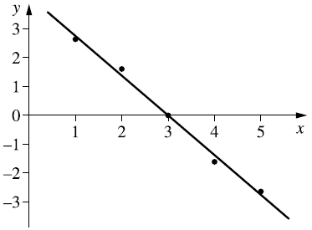
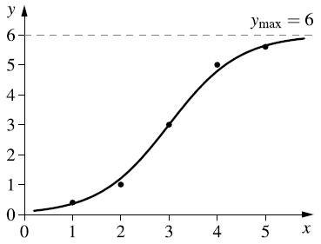
Example – Logit Transformation
x | 1 | 2 | 3 | 4 | 5
y | 0.4 | 1.0 | 3.0 | 5.0 | 5.6
The data
Can be transformed with a logit-transformation, and the linear regression line is fitted to
$$z=logit\left(y\right)=4.133−1.3775x$$
We can transform $y$ back with the logistic function, and obtain the logistic regression curve
$$y=\frac{6}{1+e^{4.133−1.3775x}}$$

Slide 36
Model vs. Black-box
When the principal functional dependency between the dependent variable $Y$ and the predictor variables $x_{1}, . . . ,x_{k}$ is known, an explicit parameterized (possibly nonlinear) regression function can be specified.
The coefficients $a_{i}$can be interpreted as weighting factors, at least when the predictor variables $x_{1}, . . . ,x_{k}$have been normalised.
They also provide information of a positive or negative correlation of the predictor variables with the dependent variable $Y$ .
Usually, complex regression functions yield black-box models, which might provide a good approximation of the data, but do not admit a useful interpretation (of the coefficients).

Slide 37
Generalization
Considering a data set as a collection of examples, describing the dependency between the predictor variables and the dependent variable, the regression function should “learn” this dependency from the data
The same function should also be able to generalize it to make correct predictions on new data.
The regression function “learns” a description of the data, not of the structure of the data.
The prediction using a complex regression function can be worse than the prediction using a simpler regression function (overfitting).

Slide 38
Robust Regression

Slide 39
Robust Regression
Ordinary regression – sensitive to outliers
Solution: robust regression
Let’s re-write the cost function as
For the least square method, the function $ρ$ is a square function
(i.e., $ρ\left(e\right)=e^{2}$)
$$F\left(a\right)={\left(Xa−y\right)}^{T}\left(Xa−y\right)=\sum_{i=1}^{n}{ρ}\left(e_{i}\right)=\sum_{i=1}^{n}{ρ}\left(x_{i}^{T}a−y_{i}\right)$$

Slide 40
Robust Regression
More generally, the $ρ$ function can be any function satisfying the following:
Parameter estimation with a cost function with a $ρ$ function satisfying these conditions are called an M-estimator.
$ρ\left(e\right)≥0,$
$ρ\left(0\right)=0,$
$ρ\left(e\right)=ρ\left(−e\right),$
$ρ\left(e_{i}\right)≥ρ\left(e_{j}\right) if \left|e_{i}\right|≥ \left|e_{j}\right|$

Slide 41
M-Estimators
Calculate the derivatives w.r.t. the parameters $a_{i}$ in
We find the solution to the system of linear equations
Where $ψ=ρ^{′}$. If we define $w(e)=ψ(e)/e$ and $w_{i}=w\left(e_{i}\right)$,
The solution is the same as the standard least squares problem with weights $\sum_{i=1}^{n}{w_{i}e_{i}^{2}}$
$$\sum_{i=1}^{n}{ρ}\left(e_{i}\right)=\sum_{i=1}^{n}{ρ}\left(x_{i}^{T}a−y_{i}\right)$$
$$\sum_{i=1}^{n}{ψ_{i}}\left(x_{i}^{T}a−y_{i}\right)x_{i}^{T}=0$$
$$\sum_{i=1}^{n}{\frac{ψ_{i}\left(x_{i}^{T}a−y_{i}\right)}{e_{i}}∙}e_{i}∙x_{i}^{T}=\sum_{i=1}^{n}{w_{i}e_{i}^{2}x_{i}^{T}}=0$$

Slide 42
M-Estimators
Problems in finding the solution:
The weights $w_{i}$ depend on the errors $e_{i}$
The errors $e_{i}$ depend on the weights $w_{i}$
Strategy: alternating optimization
Choose an initial solution $a^{(0)}$, (e.g., standard least squares solution) and set all weights to $w_{i}=1$
At step $t$, calculate the residuals $e^{(t−1)}$ and the corresponding weights $w^{(t−1)}=w(e^{(t−1)}$)
Compute the solution to the weighted least squared problem
Where $W$ is a diagonal matrix with weights $w_{i}$ on the main diagonal
$a^{(0)}={\left(X^{T}W^{(t−1)}X\right)}^{−1}$ $X^{T}W^{(t−1)}y$

Slide 43
Methods of Robust Regression
Method | $$ρ\left(e\right)$$
Least squares | $$e^{2}$$
Huber | $$\left\{\begin{aligned} \frac{1}{2}e^{2} if \left|e\right|≤k, \\ k\left|e\right|−\frac{1}{2}k^{2} if \left|e\right|>k\end{aligned}\right.$$
Tukey’s bisquare | $$\left\{\begin{aligned} \frac{k^{2}}{6}(1−{\left(1−{\left(\frac{e}{k}\right)}^{2}\right)}^{3}) if \left|e\right|≤k, \\ \frac{k^{2}}{6} if \left|e\right|>k\end{aligned}\right.$$
Where parameter k needs to be chosen for Huber and Tukey’s bisquare

Slide 44
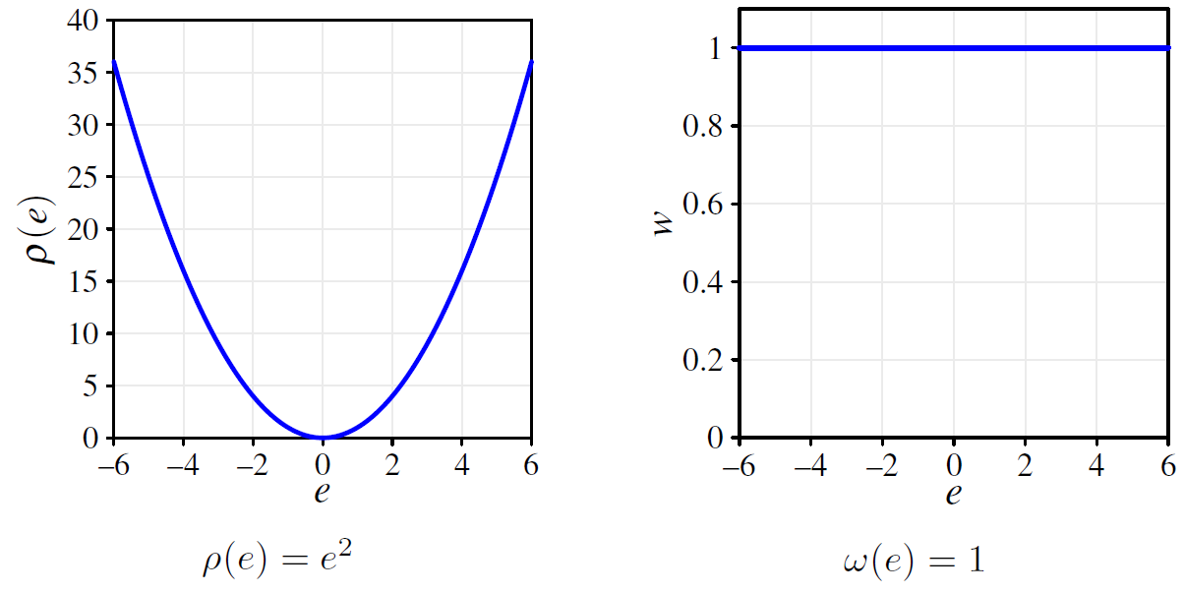
Least Squares
The error measure $ρ$ increases in a quadratic manner with increasing deviation
➔ Extreme outliers have full influence

Slide 45
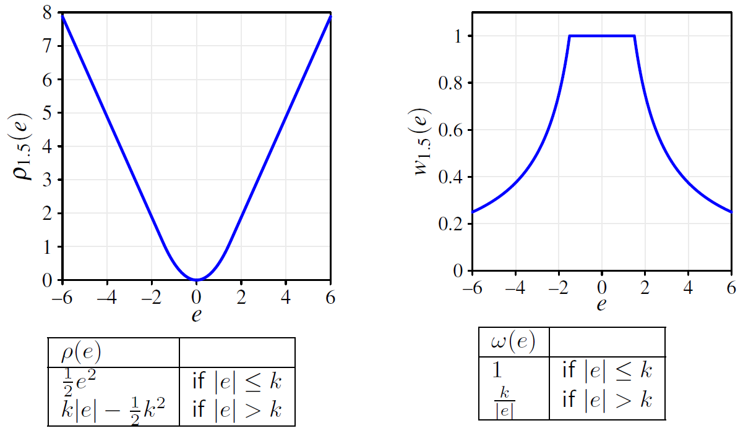
Huber (k=1.5)
The error measure $ρ$ switches from quadratic (for small errors) to linear (for large errors)
➔ Only data points with small error have full influence

Slide 46
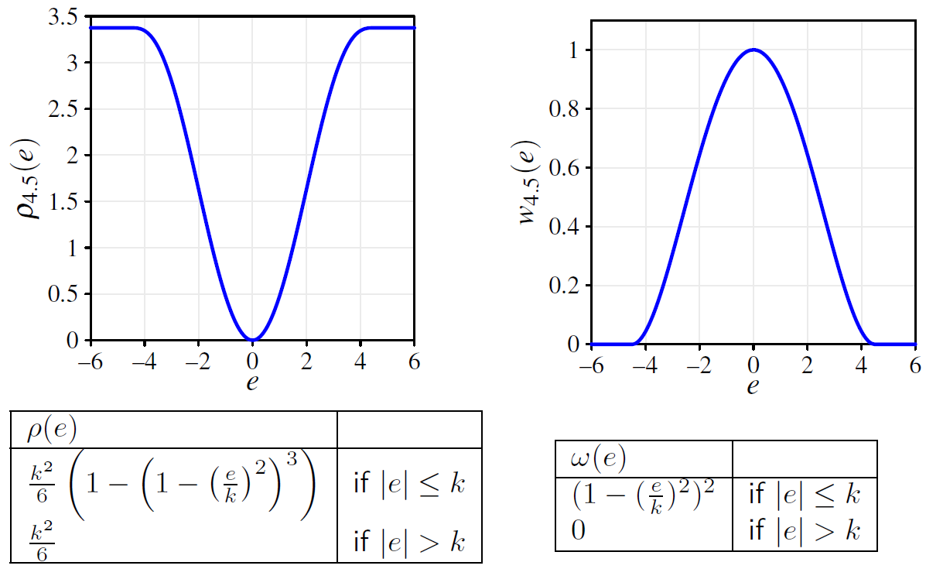
Tukey’s Bisquare (k=4.5)
The error measure $ρ$ does not increase for large errors
➔ Weights of extreme outliers drop to zero

Slide 47
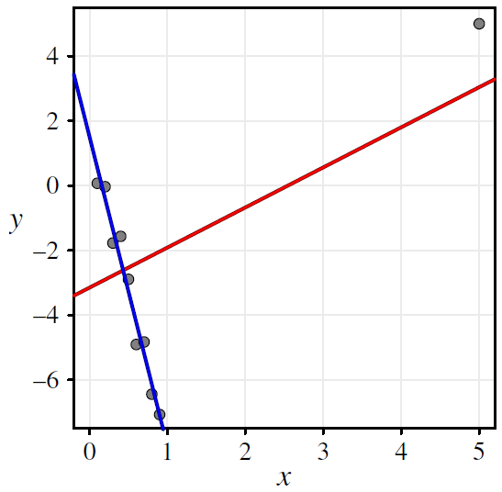
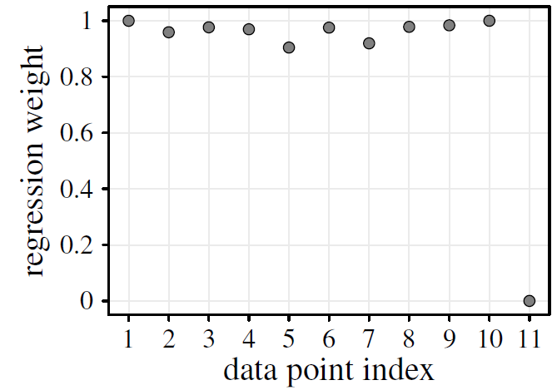
Least Squares vs. Robust Regression
An extreme outlier influences the regression line in least squares
The influence of the outlier is attenuated in robust regression
Reduced weight is apparent in a plot of regression weights in robust regression

Slide 48
Regression for Classification

Slide 49
Regression and nominal attributes
If:
most of the predictor variables are numerical,
and the few nominal attributes have small domains, and
the data set is sufficiently large and covers all combinations.
then we can construct a regression function for each possible combination of the values of the nominal attributes.
Example:
Possible solution to predict weight: four regression functions for (F,Yes),(F,No),(M,Yes),(M,No) using only age and height as predictor variables.
Attribute | Type / Domain
sex | F/M
vegetarian | yes/no
Age | numerical
Height | numerical
Weight | numerical

Slide 50
Regression and nominal attributes
Alternative approach:
Encode the nominal attributes as numerical attributes.
Binary attributes can be encoded as 0/1 or −1/1
For nominal attributes with more than two values, a 0/1 or −1/1 numerical attribute should be introduced for each possible value of the nominal attribute (1-of-n coding).
Do not encode nominal attributes with more than two values in one numerical attribute, unless the nominal attribute is actually ordinal.

Slide 51
Classification as Regression
A two-class classification problem (classes 0 vs. 1) can be viewed as a regression problem
Challenges:
A regression function usually cannot produce outcomes 0 or 1
The cost functions aim to reduce the numerical error (measured as squared residuals, for example), not misclassification
Solution:
A regression model for the probability of belonging to a certain class
A probability cut-off (e.g, probability > 0.5) can be used for classification

Slide 52
Classification as Regression: Example
1000 data objects, 500 belonging to class 0, 500 to class 1.
Regression function $f$yields 0.1 for all data from class 0 and 0.9 for all data from class 1.
Regression function $g$ always yields the exact and correct values 0 and 1, except for 9 data objects where it yields 1 instead of 0 and vice versa.
From the viewpoint of regression $g$ is better than $f$ (smaller MSE), from the viewpoint of misclassifications $f$ should be preferred.
Regression function | Mis-classifications | MSE
f | 0 | 0.01
g | 9 | 0.009

Slide 53
Logistic Regression: Two-class problem
Two-Class Problem:
If $Y$ belongs to one of two classes $\left\{c_{1},c_{2}\right\}$, then we can model the probability for one class only
Given: A set of data points $\left\{x_{1},{.., x}_{n}\right\}$each assigned to one of the two classes $c_{1}$and $c_{2}$.
Desired: Train a function, which gives us the probability $p(x)$ for each class (0 and 1) based on the input features for the given dataset.
$$P\left(Y=c_{1} | X=x\right)=p(x)$$
$$P\left(Y=c_{2} | X=x\right)=1−p(x)$$

Slide 54
Linear Regression vs. Logistic Regression
 | Linear Regression | Logistic Regression
Target variable y | Numeric $y∈(−∞,∞)/[a,b]$ | Nominal $y∈\left\{0, 1, 2, 3\right\}/\{red, white\}$
Functional relationship between features and… | … target value $y$ $$y=f(x_{1},…,x_{n}, β_{0},…,β_{n})$$ ${ y=β}_{0}+β_{1}x_{1}+…+β_{n}x_{n}$ | … class probability P (y = class i) $P\left(y=c_{i}\right)=f\left(x_{1},…, x_{n},β_{0},…, β_{n}\right)$
Goal: Find the regression coefficients $β_{0},…, β_{n}$

Slide 55
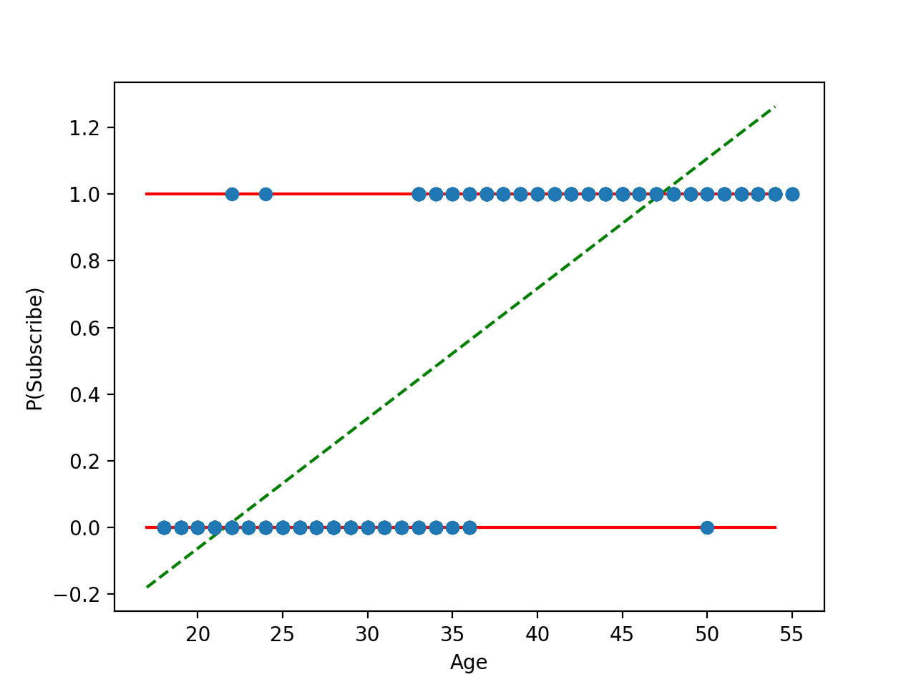
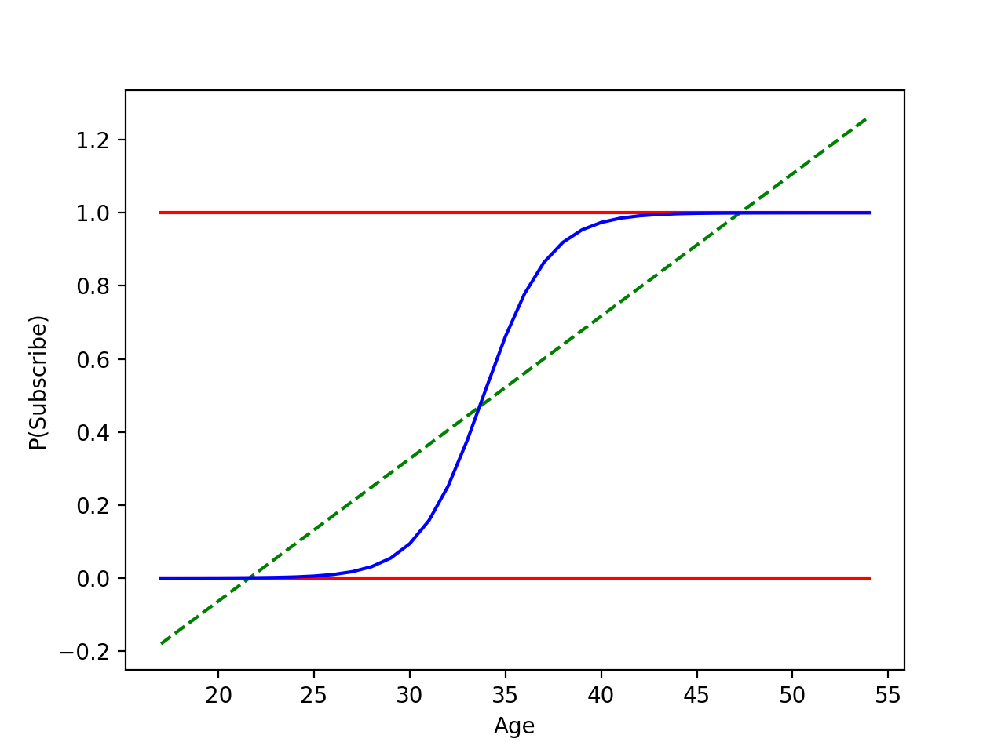
Example where Linear Regression Fails
Result: $p\left(subscribe\right)=−0.84+0.04 age$
Problem:
$p\left(subscribe\right)<0 for age=20 and p\left(subscribe\right)>1 for age=50$
Notes:
As a result of the linear regression we get the beta_0 =-0.84 and beta_1 =0.04.
This means that every additional year increases the probability of subscription by 0.04%.
If we know look at the plot of the linear regression we see that for people which are older than 50 the probability of subscribing is bigger than one and if they are younger than 20 the probability is less than zero.
As a probability is always bounded between 0 and 1 this makes no sense why we are looking for a different model, for example something that looks like a s shaped function which is always between 0 and 1 and is monotonously increasing (can be also decreasing) which converges towards 0 or 1 for x towards infinity

Slide 56
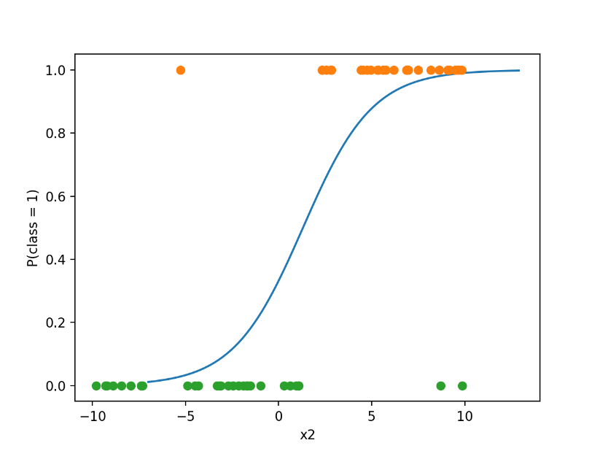
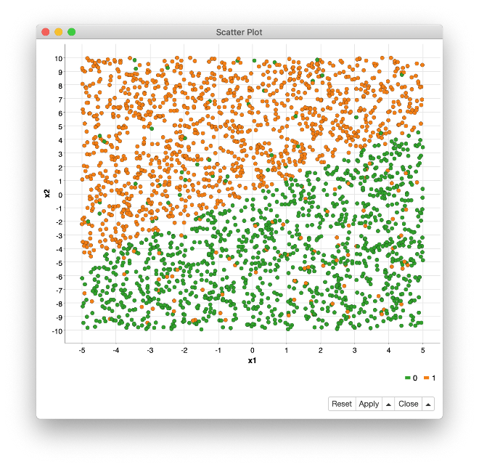
Let’s Find Out How Binary Logistic Regression Works!
Probability function given $x_{1}=2$
$$P\left(y=1\right)=f\left(x_{1}, x_{2};{β_{0},β}_{1},β_{2}\right)≔\frac{1}{{1+e}^{{{−(β}_{0}+β}_{1}x_{1}+β_{2}x_{2})}}$$
Feature space

Slide 57
Logistic Regression: two-class problem
Approach: Describe the probability p by the logistic function:
By applying the logit-transformation, we have a multivariate regression problem
that is, a multilinear regression problem, which can be solved with the introduced techniques.
$$p\left(x\right)=\frac{1}{1+exp⁡(a_{0}+\sum_{j=1}^{m}{a_{j}x_{j}})}$$
$$\ln\left(\frac{1−p\left(x\right)}{p\left(x\right)}\right)=a_{0}+\sum_{j=1}^{m}{a_{j}x_{j}}$$

Slide 58
Logistic Regression: Two-class problem
How do we determine class probability $p\left(x\right)$ for this regression problem?
If we have sufficiently many realizations for all possible data points
➔ $p\left(x\right)$ can be estimated by the relative frequencies of the classes
If there aren’t many realizations, we rely on kernel estimation

Slide 59
Kernel Estimation
Idea: Define an “influence function” (kernel), which describes how strongly a data point influences the probability estimate for neighboring points.
The “influence” is stronger from a closer point, weaker for a distant point
The “influence” is modeled by a kernel function
Example: Gaussian kernel
Where $y$ is a neighbor of $x$
Higher (or lower) influence if $x$ and $y$ are closer (or farther)
Variance $σ^{2}$ has to be chosen by the user.
$$K\left(x,y\right)=\frac{1}{{\left(2πσ^{2}\right)}^{\frac{m}{2}}}\exp\left(−\frac{{(x−y)}^{T}(x−y)}{2σ^{2}}\right)$$

Slide 60
Kernel Estimation
Kernel estimation for a two-class problem
➔ $p(x)$ is estimated as the sum of $k(∙,∙)$ between $x$ and all other data points belonging to class $c_{1}$
$$\hat{p}\left(x\right)=\frac{\sum_{i=1}^{n}{c\left(x_{i}\right)K(x,x_{i})}}{\sum_{i=1}^{n}{K(x,x_{i})}}$$
$$c\left(x_{i}\right)=\left\{\begin{matrix}1 \\ 0\end{matrix}\right.$$
if $x_{i}$ belongs to class $c_{1}$
otherwise

Slide 61
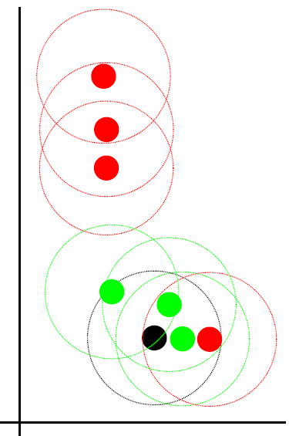
Example – Kernel Estimation
If red $≡c_{1}$, we calculate the sum of kernel functions between $x$ and all red neighbors
Data
Sum of influences from red neighbors
$$\hat{p}\left(x\right)$$
$$x$$

Slide 62
Example – Kernel Estimation
If green${≡c}_{1}$, we calculate the sum of kernel functions between $x$ and all green neighbors
Data
Sum of influences from green neighbors
$$\hat{p}\left(x\right)$$
$$x$$

Slide 63
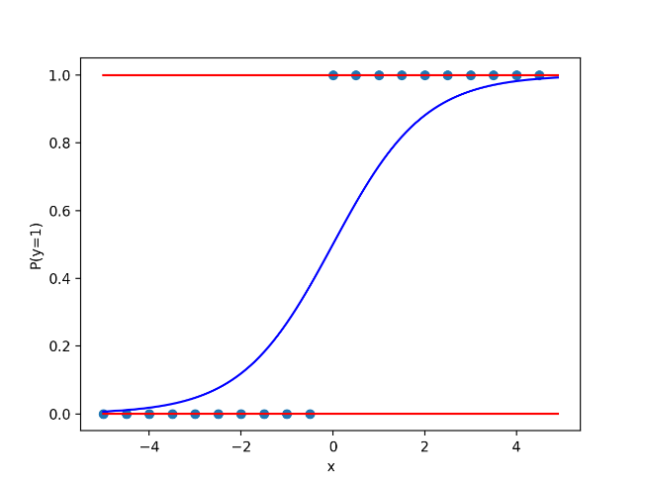
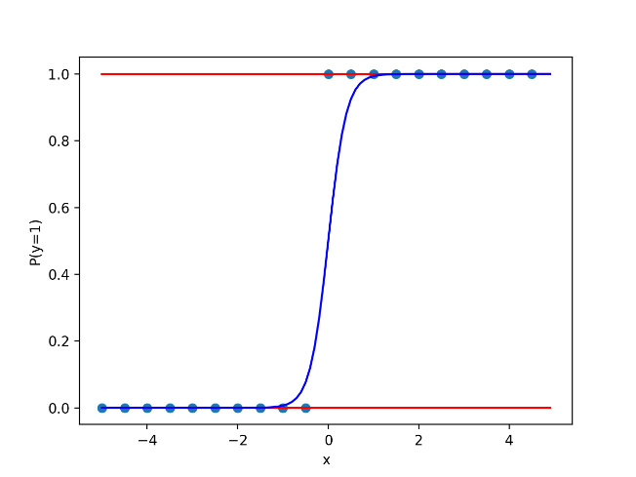
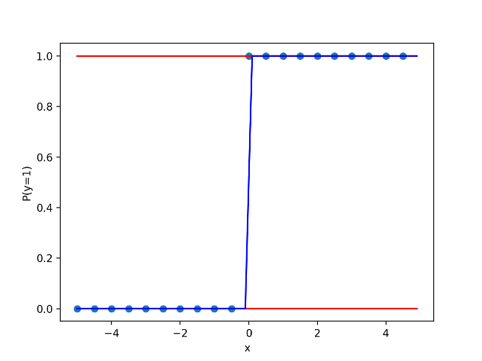
Regularization in Logistic Regression
Is there a way to handle overfitting?
If data are linearly separable, coefficients becomes extremely large
➔ Overfitting
$$P\left(y=1\right)=\frac{1}{1+e^{−x}}$$
$$P\left(y=1\right)=\frac{1}{1+e^{−5x}}$$
$$P\left(y=1\right)=\frac{1}{1+e^{−100x}}$$

Slide 64
Regularization in Logistic Regression
The parameters in a logistic regression model is determined by maximizing the likelihood function
Or equivalently, minimizing the (negative) log-likelihood function
To avoid overfitting: add regularization by penalizing large coefficients
Estimate of coefficient vector $β$ obtained by:
$$\hat{β}=\min_{β}\left\{−LL\left(β, y, x \right)+ λ R\left(β\right)\right\}$$
The choice of the regularization term $R(β)$: Gauss, Laplace, L1, L2, etc.

Slide 65
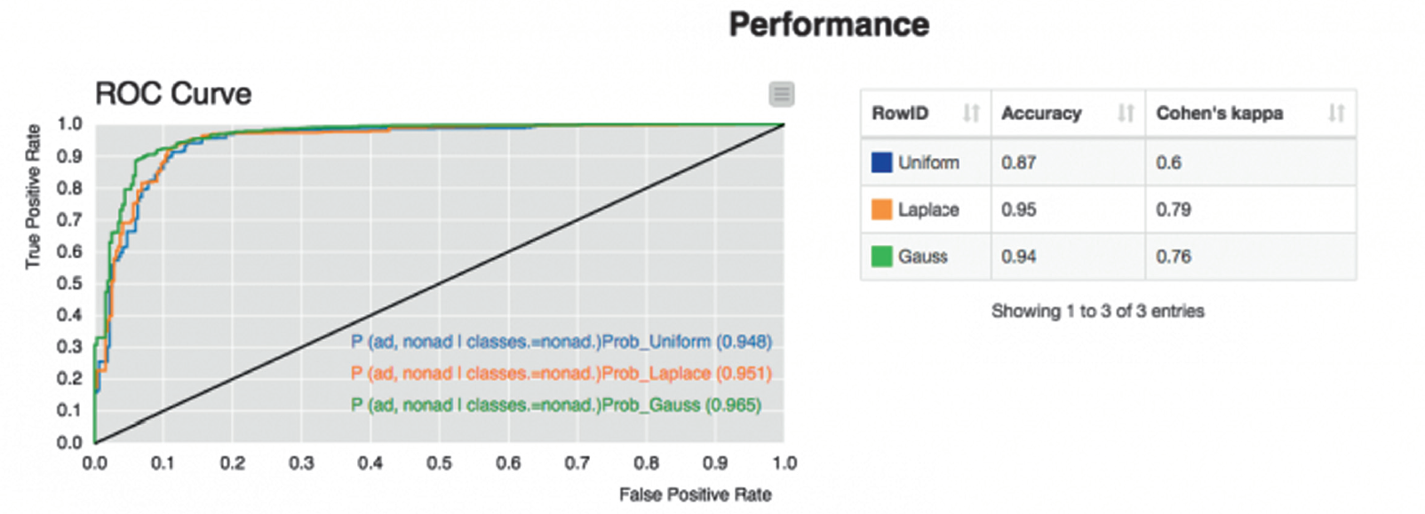
Regularization Example
Internet Advertisement Data – UCI Machine Learning Repository
More features (680) than samples (n=120)
➔ Prone to overfitting
Logistic regression with no regularization (uniform) (blue), Laplace (orange), and Gauss (green)

Slide 66
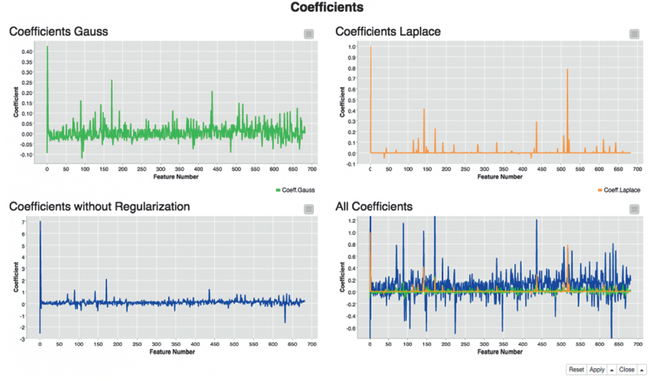
Regularization Example
Without regularization ➔ large regression coefficients

Slide 67
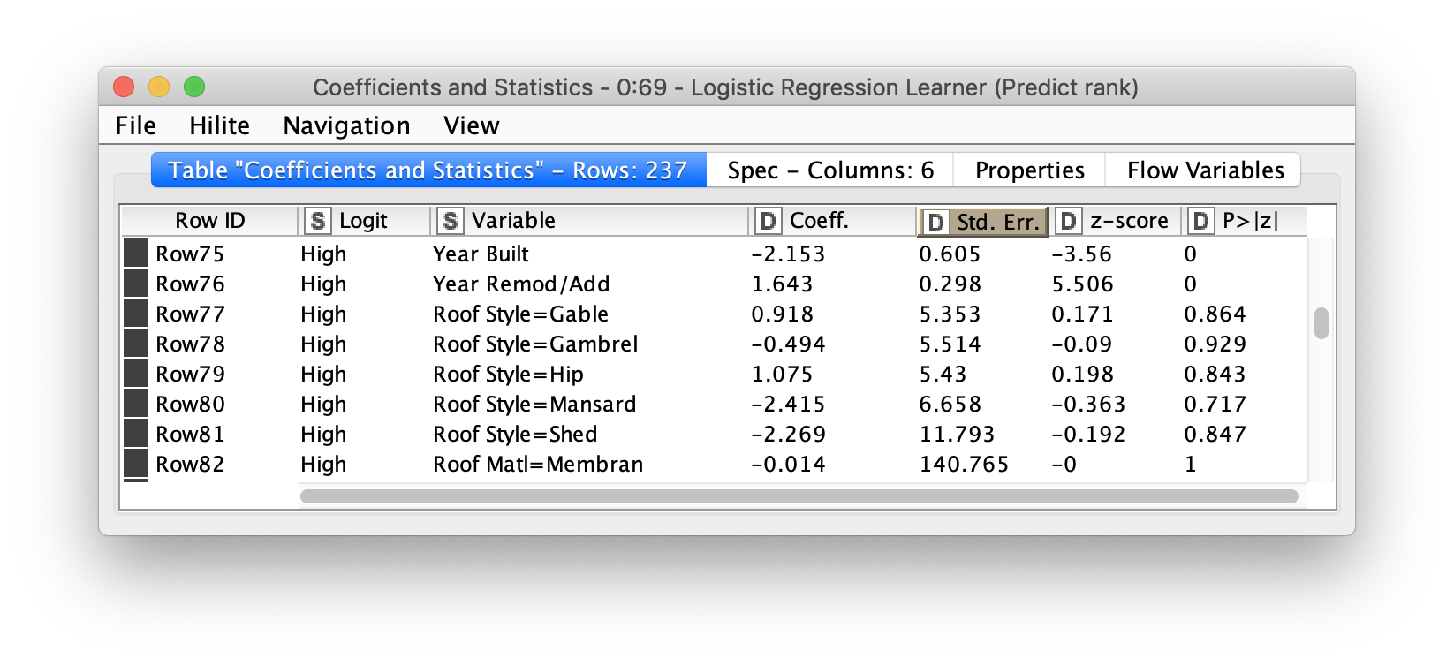
Interpretation of the Coefficients
Interpretation of the sign
$β_{i}>0$: Bigger $x_{i}$ lead to higher probability
$β_{i}<0$: Bigger $x_{i}$ lead to smaller probability

Slide 68
Interpretation of the p Value
p- value < $α$: input feature has a significant impact on the dependent variable.
Notes:
p- value < $α$: we reject the null hypothesis and say that the independent variable has a significant impact on the dependent variable.

Slide 69
Summary
Pros:
Strong mathematical foundation
Simple to calculate and to understand (for a moderate number of dimensions)
High predictive accuracy
Cons:
Many dependencies are non-linear
Global model does not adapt to locally different data distributions

Slide 70
Summary
Logistic regression is used for classification problems
The regression coefficients are calculated by maximizing the likelihood function, which has no closed form solution, hence iterative methods are used.
Regularization can be used to avoid overfitting.
The p-value shows us whether an independent variable is significant

Slide 71
Practical Example with KNIME Analytics Platform

Slide 72
Logistic Regression
Training and application of a logistic regression model. Notice the Missing Value node to fix possible missing values in the data

Slide 73
Thank you

