Slide 1
Deep Learning

Slide 2
Summary of this lesson
“What people call AI is no more than finding answers to questions we know to ask. Real AI is answering questions we haven't dreamed of yet” -Tom Golway
How deep can we dig in AI?
*This lesson refers to chapter 9 of the GIDS book

Slide 3
Content of this lesson
Recurrent Neural Networks (RNNs)
Long Short Term Memories (LSTMs)
Convolutional Neural Networks (CNNs)
Generative Adversarial Networks (GANs)

Slide 4
Datasets
Datasets used:

Slide 5
Deep Learning
Deep Learning is the recent evolution of Neural Networks
It covers:
Feedforward networks with many hidden layers (deep ☺)
New paradigms, like LSTMs in Recurrent Neural Networks, suitable for time series analysis
New topological layers, like convolutional and pooling layers, mainly for image processing
New architectures as in Generative Adversarial Networks (GANs)
...
Improvements are mainly due to:
Increased computational power for faster calculations, like GPUs
Parallel Computation
Guide to Intelligent Data Science Second Edition, 2020
Notes:
Building blocks have existed for decades
LSTMs were introduced first introduced in 1991 in the diploma theses of Sepp Hochreiter
Backpropagation
Deep learning networks are extremely data hungry. In the area of big data we have access to enough data
Training algorithms can be highly parallelized and can therefore benefit tremendously from modern GPU architectures that did not exists when these algorithms were developed

Slide 6
Recurrent Neural Networks (RNNs)

Slide 7
What are Recurrent Neural Networks?
Recurrent Neural Networks (RNNs) are a family of neural networks suitable for processing of sequential data
RNNs include auto and backward connections
RNNs are used for all sorts of tasks:
Language modeling / Text generation
Text classification
Neural machine translation
Image captioning
Speech to text
Numerical time series data, e.g. sensor data
Time series analysis
…
Guide to Intelligent Data Science Second Edition, 2020
Notes:
Stock prices
Sound waves

Slide 8
Why do we need RNNs for Sequential Data?
Goal: Translation from German to English “Ich mag Schokolade” => “I like chocolate”
Option one: Use feed forward network to translate word by word
But what happens with this question? “Mag ich Schokolade?” => “Do I like chocolate?”
$$∑$$
$$σ$$
$$∑$$
$$σ$$
$$∑$$
$$σ$$
$$x$$
$$∑$$
$$σ$$
$$∑$$
$$σ$$
$$y$$
$$∑$$
$$σ$$
$$∑$$
$$σ$$
$$∑$$
$$σ$$
Input x | Output y
Ich | I
mag | like
Schokolade | chocolate
Guide to Intelligent Data Science Second Edition, 2020

Slide 9
Why do we need RNNs for Sequential Data?
Problems with FFNN:
Each time step is completely independent
For translations we need context
More general: we need a network that remembers inputs from the past
Handle variable sequence length
Solution: Recurrent Neural Networks
$$∑$$
$$σ$$
$$∑$$
$$σ$$
$$∑$$
$$σ$$
$$x$$
$$∑$$
$$σ$$
$$∑$$
$$σ$$
$$y$$
$$∑$$
$$σ$$
$$∑$$
$$σ$$
$$∑$$
$$σ$$
Input x | Output y
Mag | Like
Ich | I
Schokolade | chocolate
Guide to Intelligent Data Science Second Edition, 2020
Notes:
Track long term dependencies and maintain information about the order
Share parameters across the sequence

Slide 10
From Feed Forward to Recurrent Neural Networks
$$W_{x}^{2}$$
$$W_{y}^{3}$$
$$∑$$
$$σ$$
$$∑$$
$$σ$$
$$x_{1}$$
$$∑$$
$$σ$$
$$y_{1}$$
$$W_{x}^{2}$$
$$W_{y}^{3}$$
$$∑$$
$$σ$$
$$x$$
$$∑$$
$$σ$$
$$y$$
$$x_{2}$$
$$∑$$
$$σ$$
$$y_{2}$$
$$∑$$
$$σ$$
$$∑$$
$$σ$$
Guide to Intelligent Data Science Second Edition, 2020
Notes:
Go into one direction from input to output
Not able to maintain information from previous events in an a sequence on events

Slide 11
From Feed Forward to Recurrent Neural Networks
$$W_{x}^{2}$$
$$W_{y}^{3}$$
$$∑$$
$$σ$$
$$∑$$
$$σ$$
$$x_{1}$$
$$y_{1}$$
$$W_{x}^{2}$$
$$W_{y}^{3}$$
$$∑$$
$$σ$$
$$x$$
$$∑$$
$$σ$$
$$y$$
$$x_{2}$$
$$y_{2}$$
$$∑$$
$$σ$$
$$∑$$
$$σ$$
Guide to Intelligent Data Science Second Edition, 2020

Slide 12
From Feed Forward to Recurrent Neural Networks
$$W_{x}^{2}$$
$$W_{y}^{3}$$
$$∑$$
$$tanh$$
$$∑$$
$$σ$$
$$x_{1}$$
$$y_{1}$$
$$W_{x}^{2}$$
$$W_{y}^{3}$$
$$∑$$
$$x$$
$$∑$$
$$σ$$
$$y$$
$$tanh$$
$$x_{2}$$
$$y_{2}$$
$$∑$$
$$tanh$$
$$∑$$
$$σ$$
Guide to Intelligent Data Science Second Edition, 2020

Slide 13
Unrolling of a RNN over time
$$y_{t}$$
$$y_{t+1}$$
$$y_{t+2}$$
$$y_{t+3}$$
$$W_{y}^{3}$$
$$W_{y}^{3}$$
$$W_{y}^{3}$$
$$W_{y}^{3}$$
$$∑$$
$$σ$$
$$∑$$
$$σ$$
$$∑$$
$$σ$$
$$∑$$
$$σ$$
$$∑$$
$$σ$$
$$∑$$
$$σ$$
$$∑$$
$$σ$$
$$∑$$
$$σ$$
$$C_{t−1}$$
$$C_{t}$$
$$C_{t+1}$$
$$C_{t+2}$$
$$C_{t+3}$$
$$∑$$
$$σ$$
$$∑$$
$$σ$$
$$∑$$
$$σ$$
$$∑$$
$$σ$$
$$W_{x}^{2}$$
$$W_{x}^{2}$$
$$W_{x}^{2}$$
$$W_{x}^{2}$$
$$x_{t}$$
$$x_{t+1}$$
$$x_{t+2}$$
$$x_{t+3}$$
time t
Guide to Intelligent Data Science Second Edition, 2020
Notes:
- Instead of having the input from the left and the output at the right, we now say we have the input from the bottom and the output on the top
- in addition we add some more hidden states. So our network gets and additional input state and outputs also and output hidden state.
- What we do next is we just copy the same network and put them in a chain structure. This means the we use the same weight matrixes at each step and we only change the input. And what we see know, is something really similar to the diagram of christopher Olah.
- So what happens here?
We start with some initialized hidden states and then we apply the same static network to each input of sequence. But the static network has some additional hidden states as in and output which allows the network to extract information from the previous values of the sequence into some dense representation and use it when making the next prediction. In other words we add context by allowing the network to remember information from the past.

Slide 14
From Feed Forward to Recurrent Neural Networks
$$W_{x}^{2}$$
$$W_{y}^{3}$$
$$∑$$
$$σ$$
$$∑$$
$$σ$$
$$x_{1}$$
$$∑$$
$$σ$$
$$y_{1}$$
$$W_{x}^{2}$$
$$W_{y}^{3}$$
$$∑$$
$$σ$$
$$x$$
$$∑$$
$$σ$$
$$y$$
$$x_{2}$$
$$∑$$
$$σ$$
$$y_{2}$$
$$∑$$
$$σ$$
$$∑$$
$$σ$$
A Recurrent Neural Network is a FFNN with auto and/or backward connections
Recurrent connections introduce the concept of time in FFNNs
Guide to Intelligent Data Science Second Edition, 2020
Notes:
Loop connection which allows information to persist over time

Slide 15
From Feed Forward to Recurrent Neural Networks
$$y(t−1)$$
$$y_{1}\text{(}\text{t}\text{−1}\text{)}$$
$$W_{x}^{2}$$
$$W_{y}^{3}$$
$$∑$$
$$σ$$
$$∑$$
$$σ$$
$$x_{1}\text{(}\text{t}\text{)}$$
$$∑$$
$$σ$$
$$y_{1}\text{(}\text{t}\text{)}$$
$$W_{x}^{2}$$
$$W_{y}^{3}$$
$$∑$$
$$σ$$
$$∑$$
$$σ$$
$$x(t)$$
$$y(t)$$
$$x_{2}\text{(}\text{t}\text{)}$$
$$∑$$
$$σ$$
$$y_{2}\text{(}\text{t}\text{)}$$
$$∑$$
$$σ$$
$$∑$$
$$σ$$
A Recurrent Neural Network is a FFNN with auto and/or backward connections
Recurrent connections introduce the concept of time in FFNNs
Guide to Intelligent Data Science Second Edition, 2020

Slide 16
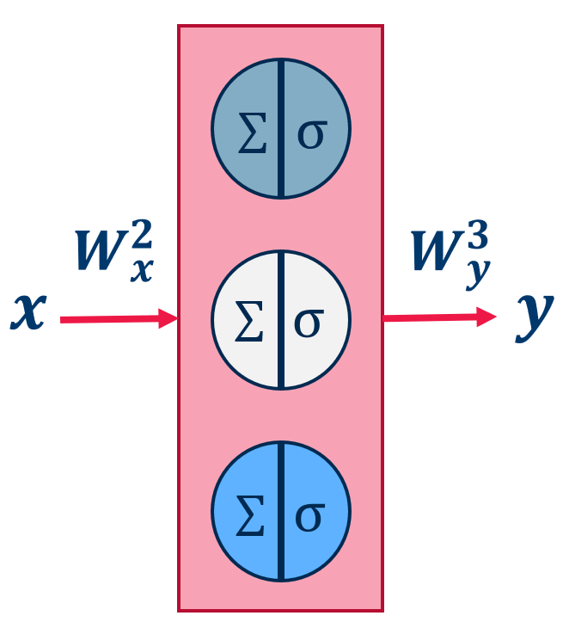
How can we represent a RNN over time?
At every time t, FFNN A has two inputs:
x(t)
some shape of y(t-1) -> state of network A: C(t-1)
The recurrent network can then be unrolled over time around A
=
Guide to Intelligent Data Science Second Edition, 2020
Notes:
Here we see an of image how RNN are often visualized which I took from a famous blog post introducing RNN by Christopher Olah .
if we take a look at the one on the left we see a loop connection, which indicates that we somehow feed some information back.
On the left you see a second way of depicting an RNN which is the unrolled version of this loop connection. But how is this related to our feed forward network we talked about in the beginning?

Slide 17
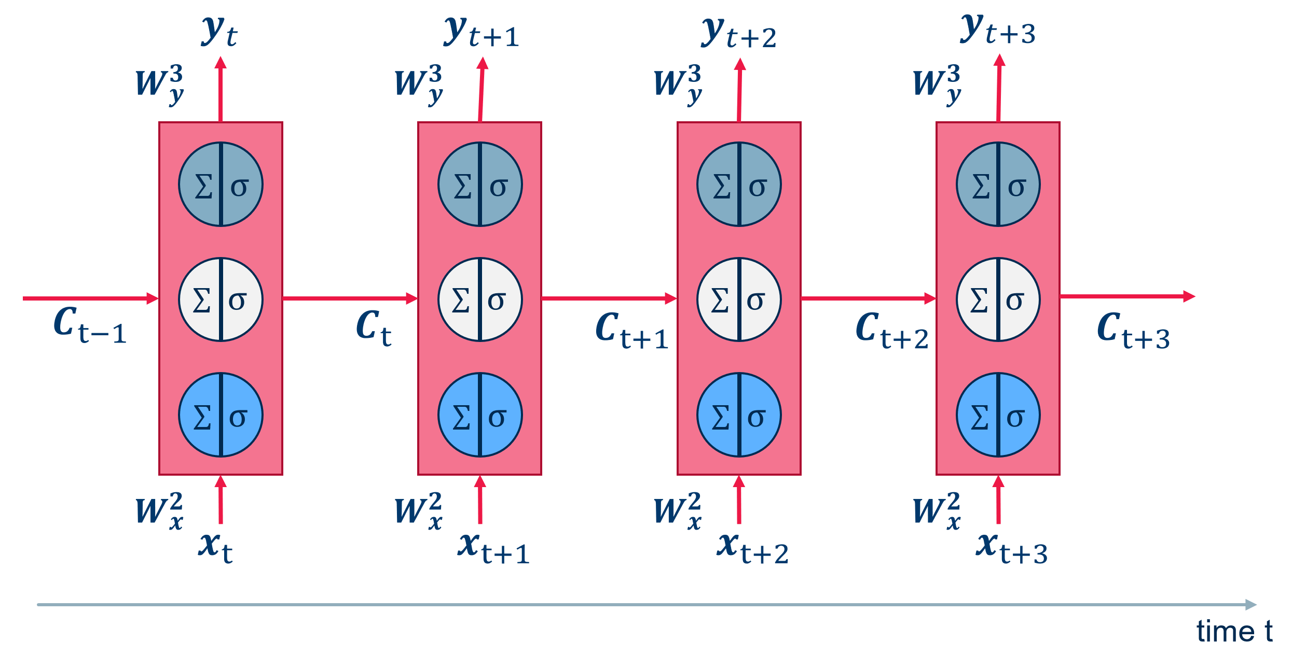
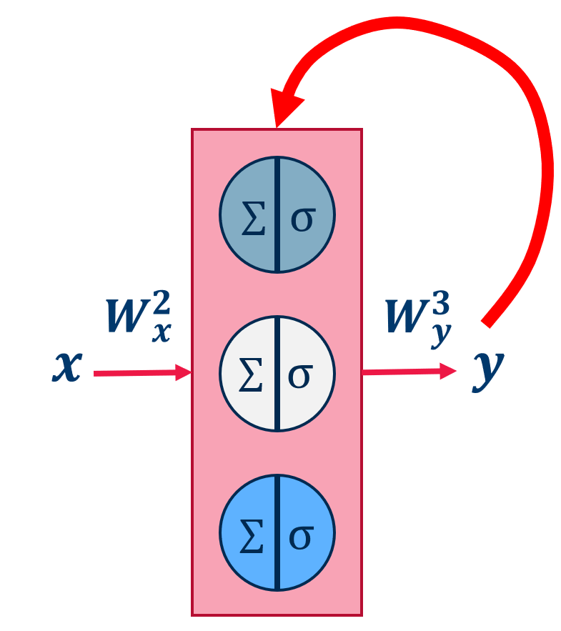
Unrolling of a RNN over time
The unrolled version of the original network in m intermediate steps becomes a FFNN and can be trained with BackPropagation: Back-Propagation Through Time (BPTT).
=
Guide to Intelligent Data Science Second Edition, 2020
Notes:
- Instead of having the input from the left and the output at the right, we now say we have the input from the bottom and the output on the top
- in addition we add some more hidden states. So our network gets and additional input state and outputs also and output hidden state.
- What we do next is we just copy the same network and put them in a chain structure. This means the we use the same weight matrixes at each step and we only change the input. And what we see know, is something really similar to the diagram of christopher Olah.
- So what happens here?
We start with some initialized hidden states and then we apply the same static network to each input of sequence. But the static network has some additional hidden states as in and output which allows the network to extract information from the previous values of the sequence into some dense representation and use it when making the next prediction. In other words we add context by allowing the network to remember information from the past.

Slide 18
Summarizing: RNNs and BPTT
Neural network architectures with recurring connections on some units are named Recurrent Neural Networks (RNNs).
Adding a recurrent connection to one unit might store information about past inputs in the evolving status of the unit.
An easy trick to represent the recurrent network is to unroll it into m copies of the feedforward internal block “A”, each with their set of static weight matrix W. Each copy of “A” receives inputs X(t) and C(t-1) and produces output y(t).
A modified version of the Back-Propagation algorithm is used to train RNNs: Back-Propagation Through Time (BPTT).
Guide to Intelligent Data Science Second Edition, 2020

Slide 19
Long Short Term Memory

Slide 20
Simple Recurrent Unit
The simplest possible recurrent unit is a single layer with an auto-connection.
$$x(t)$$
$$∑$$
$$tanh$$
$$h(t)$$
$$C\left(t\right)=h(t)$$
Image Source: Christopher Olah, https://colah.github.io/posts/2015-08-Understanding-LSTMs/
Guide to Intelligent Data Science Second Edition, 2020
Notes:
These simple rnn units to have some limitatations and quite often the memory of these simple RNNs is to limited to be useful

Slide 21
Limitations of Layers with Simple Recurrent Units
The “memory” of simple RNNs is sometimes too limited to be useful:
“Cars drive on the ” (road)
“I love the beach.
My favorite sound is the crashing of the “ (cars? glass? waves?)
Sometimes we need to go back deeper in time
Guide to Intelligent Data Science Second Edition, 2020

Slide 22
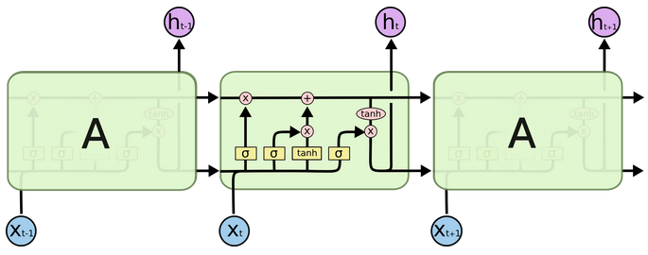
LSTM = Long Short Term Memory
Special type of unit with three gates
Forget gate
Input gate
Output gate
Image Source: Christopher Olah, https://colah.github.io/posts/2015-08-Understanding-LSTMs/
Guide to Intelligent Data Science Second Edition, 2020
Notes:
Key: Cell State, the horizontal line running through the top of the diagram. It run straight down the enter chain
Very easy for information to flow along it unchanged
Cell state might include the gender or the present subject, so the correct verbs and pronouns can be used. When we see a new subject, we want to delete the gender of the old subject
Decide which information we want to add
Tanh creates a candidate value
Input gate decides which information we want to add
In the example add the gender information
Finally we need to decide which information we want to output based on the cell state. Since the last input was a subject we might to output the information whether the subject is plural or singular to know what form a verb should be conjugated

Slide 23
LSTM = Long Short Term Memory
This is an engineered type of unit with three gates:
Forget gate
Input gate
Output gate
$$C(t−1)$$
$$C(t)$$
$$x(t)$$
Forget gate
Input gate
Output gate
$$h(t−1)$$
$$h(t)$$
Guide to Intelligent Data Science Second Edition, 2020
Notes:
Key: Cell State, the horizontal line running through the top of the diagram. It run straight down the enter chain
Very easy for information to flow along it unchanged
Cell state might include the gender or the present subject, so the correct verbs and pronouns can be used. When we see a new subject, we want to delete the gender of the old subject
Decide which information we want to add
Tanh creates a candidate value
Input gate decides which information we want to add
In the example add the gender information
Finally we need to decide which information we want to output based on the cell state. Since the last input was a subject we might to output the information whether the subject is plural or singular to know what form a verb should be conjugated

Slide 24
LSTM = Forget Gate
This is an engineered type of unit with three gates:
Forget gate
Input gate
Output gate
$$C(t−1)$$
$$C(t)$$
$$x(t)$$
Forget gate
Input gate
Output gate
$$h(t−1)$$
$$h(t)$$
Guide to Intelligent Data Science Second Edition, 2020
Notes:
Key: Cell State, the horizontal line running through the top of the diagram. It run straight down the enter chain
Very easy for information to flow along it unchanged
Cell state might include the gender or the present subject, so the correct verbs and pronouns can be used. When we see a new subject, we want to delete the gender of the old subject
Decide which information we want to add
Tanh creates a candidate value
Input gate decides which information we want to add
In the example add the gender information
Finally we need to decide which information we want to output based on the cell state. Since the last input was a subject we might to output the information whether the subject is plural or singular to know what form a verb should be conjugated

Slide 25
LSTM: Forget Gate
Forget Gate is trained to forget parts of the cell state.
At time t, the forget gate decides which item of$C\left(t−1\right)$ to keep (and how much of it) in $C\left(t\right),$given input vector$x\left(t\right)$ and previous output $h\left(t−1\right)$.
$$C_{f}(t)$$
remember (1)
forget (0)
$$C(t−1)$$
$$f_{j}$$
$$f(t)$$
$$h_{j}$$
$$x_{j}$$
$$h(t−1)$$
$$x(t)$$
Guide to Intelligent Data Science Second Edition, 2020

Slide 26
LSTM: Forget Gate
Forget Gate is trained to forget parts of the cell state.
At time t, the forget gate decides which item of$C\left(t−1\right)$ to keep (and how much of it) in $C\left(t\right),$given input vector$x\left(t\right)$ and previous output $h\left(t−1\right)$.
$$C_{f}(t)$$
$$C_{f}(t)$$
remember (1)
forget (0)
$$C(t−1)$$
$$f_{j}$$
$$f(t)$$
$$C(t−1)$$
x
$$f(t)$$
$$h_{j}$$
$$x_{j}$$
$$h(t−1)$$
$$x(t)$$
Guide to Intelligent Data Science Second Edition, 2020

Slide 27
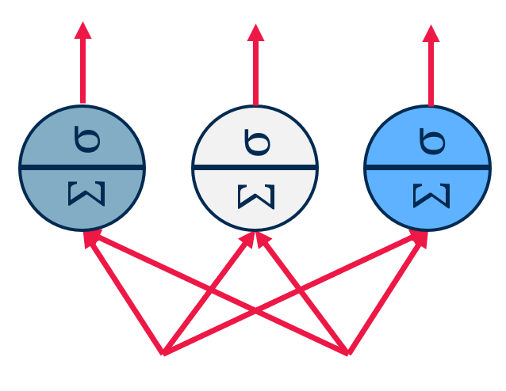
LSTM: Forget Gate
Forget Gate is trained to forget parts of the cell state.
At time t, the forget gate decides which item of$C\left(t−1\right)$ to keep (and how much of it) in $C\left(t\right),$given input vector$x\left(t\right)$ and previous output $h\left(t−1\right)$.
$$C_{f}(t)$$
$$C_{f}(t)$$
remember (1)
forget (0)
$$C(t−1)$$
$$f_{j}$$
$$f(t)$$
$$C(t−1)$$
x
$$f(t)$$
$$h_{j}$$
$$x_{j}$$
$$h(t−1)$$
$$x(t)$$
Guide to Intelligent Data Science Second Edition, 2020

Slide 28
LSTM: Forget Gate
Forget Gate is trained to forget parts of the cell state.
At time t, the forget gate decides which item of$C\left(t−1\right)$ to keep (and how much of it) in $C\left(t\right),$given input vector$x\left(t\right)$ and previous output $h\left(t−1\right)$.
$$C_{f}(t)$$
$$C_{f}(t)$$
remember (1)
forget (0)
$$C(t−1)$$
$$f_{j}$$
$$f(t)$$
$$C(t−1)$$
x
$$f(t)$$
$$σ$$
$$h_{j}$$
$$x_{j}$$
$$h(t−1)$$
$$x(t)$$
$$h(t−1)$$
$$x(t)$$
Guide to Intelligent Data Science Second Edition, 2020

Slide 29
LSTM: Forget Gate
Forget Gate is trained to forget parts of the cell state.
At time t, the forget gate decides which item of$C\left(t−1\right)$ to keep (and how much of it) in $C\left(t\right),$given input vector$x\left(t\right)$ and previous output $h\left(t−1\right)$.
$$C_{f}(t)$$
$$C_{f}(t)$$
$$C_{f}(t)=f\left(t\right)∗C(t−1)$$
remember (1)
forget (0)
$$C(t−1)$$
$$f_{j}$$
$$f(t)$$
$$C(t−1)$$
x
$$f(t)$$
$$f_{j}\left(t\right)=σ\left(W_{f}∙\left[h_{j}\left(t−1\right),x_{j}\left(t\right)\right]+b_{f}\right)$$
$$σ$$
$$h_{j}$$
$$x_{j}$$
$$h(t−1)$$
$$x(t)$$
$$h(t−1)$$
$$x(t)$$
Guide to Intelligent Data Science Second Edition, 2020

Slide 30
LSTM = Input Gate
This is an engineered type of unit with three gates:
Forget gate
Input gate
Output gate
$$C(t−1)$$
$$C(t)$$
$$x(t)$$
Forget gate
Input gate
Output gate
$$h(t−1)$$
$$h(t)$$
Guide to Intelligent Data Science Second Edition, 2020
Notes:
Key: Cell State, the horizontal line running through the top of the diagram. It run straight down the enter chain
Very easy for information to flow along it unchanged
Cell state might include the gender or the present subject, so the correct verbs and pronouns can be used. When we see a new subject, we want to delete the gender of the old subject
Decide which information we want to add
Tanh creates a candidate value
Input gate decides which information we want to add
In the example add the gender information
Finally we need to decide which information we want to output based on the cell state. Since the last input was a subject we might to output the information whether the subject is plural or singular to know what form a verb should be conjugated

Slide 31
LSTM: Input Gate
Input Gate is trained to inject significant parts of the current input into the cell state.
At time t, the input gate decides which item of$x\left(t\right)$ to inject (and how much of it) into $C\left(t\right),$given input vector$x\left(t\right)$ and previous output $h\left(t−1\right)$.
$$C_{i}(t)$$
$$\tilde{C}\left(t\right)$$
$$i(t)$$
1
Create new cell state candidate
2
Filter cell state candidate
$$h(t−1)$$
$$x(t)$$
$$h(t−1)$$
$$x(t)$$
Guide to Intelligent Data Science Second Edition, 2020

Slide 32
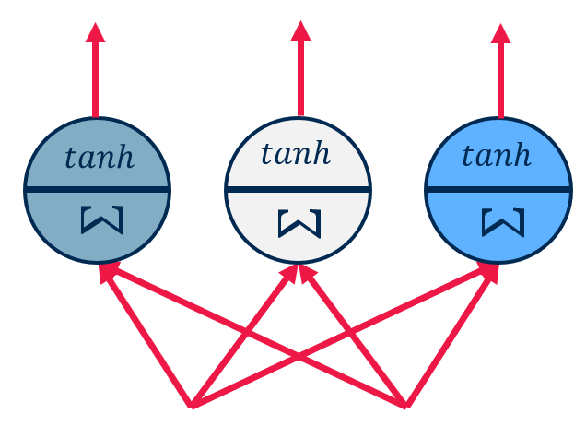
LSTM: Input Gate – create new state candidate
Input Gate is trained to inject significant parts of the current input into the cell state.
At time t, the input gate decides which item of$x\left(t\right)$ to inject (and how much of it) into $C\left(t\right),$given input vector$x\left(t\right)$ and previous output $h\left(t−1\right)$.
$$C_{i}(t)$$
$$\tilde{C}\left(t\right)$$
$$i(t)$$
Notice tanh()
2
Filter cell state candidate
$$h_{j}$$
$$x_{j}$$
$$h(t−1)$$
$$x(t)$$
$$h(t−1)$$
$$x(t)$$
Guide to Intelligent Data Science Second Edition, 2020

Slide 33
LSTM: Input Gate – inject input
Input Gate is trained to inject significant parts of the current input into the cell state.
At time t, the input gate decides which item of$x\left(t\right)$ to inject (and how much of it) into $C\left(t\right),$given input vector$x\left(t\right)$ and previous output $h\left(t−1\right)$.
$$C_{i}(t)$$
Same as for the forget gate
$$\tilde{C}\left(t\right)$$
$$i(t)$$
Notice tanh()
2
Filter cell state candidate
$$h_{j}$$
$$x_{j}$$
$$h(t−1)$$
$$x(t)$$
$$h(t−1)$$
$$x(t)$$
Guide to Intelligent Data Science Second Edition, 2020

Slide 34
LSTM: Input Gate – inject input
Input Gate is trained to inject significant parts of the current input into the cell state.
At time t, the input gate decides which item of$x\left(t\right)$ to inject (and how much of it) into $C\left(t\right),$given input vector$x\left(t\right)$ and previous output $h\left(t−1\right)$.
$$C_{i}(t)$$
inject (1)
ignore (0)
$$\tilde{C}\left(t\right)$$
$$i_{j}$$
$$i(t)$$
$$h_{j}$$
$$x_{j}$$
$$h_{j}$$
$$x_{j}$$
$$h(t−1)$$
$$x(t)$$
$$h(t−1)$$
$$x(t)$$
Guide to Intelligent Data Science Second Edition, 2020

Slide 35
LSTM: Input Gate
Input Gate is trained to inject significant parts of the current input into the cell state.
At time t, the input gate decides which item of$x\left(t\right)$ to inject (and how much of it) into $C\left(t\right),$given input vector$x\left(t\right)$ and previous output $h\left(t−1\right)$.
$$C_{i}\left(t\right)=i\left(t\right)∗\tilde{C}\left(t\right)$$
$${\tilde{C}}_{j}\left(t\right)=tanh\left(W_{C}∙\left[h_{j}\left(t−1\right),x_{j}\left(t\right)\right]+b_{C}\right)$$
$$\tilde{C}\left(t\right)$$
inject (1)
ignore (0)
$$i_{j}$$
$$i(t)$$
$$i_{j}\left(t\right)=σ\left(W_{i}∙\left[h_{j}\left(t−1\right),x_{j}\left(t\right)\right]+b_{i}\right)$$
$$h_{j}$$
$$x_{j}$$
$$h_{j}$$
$$x_{j}$$
$$h(t−1)$$
$$x(t)$$
$$h(t−1)$$
$$x(t)$$
Guide to Intelligent Data Science Second Edition, 2020

Slide 36
LSTM: Input Gate
Input Gate is trained to inject significant parts of the current input into the cell state.
At time t, the input gate decides which item of$x\left(t\right)$ to inject (and how much of it) into $C\left(t\right),$given input vector$x\left(t\right)$ and previous output $h\left(t−1\right)$.
$$C_{i}\left(t\right)=i\left(t\right)∗\tilde{C}\left(t\right)$$
$$\tilde{C}\left(t\right)$$
$${\tilde{C}}_{j}\left(t\right)=tanh\left(W_{C}∙\left[h_{j}\left(t−1\right),x_{j}\left(t\right)\right]+b_{C}\right)$$
x
$$i(t)$$
$$i_{j}\left(t\right)=σ\left(W_{i}∙\left[h_{j}\left(t−1\right),x_{j}\left(t\right)\right]+b_{i}\right)$$
$$σ$$
$$h_{j}$$
$$x_{j}$$
$$h(t−1)$$
$$x(t)$$
$$h(t−1)$$
$$x(t)$$
Guide to Intelligent Data Science Second Edition, 2020

Slide 37
LSTM: Input Gate
Input Gate is trained to inject significant parts of the current input into the cell state.
At time t, the input gate decides which item of$x\left(t\right)$ to inject (and how much of it) into $C\left(t\right),$given input vector$x\left(t\right)$ and previous output $h\left(t−1\right)$.
$$C_{i}\left(t\right)=i\left(t\right)∗\tilde{C}\left(t\right)$$
$$\tilde{C}\left(t\right)$$
$${\tilde{C}}_{j}\left(t\right)=tanh\left(W_{C}∙\left[h_{j}\left(t−1\right),x_{j}\left(t\right)\right]+b_{C}\right)$$
x
$$i(t)$$
$$i_{j}\left(t\right)=σ\left(W_{i}∙\left[h_{j}\left(t−1\right),x_{j}\left(t\right)\right]+b_{i}\right)$$
$$tanh$$
$$σ$$
$$h(t−1)$$
$$x(t)$$
$$h(t−1)$$
$$x(t)$$
Guide to Intelligent Data Science Second Edition, 2020

Slide 38
LSTM = Input Gate
This is an engineered type of unit with three gates:
Forget gate
Input gate
Output gate
$$C(t−1)$$
$$C(t)$$
$$x(t)$$
Forget gate
Input gate
Output gate
$$h(t−1)$$
$$h(t)$$
$${C\left(t\right)=C}_{f}\left(t\right)+C_{i}\left(t\right)=f\left(t\right)∗C\left(t−1\right)+ i\left(t\right)∗\tilde{C}\left(t\right)$$
Guide to Intelligent Data Science Second Edition, 2020
Notes:
Key: Cell State, the horizontal line running through the top of the diagram. It run straight down the enter chain
Very easy for information to flow along it unchanged
Cell state might include the gender or the present subject, so the correct verbs and pronouns can be used. When we see a new subject, we want to delete the gender of the old subject
Decide which information we want to add
Tanh creates a candidate value
Input gate decides which information we want to add
In the example add the gender information
Finally we need to decide which information we want to output based on the cell state. Since the last input was a subject we might to output the information whether the subject is plural or singular to know what form a verb should be conjugated

Slide 39
LSTM = Output Gate
This is an engineered type of unit with three gates:
Forget gate
Input gate
Output gate
$$C(t−1)$$
$$C(t)$$
$$x(t)$$
Forget gate
Input gate
Output gate
$$h(t−1)$$
$$h(t)$$
Guide to Intelligent Data Science Second Edition, 2020
Notes:
Key: Cell State, the horizontal line running through the top of the diagram. It run straight down the enter chain
Very easy for information to flow along it unchanged
Cell state might include the gender or the present subject, so the correct verbs and pronouns can be used. When we see a new subject, we want to delete the gender of the old subject
Decide which information we want to add
Tanh creates a candidate value
Input gate decides which information we want to add
In the example add the gender information
Finally we need to decide which information we want to output based on the cell state. Since the last input was a subject we might to output the information whether the subject is plural or singular to know what form a verb should be conjugated

Slide 40
LSTM: Output Gate – input inject into status
Output Gate is trained to output a reasonable result.
At time t, output gate decides which parts of status $C\left(t\right)$ (and how much of it) will be output, given input vector$x\left(t\right)$ and previous output $h\left(t−1\right)$.
$$h(t)$$
Sigma filter
$$out\left(t\right)$$
$$o(t)$$
1
Create output candidate from C(t)
2
Filter output candidate
$$C(t)$$
$$h(t−1)$$
$$x(t)$$
Guide to Intelligent Data Science Second Edition, 2020

Slide 41
LSTM: Input Gate – input inject into status
Output Gate is trained to output a reasonable result.
At time t, output gate decides which parts of status $C\left(t\right)$ (and how much of it) will be output, given input vector$x\left(t\right)$ and previous output $h\left(t−1\right)$.
$$h\left(t\right)=o\left(t\right)∗C\left(t\right)$$
$$out\left(t\right)$$
x
1
Create output candidate from C(t)
$$o(t)$$
$$o_{j}\left(t\right)=σ\left(W_{o}∙\left[h_{j}\left(t−1\right),x_{j}\left(t\right)\right]+b_{o}\right)$$
$$σ$$
$$C(t)$$
$$h(t−1)$$
$$x(t)$$
Guide to Intelligent Data Science Second Edition, 2020

Slide 42
LSTM: Input Gate – prepare output candidate
Output Gate is trained to output a reasonable result.
At time t, output gate decides which parts of status $C\left(t\right)$ (and how much of it) will be output, given input vector$x\left(t\right)$ and previous output $h\left(t−1\right)$.
tanh() filter
$$h\left(t\right)=o\left(t\right)∗C\left(t\right)$$
$$out\left(t\right)$$
x
1
Create output candidate from C(t)
$$o(t)$$
$$o_{j}\left(t\right)=σ\left(W_{o}∙\left[h_{j}\left(t−1\right),x_{j}\left(t\right)\right]+b_{o}\right)$$
$$σ$$
$$C(t)$$
$$h(t−1)$$
$$x(t)$$
Guide to Intelligent Data Science Second Edition, 2020

Slide 43
LSTM: Input Gate – prepare output candidate
Output Gate is trained to output a reasonable result.
At time t, output gate decides which parts of status $C\left(t\right)$ (and how much of it) will be output, given input vector$x\left(t\right)$ and previous output $h\left(t−1\right)$.
$$h\left(t\right)=o\left(t\right)∗tanh\left(C(t)\right)$$
$$tanh\left(C(t)\right)$$
$$out\left(t\right)$$
x
$$o(t)$$
$$o_{j}\left(t\right)=σ\left(W_{o}∙\left[h_{j}\left(t−1\right),x_{j}\left(t\right)\right]+b_{o}\right)$$
$$tanh$$
$$σ$$
$$C(t)$$
$$h(t−1)$$
$$x(t)$$
Guide to Intelligent Data Science Second Edition, 2020

Slide 44
LSTM = Long Short Term Memory
Special type of unit with three gates:
Image Source: Christopher Olah, https://colah.github.io/posts/2015-08-Understanding-LSTMs/
Forget gate
Input gate
Output gate
Guide to Intelligent Data Science Second Edition, 2020
Notes:
Summarizing LSTMs
Maintain separate cell state
Use gates to control the flow of information
Backpropagation through time is used to train the RNNS

Slide 45
Different Network-Structures and Applications
Many to Many
Ich
gehe
gerne
segeln
I
like
sailing
<eos>
D
D
D
D
A
A
A
A
E
E
E
Ich
gehe
gerne
<sos>
I
like
sailing
I
like
sailing
Language model
Neural machine translation
Guide to Intelligent Data Science Second Edition, 2020

Slide 46
Different Network-Structures and Applications
Many to one
One to many
English
Couple
sailing
on
a
lake
A
A
A
A
A
A
A
A
A
A
I
like
to
go
sailing
Language classification
Text classification
Image captioning
Guide to Intelligent Data Science Second Edition, 2020

Slide 47
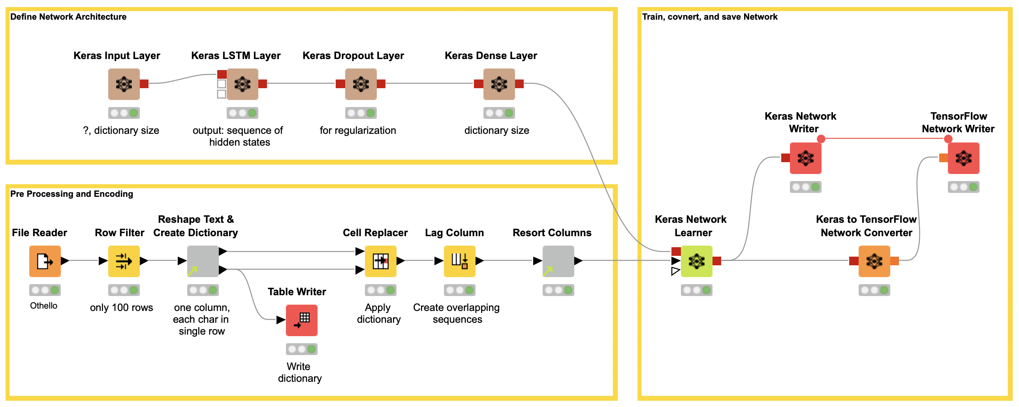
Neural Network: Code-free Example

Slide 48
Neural Network: Code-free Example

Slide 49
Convolutional Neural Networks (CNNs)

Slide 50
AlexNet & friends
The big breakthrough in deep learning happened in 2012 with deep convolutional neural networks
Here deep learning based AlexNet network won the ImageNet challenge with an unprecedented margin.
The top-five error rate of AlexNet was 15 percent, while the next best competitor ended up with 26 percent.
This victory kicked off the surge in deep learning networks.
https://neurohive.io/en/popular-networks/alexnet-imagenet-classification-with-deep-convolutional-neural-networks/
Guide to Intelligent Data Science Second Edition, 2020

Slide 51
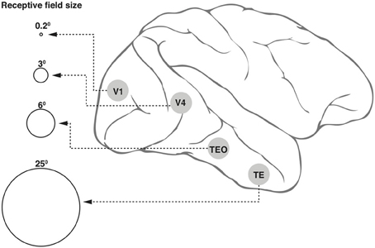
Convolutional Neural Networks - CNN
Inspired by the organization of the visual cortex in the human brain, convolutional layers simulate the concept of a receptive field.
Individual neurons in the convolutional layer respond only when a specific area of the image (the visual field) is active.
An array of such neurons covers the entire image by responding to slightly overlapping separated areas of the input image.
Image from: Wikimedia commons –
https://commons.wikimedia.org/wiki/File:Receptive_field_sizes_along_the_ventral_cortical_stream_in_the_primate.jpg
Guide to Intelligent Data Science Second Edition, 2020

Slide 52
Numerical Representation of a Black and White Image
0 | 0 | 0 | 0 | 0
0 | 0 | 0.5 | 1 | 0
0 | 0.5 | 1 | 0.5 | 0
0 | 1 | 0.5 | 0 | 0
0 | 0 | 0 | 0 | 0
Guide to Intelligent Data Science Second Edition, 2020

Slide 53
Numerical Representation of a Color Image
0.8 | 0.6 | $$…$$ | 0.6 | 0.9
0.1 | 0 | 0.5 | 1 | 0
$$⋮$$ | 0.5 | 1 | 0.5 | 0
0.8 | 1 | 0.5 | 0 | 0
0.6 | 0 | 0 | 0 | 0
0.1 | 0.5 | $$…$$ | 0.5 | 0.2
0.2 | 0 | 0.5 | 1 | 0
$$⋮$$ | 0.5 | 1 | 0.5 | 0
0.1 | 1 | 0.5 | 0 | 0
0.2 | 0 | 0 | 0 | 0
0.1 | 0.1 | $$…$$ | 0.1 | 0.3
0.3 | 0.2 | $$…$$ | 0.1 | 0.1
$$⋮$$ | $$⋮$$ | $$…$$ | $$⋮$$ | $$⋮$$
0.8 | 0.7 | $$…$$ | 0.8 | 0.8
0.8 | 0.6 | $$…$$ | 0.6 | 0.9
$$=$$
Guide to Intelligent Data Science Second Edition, 2020

Slide 54
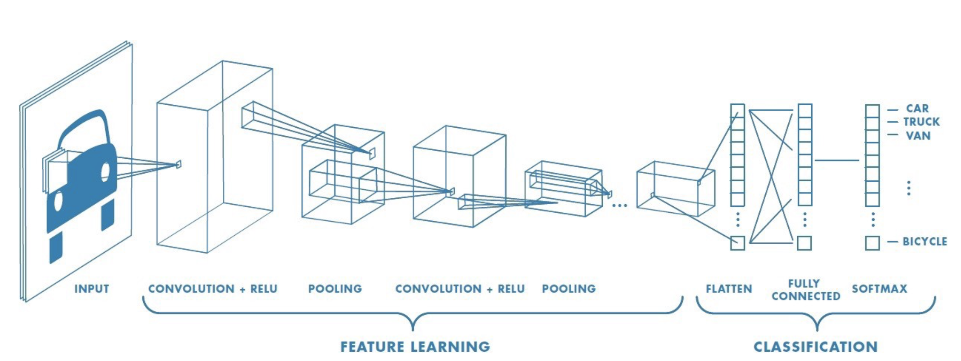
Convolutional Neural Networks
Guide to Intelligent Data Science Second Edition, 2020

Slide 55
Convolutional Neural Networks - CNN
The idea of convolution relies on a kernel K, a mask to overlap onto a portion P of the image pixels for the convolution operation.
From the product of the kernel K and the pixels in portion P we get a number, which will be the output of the first neuron in the convolutional layer.
Then the kernel K moves n steps on the right and goes to cover another portion P of the image possibly slightly overlapping with the previous one; the output for the second unit of the convolutional layer is generated.
And so on till the whole image has been covered by the kernel K and convoluted into output values.
The distance in number of pixels n between two adjacent portions P is called stride.
Guide to Intelligent Data Science Second Edition, 2020

Slide 56
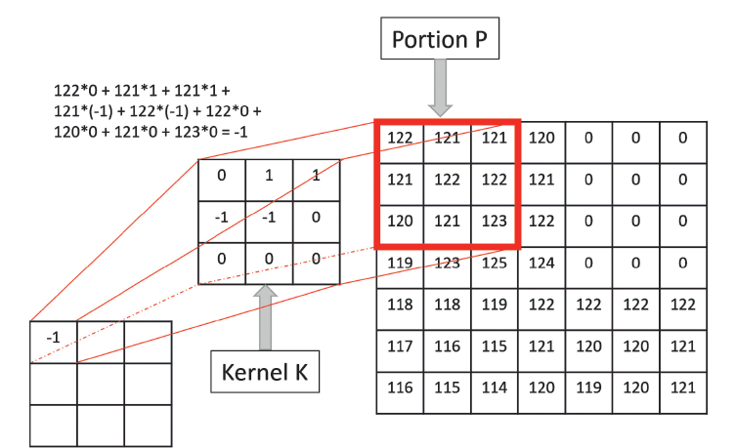
Convolutional Neurons: Example
Guide to Intelligent Data Science Second Edition, 2020

Slide 57
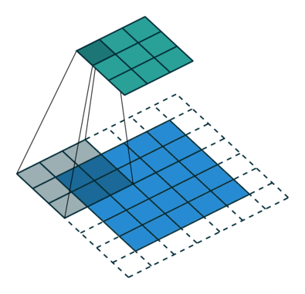
Convolutional Neural Networks (CNN)
Zero padding
Artificially increases the input at the boundary
Helps with preserving the spatial resolution and alignment
Stride
The jump the kernel makes when moving over the input
Reduces the spatial resolution
Image from: https://towardsdatascience.com/a-comprehensive-guide-to-convolutional-neural-networks-the-eli5-way-3bd2b1164a53
Guide to Intelligent Data Science Second Edition, 2020

Slide 58
Pooling Layers
Usually a number of convolutional layers are used.
Each layer provides one further step in the process of extracting high-level features from the input image (colors, edges, entities, …).
Pooling layers are often used to reduce the spatial resolution in between convolutional layers to
Increase the receptive field of the following layers
Reduce computational complexity
Two types of Pooling
Max Pooling returns the maximum value from the portion of the image covered by the Kernel.
Average Pooling returns the average of all values from the portion of the image covered by the Kernel.
Guide to Intelligent Data Science Second Edition, 2020

Slide 59
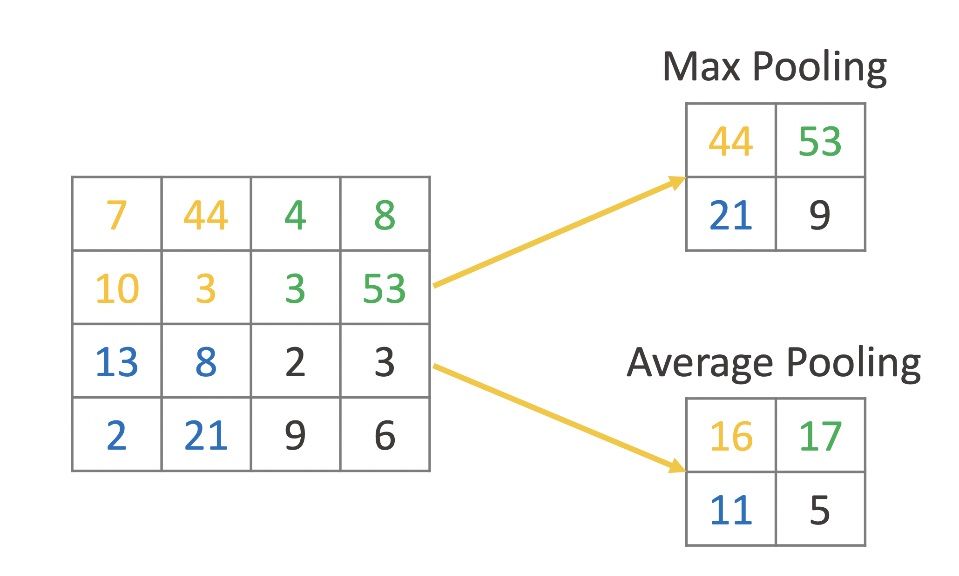
Example Pooling

Slide 60
Classification Layers
After the sequence of convolutional + pooling layers, a classic feedforward multilayer Perceptron network is applied to carry out the classification process.
Successful examples of CNNs for image recognition : LeNet, AlexNet, VGGNet, GoogLeNet, ResNet, ZFNet.
Guide to Intelligent Data Science Second Edition, 2020

Slide 61
CNN: Transfer Learning
Training such networks is a long and complex process, requiring very powerful machines.
Instead of retraining a new network completely from scratch, we could recycle existing networks, already built and trained by others on similar data.
This technique is called Transfer Learning.
In Transfer Learning a model developed for a task is reused as the starting point for another model on a second task.
On top of a previously trained network we add one or more neural layers
We freeze all or some of the previously trained layers
And we retrain only the remaining part of the whole network on our new task
Guide to Intelligent Data Science Second Edition, 2020

Slide 62
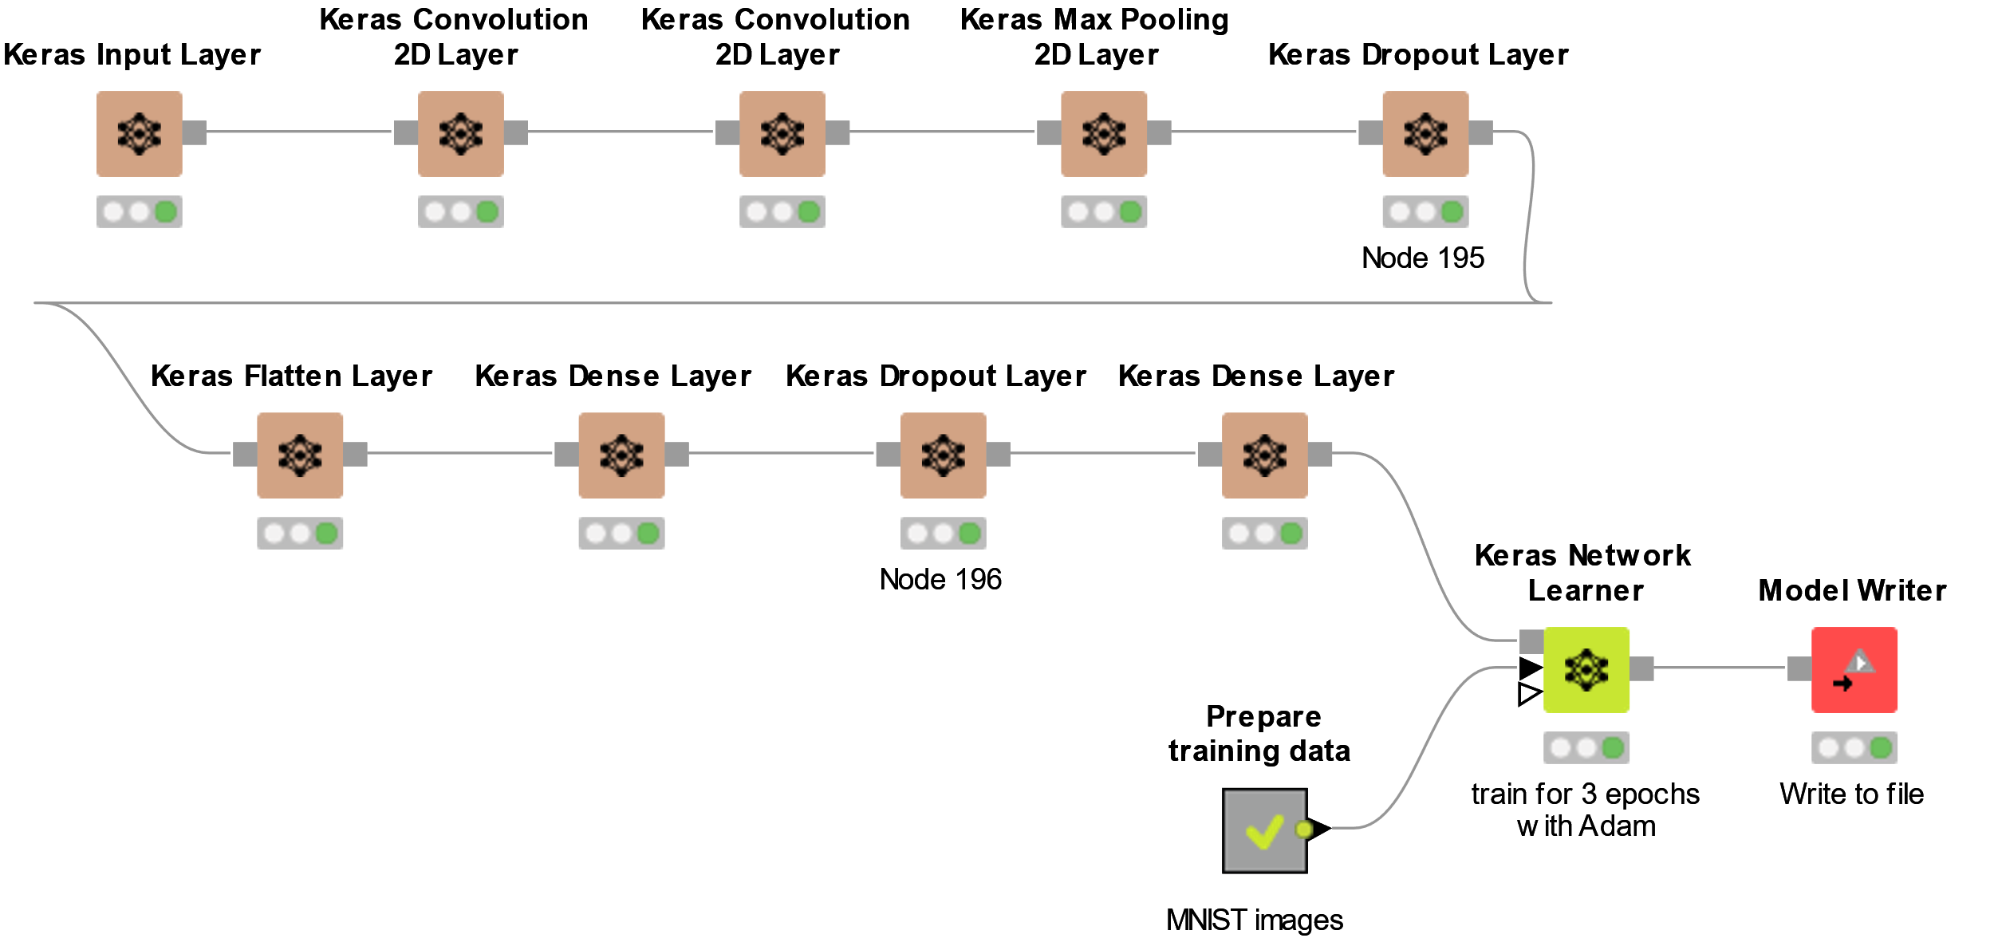
Building CNNs with KNIME
Guide to Intelligent Data Science Second Edition, 2020

Slide 63
Generative-Adversarial Networks (GANs)

Slide 64
GANs
So far: RNNs and CNNs
Recurrent Neural Networks (RNNs) and Convolutional Neural Networks (CNNs) represent probably the biggest contribution of deep learning to the field of neural networks.
However, deep learning is responsible for other innovations, such as for example Generative Adversarial Networks (GANs).
Guide to Intelligent Data Science Second Edition, 2020

Slide 65
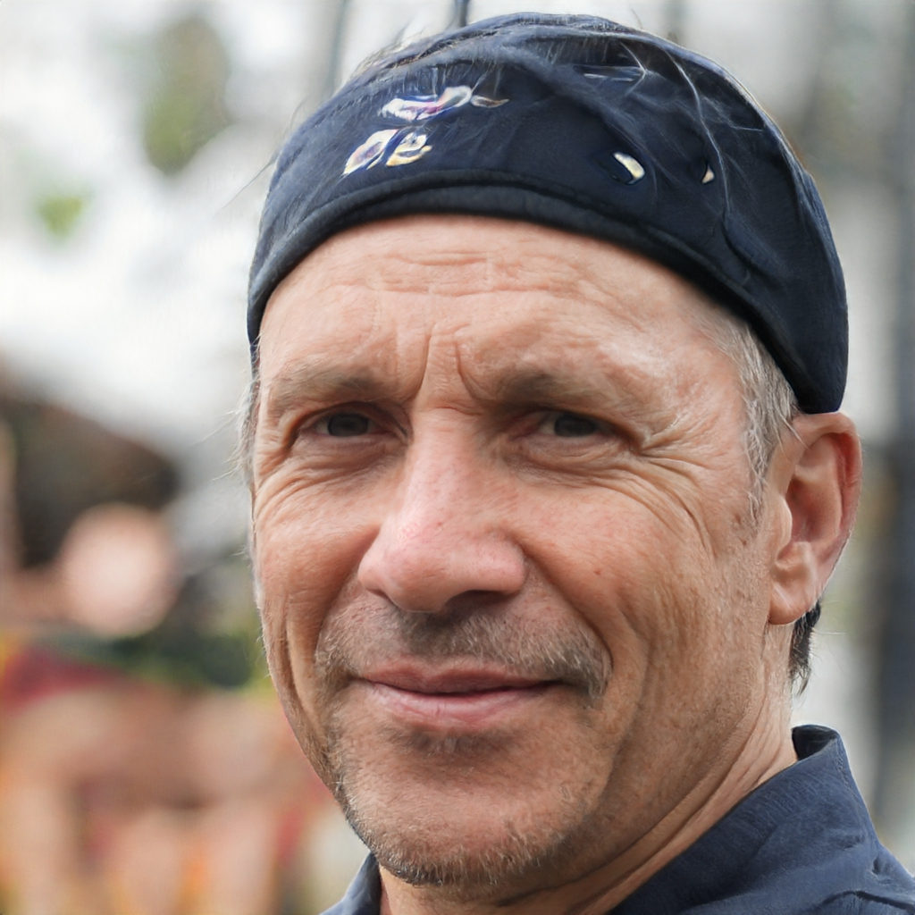
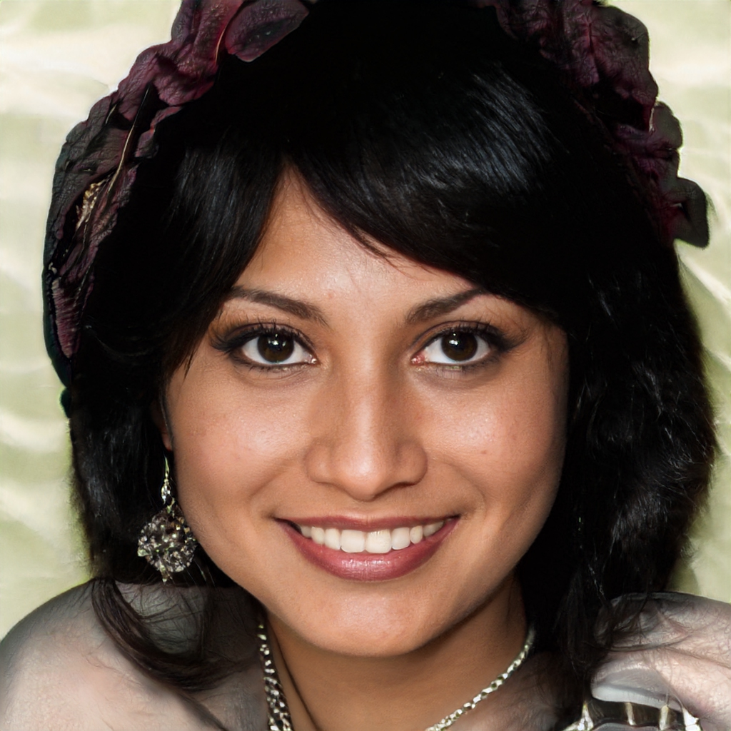
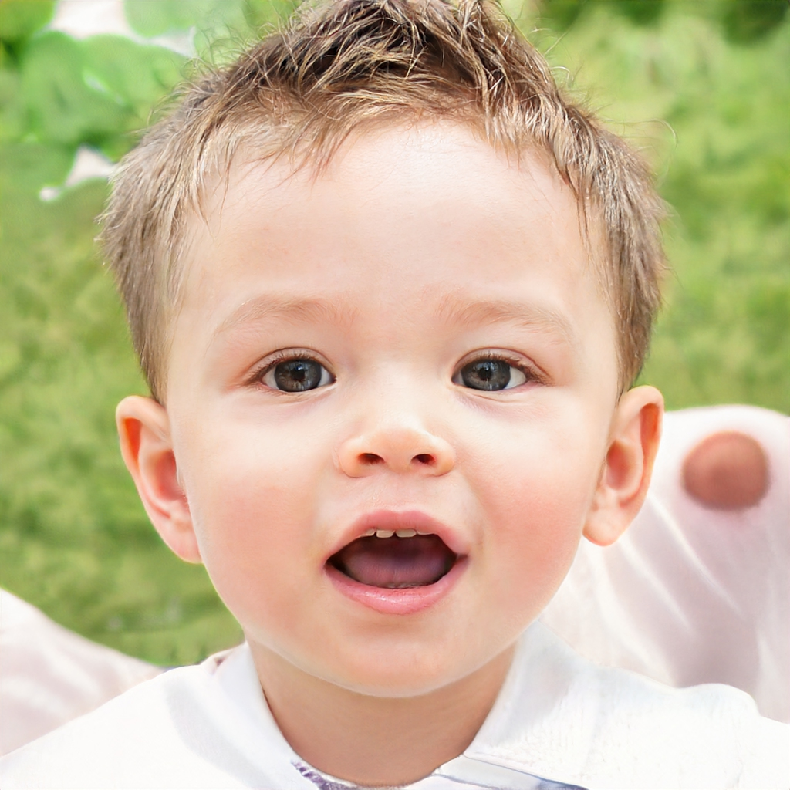
Can You Tell Real from Fake?
Source: https://thispersondoesnotexist.com
Guide to Intelligent Data Science Second Edition, 2020

Slide 66
GAN: Generator
GANs include two neural networks competing with each other: the generator and the discriminator.
A generator G is a transformation that transforms the input noise z into a tensor – usually an image – x (x=G(z)). The generated image x is then fed into the discriminator network D.
The discriminator network D compares the real images in the training set and the image generated by the generator network and produces an output D(x), which is the probability that image x is real.
Guide to Intelligent Data Science Second Edition, 2020

Slide 67
GAN: Training
Both generator and discriminator are trained using the backpropagation and gradient descent.
Both networks are trained in alternating steps, competing with each other to improve themselves.
The objective of the generator is to fool the discriminator i.e. $D\left(G\left(z\right)\right)=1$
The objective of the discriminator is to output $D\left(G\left(z\right)\right)=0$ and $D\left(x_{real}\right)=1$
The GAN model eventually converges and produces images that look real.
Given a training set, this technique learns to generate new data under the same statistics as the training set.
Guide to Intelligent Data Science Second Edition, 2020

Slide 68
GAN: Architecture
$$x \sim p_{data}$$
Discriminator $D\left(x; θ_{d}\right)$
$$\tilde{x} is real?$$
dataset
$$s\left(\tilde{x}\right)$$
Score function
Generator $G\left(z; θ_{g}\right)$
$$\tilde{x} \sim p_{g}$$
$$z \sim p_{z}$$
Guide to Intelligent Data Science Second Edition, 2020

Slide 69
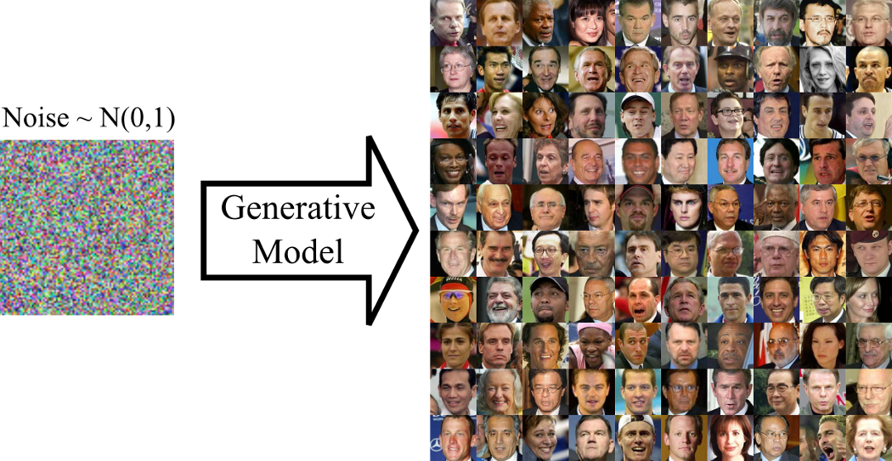
GANs
For example, a GAN trained on photographs can generate new photographs that look at least superficially authentic to human observers, having many realistic characteristics.
GANs have been successfully applied to image tensors to create anime, human figures, and even van Gogh-like masterpieces.
Image from: Pankaj Kishore, Towards data Science
https://towardsdatascience.com/art-of-generative-adversarial-networks-gan-62e96a21bc35
Guide to Intelligent Data Science Second Edition, 2020

Slide 70
Summary
Recurrent Neural Networks (RNNs)
Long Short Term Memories (LSTMs)
Convolutional Neural Networks (CNNs)
Generative Adversarial Networks (GANs)

Slide 71
Practical Examples with KNIME Analytics Platform

Slide 72
RNN Workflow: Text Generation

Slide 73
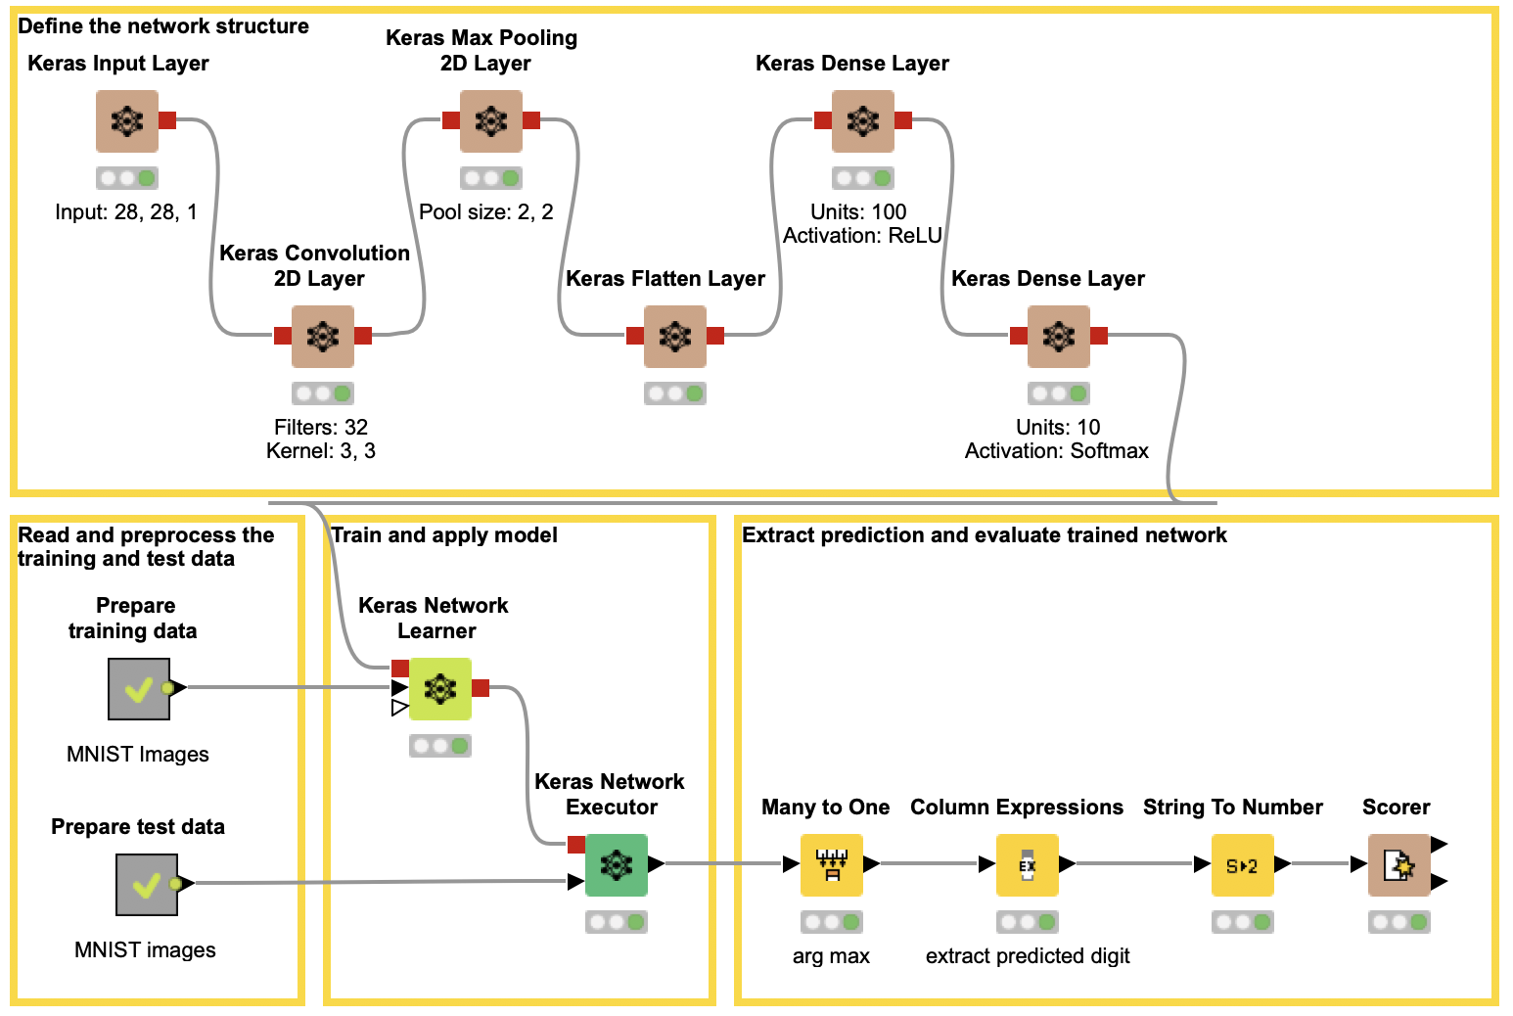
CNN Workflow: Image Classification using MNIST
Extensions required:
KNIME Image Processing
KNIME Image Processing – Deep Learning Extension

Slide 74
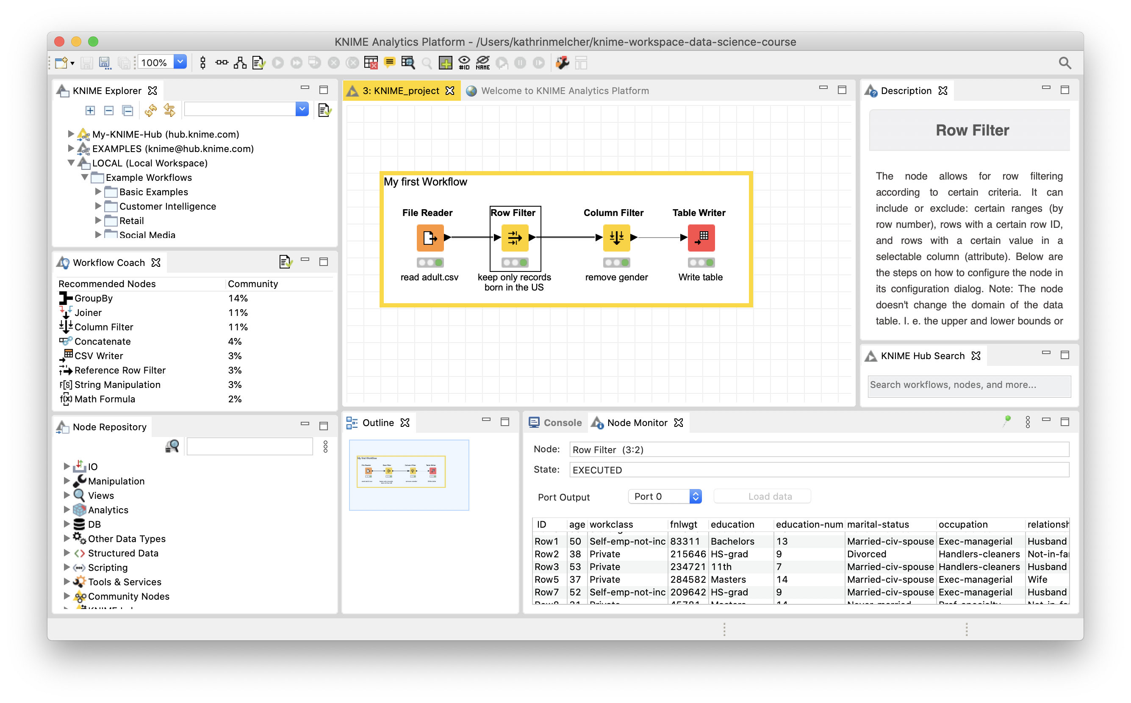
Installing Extensions
Install extension by going to File -> Install KNIME Extension or via Drag & Drop from the KNIME Community Hub
Guide to Intelligent Data Science Second Edition, 2020

Slide 75
Thank you

