Slide 1
Ensemble Learning

Slide 2
Summary of this lesson
“If I do not believe the news in todays paper, I buy 100 copies of the paper. Then I believe.”
-Ludwig Wittgenstein
How can we learn from multiple models together?
*This lesson refers to chapter 9 of the GIDS book

Slide 3
Content of this lesson
Wisdom of the Crowd
Bagging & Boosting
Stacking and Cascade Generalization
Cascading and Delegating
Tree Ensembles and Random Forest
AdaBoost
Gradient Boosted Trees
Practical Examples

Slide 4
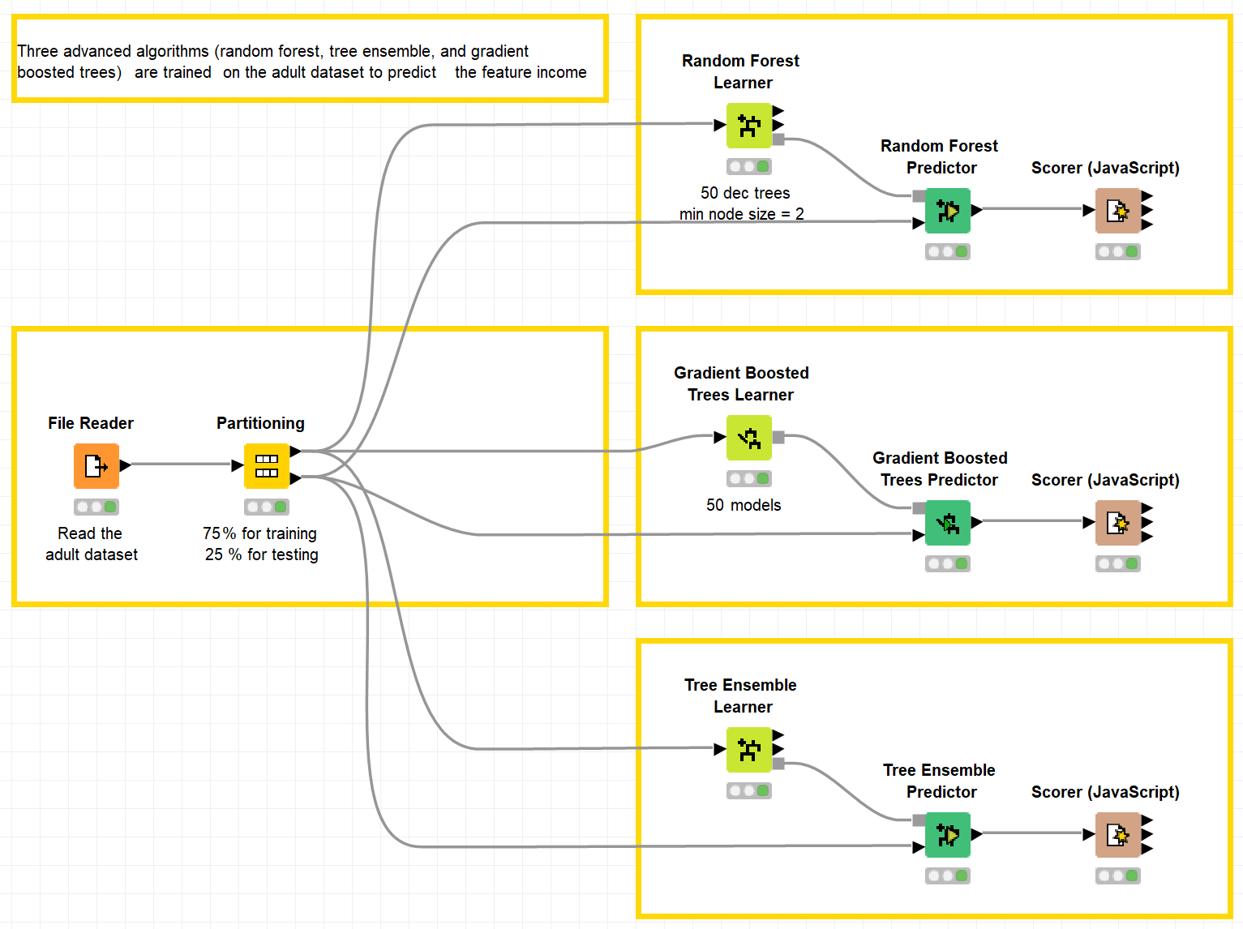
Datasets
Datasets used : adult dataset
  „Random Forest, Gradient Boosted Trees, and Tree Ensemble“ https://kni.me/w/Ueq3QR9hty8Osh2E
    Random forest
    Gradient boosting
    Tree ensemble

Slide 5
Ensemble Models
General idea: take advantage of the “wisdom of the crowd”
Training of many weak classifiers (or regression models)
Combining them to construct a classifier (regression model) more accurate than any of the individual ones
Leads to a more accurate and robust model
Interpretation of an ensemble learning model is difficult
  Since it consists of many models!

Slide 6
Wisdom of the Crowd

Slide 7
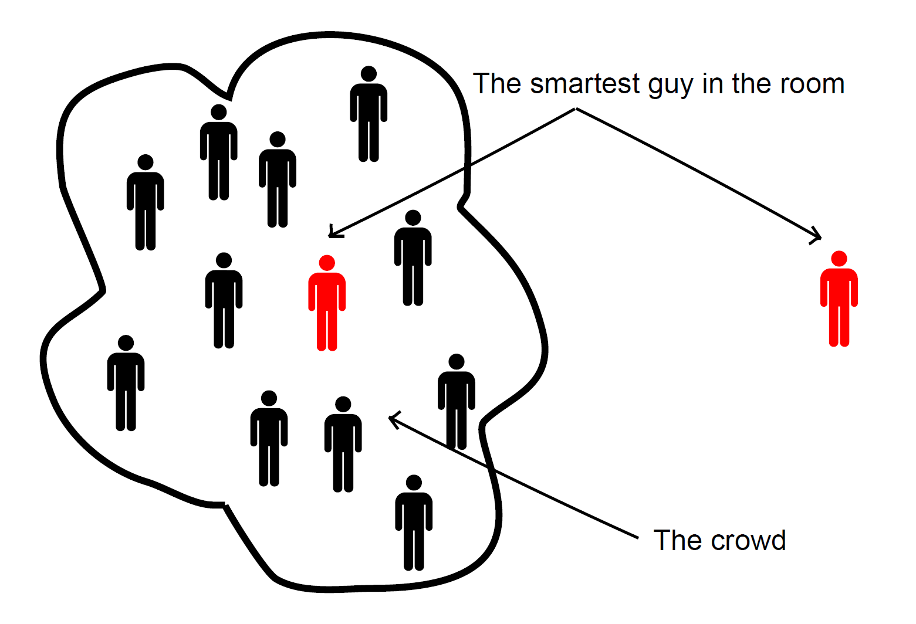
Wisdom of the Crowd
Crowd wiser than any individual
When?
For which questions?
The collective knowledge of a diverse and independent body of people typically exceeds the knowledge of any single individual and can be harnessed by voting.
http://www.csc.kth.se/utbildning/kth/kurser/DD2431/ml11/schedule/07-ensamble.pdf

Slide 8
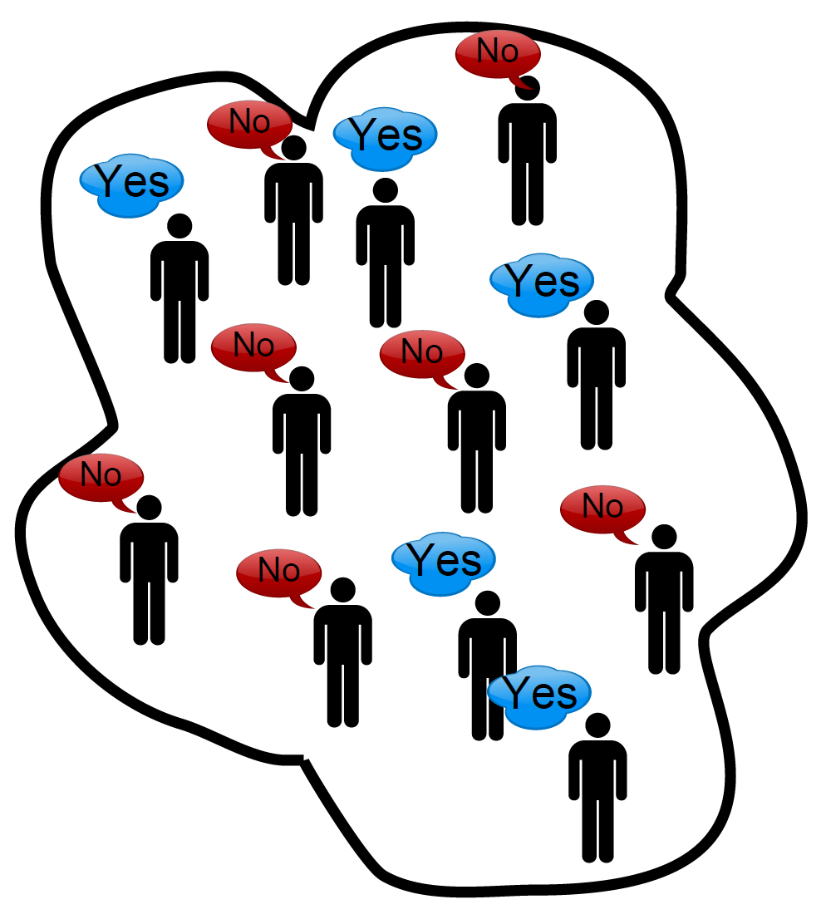
Wisdom of the Crowd: Scenario
Ask each person in the crowd:
Will Mr. X win the general election in country Y?
The Crowd’s prediction:
MAJORITY answer.
This crowd predicts No. (Mr. X will not win the election.)

Slide 9
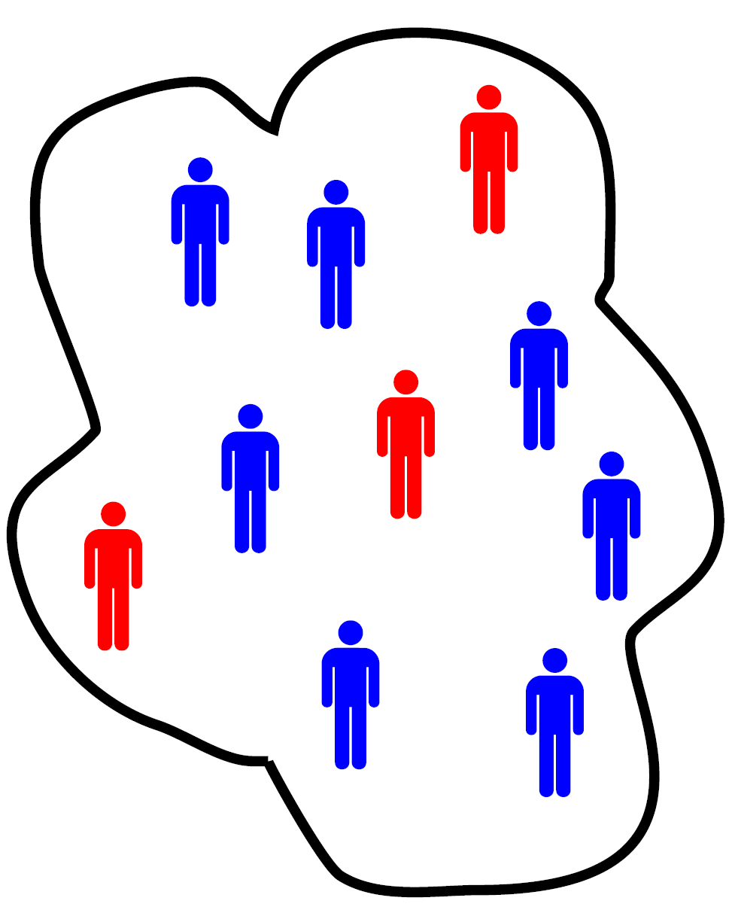
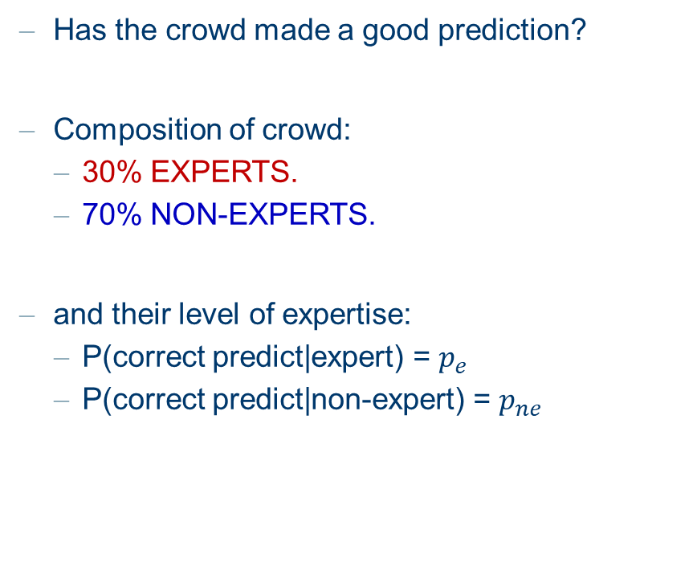
Wisdom of the Crowd: Scenario
Has the crowd made a good prediction?
Composition of crowd:
  30% EXPERTS.
  70% NON-EXPERTS.
and their level of expertise:
  P(correct predict|expert) = $p_{e}$
  P(correct predict|non-expert) = $p_{ne}$

Slide 10

Wisdom of the Crowd: Scenario
Let $p_{e}=0.8$ and $p_{ne}=0.5$
For a random person from the crowd
P(correct predict|individual) = ${0.3 p}_{e}+0.7p_{ne}=0.59$

Slide 11
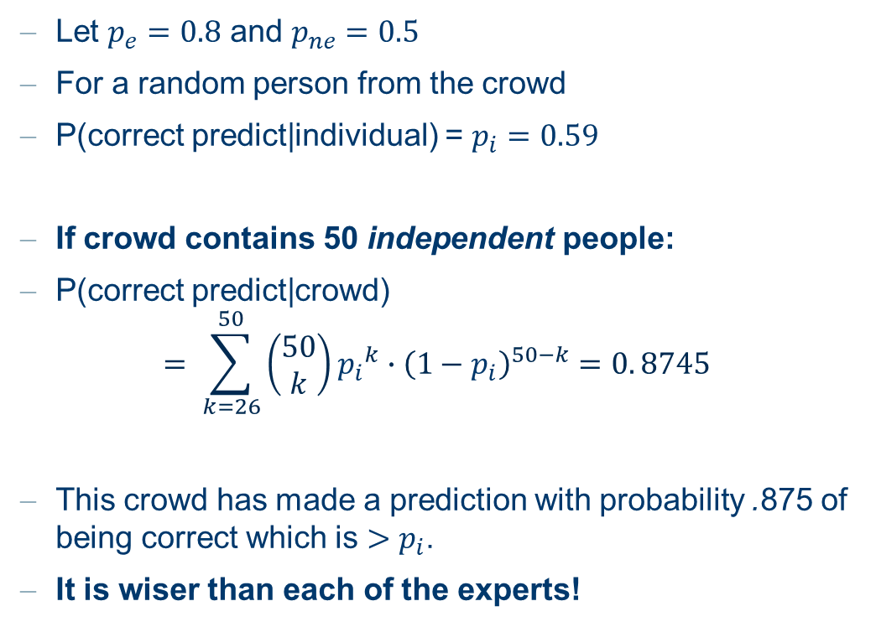
Wisdom of the Crowd: Scenario
Let $p_{e}=0.8$ and $p_{ne}=0.5$
For a random person from the crowd
P(correct predict|individual) = $p_{i}=0.59$
If crowd contains 50 independent people:
P(correct predict|crowd)
$$= \sum_{k=26}^{50}{\left(\begin{aligned}50 \\ k\end{aligned}\right){p_{i}}^{k}∙{\left(1−p_{i}\right)}^{50−k}=0. 8745}$$
This crowd has made a prediction with probability .875 of being correct which is $>p_{i}$.
It is wiser than each of the experts!

Slide 12
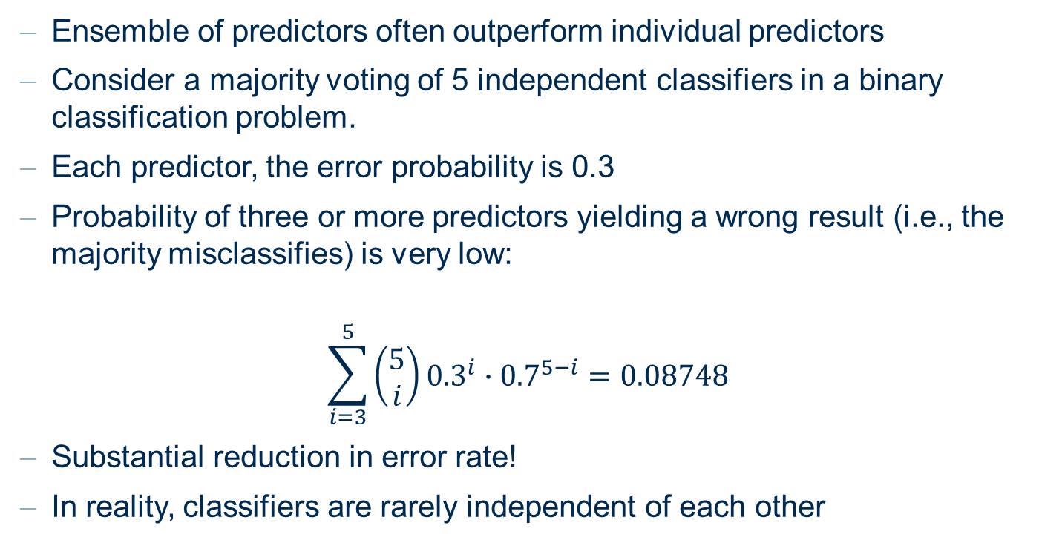
Wisdom of the Crowd
Ensemble of predictors often outperform individual predictors
Consider a majority voting of 5 independent classifiers in a binary classification problem.
Each predictor, the error probability is 0.3
Probability of three or more predictors yielding a wrong result (i.e., the majority misclassifies) is very low:
$$\sum_{i=3}^{5}{\left(\begin{aligned}5 \\ i\end{aligned}\right){0.3}^{i}∙{0.7}^{5−i}=0.08748}$$
Substantial reduction in error rate!
In reality, classifiers are rarely independent of each other

Slide 13
But ...
Why didn’t I just asked a bunch of experts??
Large enough crowd
  ➔ high probability that a sufficient number of experts will be in crowd (for any question).
Random selection
  ➔ don’t make a biased choice in experts.
For some questions it may be hard to identify a diverse set of experts

Slide 14
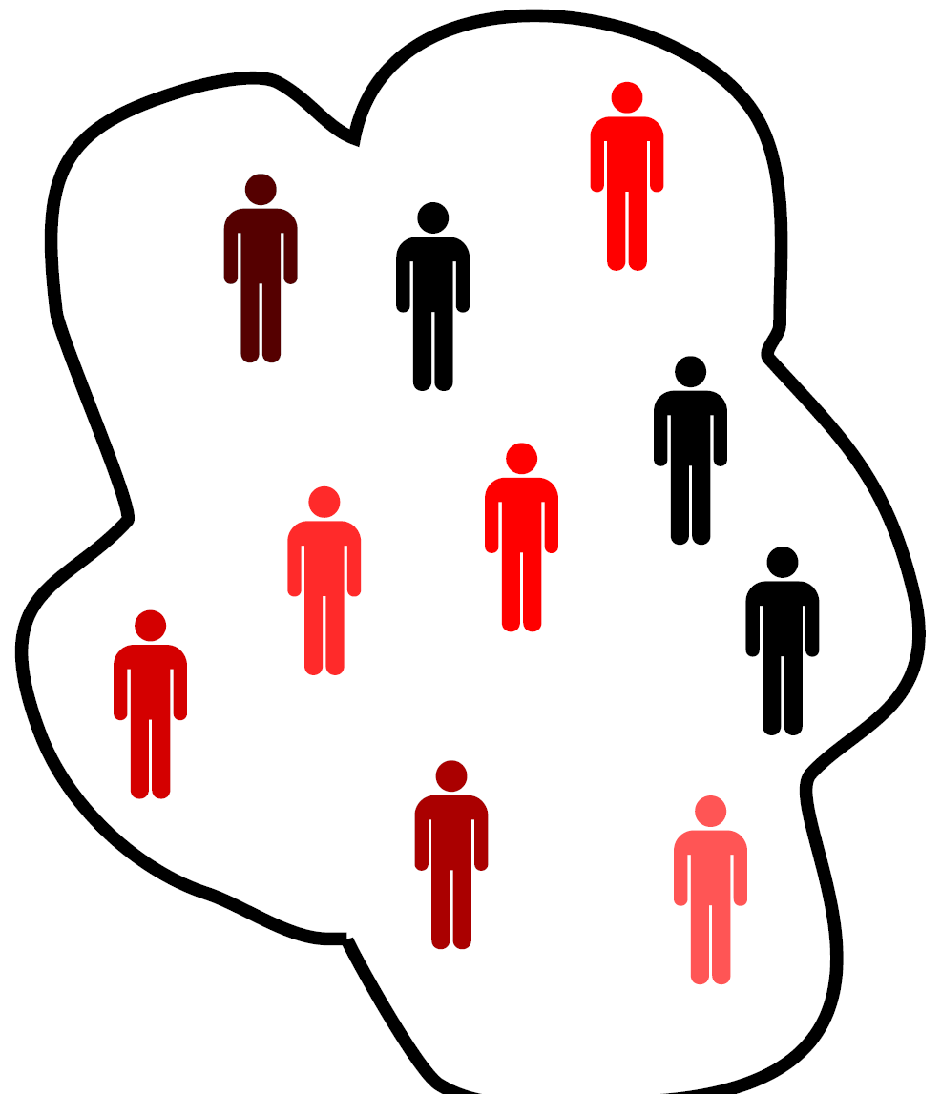
For a random crowd
Given a random question expect each person to have a different level of expertise.
Will it rain tomorrow?
  redness proportional to expertise

Slide 15
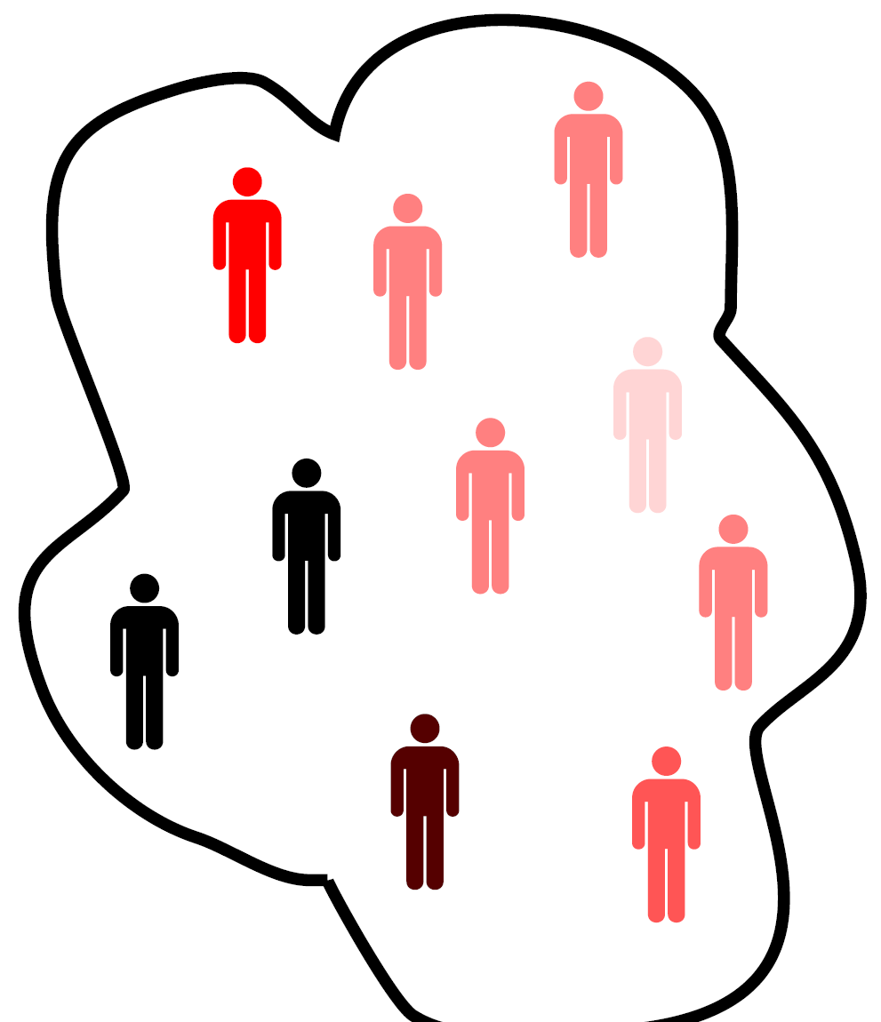
For a random crowd
Given a random question expect each person to have a different level of expertise.
Will the world go down in December?
  redness proportional to expertise

Slide 16
What makes a crowd wise?
According to James Surowiecki there are four elements required to form a wise crowd:
Diversity of opinion. People in crowd should have a range of experiences, education and opinions. (Encourages independent predictions)
Independence. Prediction by person in crowd is not influenced by other people in the crowd.
Decentralization. People have specializations and local knowledge.
Aggregation. There is a mechanism for aggregating all predictions into one single prediction.

Slide 17
The crowd must be careful
In the analysis of the crowd it is implicitly assumed:
each person is not concerned with the opinions of others, no-one is copying anyone else in the crowd.
In the analysis of the crowd we implicitly assumed:
The non-experts will predict a completely random wrong answer - these will cancel each other out (to some degree).
However, there may be a systematic and consistent bias in the non-experts’ predictions.

Slide 18
... Back to Ensemble Models

Slide 19
Back to Machine Learning
We will exploit Wisdom of crowd ideas for specific tasks by:
combining (classifier) predictions
aim to combine independent and diverse predictors (classifiers).
We can also use labeled training data
to identify the expert classifiers in the pool;
to identify complementary classifiers;
to indicate how to best combine them.
X
1
4
…
1
5
2
2
7
7
6
2
9
6
7
6
8
9
3
3
9
5
7
P1
P2
…
Pn
y

Slide 20
Why Do Ensemble Methods Work?
Statistical reason:
Able to average many good models
Reduces the influence of bad models
Computational reason:
Able to explore the model space efficiently
Representational reason:
Reduce the bias of a learning algorithm by extending its model space

Slide 21
Basic Terms
Remember?
Bias = model error + algorithmic error
  Model error: the error we get by selecting a model
  Algorithmic error: by selecting the algorithm itself and the parameters of the algorithm
Base-Learning: Fixed Bias / User parameterized
Meta-Learning: Dynamic bias selection using meta-knowledge
Meta-Knowledge: Knowledge achieved during the learning process

Slide 22
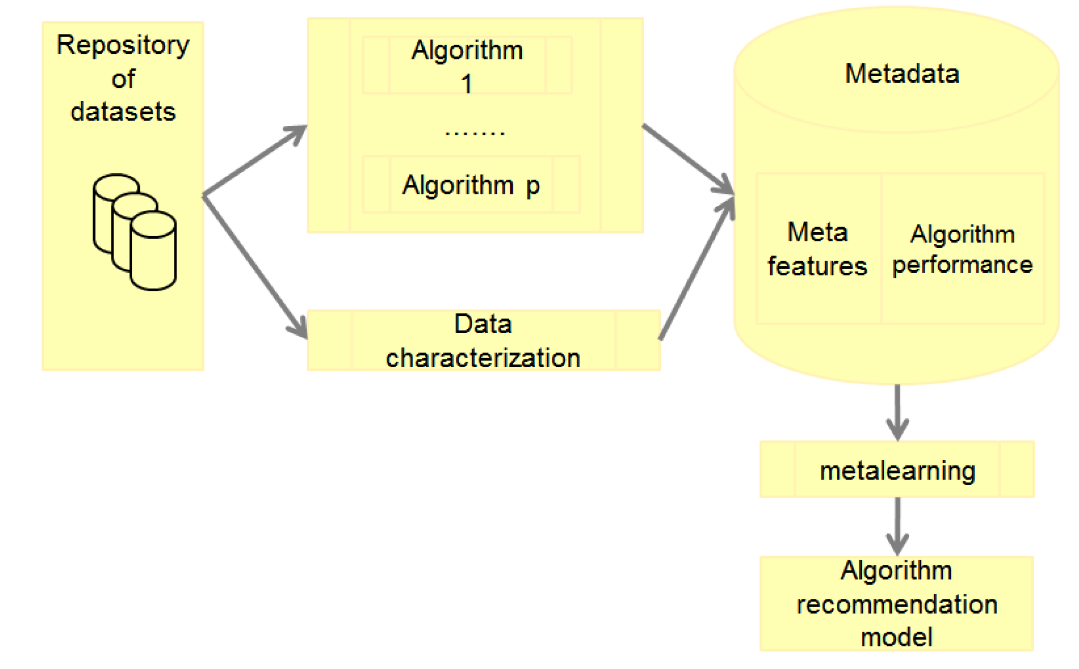
Ensemble Learning for Algorithm Recommendation

Slide 23
Combining base-learners: Categories
Philosophy | Technique
Bagging, Boosting | Variation in data
Stacking | Variation among learners (multi-expert)
Cascading, Delegating | Variation among learners (multi-stage)
Arbitrating | Variation among learners (refereed)
Meta decision trees | Variation in data and among learners

Slide 24
Bagging and Boosting

Slide 25
Bagging and Boosting
Best-known techniques
Based on selection of multiple data sub sets
Meta model is created by combining the base models
Advantages:
  Reduces overfitting
  Most effective when the base learner is highly sensitive to data
  Typically increases accuracy
Disadvantages:
Interpretability of interpretable base learners is lost

Slide 26
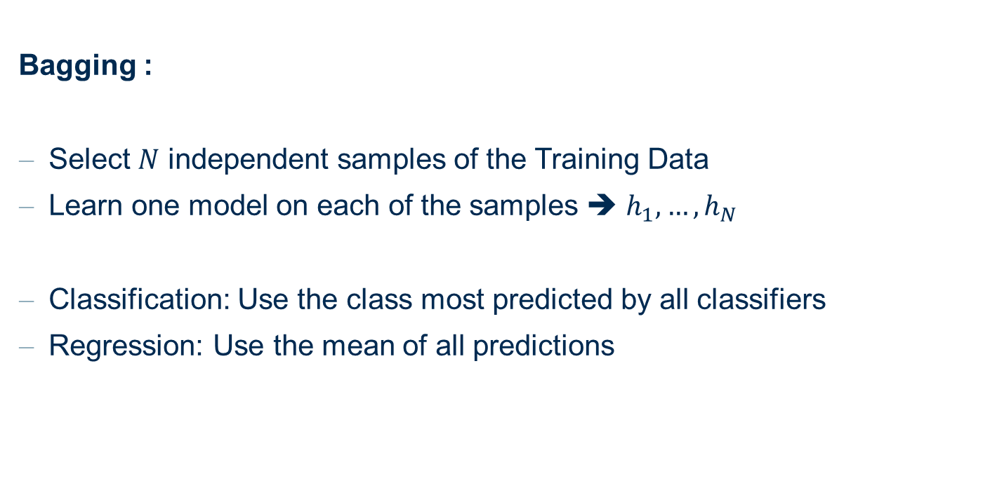
Bagging
Bagging :
Select $N$ independent samples of the Training Data
Learn one model on each of the samples ➔ $h_{1}, …,h_{N}$
Classification: Use the class most predicted by all classifiers
Regression: Use the mean of all predictions

Slide 27
Boosting
Boosting:
Tries to learn a weighting for the models
Later base learners focus more on the examples that previous base learners misclassified
There is no single “best” boosting method

Slide 28
Boosting
One boosting method after Schapire
Training :
  Create c1: base learner on a sample t1 of the data
  Create t2: sample which is 50% misclassified by c1
  Create c2: base learner on the sample t2
  Create t3: subset of the data where c1 predicts differently than c2
  Create c3: base learner on the sample t3
Classification :
  Classify with c1 and c2
  If unequal, use c3 as final classification

Slide 29
Stacking and Cascade Generalization

Slide 30
Stacking
Stacking
In Bagging and Boosting: we used always the same base learner
Stacking exploits differences among base learners
Two levels of learning
  Base learners are trained, each on the whole data set
  Meta learners are created on meta data (e.g. predicted class) obtained in level 1
Two levels of classifying
  Base learner are used on data point
  Meta learners are applied on base learner predictions

Slide 31
Cascade Generalization
Stacking: Base learners are used in parallel
Cascade Generalization
Base learners are used in a sequence with ”partial” meta-learners
Knowledge from previous classifiers can be used in later ones
After each base learner has been trained, the data set is adjusted using the new information
For classification :
Only the last model is used, which incorporates the knowledge from previous models (all base methods are used)

Slide 32
Cascading and Delegating

Slide 33
Cascading and Delegating
Until now: all base classifiers are used for classification
Here: Multistage classifiers, not all are required for classification
Main advantage: faster classification

Slide 34
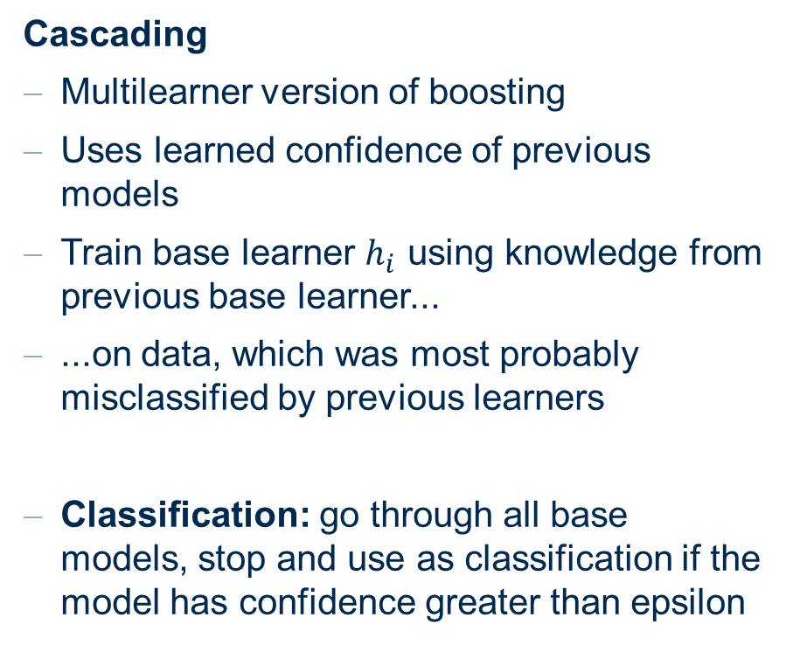
Cascading
Cascading
Multilearner version of boosting
Uses learned confidence of previous models
Train base learner $h_{i}$ using knowledge from previous base learner...
...on data, which was most probably misclassified by previous learners
Classification: go through all base models, stop and use as classification if the model has confidence greater than epsilon

Slide 35
Delegating
Cascading: all instances are used in each step
Delegating: only instances below confidence threshold are processed in the next step
Idea:
  Use everything and test for which data points you are good enough
  Pass the remaining work to someone else.
  If there is no someone else, ... guess
Advantages:
  Still understandable (no model combination)
  Improved efficiency, due to the decreasing number of examples.

Slide 36
Tree Ensembles and Random Forest

Slide 37
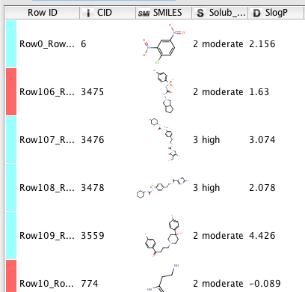
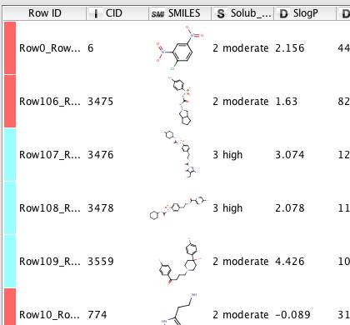
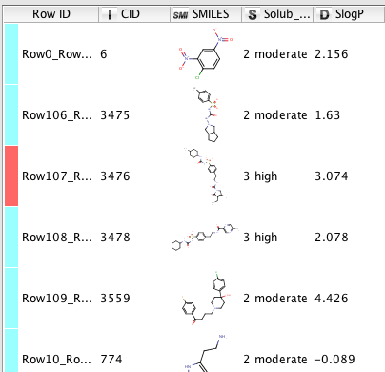
Bagging - Idea
Bagging ≡ Bootstrap AGGregatING
For each tree / model a training set is generated by sampling uniformly with replacement from the standard training set
…
Build tree
Build tree
Build tree
1
4
…
1
5
2
5
7
7
6
2
9
6
7
2
8
9
3
3
9
5
7

Slide 38
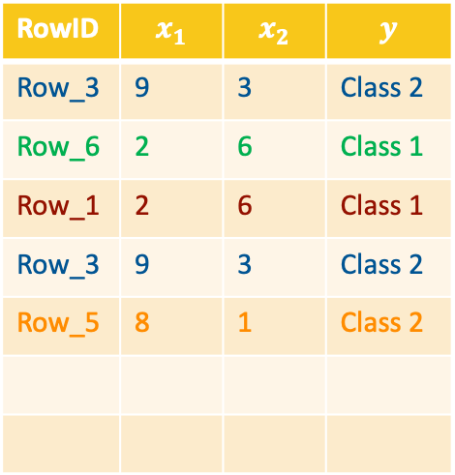
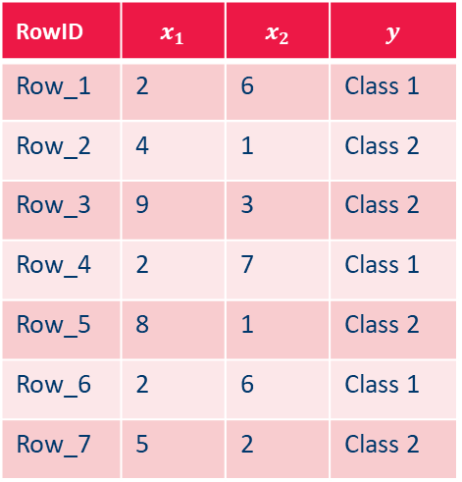
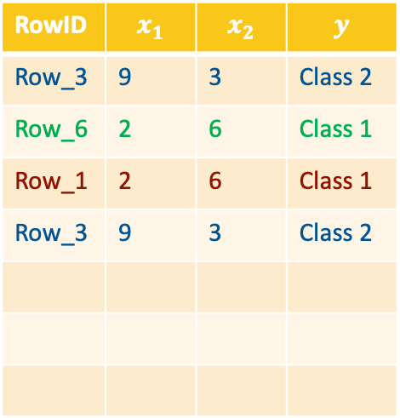
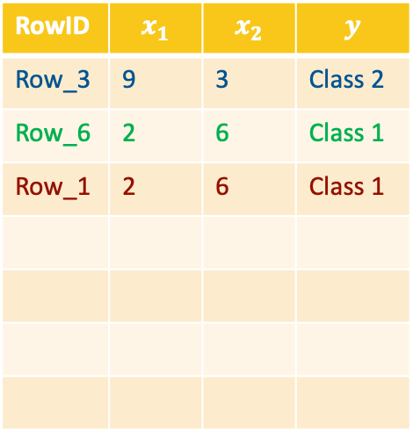
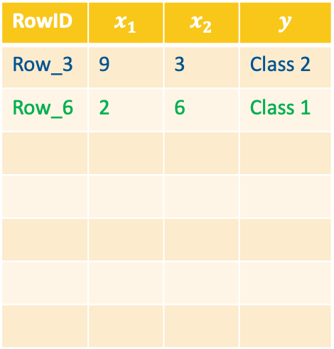
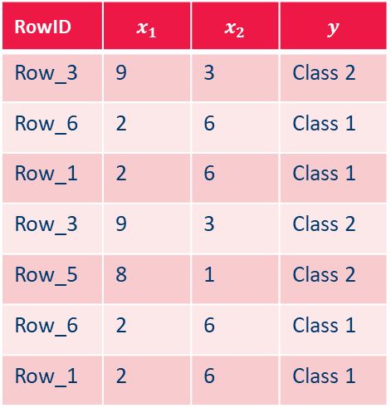
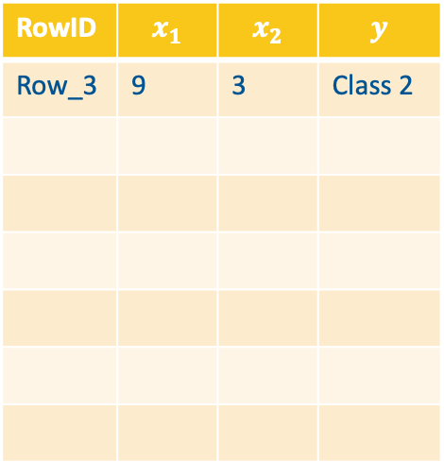
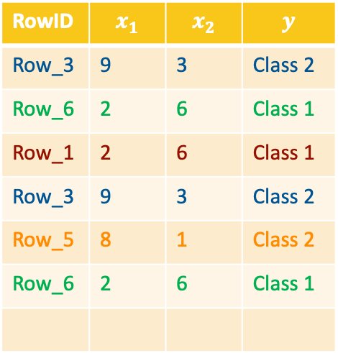
Example for Bagging
Full training set
Sampled training set
RowID | $$x_{1}$$ | $$x_{2}$$ | $$y$$
Row_1 | 2 | 6 | Class 1
Row_2 | 4 | 1 | Class 2
Row_3 | 9 | 3 | Class 2
Row_4 | 2 | 7 | Class 1
Row_5 | 8 | 1 | Class 2
Row_6 | 2 | 6 | Class 1
Row_7 | 5 | 2 | Class 2
Sampled dataset
RowID | $$x_{1}$$ | $$x_{2}$$ | $$y$$
Row_3 | 9 | 3 | Class 2
RowID | $$x_{1}$$ | $$x_{2}$$ | $$y$$
Row_3 | 9 | 3 | Class 2
Row_6 | 2 | 6 | Class 1
RowID | $$x_{1}$$ | $$x_{2}$$ | $$y$$
Row_3 | 9 | 3 | Class 2
Row_6 | 2 | 6 | Class 1
Row_1 | 2 | 6 | Class 1
RowID | $$x_{1}$$ | $$x_{2}$$ | $$y$$
Row_3 | 9 | 3 | Class 2
Row_6 | 2 | 6 | Class 1
Row_1 | 2 | 6 | Class 1
Row_3 | 9 | 3 | Class 2
RowID | $$x_{1}$$ | $$x_{2}$$ | $$y$$
Row_3 | 9 | 3 | Class 2
Row_6 | 2 | 6 | Class 1
Row_1 | 2 | 6 | Class 1
Row_3 | 9 | 3 | Class 2
Row_5 | 8 | 1 | Class 2
RowID | $$x_{1}$$ | $$x_{2}$$ | $$y$$
Row_3 | 9 | 3 | Class 2
Row_6 | 2 | 6 | Class 1
Row_1 | 2 | 6 | Class 1
Row_3 | 9 | 3 | Class 2
Row_5 | 8 | 1 | Class 2
Row_6 | 2 | 6 | Class 1
RowID | $$x_{1}$$ | $$x_{2}$$ | $$y$$
Row_3 | 9 | 3 | Class 2
Row_6 | 2 | 6 | Class 1
Row_1 | 2 | 6 | Class 1
Row_3 | 9 | 3 | Class 2
Row_5 | 8 | 1 | Class 2
Row_6 | 2 | 6 | Class 1
Row_1 | 2 | 6 | Class 1

Slide 39
Bagging - Idea
Why sampling with replacement?
➔ So that a sample approximates the distribution of the population
Frequent values are represented more
Less frequent values are represented less
Ultimately leads to the model with smaller variance and smaller bias

Slide 40
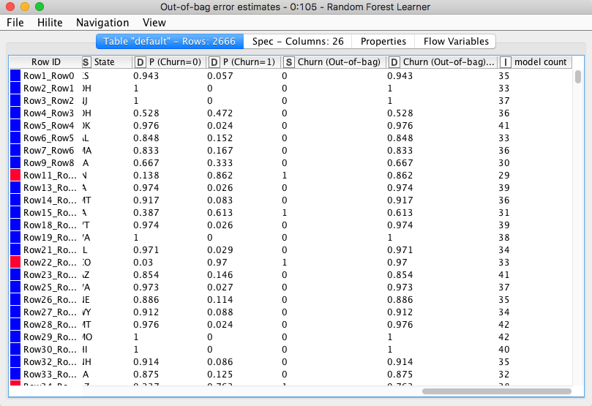
An Extra Benefit of Bagging: Out of Bag Estimation
Able to evaluate the model using the training data
Apply trees to samples that haven’t been used for training
X₁
X₂
1
4
…
1
1
4
…
1
5
2
2
7
7
6
5
2
2
7
7
6
2
9
6
7
6
8
9
3
3
9
5
7
2
9
6
7
6
8
9
3
3
9
5
7
P1
P2
…
Pn
P1
P2
…
Pn
y₁^{OOB}
y₂^{OOB}

Slide 41
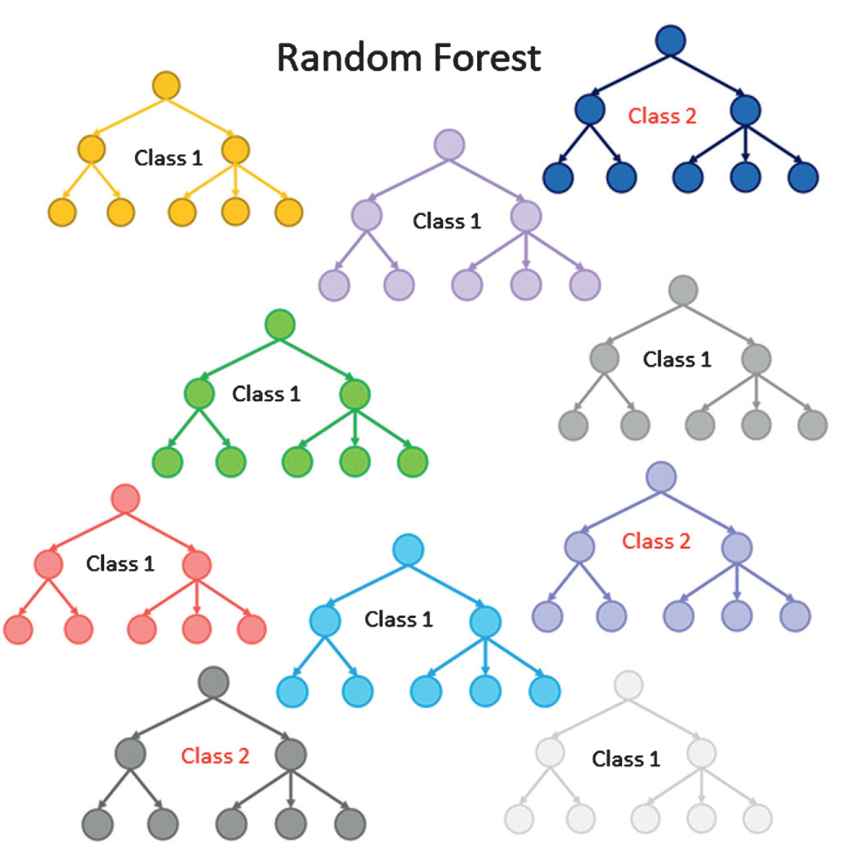
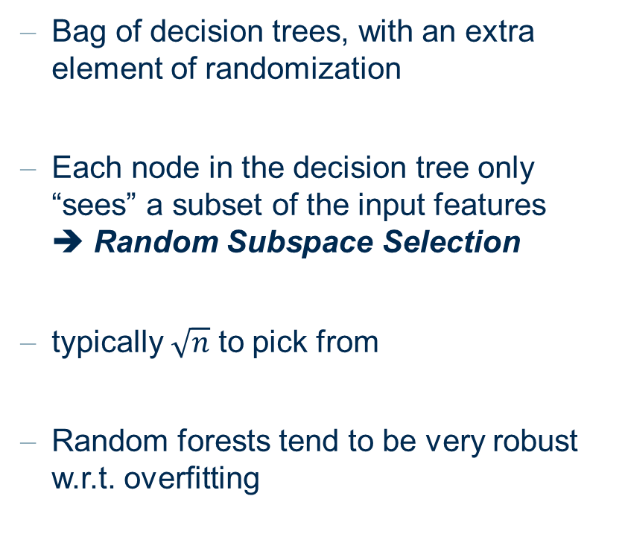
Random Forest
Bag of decision trees, with an extra element of randomization
Each node in the decision tree only “sees” a subset of the input features
➔ Random Subspace Selection
typically $\sqrt{n}$ to pick from
Random forests tend to be very robust w.r.t. overfitting

Slide 42
AdaBoost

Slide 43
AdaBoost
Freund & Schapire (1995)
AB is a linear classification algorithm
AB has good generalization properties
➔(Avoids overfitting as long as the training data is not too noisy)
AB is a feature selector

Slide 44
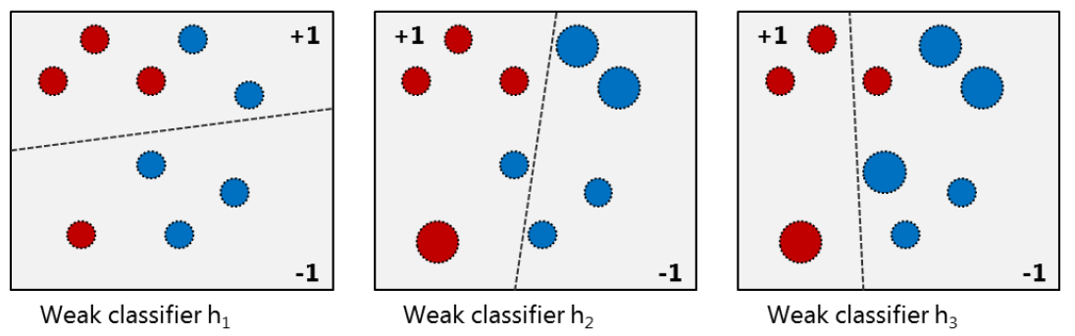
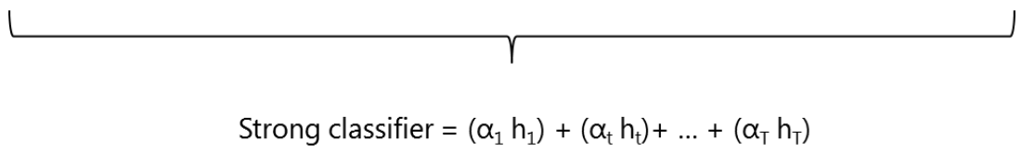
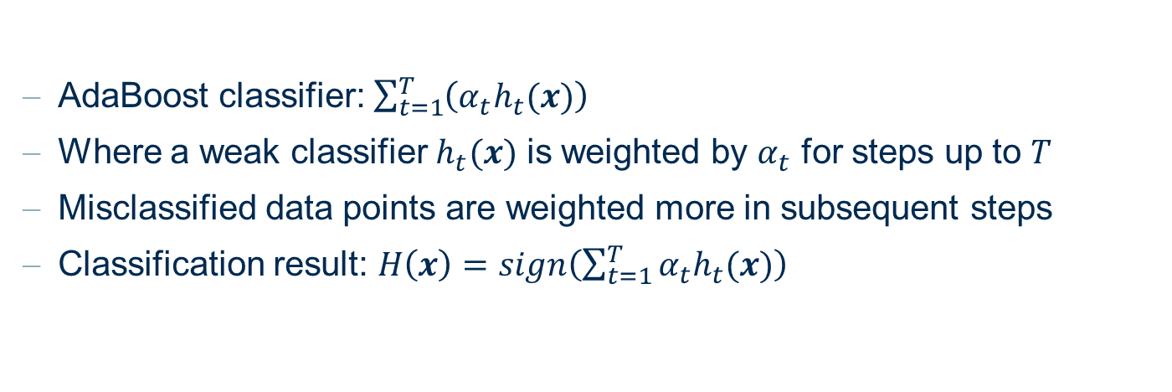
AdaBoost
AdaBoost classifier: $\sum_{t=1}^{T}{\left(α_{t}h_{t}(x)\right)}$
Where a weak classifier $h_{t}(x)$ is weighted by $α_{t}$ for steps up to $T$
Misclassified data points are weighted more in subsequent steps
Classification result: $H\left(x\right)=sign\left(\sum_{t=1}^{T}{α_{t}h_{t}(x)}\right)$

Slide 45

AdaBoost: Terminology
Strong Classifier: $\sum_{t=1}^{T}{\left(α_{t}h_{t}(x)\right)}$
Where $h_{t}(x)$ is a base classifier weighted by $α_{t}$
Classification result:
$$H\left(x\right)=sgn\left(\sum_{t=1}^{T}{\left(α_{t}h_{t}(x)\right)}\right)$$

Slide 46

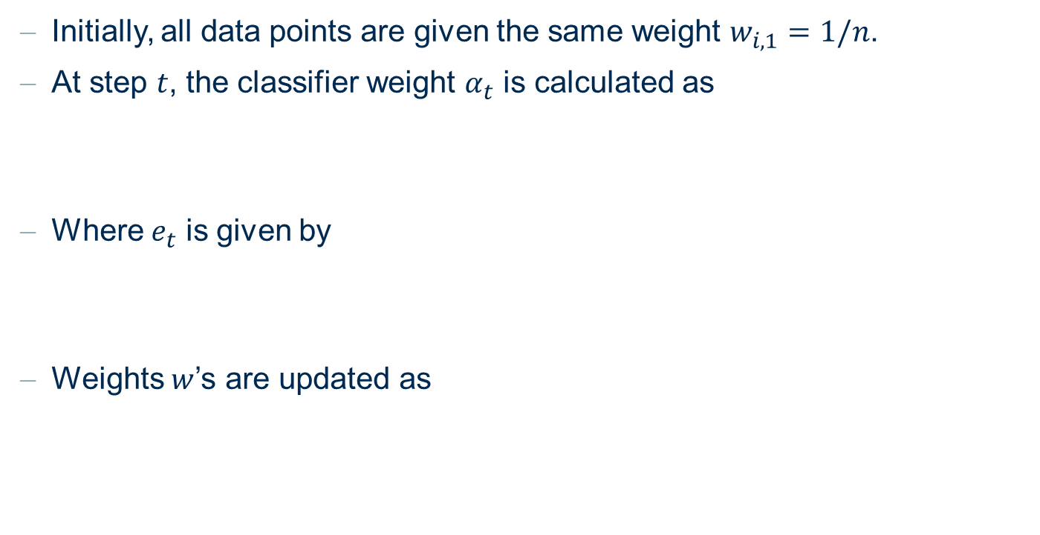
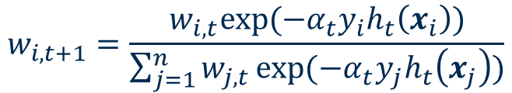
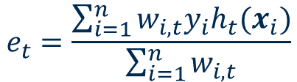
AdaBoost
Initially, all data points are given the same weight $w_{i,1}=1/n$.
At step $t$, the classifier weight $α_{t}$ is calculated as
Where $e_{t}$ is given by
Weights $w$’s are updated as
$$α_{t}=\frac{1}{2}ln⁡\left(\frac{1−e_{t}}{1+e_{t}}\right)$$
$$e_{t}=\frac{\sum_{i=1}^{n}{w_{i,t}y_{i}h_{t}(x_{i})}}{\sum_{i=1}^{n}{w_{i,t}}}$$
$$w_{i,t+1}=\frac{w_{i,t}exp⁡(−α_{t}y_{i}h_{t}\left(x_{i}\right))}{\sum_{j=1}^{n}{w_{j,t}}exp⁡(−α_{t}y_{j}h_{t}\left(x_{j}\right))}$$

Slide 47
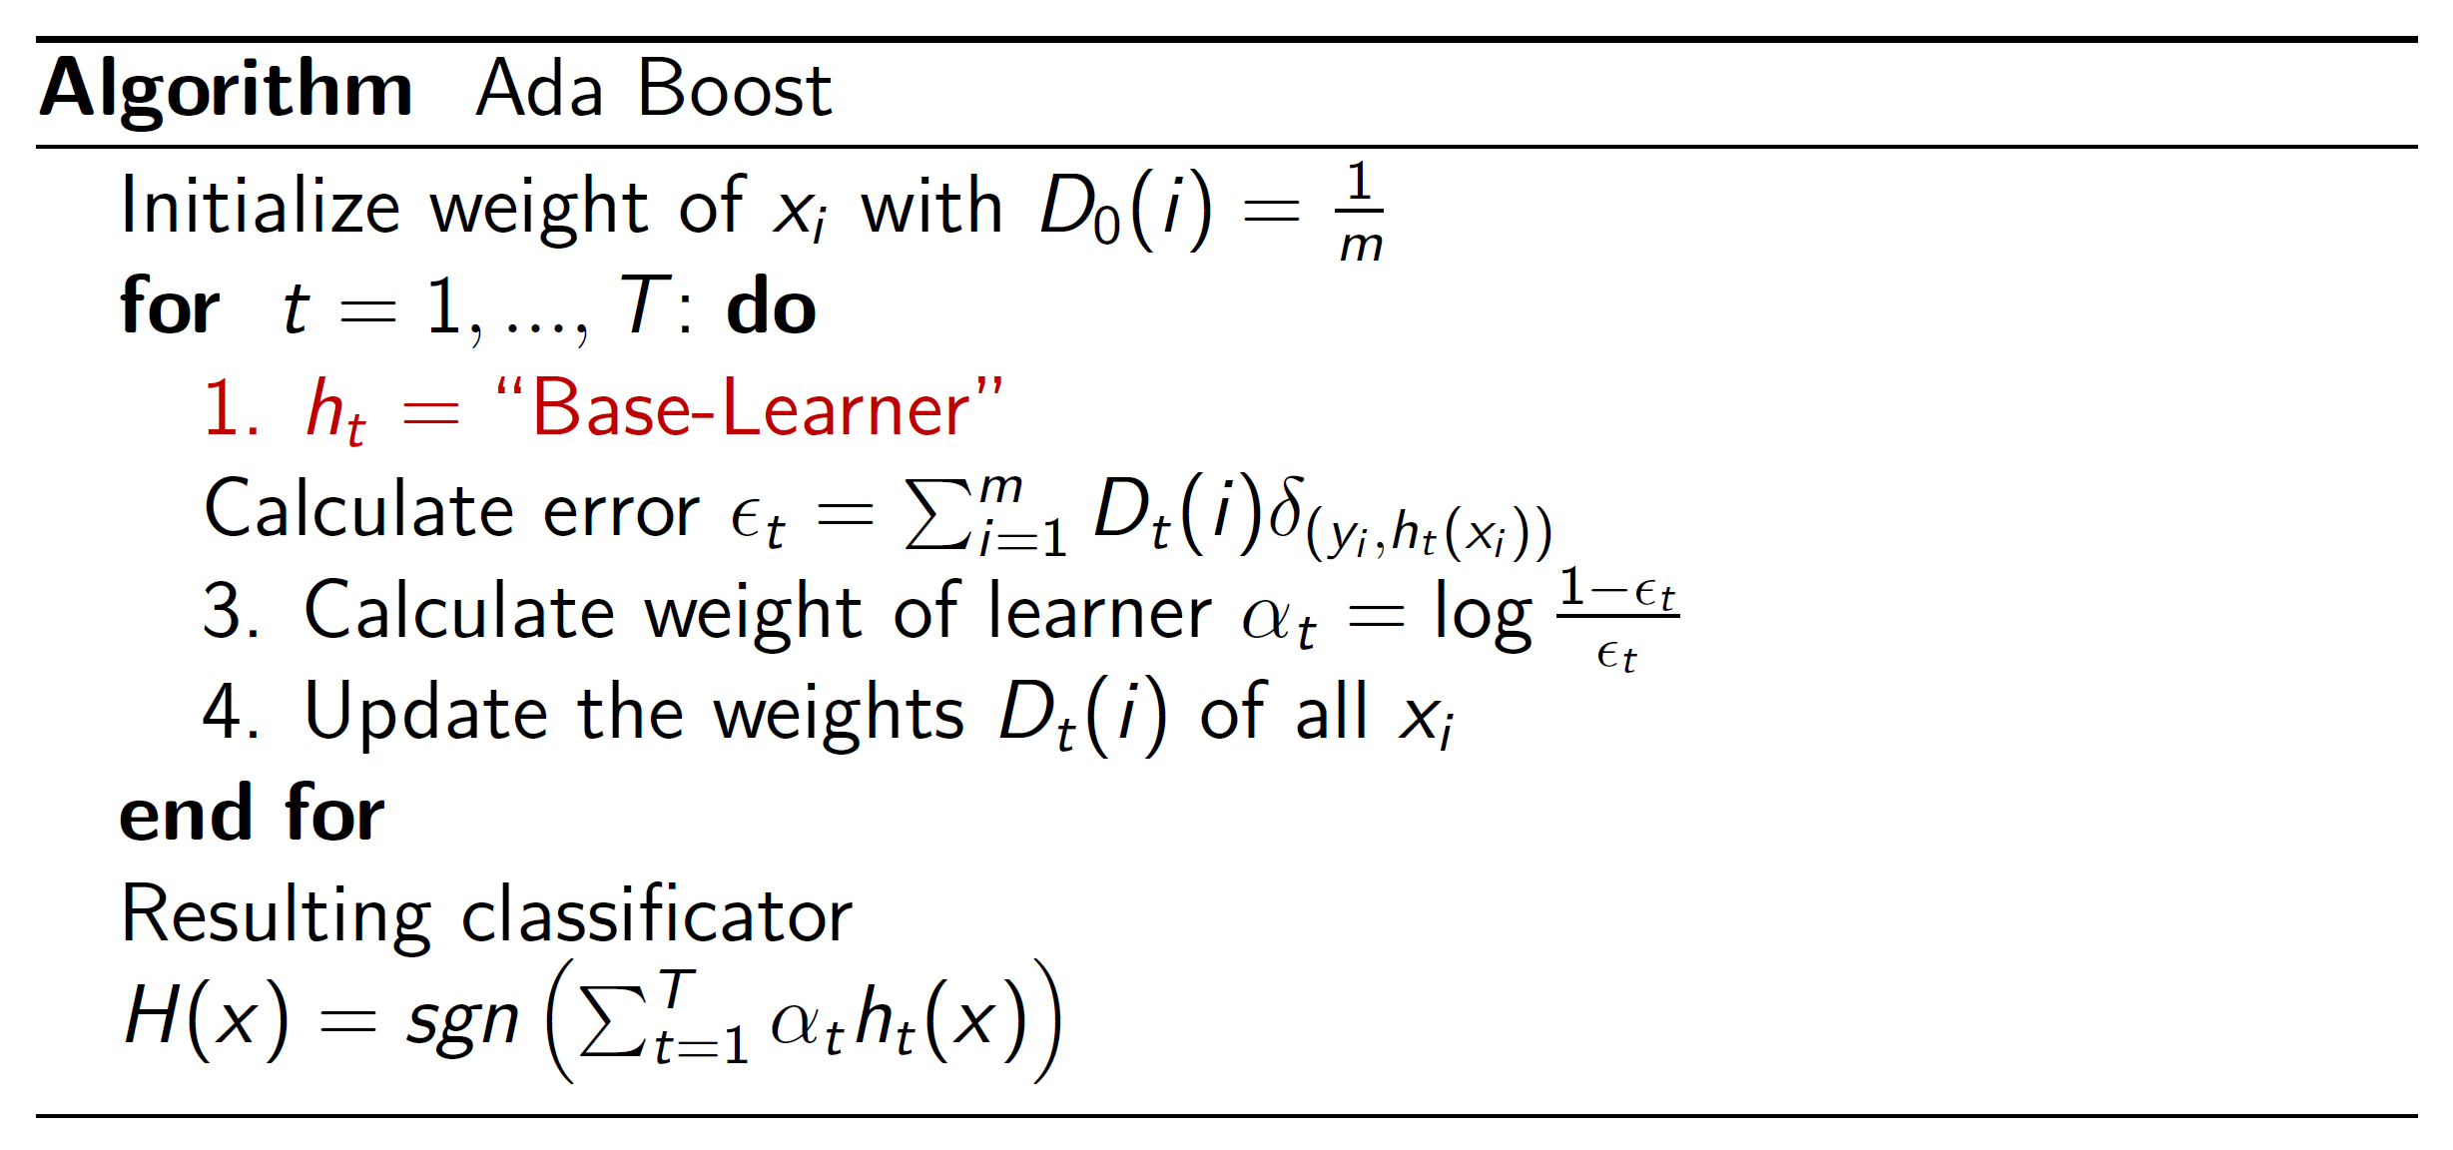
Adaboost pseudo-code Overview

Slide 48
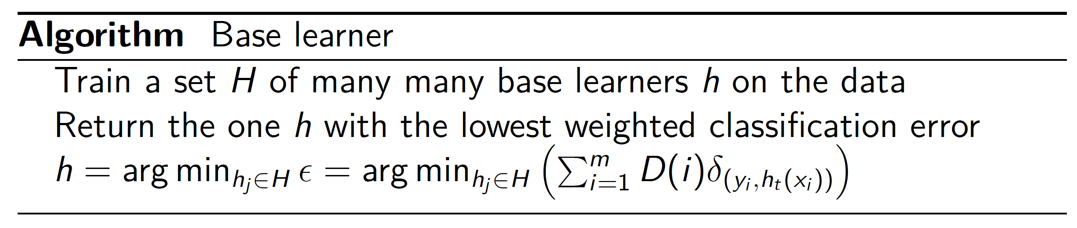

Adaboost pseudo-code Overview
Make sure $ε<0.5$

Slide 49
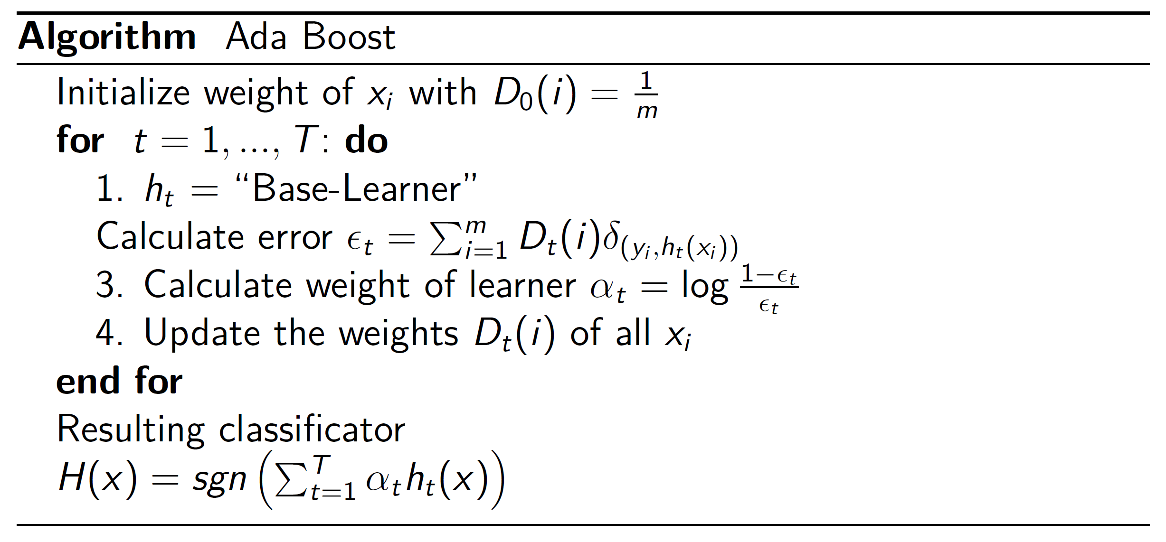
Adaboost pseudo-code Overview

Slide 50
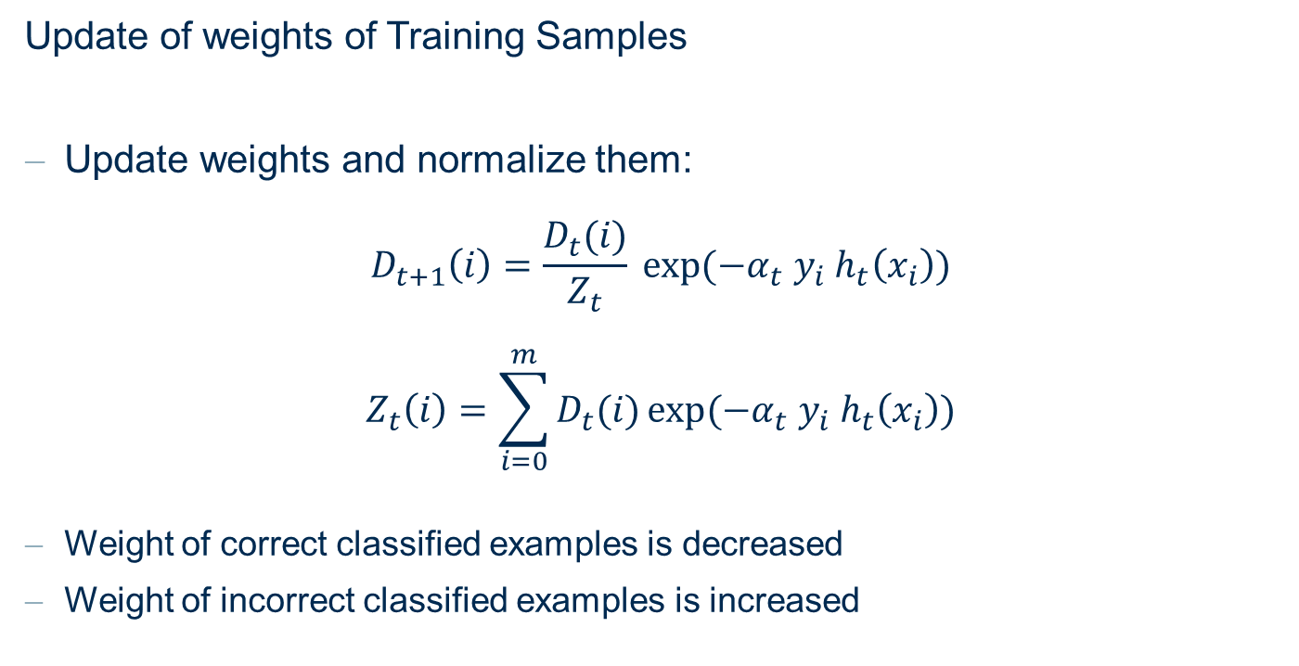
AdaBoost
Update of weights of Training Samples
Update weights and normalize them:
$$D_{t+1}\left(i\right)=\frac{D_{t}(i)}{Z_{t}} exp⁡(−α_{t} y_{i} h_{t}\left(x_{i}\right))$$
$$Z_{t}\left(i\right)=\sum_{i=0}^{m}{D_{t}(i)}exp⁡(−α_{t} y_{i} h_{t}\left(x_{i}\right))$$
Weight of correct classified examples is decreased
Weight of incorrect classified examples is increased

Slide 51
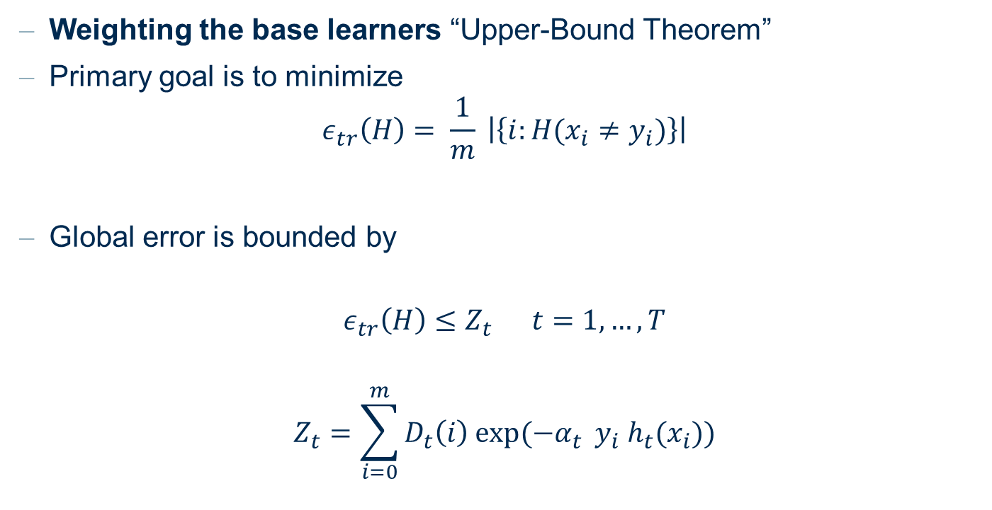
AdaBoost: Why does it work?
Weighting the base learners “Upper-Bound Theorem”
Primary goal is to minimize
$$ε_{tr}\left(H\right)= \frac{1}{m} \left|\left\{i:H(x_{i}≠y_{i})\right\}\right|$$
Global error is bounded by
$$ε_{tr}\left(H\right)≤Z_{t} t=1, …, T$$
$$Z_{t}=\sum_{i=0}^{m}{D_{t}\left(i\right) exp⁡(−α_{t}} y_{i} h_{t}(x_{i}))$$

Slide 52
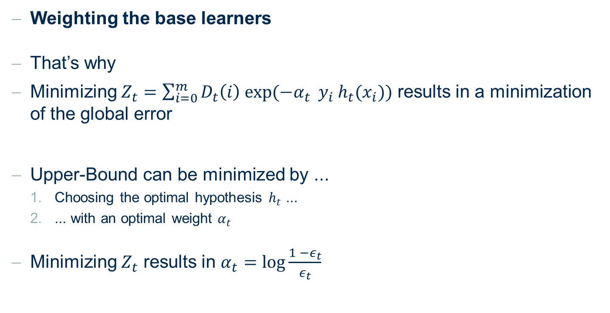
AdaBoost: Why does it work?
Weighting the base learners
That’s why
Minimizing $Z_{t}=\sum_{i=0}^{m}{D_{t}\left(i\right) exp⁡(−α_{t}} y_{i} h_{t}(x_{i}))$ results in a minimization of the global error
Upper-Bound can be minimized by ...
  Choosing the optimal hypothesis $h_{t}$ ...
  ... with an optimal weight $α_{t}$
Minimizing $Z_{t}$ results in $α_{t}=\log{\frac{1 −ε_{t}}{ε_{t}}}$

Slide 53
AdaBoost
Advantages
Very simple to implement
Feature selection on very large features spaces
Fairly good generalization
Disadvantages
Can overfit in presence of noise
Unclear which weak-learning algorithm fits best for a given problem

Slide 54
Gradient Boosted Trees

Slide 55
Boosting - Idea
Starts with a single tree built from the data
Fits a tree to residual errors from the previous model to refine the model sequentially
Residual errors
from previous model
…
Residual errors
from previous model
Build tree
Build tree
Build tree
1
4
…
1
5
2
5
7
7
6
2
9
6
7
2
8
9
3
3
9
5
7

Slide 56
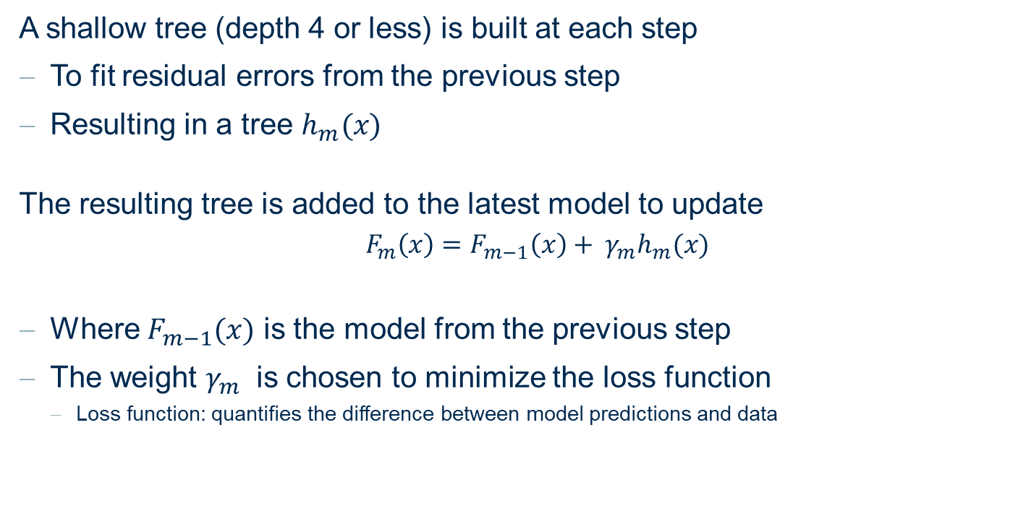
Gradient Boosted Trees
A shallow tree (depth 4 or less) is built at each step
To fit residual errors from the previous step
Resulting in a tree $h_{m}(x)$
The resulting tree is added to the latest model to update
  $F_{m}\left(x\right)=$ $F_{m−1}\left(x\right)+ γ_{m}h_{m}(x)$
Where $F_{m−1}(x)$ is the model from the previous step
The weight $γ_{m}$ is chosen to minimize the loss function
  Loss function: quantifies the difference between model predictions and data

Slide 57
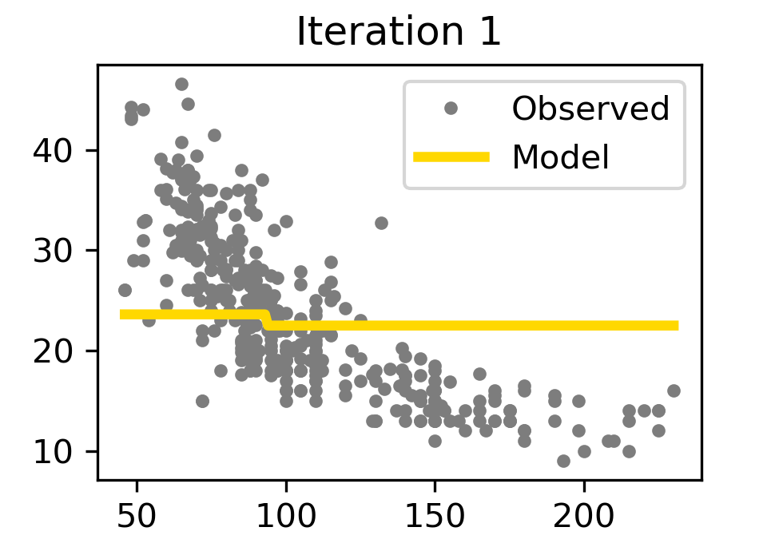
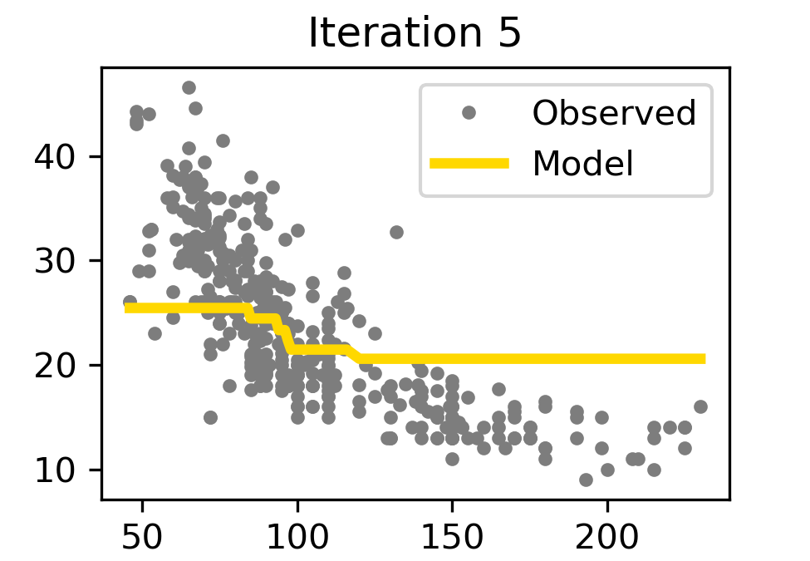
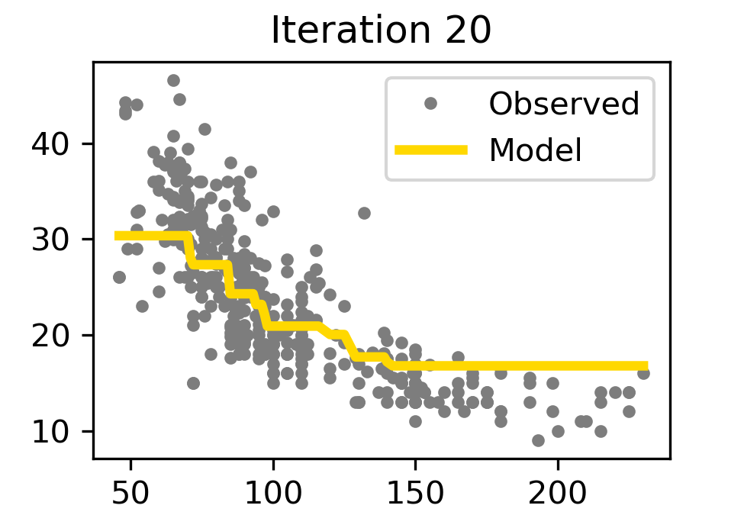
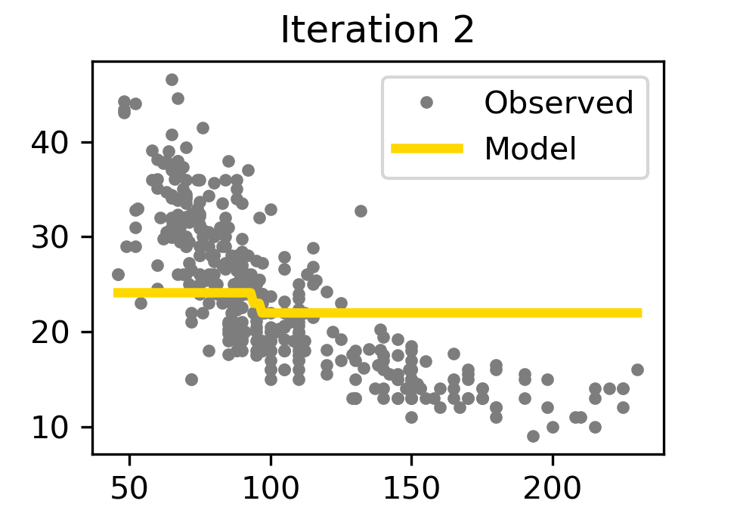
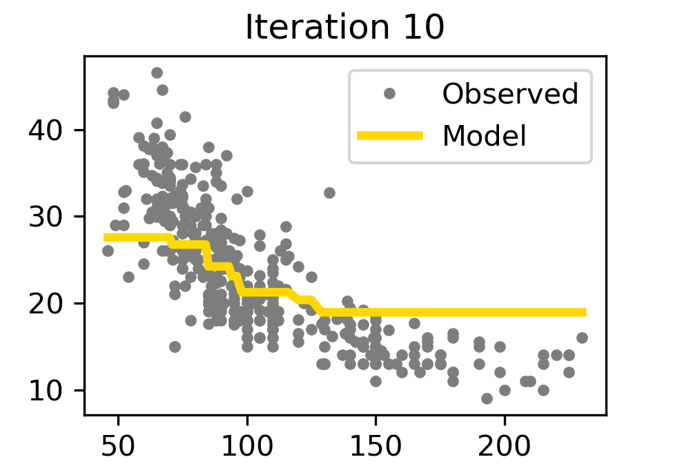
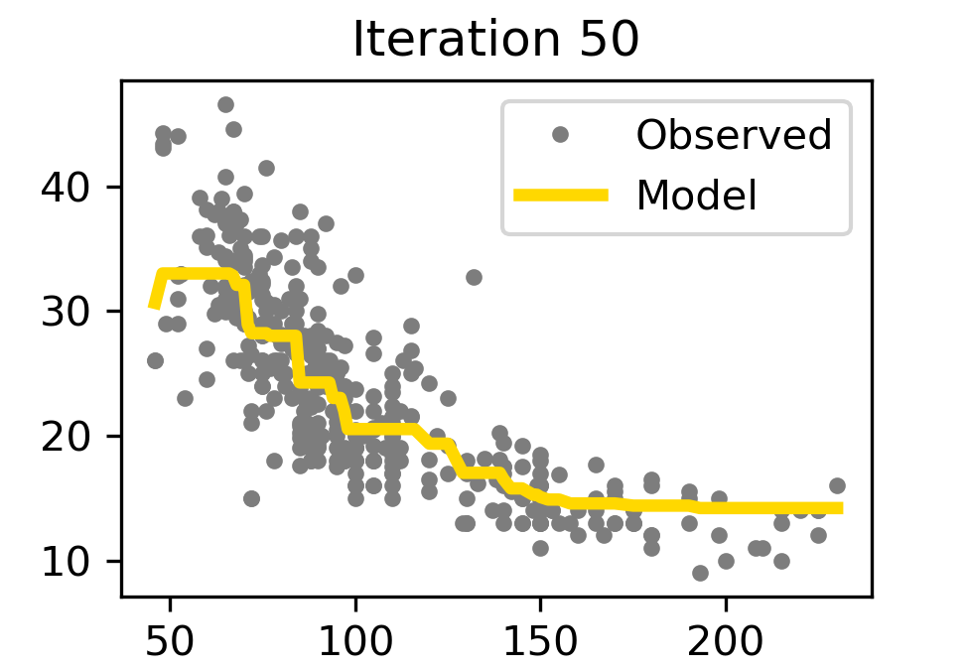
Gradient Boosted Trees Example – Regression
Regression tree with depth 1

Slide 58
Gradient Boosted Trees
Can be used for classification and regression
Large number of iterations – prone to overfitting
  ~100 iterations are sufficient
Can introduce randomness in choice of data subsets (“stochastic gradient boosting”) and choice of input features

Slide 59
Practical Examples with KNIME Analytics Platform

Slide 60
Tree Ensemble, Random Forest, and Gradient Boosted Tree
Tree Ensemble, Random Forest, and Gradient Boosted Tree applied to the adult dataset

Slide 61
Thank you

